Slide 1
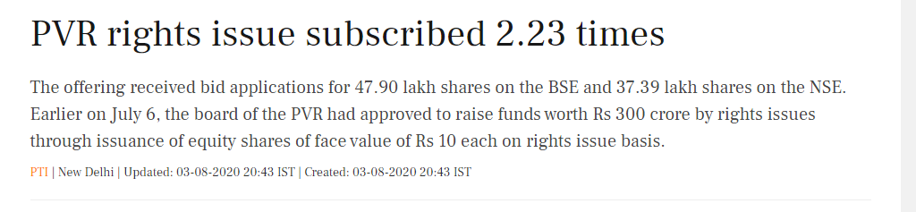
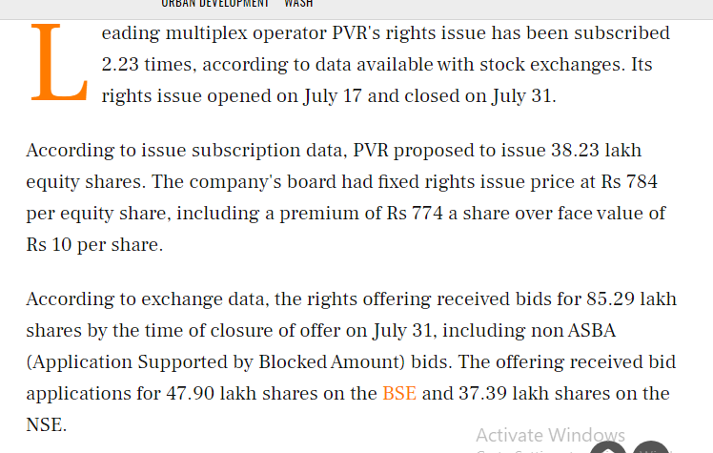

Slide 2
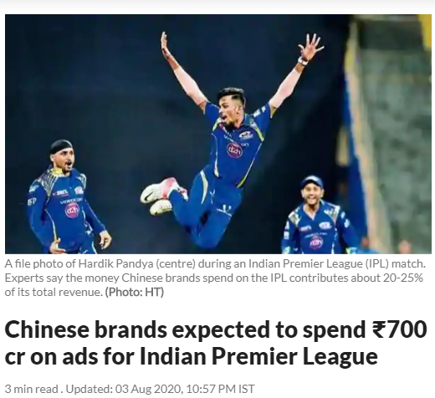
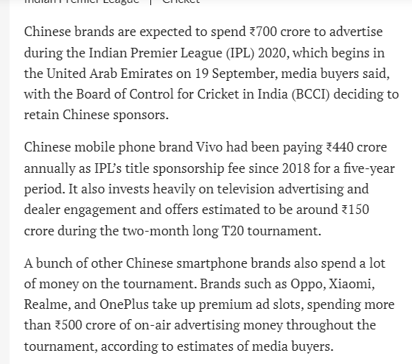

Slide 3
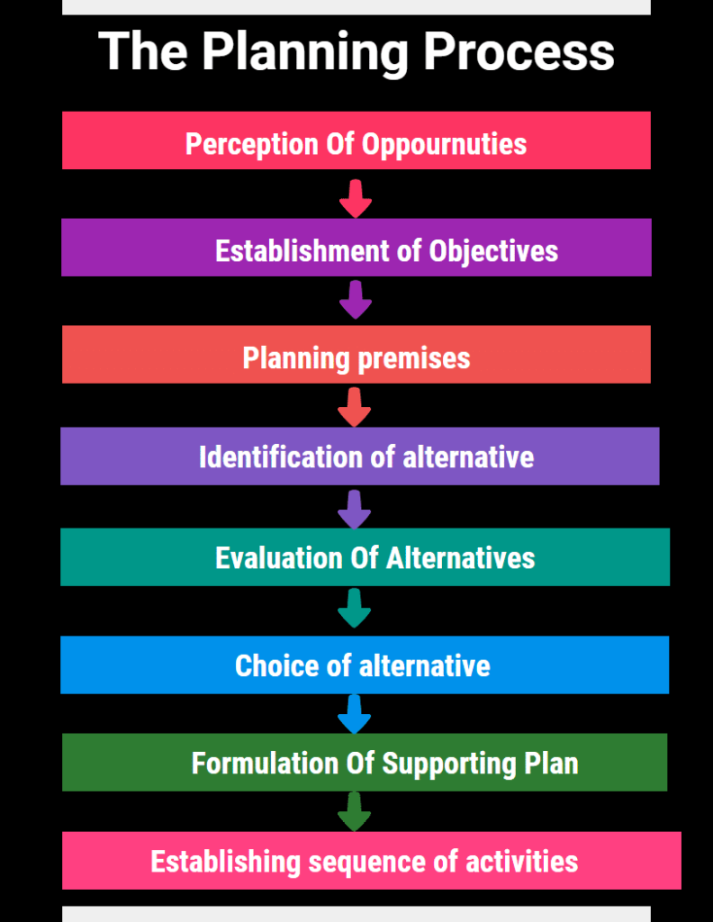
Let’s Revise Previous lecture ....

Slide 4
Components
Of
Planning

Slide 5
Components of Planning
Standing Plan
Repeated use plan
Single Use plan
Used for specific activity
Mission
Objectives
Strategies
Policies
Procedures
Rules
Programmes
Budgets
Schedules
Projects

Slide 6
1. Mission
basic values and beliefs of the organization
dictates its fundamental purposes
may be either written or implicit from the organization’s functioning.
shows the direction in which the business intends to move
what it aims to achieve

Slide 7
Examples of Mission Statements
Twitter “To give everyone the power to create and share ideas and information, instantly, without barriers.”
Coca-Cola :“To refresh the world…To inspire moments of optimism and happiness…To create value and make a difference.”
Google : “to organize the world’s information and make it universally accessible and useful

Slide 8
2. Objectives
goals or targets
the end results which an organization aims to reach
all factions of business management begin with the setting of objectives
either individualistic or collective
can be long-term and short-term
EX. Objectives of marketing department- increase market share, improved customer service

Slide 9
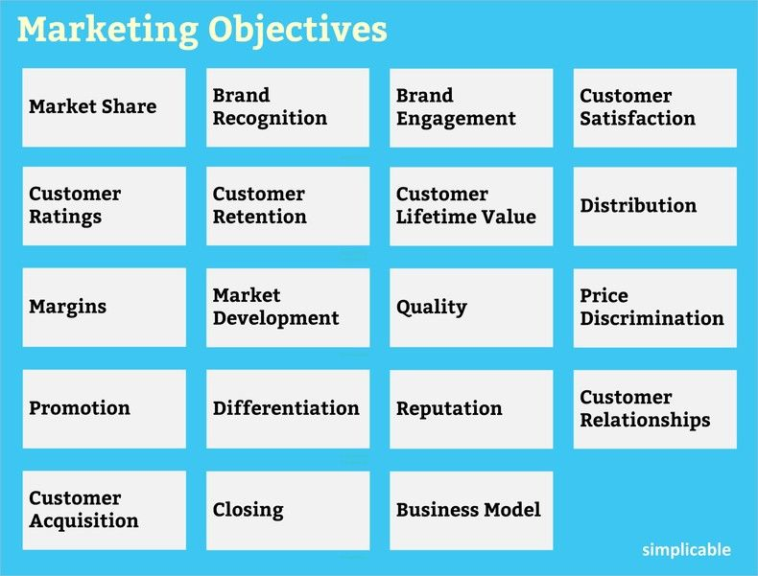

Slide 10


Slide 11
3. Strategies
Greek word- ‘Strategos’ means the art of the general
Long term objectives
Broad long term plan
Ex. Strategy to increase future position of the organisation

Slide 12
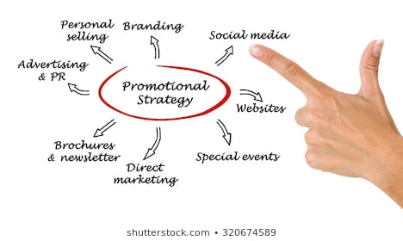

Slide 13
4. Policies
statements of understanding or course of action.
guide the decision-making process
impose limits on the scope of decisions
should never be too rigid
For example, a company might have a policy of always paying a minimum dividend of 5% of profits.

Slide 14

5. Procedures
exact manner in which something has to be done
include step-by-step methods
procedures are always practical.
should not be rigid and difficult to implement
Ex. In college admission procedure

Slide 15
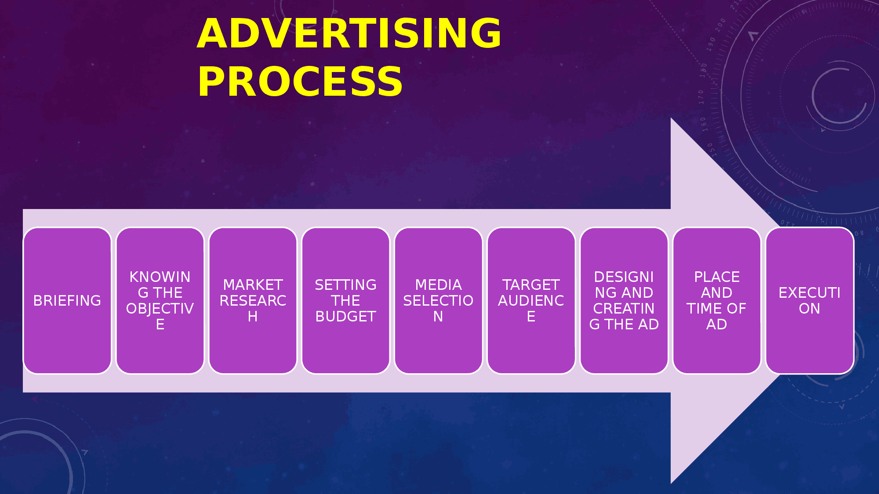

Slide 16
6. Rules
Specific statements of what should be done and what should not be done
Ex. No smoking in company’s premises
Different than policies
Policies provide flexibility
Rules do not allow flexibility

Slide 17
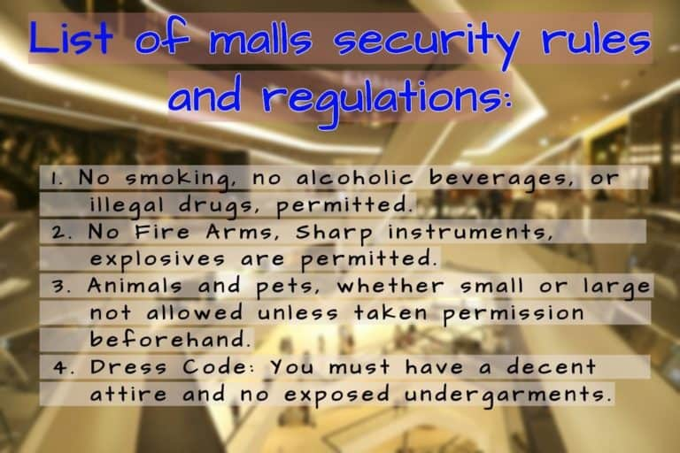

Slide 18
7. Programme
outline of a broad objective
includes many other components of planning.
contains a series of methods, procedures, and policies that the organization needs to implement
Ex. Training programme

Slide 19
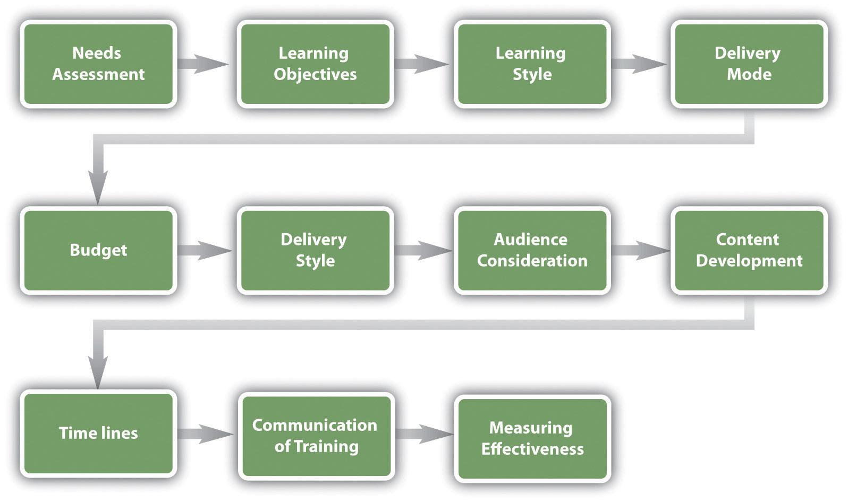

Slide 20
8.Budget
express expected results in numerical terms
activities, targets, and decisions require budgeting
For example, an income budget shows expected financial results and profits.
Sales budget, advertising budget

Slide 21
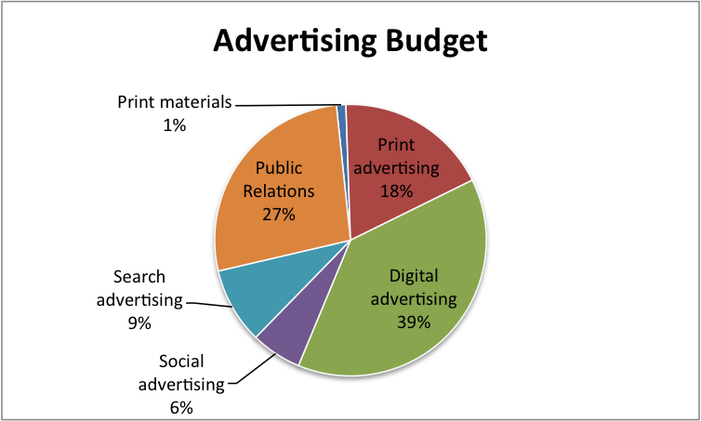

Slide 22
9. Schedules
Time table for activities
Start point and completion point of each work
Ensure timely completion of work

Slide 23
10. Projects
Single use plan
Separate team assigned for separate project
Ex. Advertising Campaign
Product launch project
Constructions of building project

Slide 24
Summary ...
Components of Planning
Standing Plan
Repeated use plan
Single Use plan
Used for specific activity
Mission
Objectives
Strategies
Policies
Procedures
Rules
Programmes
Budgets
Schedules
Projects

Slide 25


Slide 26
CUSTOMER SATISFACTION – MISSION
MARKTING – effective ads
HR – component employees
Production – quality products

