Slide 1
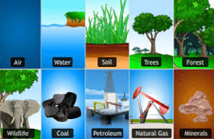

FYBBI-SEMESTER-I-FOUNDATION COURSE
ENVIRONMENTAL SCIENCE
UNIT 2- Natural Resources
SYLLABUS AT A GLANCE
Natural Resources :- Definition,Importance & Classification
Utilisation & Conservation of Resources:- Water,Forest,Soil & Energy
Issues Associated with Natural Resources

Slide 2
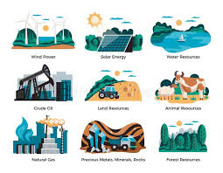
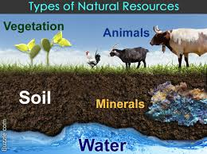
CONCEPT – NATURAL RESOURCES
Natural Resources are derived from- ‘Environment’
Many of them are essential for Human Survival,while others are used for Satisfying Human Needs

Slide 3
DEFINITIONS
According to Zimmerman-
‘Resources are means of attaining given ends’.
A Natural Resource can be a substance,or an energy unit or a natural process or a phenomenaon,for e.g.-Land,Soil,Forests,Grasslands etc.
Natural Resources can be defined as the substances which occur in nature & are found to be useful tools for development.
A resource is a form of energy or matter which is essential for the functioning of living organisms.

Slide 4
ON THE BASIS OF
KNOWLEDGE
CAPITAL
AVAILABILITY OF TECHNOLOGY
ENDOWMENT
POTENTIAL
RESOURCES
UNDERDEVELOPED
COUNTRIES
DEVELOPING COUNTRIES
DEVELOPED COUNTRIES

Slide 5
As Resources are available in large variety & quantity,they can be classified on number of bases,depending upon-
Field of Study
Geographical Locations
Value
Resources can be classified on the basis of- A) Stages of Development :-
STAGES OF DEVELOPMENT
ACTUAL
POTENTIAL
PETROLEUM OR NATURAL GAS-LOCKED UP IN SEDIMENTARY ROCKS
RESERVE
STOCK
EXTRACTED-CRUDE OIL,COAL
HYDROGEN

Slide 6
B) Frequency of Occurance:-
FREQUENCY OF OCCURANCE
UBIQUITOUS
LOCALIZED
AIR, SUNLIGHT
COPPER,IRON ORE,
NATURAL OIL,GEOTHERMAL POWER

Slide 7
B) Ownership:-
OWNERSHIP OF RESOURCES
INDIVIDUAL
NATIONAL
INTERNATIONAL
LAND,HOUSE,SKILL,
KNOWLEDGE
MINERALS,FORSET,
RIVER,DAM
OCEAN,
ATMOSPHERE,SUNLIGHT

Slide 8
C) Origin:-
ORIGIN
ORGANIC/BIOTIC
INORGANIC/ABIOTIC
FOREST,LAND,
MARINE ANIMALS,BIRDS,
FOSSIL FUELS
AIR,WATER,
MINERALS,
ROCKS

Slide 9
D) Durability,Availability & Regeneration:-
Durability,Availability & Regeneration
Human/Cultural
Natural/Physical
Inexhaustible/Renewable/Flow
Exhaustible/Renewable/Fund
Automatically Renewable
Recyclable
Sunlight,Air,Water,Wind
Non-Recyclable
All Metals,Ores,Minerals
Renewable with Human Efforts
Fossil Fuels,Uranium,Thorium
Agricultural Area,Animals,Forest,Soil,
Natural & Cultivated Landscapes

Slide 10
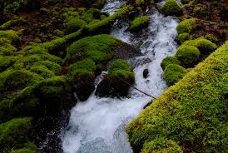
WATER RESOURCE
Everything originated in water & everything is sustained by water.
Year 2003 was declared as ‘International Year of Freshwater’ by United Nations.
GLOBAL DISTRIBUTION OF WATER
100 % WATER ON SURFACE OF EARTH
97.5 % OCEANS (SALINE WATER)
2.5 % FRESHWATER
69 % GLACIERS
1% FRESHWATER
30% GROUNDWATER
1% LIVING ORGANISMS
38% SOIL
8% VAPOUR
1% RIVER
52% LAKES

Slide 11
DRIVING OF HYDROLOGICAL CYCLE (Fundamental Importance)
USEFUL AS A SOLVENT & COOLANT IN INDUSTRIES
AVAILABLE AS UNDERGOUND SOIL WATER DUE TO SURFACE TENSION
IMPORTANCE OF WATER RESOURCE
TRANSPARENT BODY HELPFUL FOR SOLAR RADIATION PENETRATION
SOURCE OF CLEAN HYDROPOWER
USEFUL FOR DEVELOPMENT OF HUMAN CIVILISATION
LARGE HEAT ABSORPTION CAPACITY

Slide 12
Continued..
DOMESTIC PURPOSE
DISPOSAL-BEST MEDIUM OF DILUTION
IMPORTANCE OF WATER RESOURCE
MINING
NAVIGATION
AESTHETIC SIGNIFICANCE
SALT PRODUCTION

Slide 13
70% AGRICULTURE
% OF GLOBAL WATER USE
25% INDUSTRY
5% DOMESTIC USE

Slide 14
OVERUTILISATION
ISSUES RELATED WITH WATER
POLLUTION DUE TO AGRICULTURE & INDUSTRIES
WATER CRISIS

Slide 15
CREATION OF PUBLIC AWARENESS
HARVEST & STORE-ROOF TOP RAIN WATER
MEASURES FOR WATER CONSERVATION
RECYCLING OF INDUSTRIAL WASTE WATER AFTER-SUITABLE TREATMENT
REVIVAL/REHABILITATION OF VILLAGE POND & CHECK ON IMPROPER USE OF RIVER WATER
CHECK ON WATER-POLLUTION & LEAKAGE
RECLAMATION OF-WASTE WATER
STORAGE OF- GROUND WATER
TRANSFER OF-SURPLUS WATER TO-DEFICIT AREAS

Slide 16
CONTINUED..
NATIONAL & STATE LEVEL-WATER HARVESTING PERSPECTIVE PLANS
ADEQUATE AFFORESTATION PROGRAMMES
MEASURES FOR WATER CONSERVATION
IMPROVING DRAINAGE IN IRRIGATED AREAS TO REDUCE WATER LOGGING & SALINISATION
HIERING-PROFESSIONAL ORGANISATIONS TO MANAGE RESERVOIRS & LARGE CANAL SYSTEM.
IMPLEMENTATION OF PRICING POLICY ON WATER USE
CHECKING THEFT & WATER CONTAMINATION & INCREASE OF TRANSPARENCY & ACCOUNTABILITY IN WATER BUSINESS

Slide 17
CENTRAL WATER COMMISSION FOR SURFACE WATER
CENTRAL GROUND WATER BOARD
CENTRAL & STATE ORGANISATIONS WITH SPECIFIC ASPECTS OF WATER RESOURCE MANAGEMENT
CENTRAL PUBLIC HEALTH & ENVIRONMENT
CENTRAL & STATE POLLUTION CONTROL BOARDS

Slide 18
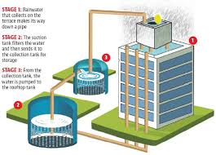
RAINWATER HARVESTING
It is ancient practice for the purpose of irrigation.
It is the system of collection of rainwater from the surface that receives direct rainfall.
It helps to –
collect & use-Natural Source of water
Increase Ground Water Level
Cultivate the habit of conservation of essential resources & pave way for-A more green & Healthy environment for next generation

Slide 19
WAYS OF RAINWATER HARVESTING
Artificial Recharge of Ground Water :- As due to rapid Urbanisation process,process of percolation of rainwater has reduced, by using technique of Rainwater Harvesting,it is possible to increase percolation of rainwater into ground,thereby increasing groundwater.
Roof-Top Rainwater Harvesting :- Roof acts as the catchment areas in case of roof-top harvesting.This water is then stored using pipes.The first flush is a concept that flushes off the first rainwater that is known to be impure.Appropriate filters are placed to treat the collected rainwater so that it is free from any impurity and is safe for use.
This water is used for-Gardens,Livestock,irrigation,domestic use with proper treatment & indoor heating for
houses etc.
This water can be also used for-Drinking,Long-Term storage & for other purposes such as-Groundwater
Recharge.

Slide 20
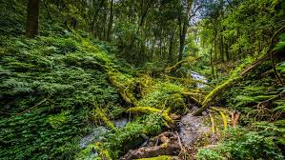
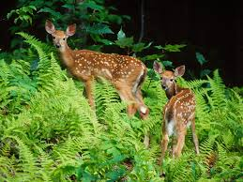
FOREST RESOURCES
A Forest can be defined as-” A biotic community predominant of trees,shrubs,climbers or any other woody vegetation.
It is derived from Latin word- ‘foris’ means- ‘Outside’.They contain almost 90% of world’s terrestrial biodiversity.
According to-FAO (Food & Agricultural Organisation) Global Forest Resource Assessment,approximately 1/3rd world’s land area is covered by forest out of which 95% is natural forest & 5% is planted forest.

Slide 21
CONTINENT WISE DISTRIBUTION OF FORESTS

Slide 22
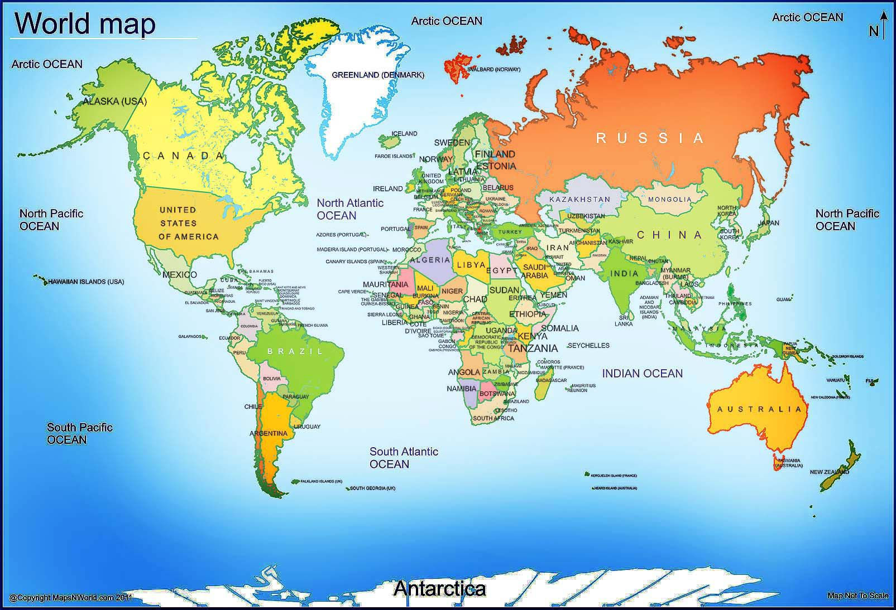

Slide 23
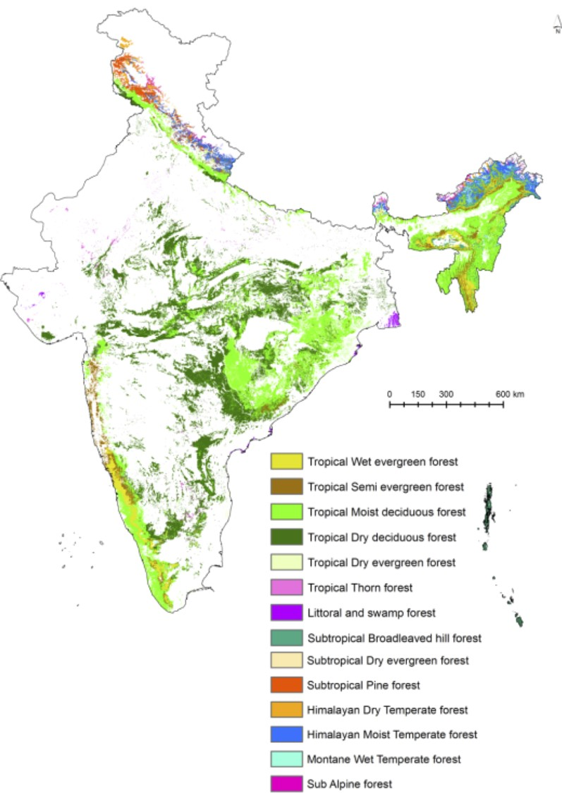
FOREST COVER OF INDIA
India’s forest cover in 2003 was 20.46 % of total Geographic Area.But today we have only 12%,thus we not only need to protect our forest,but also increase the cover under it.
Scientists & Environmentalists estimate that-India should ideally have 33% of it’s land under forests.
Most of India’s forests are concentrated in few states only like-
Assam,Madhya Pradesh,Orissa & a few union territories.
In Northern India, in particular,the proportion of forest land to the total area is much lower than allover India on an average.

Slide 24
WATERSHED PROTECTION (REDUCING SURFACE RUN OFF)
UTILISATION/IMPORTANCE OF FOREST
ATMOSPHERIC REGULATION BY ABSORBING SOLAR RADIATION & CO2
CONTROL OF SOIL EROSION
MAINTENANCE OF SOIL NUTRIENTS & STRUCTURE

Slide 25
FOOD
FODDER FOR CATTLE
MEDICINAL PLANTS
LOCAL USES OF FORESTS
FUELWOOD & CHARCOAL FOR COOKING
SERICULTURE (SILK) & APICULTURE (HONEY)
POLES FOR BUILDING HOMES IN RURAL AREAS
TIMBER FOR HOUSEHOLD ARTICLES & CONSTRUCTION
FIBRE FOR WEAVING BASKET,ROPES,NETS,STRINGS

Slide 26
MINOR FOREST PRODUCTS LIKE-FUELWOOD,FRUITS,GUM & FIBRE
PRODUCTIVE USE
OF FORESTS
EXPORT ITEMS LIKE-TEAK,PAPER,PAPERBOARD,
NATURAL RESINS,SEEDS
PROMOTES ECOTOURISM
SUPPLY OF INDUSTRIAL RAW MATERIAL LIKE-PULP-PAPER,NEWS PRINT,SAW MILLING (WOOD CUTTING FACTORY),MATCHSTICKS & MEDICINAL HERBS

Slide 27
SOURCE OF REVENUE FOR GOVERNMENT IN THE FORM OF TAX ON FOREST PRODUCTS
DEVELOPMENTAL FUNCTIONS
SOURCE OF EMPLOYMENT TO MANY PEOPLE
(FACTORIES THAT PROCESS FOREST PRODUCTS)

Slide 28
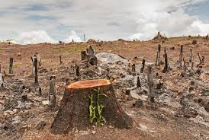
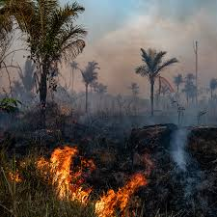
DEFORESTATION
Deforestation refers to-Loss of forest cover ;land that is permananently converted from forest to non-forest uses such as-Agricultural Pasteures,Desert & Human Settlement.
It can be defined as- ‘Removal or damage of vegetation in forest to the extent,that it no longer supports it’s natural flora & fauna.
Forest loss is caused by complex set of-Social & Economic pressures.
The rapid rate of Deforestation in tropical countries is a main cause of-Yearly increase in flood disasters.

Slide 29
AGRICULTURAL EXPANSION
ANIMAL GRAZING
CAUSES OF DEFORESTATION
MINING
COMMERCIAL LOGGING
OTHER FACTORS SUCH AS-FOREST FIRES &
POLLUTION DUE TO-ACID RAIN
CASH CROP ECONOMY

Slide 30
ATMOSPHERIC POLLUTION
INCREASE IN SOIL EROSION
DISTURNCE & IMBALANCE IN GLOBAL WATER CYCLE
IMPACTS
/EFFECTS OF DEFORESTATION
IMBALANCE IN GLOBAL CARBON CYCLE
LOSS OF BIODIVERSITY

Slide 31
REGULATED & SELECTED CUTTING
CONTROL OVER FOREST FIRE
MEASURES FOR FOREST CONSERVATION
PROPER UTILSATION OF FORESTS & IT’S PRODUCTS
REFORESTATION & AFORESTATION
CHECK OVER FOREST CLEARANCE FOR AGRICULTURAL & HABITAT PURPOSE
FOREST PROTECTION FROM PESTS & DISEASES

Slide 32
Continued..
RECYCLING & SUBSTITUTION OF FOREST PRODUCTS
NATURE CONSERVATION-IMP ASPECT OF FOREST DEVELOPMENT
MEASURES FOR FOREST CONSERVATION
FOREST MANAGEMENT
PUBLIC COOPERATION
PUBLIC AWARENESS & PLANNING OF PUBLIC MOVEMENTS TO SAVE TREES
(Appiko,Chipko ,Bishnoi,Save Narmada etc.)
CRUCIAL ROLE OF GOVERNMENT

Slide 33
Steps to be taken by National & Provincial Government for –Forest Conservation
Pass acts to conserve forests
Conduct Survey of forest resources
Categorise forest areas & proper delimitation of reserved forest areas
Find out areas where reforestation can be carried out
Regulate commercial use of forest products
Protect forest from fire,mining & other natural calamities
Develop National Parks
Encourage forest development activities like-Social Forerstry,Agro Forestry etc
Master Plan preparation for both-Long Term & Short term

Slide 34
Aspects of-Forest Management :-
Survey of Forest
Categorization of Forest
Economic use of forest
Administrative setting for forest management
Training programmes for persons engaged in forest conservation activities
Use of Forest land as –Tourist Centre
Social & Agro-Forestry
Development of new techniques for conservation of forestd
Research for efficient use & conservation of forests
Policy decision & proper implementation

Slide 35
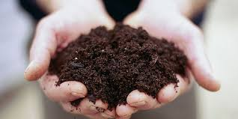
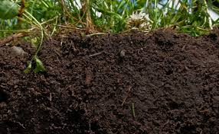
SOIL RESOURCES
Soil is world’s most important natural resource.
It not plays important role in feeding world population but also plays major role in recycling of –Air,Water,nutrients & maintaining a number of Natural Cycles,ensuring there will be a basis for life in generations to come.
The layer of soil has thickness of just one-two meters.
Soil consists of mixture of mineral grains that come from rock deposits & sediments beneath them.Soil also contains organic matter,mainly in the top 20 cms.Organic matter comes from rotten,decomposed vegetation broken down by soil microorganisms.
Soil is a thin,fragile & extremely precious resource.And thus as it is essential for existence of living organisms,it is necessary to check loss of soil by adopting suitable conservation mechanism.

Slide 36
FARMING & FOOD PRODUCTION
INFLUENCES HYDROLOGICAL CYCLE
FORESTRY
IMPORTANCE OF SOIL
FOUNDATION FOR INFRASTRUCTURES
FILTER OF RAINWATER
ECOLOGICAL SERVICES
HISTORY PRESERVER BY ACTING AS A FOSSIL STOREHOUSE
CLIMATE REGULATOR BY TRAPPING & REGULATING CARBON & GREENHOUSE Gases like-N20 & METHANE

Slide 37
DESERTIFICATION
ACID RAIN
EROSION DUE TO WIND & WATER
CHEMICAL FERTILIZERS
THREATS TO SOIL
WATER POLLUTANTS
SOIL COMPACTION
DEFORESTATION
ACIDIFICATION
IMPACT ON SOIL BIODIVERSITY
LOSS OF ORGANIC MATTER
STALINISATION (SOIL & SODIUM ACCUMULATION)

Slide 38
SOIL CONSERVATION MEASURES
Although expensive,cleaning of polluted soil should be done
Waste recycling should be carried out.Garden compost should be made out of organic waste like-Plant & Vegetable Waste
Better farming methods with appropriate water use & stalinisation control
Conducting suitable crop rotation to enable protection of fragile soil
Protection of soil from impact of raindrops by giving vegetation cover throughout the year
Prevention of water from concentrating & passing through slopes
Slowing down water momentum by adopting various scientific techniques
Minimizing wind velocity by massive afforerstation & social forestry
Covering precious top soil by grasses
Protection of vegetation cover from reckless destruction by local people
Avoiding repeated land cultivation,instead it should be reclaimed for forestry pasture or Horticulture for certain time
Education & creation of general awareness amongst local people for local area management

Slide 39
ENERGY RESOURCES
Definition :- Energy is ability to do work.
It is defined as- Any property,which can be,produced from or converted into work.
Energy production & energy utilisation are both indicators of our country progress.
India has approximately 1% of world’s total energy resources,but 16% of world population.
Hence we need to conserve energy.

Slide 40
NON-RENEWABLE ENERGY SORCES
Coal , oil & Natural Gas are the non-renewable energy sources.They are also called as Fossil Fuels as they are products of plants which existed thousands of years ago.
Fossil fuels are valuable sources of energy.They are relatively inexpensive to extract.
They can be also stored,piped or shipped anywhere in world.
However burning of fossil fuels is harmful to environment as it causes tremendous Air Pollution.
The world is experiencing fast degradation of non-renewable sources in terms of fossil fuels

Slide 41
NON-RENEWABLE ENERGY SOURCES
COAL
Coal is the most abundant form of fossil fuel available on earth.
It was formed by the decay of old plants & animals which existed several years ago.
When Coal is burnt,it produces heat which is used to convert water into steam.
This steam is used to move turbines which in turn activates generators which produce electricity

Slide 42
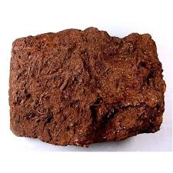
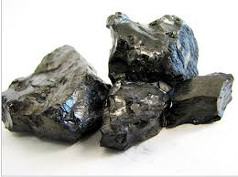
TYPES OF COAL
ANTHRACITE-HIGHEST QUALITY COAL
PEAT-LOWEST QUALITY COAL
Peat is lowest rank of coal.
It is an important fuel in areas of world including Scotland,Ireland & Finland.
Anthracite is highest rank of coal,which is found abundant in-Appalachian Mountains,in the eastern part of United States,are rich in Anthracite.
Although Coal is still available in big quantity on earth,it is predicted that it will not last for more than 40-50 years with present rate of consumption.
Coal supplies more than 50% of the country’s total energy requirements.

Slide 43
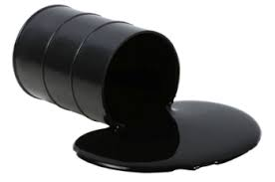
PETROLEUM
Petroleum is abundantly found fossil fuel in middle east countries such as- Saudi Arabia,Kuwait,Iran,Iraq & UAE
It is reliable,portable & dependable source of energy
It is also made up of dead plants & animals which lived millions of years ago.When these plants & animals died,they were covered with thick layer of mud & sand,which created huge pressure & temperature.

Slide 44
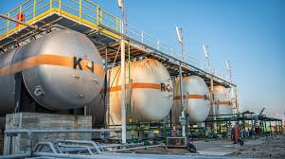
NATURAL GAS
Natural Gas is a mixture of –Methane,Ethane,Propane,Butane.Out of these,Methane is highly inflammable.
Middle East countries,especially Iran & Iraq,hold high reserves of Natural Gas.
It is cheap,almost clean source of energy,used for heating & cooking.Natural Gas can be burnt as well to get electricity.
But extraction of Natural Gas causes Environmental Complications/Disasters,such as-Mini-Earthquakes.
High Pressure water & chemicals are forced underground,can contaminate groundwater.
Such contaminated water sources are unsafe for-Drinking,Bathing & are unsafe & contaminated.

Slide 45


NUCLEAR ENERGY
Around 16% of world’s electricity production comes through nuclear energy.
Uranium-235 is used to obtain energy by nuclear fission.It is bombarded with slow moving neutrons which break atom & release energy.
Atoms which get split are again hit by neutrons to produce mass amount of energy.
It does not produce any greenhouse gas emission.
The downside of nuclear energy is that it can be used to make nuclear bomb,thus remains target for variety of terrorist organisations.

Slide 46

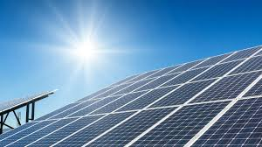
RENEWABLE ENERGY SOURCES
SOLAR ENERGY
Sun is primary source of energy.Solar energy is clean,renewable,sustainable source of energy.
Advantages of Solar Energy :-
It is free,plentily available source of energy.
It is non-polluting & does not cause- Greenhouse gas emission.
It does not get affected by price volatility which happens in case of-Fossil Fuel Markets.It does not need deforestation
It can be used to obtain electricity.
Disadvantages of Solar Energy :-
Distribution varies according to season & weather,does not work in night.
Requires high initial investment
Solar electricity storage technology has not reached it’s potential yet.
Solar Panels are bulky.

Slide 47
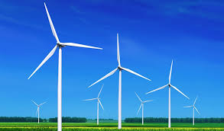
WIND ENERGY
Wind is natural movement of air across land or sea.
When wind is used to turn blades of wind mill,turns the shaft to which they are attached.The movement of shaft through a pump,generates electricity.
India has the 5th largest wind power installed capacity in world,which has reached 22,465 MW.
Advantages :-
It is environment friendly,freely & abundantly available.
Disadvantages :-
It requires high investment.
Wind speed is not uniform at all times,which affects power generation.

Slide 48
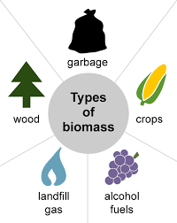
BIOMASS
Green plants fix solar energy via the process of Photosynthesis to produce-Biomass.
This biomass passes through variety of cycles forming different sources of energy.
For e.g.- Fodder for animals that in produces cowdung,agricultural waste for cooking (Biogas)
Biomass is an important source of energy accounting for about 1/3rd of total fuel used in our country & in about 90% of total rural households.
The main widespread use of biomass is for cooking & heating.
Types of biomass used are-Agricultural Waste,wood,charcoal or dried dung.

Slide 49
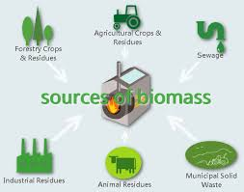
Advantages of Biomass :-
It is available locally in abundant amount.
It’s a relatively clean fuel as compared to Fossil Fuels.
Disadvantages of Biomass :-
At the time of indoor cooking,if there is insufficient ventilation,fuels such as Cowdung causes Air Pollution,leading to-Serious Health Hazard.
Unsustainable & inefficient use of biomass often leads to destruction of vegetation & thus ‘Environmental Degradation’

Slide 50
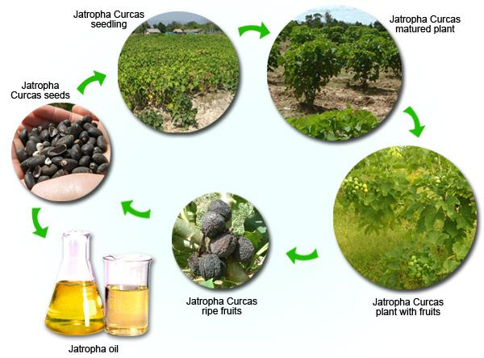
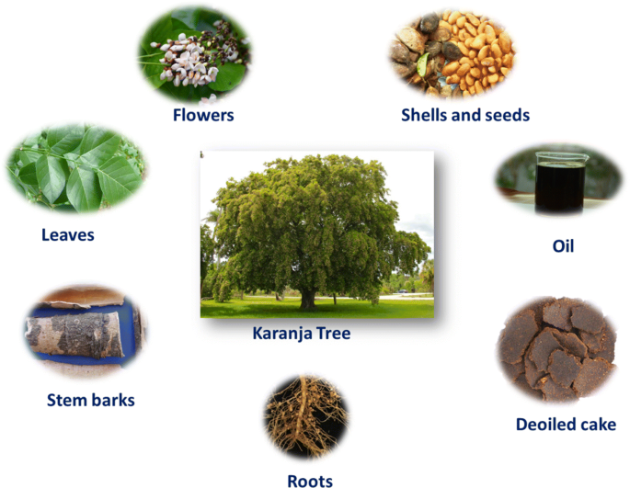
BIOFUELS
Biofuels are predominantly produced from biomass feed stocks or as a by product from industrial processing of food/agricultural products,or by recovery & reprocessing of products such as cooking & vegetable oil.
Biofuel contains no petroleum,but it can be blended at any level with petroleum fuel to create a biofuel blend.
It can be used in conventional healing equipment or dieasel engine without major modifications.
Biofuel is simple to use,biodegradable,non-toxic & essentially free of Sulphur & aroma.

Slide 51
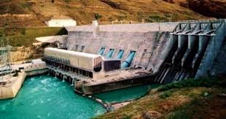
Hydroelectric Power & Small Hydro Power Plants
Since ancient times,energy of falling water is being used as a source of energy.Invention of Water Turbines in 14th century increased efficiency of Hydroelectric Power.
Water flowing in river is collected by constructing a big dam & allowed to flow from a height.Blades of turbine rotate & generate electricity.
Hydroelectricity,being most abundant & widely used source of energy,accounts for 19% of total electricity production in world.
China is largest producer of Hydroelectricity,followed by –Norway,Canada,Brazil,Newzealand & USA.

Slide 52
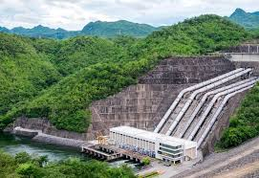
Small Hydro power plants are a new means of energy obtaining.Heavy investments are made on large projects.
In recent years,Hydel energy through small & mini Hydel Power plants is also used to meet power requirements.
The estimated Potential of Small Hydro Power plants is about 15,000 Megawatts in country.

Slide 53
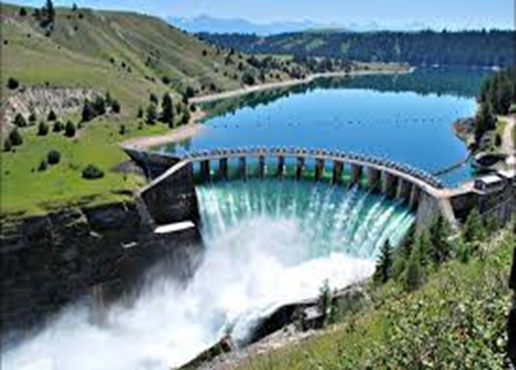
Advantages of-Hydro-Power Plants:-
Reliable,Eco-Friendly & Proven Technology.
More suited for sensitive mountain technology & can be exploited wherever sufficient water flows in small streams & medium to small rivers.
Does not involve setting up of large dams or problems of-Deforestation,Submergence or Rehabilitation.
Non-Polluting,neither waste nor production of toxic gases,thus quite environment-friendly.
Small capital investment & minimum transmission loss.
With careful planning & adoption of simplified & standardised design,SHP (Small Hydro Power) installations are becoming increasingly competitive with thermal,diesel or gas based power generation.

Slide 54
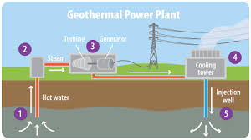
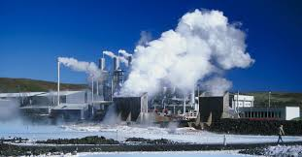
GEOTHERMAL ENERGY
Geothermal Energy is heat stored in earth’s crust & being used for electricity obtaining & also for direct heat application.
It is extracted from heat gradient of earth surface,hot springs,Geysers,Volcano etc.
The availability of Geothermal Power is most Environment Friendly Power,throughout the year,which does not affect much due to climatic changes.

Slide 55
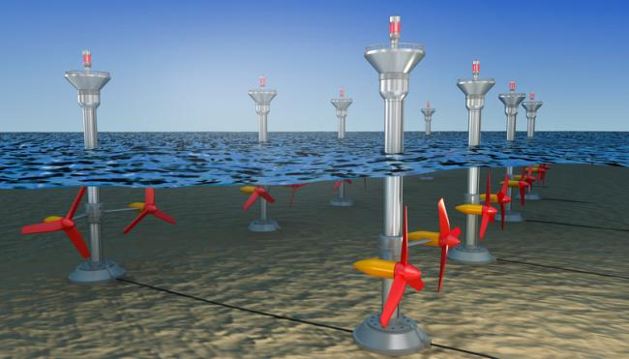
TIDAL ENERGY
Ocean tides contain enormous amount of energy,which can be used to harness energy.
The difference between high & low tides of water level,spins the turbines & electricity is obtained.
It is obtained in-France,England,Canada etc.

Slide 56
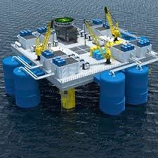
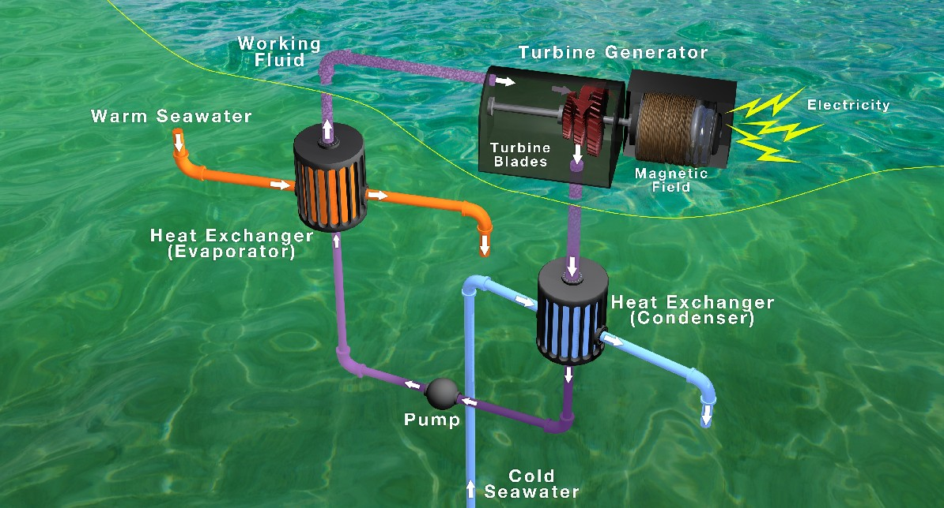
OCEAN GEOTHERMAL ENERGY
It is a constant source of energy available in heat gradient in ocean waters.
Currently.it is at experimental Level.

Slide 58


MEASURES FOR ENERGY CONSERVATION
Energy Conservation is defined as- “The act of saving energy by reducing a service.In other words, to conserve energy,there is a need to cut down usage.”
Energy conservation can help reduce monthly electricity bills & save money.
Energy Efficiency is one of the important factor in –Energy Conservation.
It can be defined as- “Saving energy,by keeping the same level of service.
For e.g.- i)Turning off lights while leaving the room.
ii) Replacing an inefficient incandescent light bulb with more efficient compact fluorescent bulb.
(LED)

Slide 59
USE OF LAPTOP INSTEAD OF DESKTOP,USE OF INKJET PRINTER INSTEAD OF LASER PRINTER & LESS PRINTING OR USING BOTH SIDES OF PAPER TO PRINT
USE OF LED (COMPACT FLUOROSCENT BULB (LED)
METHODS FOR ENERGY EFFICIENCY & CONSERVATION
DRIVE LESS,WALK MORE OR USE CYCLE
USE OF ENERGY EFFICIENT ELECTRIC APPLIANCE
USE OF RENEWABLE ENERGY SOURCES
TURNING OFF ELECTRONIC DEVICES WHEN NOT IN USE

Slide 60
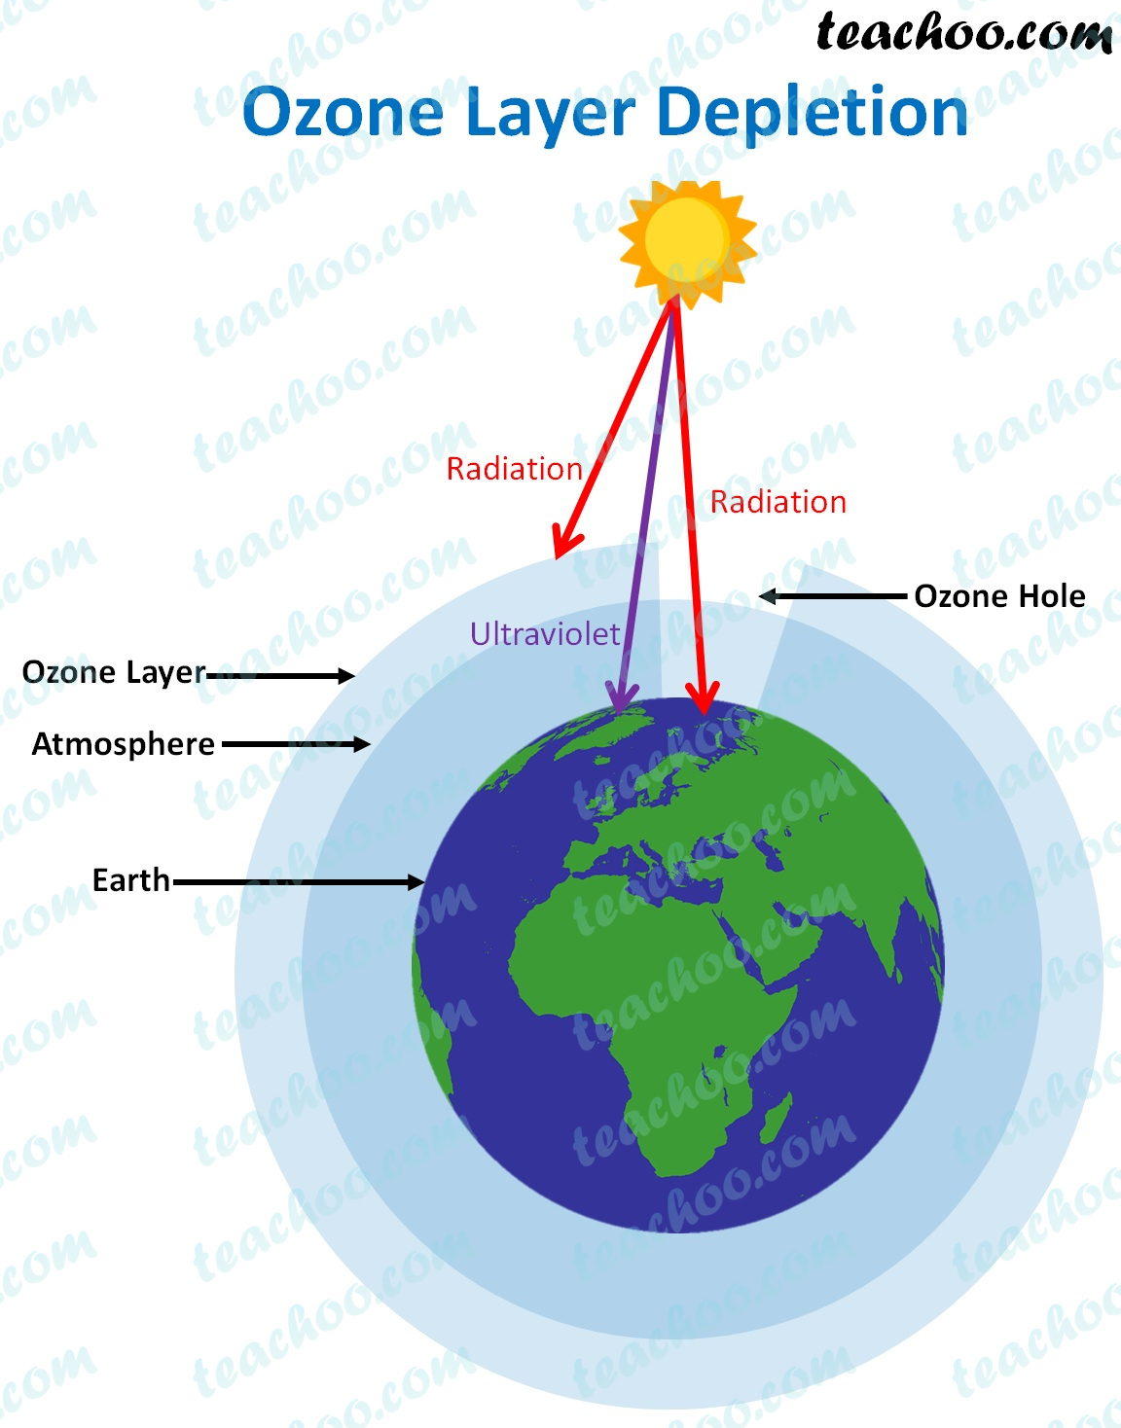
PROBLEMS ASSOCIATED WITH USE OF- NATURAL RESOURCES
Land Resources :- Deforestation,Destruction of wetlands,Desertification,Soil Erosion,Diminishing oil & mineral supplies, Extinction of species
Marine Resources :- Coastal Degradation, Overfishing
Freshwater Resources :- Depletion & contamination of Groundwater,Shortage of Surface Water
Atmospheric Resources :- Depletion of Ozone

Slide 61
RAPID INCREASE IN HUMAN POPULATION
HIGH RATE OF RESOURCE CONSUMPTION
CAUSES OF EXPLOITATION OF NATURAL RESOURCES
POVERTY
INDUSTRIALISATION

Slide 62
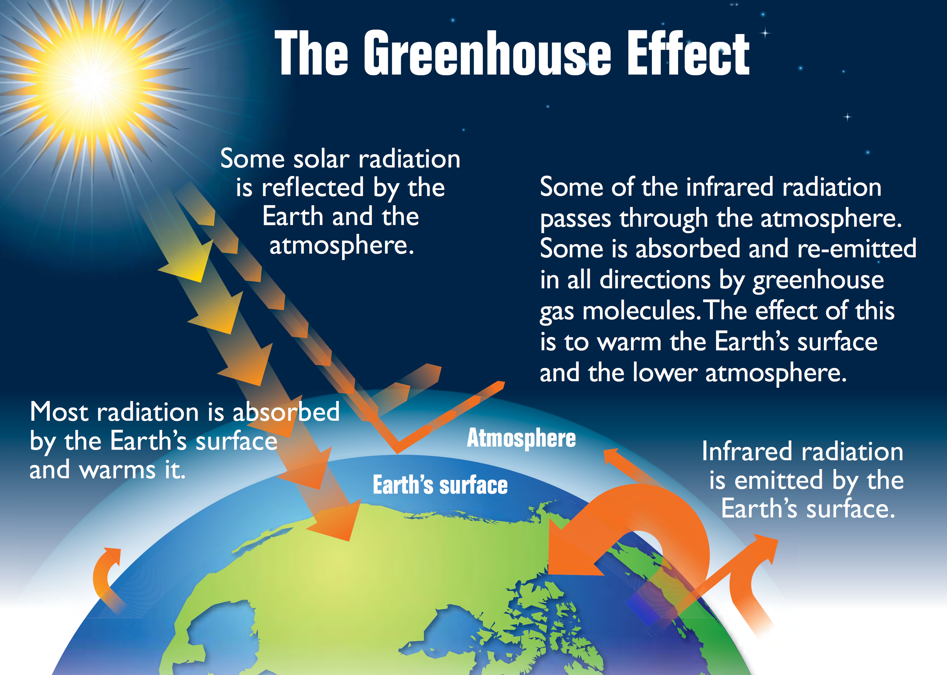
MAJOR ISSUES OF DEVELOPMENT
1.GREENHOUSE EFFECT
Greenhouse effect is a natural process that warms the surface of earth.When sunlight reaches surface of earth,some is absorbed & surface of earth turns warm.
Rest is radiated back to the atmosphere at a longer wavelength than sunlight.
Some of these longer wavelengths are absorbed by Greenhouse gases in atmosphere,before they are lost to space.
Absorption of these longwave radiant energy, warms the atmosphere.
These Greenhouse Gases reflect back to the earth some of the heat energy,which would be otherwise lost to space.
This reflecting back of heat energy by Atmosphere is called as- ‘Greenhouse Gas Effect’

Slide 63
CARBON DIOXIDE
TROPOSPHERIC OZONE
CARBON MONOXIDE
CAUSATIVE AGENTS/GASES FOR –GLOBAL WARMING
METHANE
WATER VAPOUR
CHLOROFLUOROCARBONS (CFC’S)
NITROUS OXIDE

Slide 65
DESERTIFICATION
STRONGER HURRICANES & CYCLONES
IMPACTS OF GLOBAL WARMING
INCREASED MELTING OF SNOW & ICE
RISING SEA LEVEL
ADVERSE IMPACT ON NATURAL RESOURCES LIKE-WATER,FLORA & FAUNA

Slide 66
REDUCTION IN EMISSION OF GREENHOUSE GASES
REDUCTION IN DEFORESTATION
SOLUTIONS TO GLOBAL WARMING
REDUCE,REUSE,RECYCLE
STOP OPEN GARBAGE BURNING
TURNING OFF ELECTRICITY WHEN NOT IN USE

Slide 67
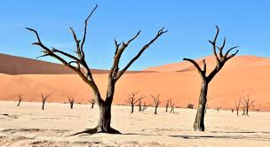
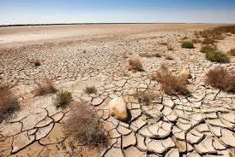
DESERTIFICATION
It is defined as the process of Land Degradation, in arid,semi-arid & sub-humid areas due to variety of factors,such as- Climatic Variations & Human Activities.
It results in persistent degradation of dryland & fragile ecosystems due to man made activities & climate variation.
Desertification occurs when land,which was originally of another type of biome,turns into a Desert biome due to changes.
According to UNESCO, one third of land’s surface is threatened by Desertification & across the world, it affects livelihood of millions of people who depend on benefits of ecosystem,which dryland provides.

Slide 68
OVERGRAZING
DEFORESTATION
CAUSES OF DESERTIFICATION
CLIMATE CHANGE
URBANISATION
STRIPPING LAND OF RESOURCES
FAULTY AGRICULTURAL PRACTICES

Slide 69
INCREASED HUNGER
FARMING BECOMES IMPOSSIBLE
EFFECTS OF DESERTIFICATION
POVERTY
FLOODING
POOR WATER QUALITY DUE TO ABSENCE OF PLANTS
OVERPOPULATION

Slide 70
BETTER/IMPROVED FARMING METHODS
IMPROVED LAND USE PATTERN
SOLUTION FOR DESERTIFICATION
FURTHER RESEARCH
TECHNOLOGY ADVANCEMENT
PUTTING TOGETHER REHABILITATION EFFORTS FOR VICTIMS
EDUCATING PEOPLE REGARDING SUSTAINABLE PRACTICES

Slide 71
SUSTAINABLE MANAGEMENT OF NATURAL RESOURCES
Resources are backbone of every economy.
While using resources & transforming them,capital stocks are built up,which add to the wealth of present & future generations.
But,dimensions of our current resource use are such that the chances of future generation & developing countries to have access to their fare share of scarce resources is endangered.
Moreover,the consequences of resource use in terms of impact on environment can induce serious damage,which goes beyond carrying capacity of environment.
Thus the measures required in this regard are- Maximizing use of Renewable Energy Sources & limiting,avoiding wherever possible –Use of non-renewable natural resources.

Slide 72

LAST BUT NOT THE LEAST
It is clear that-If man wants to survive on this planet, he/she must conserve crucial natural resources rather than mere their exploitation.
It does not mean mere preservation of resources without using them.
Man needs to use resources wisely & judiciously without wasting them & without any compromise on current economic development.

