Slide 1
Horticulture
Important gardens of India
Brindavan garden (Mandya)
Shalimar bagh (Srinagar)
Jijamata udyaan(Mumbai)

Slide 2
Garden
"The cultivation, processing, and sale of fruits, nuts, vegetables, ornamental plants, and flowers as well as many additional services". ... Horticulture even refers to the growing of plants in a field or garden.

Slide 3
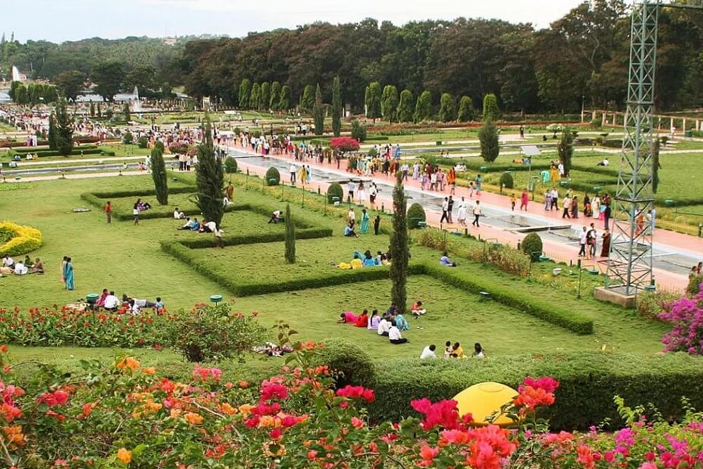
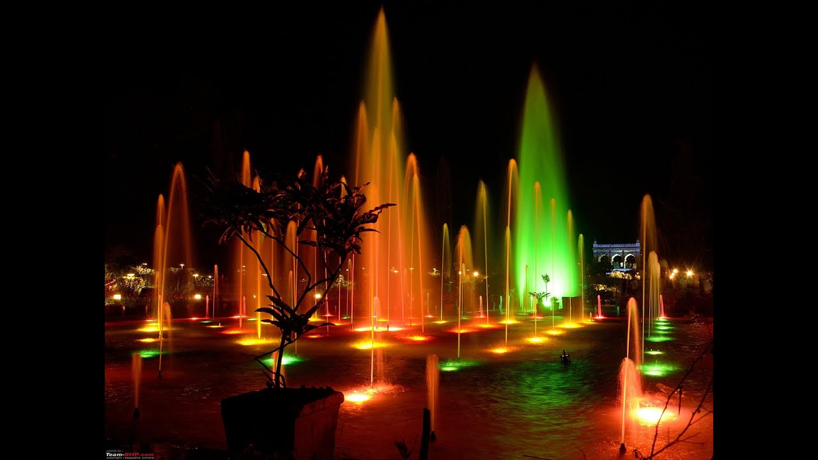
Brindavan garden
(Mysore)
The Brindavan Gardens is a garden located in the Mandya District of the Indian State of Karnataka. It lies adjoining the Krishnarajasagara dam which is built across the river Kaveri. The work on laying out this garden was started in the year 1927 and completed in 1932.

Slide 4
History of Brindavan garden :-
The Brindavan Gardens, a celebrated beauty spot in this part of India is world famous for its symmetric design. It is one of the most beautifully laid out terrace gardens in the world.
The creation of this garden in the Krishna raja Sagar Dam site has been the achievement of Sir Mirza Ismail, the then Dewan of the princely State of Mysore.
The beautification of the whole dam complex was conceived by Sir Mirza Ismail. Modeled on the design of the Shalimar Gardens of Kashmir in the Mughal style, the garden is enriched with a number of terraces, parterres, fountains, running and cascading water channels, water chutes, lush green lawns, flower beds, shrubs and trees. Today, the Brindavan Gardens is world famous for its ethereal beauty, grandeur and illumination/ musical fountain.
Located in the Krishnaraja Sagar dam site in Srirangapatna taluk of Mandya district, the Brindavan Gardens is at a distance of 24 Km. from the famous cultural heritage centre of Karnataka – the city of Mysore, and 143 Km. from Bangalore, the capital city of Karnataka.
The Krishnaraja Sagar dam is built across the river Cauvery, one of the principal rivers in South India. The Cauvery rises in the hills of Brahmagiri – in Talacauvery, Kodagu District in the Western Ghats and traverses Eastwards in Karnataka for about 320 Km. before entering Tamil Nadu and finally joining the Bay of Bengal.
The dam is named after Krishnaraja Wodeyar IV during whose rule the Chief Engineer, Sir M. Vishveswaraya engineered the construction of the dam. The River Cauvery below the giant dam divides the garden into two parts.

Slide 5
Description
The Brindavan Gardens, primarily a terrace garden is laid out immediately behind the Krishnaraja Sagar dam site. The Department of Horticulture in 1927 started the work of laying out this garden, then called the Krishnarajendra Terrace Garden.
Today, the garden extends over an area of 60 acres and it is laid out in the three terraces, which ends in a horseshoe shape. The slopes are planted with colourful Bougainvilleas and ornamental plants.
This garden is a public park and it is one of the important tourist spots of India. The garden is enriched with innumerable fountains decorated with coloured lighting. The illuminated running waters and fountains with changing colours of lights is an event that the tourists can look forward to in the evenings. The garden has many open spaces, lawns, illuminated flower beds and ornamental plants. It also has well laid out roads and pathways.
The Brindavan Gardens is the best-illuminated terrace garden in India. The boating pond in the midst of the garden is a location where the visitors can enjoy a boat ride. The whole garden when illuminated is an enchanting site to see.

Slide 6
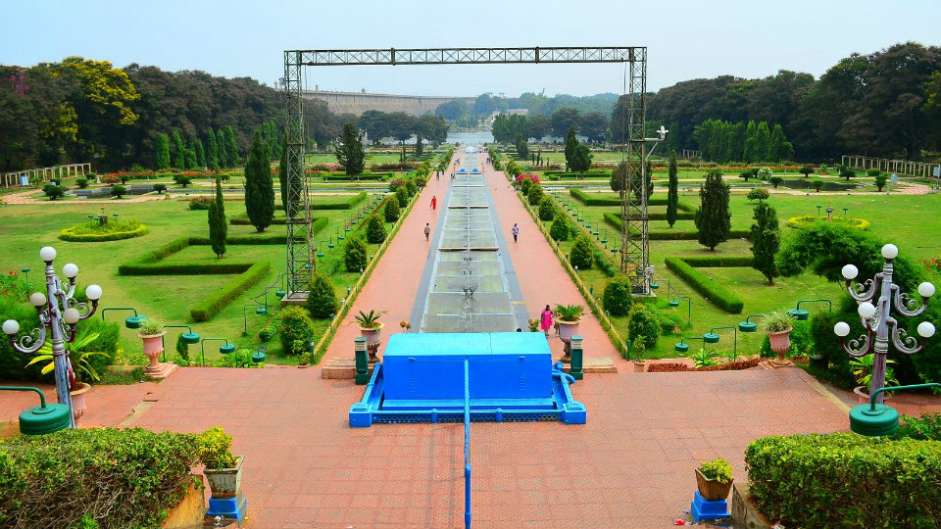
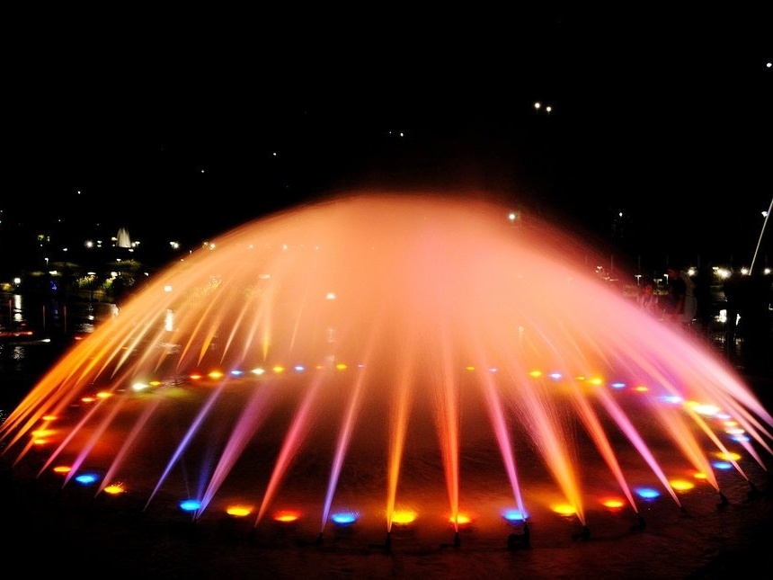

Slide 7
Brindavan Gardens
The garden is divided into -
The main gate area
South Brindavan
North Brindavan
Childrens’ Garden
The main gate is designed on the model of the India Gate, New Delhi. Rose gardens on either side of the gate are worth seeing. Attractive lawns, annual flowerbeds, perennial flowering plants, ornamental hedges are maintained.
South Brindavan is the area near the Cauvery Statue. The area in front of the statue is the Kaveramma circle which has big sized water fountains. Distinct styles of terrace gardens can be seen here. Bougainvillea and allamanda plants are grown on the slopes of the terraces. A lawn is maintained in the terrace garden with annual and perennial flower beds and ornamental hedges in the periphery. Cypress plants are found in the centre. Dwarf statutes are found aplenty in the terraces and many fountains are also located. The fountain always sprinkles water and this is maintained by the water pressure when the dam in its full capacity. The garden is made more attractive with different coloured lights for illumination. This garden is most spectacular in the evenings when the area is illuminated with the fountains on. A glass house in the South Brindavan is used for propagating and maintaining different types of ornamental plants that are required for beautifying the Brindavan Gardens so also for sale at scheduled rates.

Slide 8
North Brindavan: consists of an area encompassing four extensive terraces. In each of the four terraces, extensive lawns, many ornamental annual and perennial flowerbeds and rows of ornamental trees are found. The terrace gardens are beautified with small fountains decorated with different coloured lights. Tree avenues of Sago Palm, copper pod, polyalthea are found in the road that runs parallel to the main dam road. Arches of Bougainvilleas and Bignonia venusta are found over the pathways on either side of the garden. Shrubs of Bougainvillea, Allamanda, Bignonia magnifica, Homskloidia sanguina are found on the slopes of the terraces. Many ornamental trees are also found in the North Brindavan gardens. An ornamental plant nursery is maintained for multiplication and maintenance of plants for sales.
A glass house with collection of cacti and succulents is maintained to cater to the needs of planting material for the garden and for sales. In between the North and South Brindavan is the river Cauvery. Visitors can enjoy a boat ride in the river. Boating facilities are also provided for tourists. These facilities are maintained by the Karnataka State Tourism Development Corporation.

Slide 9
Childrens’ Park
Located beside the South Brindavan towards the right is the Childrens’ Park. In the park are found slide, and concrete animals, birds and aquatic species and items/structures for children to play.
Government Fruit Orchard
A fruit orchard has been established in an area of 75 acres near the North bank of the Krishnaraja Sagar Dam. Established based on modern technology, the fruit orchard is a model farm; a place for teaching about fruit culture to the visitors and those interested in horticulture. This farm was developed with the aim of producing quality-planting materials of fruits and high yielding hybrid coconut seedlings. The fruits and plantation crops grown in this garden are Mango, Guava, Sapota, Litchi, Roseapple, Bilimbi, Aonla, Avacado, Malayan apple, Arecanut, Coconut etc.
The TxD (Tall x Dwarf Centrally sponsored scheme / Coconut hybrid development scheme has been in operation from the year 1968-69. Every year a large number of TxD hybrids are developed in this farm for distribution to the farmers. Perhaps, this is the most important hybrid coconut seedling production centre in the State.

Slide 10
Naguvana Horticulture Farm
Established in an area of 30 acres during 1972–73, this farm is an island near the main gate behind the dam. Various types of fruits plants and coconut trees are grown here. The Horticulture Training Centre of the Department of Horticulture is located in this farm. Every year a 10-month Horticulture training programme is organised for the rural youth of Mandya district.
Chandravana Horticulture Farm
This farm is developed in an area of 5 acres in the centre of the river Kaveri. Coconut and mango are grown in this farm. This farm looks like a beautiful island surrounded by water from July to January.
Cacti and Succulent Garden
A model cacti and succulents gardens is maintained near the office of the Senior Asistant Director of Horticulture. Many species of cacti and succulents are grown and this garden is worth seeing.

Slide 11
Places of Interest:
North Brindavan
South Brindavan Gardens
Arch Fountains
Cross-fountain
End fountains
Cross Channel fountain
RadhaKrishna Falls
Umbrella fountain
Childrens’ park
Pyramid Fountain
Inverted Basket fountain
Fountain in front of the Kaveramma statue
Goddess Cauvery Statue.
The Gardens are regularly illuminated on Wednesday, Saturday and Sunday at 7 P.M. The Childrens’ Park , Horticultural farm and Nursery, Fisheries Pond and the Hydraulic Research Station here are other places of tourist attraction. There is a beautiful statue of the Goddess Cauvery at the foot of the dam.

Slide 12
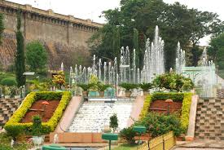
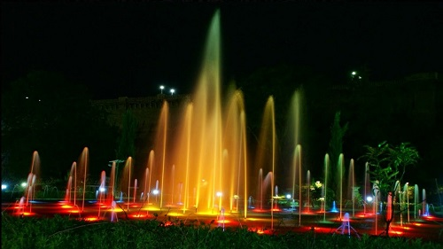
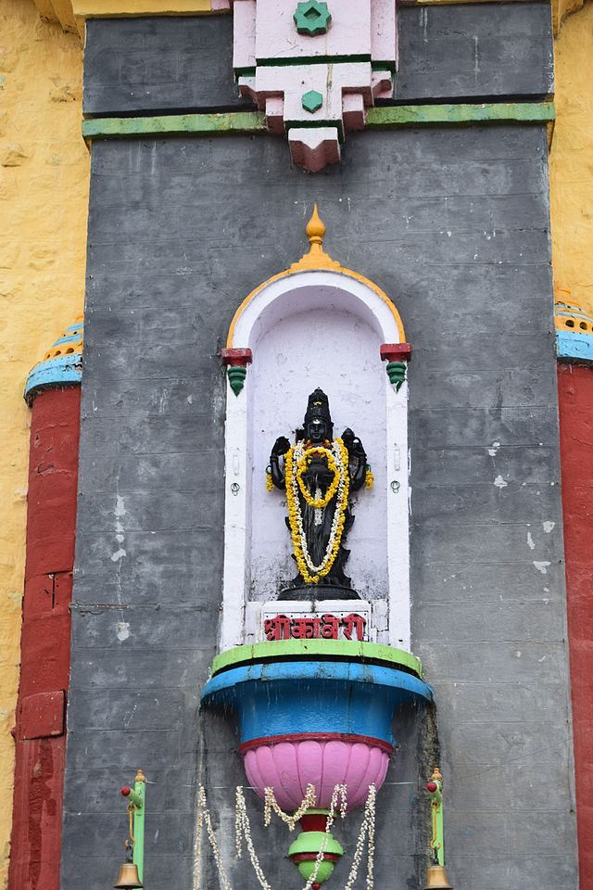
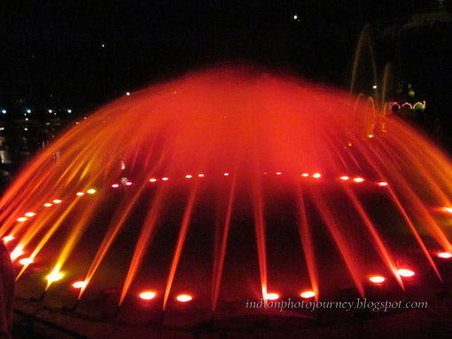

Slide 13
Brindavan Gardens- Quick Facts
Timings: 6.30 AM to 8.00 PM
Entry Fee: INR 15/- per adults and INR 5/- per children between 5 and 10
Music Foundation Show: 6.30 pm to 7.30 pm
Visit Duration: 2 to 3 hours
Address: KRS Dam Road, Krishna Raja Sagar Dam, Mandya – 570005

Slide 14
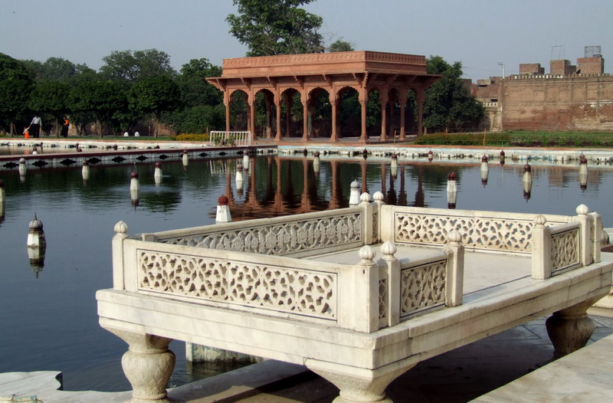
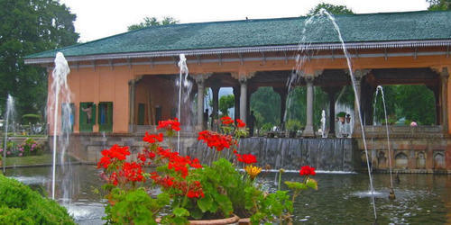
Shalimar garden

Slide 15
Shalimar garden
Shalimar Bagh is a Mughal garden in Srinagar, linked through a channel to the northeast of Dal Lake, on its right bank located on the outskirts of Srinagar city in Jammu and Kashmir, India.
The Bagh was built by Mughal Emperor Jahangir for his wife Nur Jahan, in 1619. The Bagh is considered the high point of Mughal horticulture It is now a public park. It is also called the "Crown of Srinagar“.

Slide 16
Layout :
The layout of the garden is an adaptation of another Islamic garden layout known as the Persian gardens .This garden built on a flat land on a square plan with four radiating arms from a central location as the water source. It needed to be modified to suit the hilly terrain and availability of a well, which could be diverted from a higher elevation to the planned gardens.
Modifications involved the main channel running through the garden axially from top to the lowest point. This central channel, known as the Shah Nahar, is the main axis of the garden. It runs through three terraces. This layout left out the radial arms and the shape became rectangular, instead of a square plan of the Chahar Bagh.

Slide 17
The garden, as finally laid out, covers an area of 12.4 hectares (31 acres) built with a size of 587 metres (1,926 ft) length on the main axis channel and with a total width of 251 metres (823 ft). The garden has three terraces fitted with fountains and with chinar (sycamore) tree-lined vistas. The Shahnahar is the main feeder channel to all the terraces. Each one of the three terraces has a specific role.
The garden was linked to the open Dal Lake water through a canal of about 1 mile (1.6 km) length and 12 yards (11 m) in width that ran through swampy quagmire. Willow groves and rice terraces fringed the lake edge. Broad green paths bordered the lake with rows of chinar trees. The garden was laid in trellised walkways lined by avenues of aspen trees planted at 2 feet (0.61 m) interval.

Slide 18
architectural details :
The architectural details of the three terraces of the garden are elaborate.
The first terrace is a public garden or the outer garden ending in the Diwan-e-Aam (public audience hall). In this hall, a small black marble throne was installed over the waterfall.^{[2][5]}
The second terrace garden along the axial canal, slightly broader, has two shallow terraces. The Diwan-e-Khas (the Hall of Private Audience), which was accessible only to the noblemen or guests of the court, now derelict, is in its centre. However, the carved stone bases and a fine platform surrounded by fountains are still seen. The royal bathrooms are located on the north-west boundary of this enclosure. The fountain pools of the Diwan-e-Khas, the Diwan-e-Aam, and in turn, the Zenana terrace are supplied in succession.^{[6]} It has 410 fountains.

Slide 19
It is encircled by a fountain pool that receives its supply from a higher terrace. A double cascade falls against a low wall carved with small niches (chini khanas), behind the pavilion. Two smaller, secondary water canals lead from the Black Pavilion to a small baradari. Above the third level, two octagonal pavilions define the end wall of the garden. The baradari has a lovely backdrop of the snow mountains, which is considered a befitting setting for the Bagh.
The Shalimar Bagh is well known for chini khanas, or arched niches, behind garden waterfalls. They are a unique feature in the Bagh. These niches were lighted at night with oil lamps, which gave a fairy tale appearance to the water falls. However, now the niches hold pots of flower pots that reflect their colours behind the cascading water.
Another unusual architectural feature mentioned is about the doors of the Baradari. In the garden complex, the Baradari had four exquisite doors made of stones supported by pillars. It is conjectured that these stone doors were ruins from old temples that were demolished by Shahajahan. The garden also provided large water troughs where a variety of fountains were fixed

Slide 20
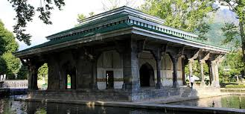
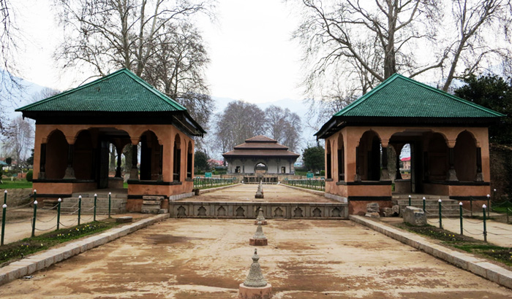
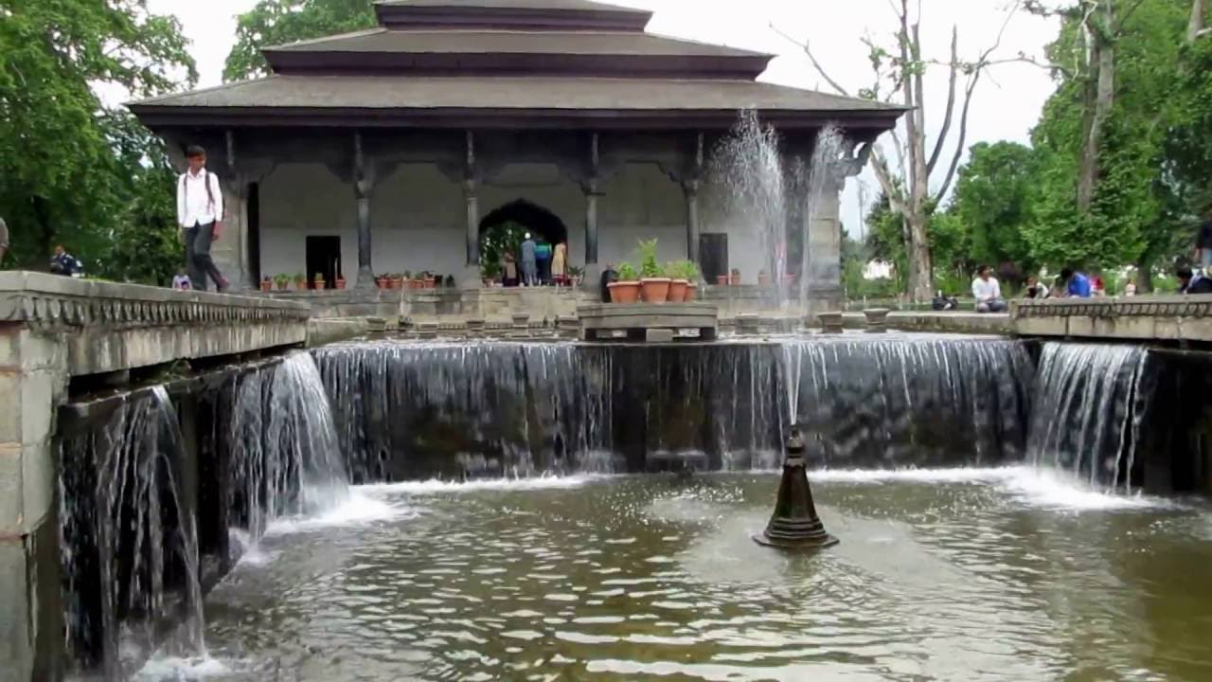
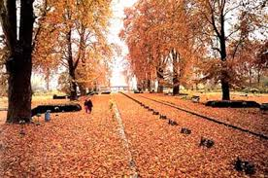
Diwan- e- aam
Diwan -e-khas
Fountain
Shalimar during autumn

Slide 21
Plants found in shalimar garden

Slide 22
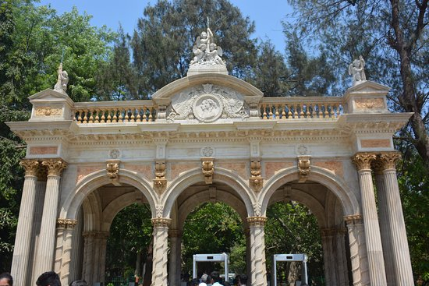
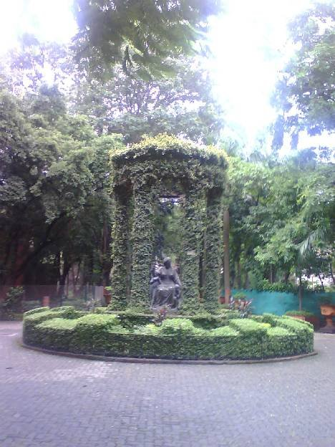
Veermata Jijabai udyaan

Slide 23
Introduction
Formerly known as 'Rani Bagh' or 'Victoria Gardens', this place has been renamed as 'Jijamata Udyaan' or 'Veermata Jijabai Bhonsle Udyan' in the memory of Maratha warrior Shivaji's mother. Victoria Gardens is located in Byculla, the heart of Mumbai. Inaugurated in 1861, this is considered to be one of the oldest zoos of India.
Another major attraction of this garden is the Bhau Daji Lad Museum (previously known as Victoria and Albert Museum).This museum is located in the same premises with the purpose of enhancing industrial as well as agricultural interests

Slide 24
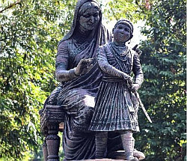
History
The land where Victoria Gardens/Rani Bagh now stands was previously owned by an affluent Jewish businessman, David Sassoon. He instructed the famous Lundons architect to design the Victoria and Albert Museum. A clock tower was also built along with this, which still exists in the garden, but doesn't tell the time anymore. The interiors of this museum are quite similar to the Magen David synagogue of Byculla. Later, David Sassoon donated this land to the Municipal Corporation of Mumbai.

