Slide 1
E-Banking Business models
S.Y.BBI SEM-IV

Slide 2
What is E-Banking?
Also known as internet banking, web banking, or online banking too.
Enables customers of a bank to transact from another bank.
E-banking is a blanket term used to indicate a process through which a customer is allowed to carry out, personal or commercial banking transactions using electronic and telecommunication network.

Slide 3
Home-Banking
A practice of conducting bank transactions from home instead of branch bank.
It refers to mobile banking, web banking, banking over phone, etc.
The services are mostly used in home banking are balance and transactions per dinar, foreign exchange and savings accounts, information on unrealized checks, information on loans, transfer funds between accounts, paying credit, loans, etc.

Slide 4
Office-Banking
Banking that takes place with the help of office employee.
A model based on the principle of banking from home where staff in the business system through their computer systems (terminals) can use banking services.

Slide 5
Online banking
Transaction that take places everywhere except banks.
It is cash less process.
Feasible.
Financial transactions to the current account balance and credit cards, pay overdue bills, transfer funds between accounts, planned and scheduled payments for a specific term that will be executed automatically.

Slide 6
Internet Banking
Also called as online transaction that customers can use through internet.
Easy to use.
A method where users perform financial transactions over the Internet, due to speed, efficiency, and effectiveness of execution of transactions.
Modern banks through Internet Banking provide its clients individuals and legal entities around the world throughout the whole year (365 days).

Slide 7
Mobile Banking
Transaction taking place through mobile apps or websites.
Can be done 24/7.
It allows users to perform the following banking operations:
Check account balances for all accounts.
Credit cards.
To make payments of dues.
To transfer funds from account to account.

Slide 8
SMS Banking
The message which occur while a transaction has been occur.
It keeps updated to customers about their transactions.
SMS banking allows clients insight into the current account balance after each change, insight into the state of the current account at any time requested by the client, financial transactions via SMS.

Slide 9
Benefits of E-Banking
1. Price- In the long run a bank can save on money by not paying for tellers or for managing branches. Plus, it’s cheaper to make transactions over the Internet.
2. Customer Base- The Internet allows banks to reach a whole new market- and a well off one too, because there are no geographic boundaries with the Internet.

Slide 10
Cont…
3. Efficiency.
4. Customer Service and Satisfaction.
5. Image.

Slide 11
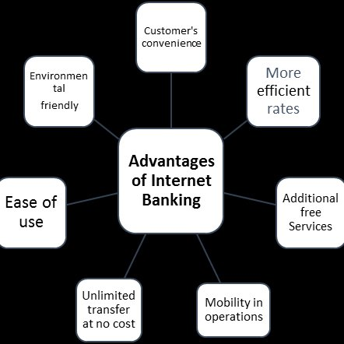
Advantages of E-Banking

Slide 12
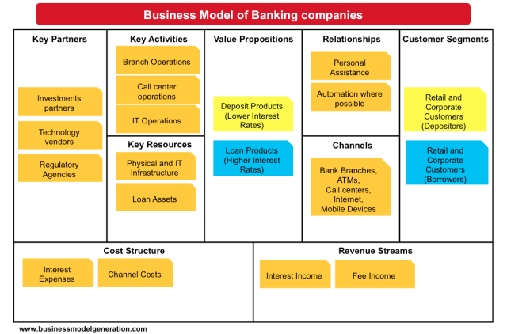
Business Model of Banking

Slide 13
Models of Electronic Payment
An electronic payment is any kind of non-cash payment that doesn't involve a paper check. Methods of electronic payments include credit cards, debit cards and the ACH (Automated Clearing House).
When you purchase goods and services online, you pay for them using an electronic medium.

Slide 14
Cont…
This mode of payment, without using cash or cheque, is called an e-commerce payment system and is also known as online or electronic payment systems.
Electronic banking (e-banking) is a contemporary business model that involves the use of modern information and telecommunication technologies in carrying out banking transactions from home, the office, or from business trip, 24 hours a day, 365 days in a year.

Slide 15
TYPES OF ELECTRONIC PAYMENT

Slide 16
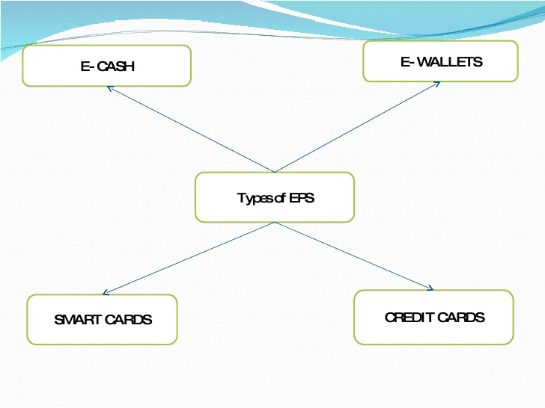
TYPES

Slide 17
1. Credit Card
The most popular form of payment for any transactions is through credit cards.
It is simple to use; the customer has to just enter their credit card number and date of expiry in the appropriate area on the seller’s web page.
To improve the security system, increased security measures, such as the use of a card verification number (CVN), have been introduced to on-line credit card payments.
The CVN system helps detect fraud by comparing the CVN number with the cardholder's information.

Slide 18
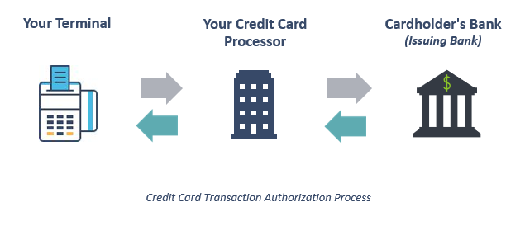
Working of Credit Card

Slide 19
2. Debit Cards
Debit cards are the second largest e-commerce payment medium in India.
Customers who want to spend online within their financial limits prefer to pay with their Debit cards.
With the debit card, the customer can only pay for purchased goods with the money that is already there in his/her bank account as opposed to the credit card where the amounts that the buyer spends are billed to him/her and payments are made at the end of the billing period.

Slide 20
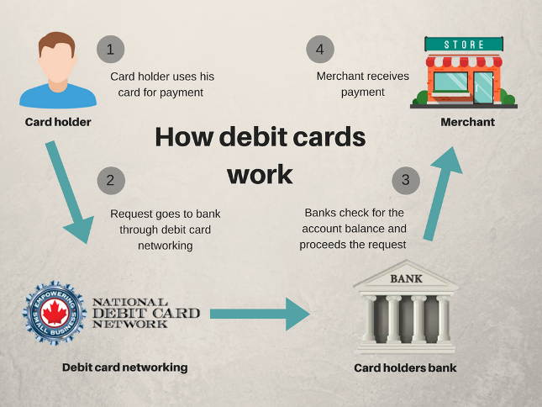
Working of Debit Card

Slide 21
3. Smart Card
It is a plastic card embedded with a microprocessor that has the customer’s personal information stored in it and can be loaded with funds to make online transactions and instant payment of bills.
The money that is loaded in the smart card reduces as per the usage by the customer and has to be reloaded from his/her bank account.

Slide 22
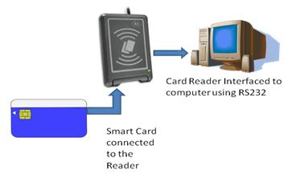
Working of Smart Cards

Slide 23
4. E-Wallet
E-Wallet is a prepaid account that allows the customer to store multiple credit cards, debit card and bank account numbers in a secure environment.
This eliminates the need to key in account information every time while making payments.
Once the customer has registered and created E-Wallet profile, he/she can make payments faster.

Slide 24
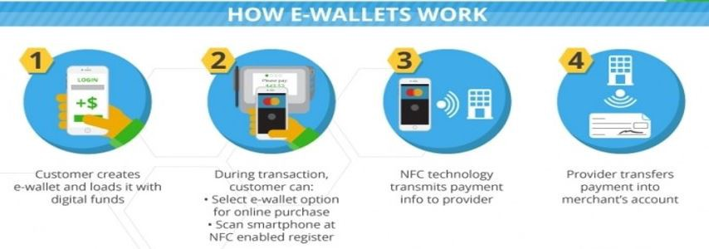
Working of E-Wallet

Slide 25
5. Netbanking
This is another popular way of making e-commerce payments.
It is a simple way of paying for online purchases directly from the customer’s bank.
It uses a similar method to the debit card of paying money that is already there in the customer’s bank.
Net banking does not require the user to have a card for payment purposes but the user needs to register with his/her bank for the net banking facility.

Slide 26
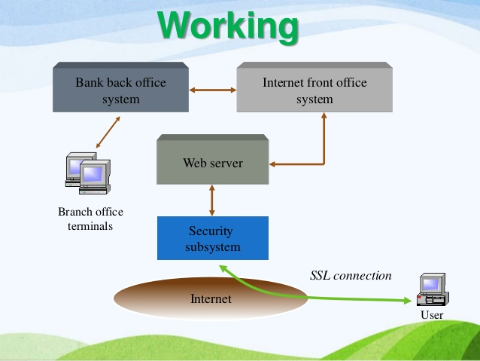
Working of NetBanking

Slide 27
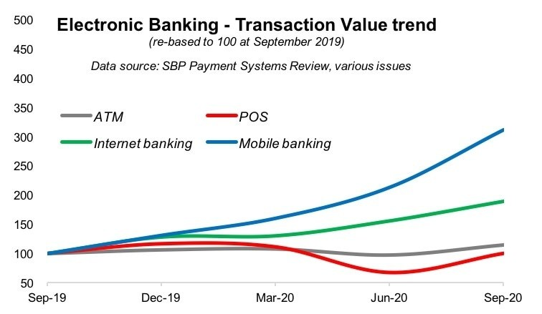
Impact of E-Banking

Slide 28
Case Study

Slide 29
1. Introduction
The rapid growth of the Internet has led to its usage to facilitate electronic commerce, known as Internet-based electronic commerce (IBEC).
IBEC defined as a set of business information exchange processes, maintaining business relationships and conducting business transactions over the Internet.
The rapid growth in information technology (IT) in commerce has propelled the economic
developmental officials to constantly improve their competitive communities in order to anticipate the future.

Slide 30
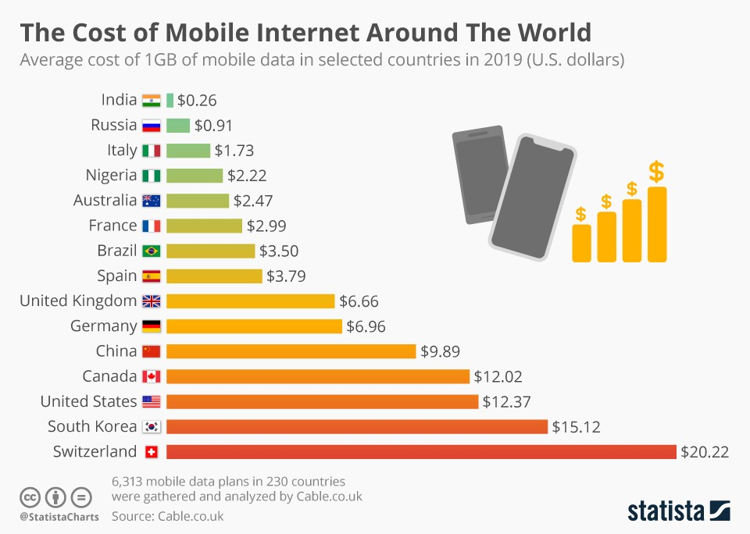
Cont…

Slide 31
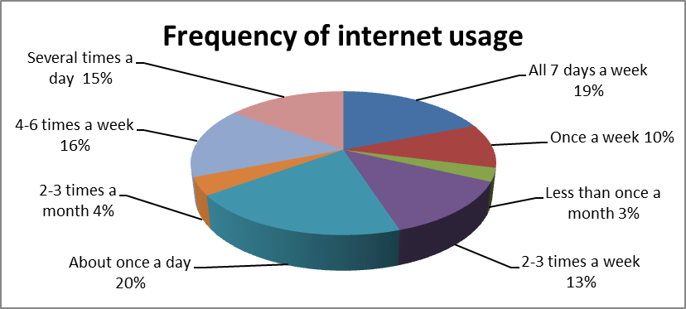
Cont…

Slide 32
2. Factors leading to the acceptance of mobile banking
The importance of perceived usefulness in the adoption of information systems (IS) and the Internet has been previously shown to positively affect online purchase intention.
The perceived usefulness of the Mobile Internet (M – Internet) also plays a key role in developing a positive attitude towards the Internet, as well as in the intention of use.
This only happens if consumers become more interested in the benefits offered by online banking than in the ones provided by regular banking channels.
“Ease of use” is the level to which a person believe that the use of a particular system will be stress free.

Slide 33
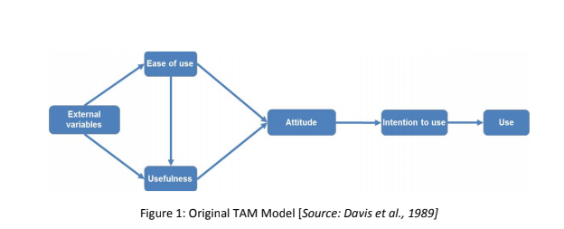
Cont…

Slide 34
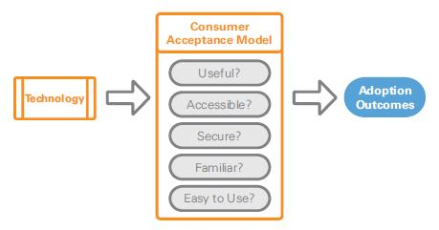

Slide 35
3. Security purposes.
Safety has been widely recognized as one of the main obstacles to the adoption of electronic banking.
Those who feel safer in Internet are more likely to trust a specific website, such that this is a way to enhance trust among consumers.
Web seals or guarantees, such as Third-Party Certifications (TPC) can also encourage customers, helping reduce security and trust issues.

Slide 36
Cont…
Consumers are generally concerned about how banking transactions are made.
By eliminating the risks of an unauthorized transaction, customers develop feelings of trust in the service provider.

Slide 37
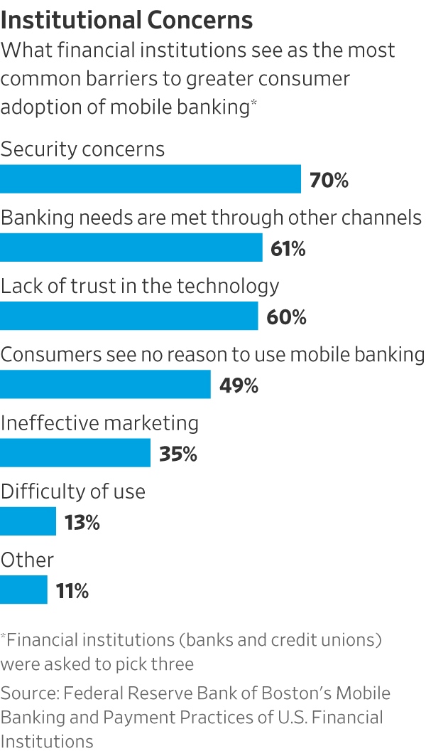

Slide 38
3.2 Effects of concern for privacy.
Privacy concerns have been identified as a major, if not the most critical obstacle to e-commerce.
It is a barrier to the rapid growth of electronic commerce since the lack of consumer trust and privacy laws create this problem in the online environment.
One of the problems associated with the lack of privacy on the Internet is spam.
This implies usage tracking and data collection that may allow sharing information with others.

Slide 39
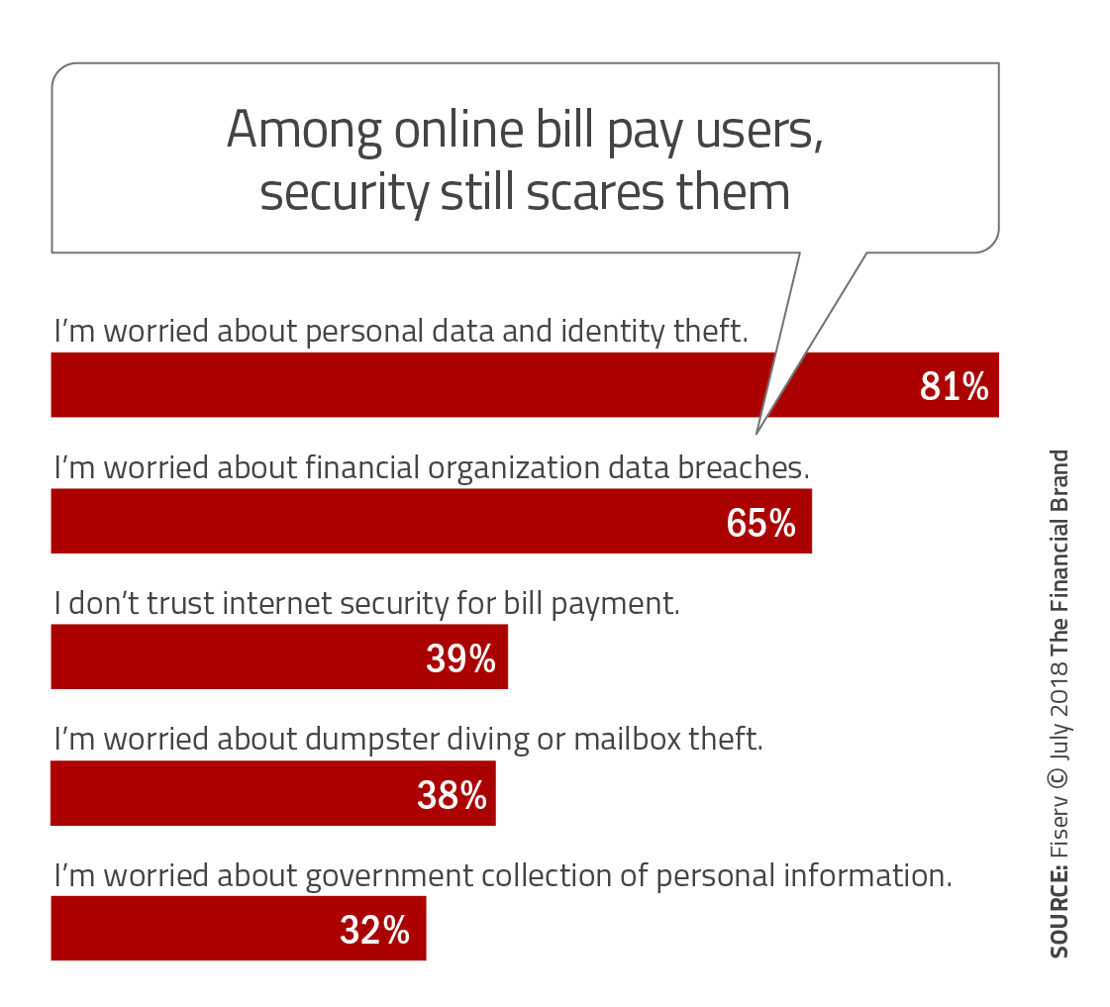

Slide 40
3.3 Effects of perceived usefullness
The importance of perceived usefulness has been widely recognized in the field of electronic banking.
The usefulness is the subjective probability that a new technology will improve the way a user achieves his/her goal.
Usefulness refers to the degree to which a person believes that using a particular system will increase their effectiveness and job performance.

Slide 41
3.4 Effects of usability.
Ease of use refers to the individual's perception that using a particular system is free of effort or simply easy to do.
It is considered one of the most influential attributes in the adoption of a new technology.
Ease of use has a double impact on attitudes, both through self-efficacy and instrumentality, and through utility.

Slide 42
3.5 Effects of Trust
People make important purchasing decisions based in part on their level of trust in the product, seller and / or company.
Trust has been viewed as a catalyst in many transactions between buyers and sellers, which can provide consumers with high expectations of satisfying exchange relationships.

