Slide 1
Risk Management
TY BIM
YEAR 2020-2021
BY Prof Aarti Vyas

Slide 2

Meaning
Risk management is the process of identification, analysis, and acceptance or mitigation of uncertainty in investment decisions.
Risk is inseparable from return in the investment world.
A variety of tactics exist to ascertain risk; one of the most common is standard deviation, a statistical measure of dispersion around a central tendency.
Beta, also known as market risk, is a measure of the volatility, or systematic risk, of an individual stock in comparison to the entire market.
Alpha is a measure of excess return; money managers who employ active strategies to beat the market are subject to alpha risk.

Slide 3
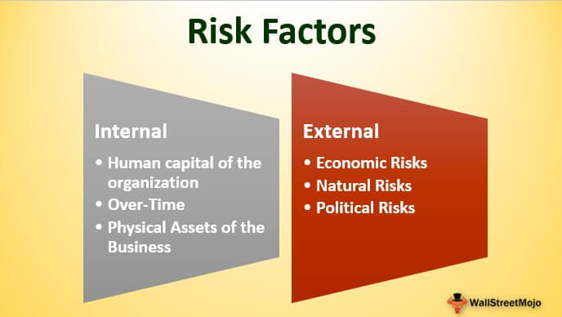
Types of Risk
Internal Risk
Market Risk
Technical Risk
External Risk

Slide 4
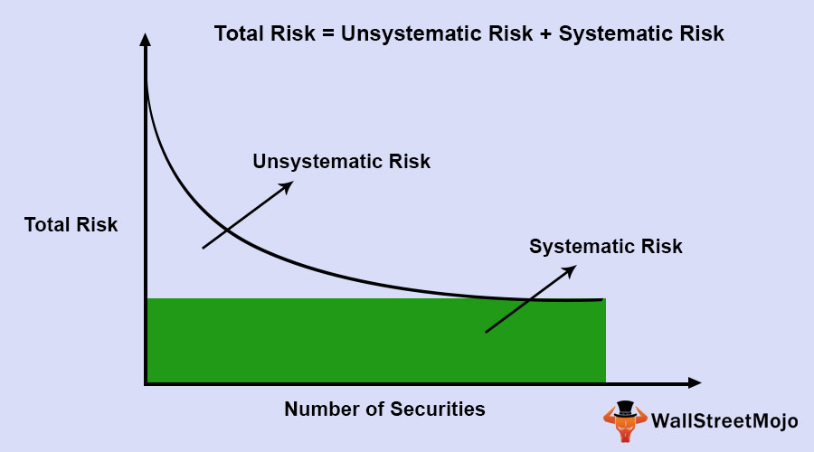
Classification of Risk
Firm Risk
Systematic Risk

Slide 5

Risk Management Process
Risk Management Planning
Risk Identification
Qualitative Risk Analysis
Quantitative Risk Analysis
Risk Response Planning
Risk Monitoring and Control

Slide 6


Risk Analysis and Identification
Risk anlaysis is a process that helps you uidentify and manage potential problem that could undermine key business projects
Risk Identification is the hardest and most important part under risk management process

Slide 7
Techniques of Risk Identification
Analyzing historical records
Structured questionnaires
Structured interviews
Brainstorming
Structured checklist
Flow charts
Judgement based on knowledge and experience
System analysis
Scenario analysis

Slide 8

Impact of Risk Handling Measures
Risk Mitigation Planning
Risk Transfer and contracting
Risk Buffering
Risk avoidance
Risk Control organizational Flexibility
Risk Assumption

