Slide 1


Role of Entrepreneur’s in Economic Development

Slide 2

ECONOMIC DEVELOPMENT
Economic Development is a process in which all efforts are made to increase national income, national output, per capita income , per capita output and standards of living of people by exploiting all the available resources of country.

Slide 3
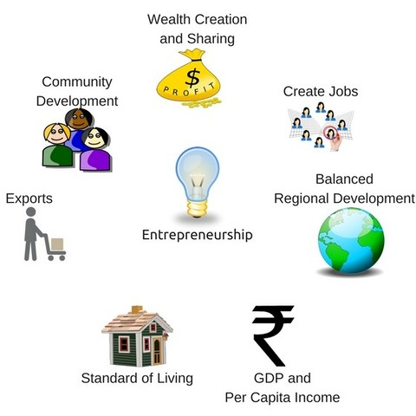
ROLL OF ENTREPRENEUR IN ECONOMIC DEVELOPMENT

Slide 4

1. WEALTH CREATION AND SHARING

Slide 5

2. CREATE JOBS

Slide 6

3. BALANCED REGIONAL DEVELOPMENT

Slide 7
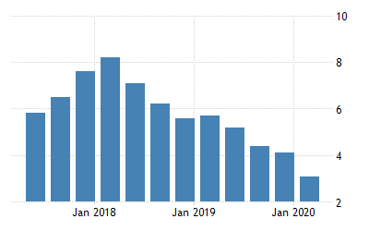
4. GDP AND PER CAPITA INCOME

Slide 8
PER CAPITA INCOME
The country's per-capita monthly income is estimated to have risen by 6.8 per cent to Rs 11,254 during 2019-20, government data on national income showed on Tuesday.
In 2018-19, the monthly per-capita income had stood at Rs 10,534.
The per-capita income is a crude indicator of the prosperity of a country.

Slide 9
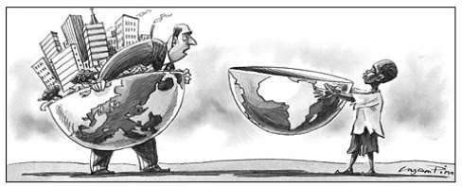
5. STANDARD OF LIVING

Slide 10

6. EXPORTS

Slide 11

7. COMMUNITY DEVELOPMENT

Slide 12
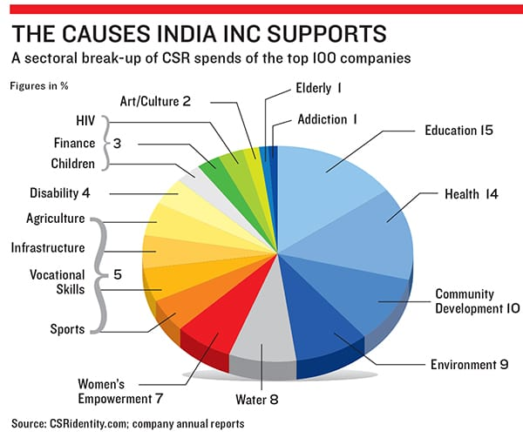

Slide 13
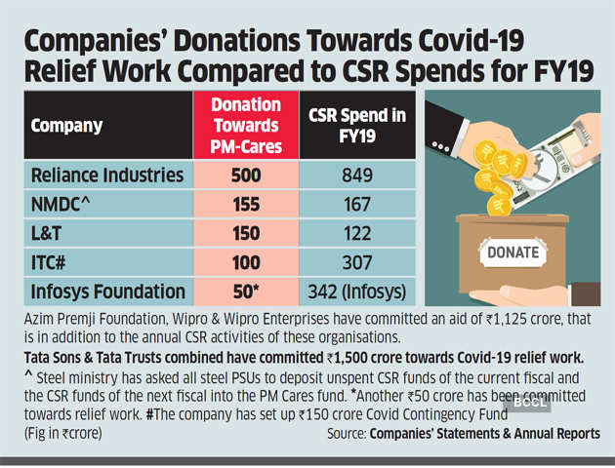

Slide 14



