Slide 1
UNIT-1
INTRODUCTION TO ECONOMICS
TOOLS OF ECONOMIC ANALYSIS

Slide 2
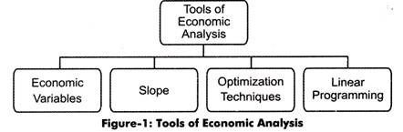
Economic analysis is a process in which the strengths and weaknesses of an economy are determined.
It is a systematic approach to determine the optimum use of scarce resources, compare available alternatives, and select the best alternative to achieve a particular goal. In addition, economic analysis helps in determining the causes of various economic problems, such as inflation, depression, and economic instability.
Economic analysis is performed with the help of various tools, which are shown in Figure
Economic analysis

Slide 3
Economic Variables:
An economic variable refers to the any economic quantity whose value changes with a change in its determinants or change in economic activities.
For example, demand, supply, prices, production cost, wages labor and capital are the economic variables whose value changes with change in their determinants or in different trade cycles.
Economic variables can be classified as follows:
Dependent Variables: Involve those variables whose values are dependent on the values of other variables. For example, demand of a product is dependent on its price.
(b) Independent Variables: Refer to variables that are independent and are not affected by a change in any other variable. In the preceding example of demand of a product and its price, the demand of the product is a dependent variable, while price of the product is an independent variable.
(c) Endogenous Variables: Refer to variables whose value can be obtained within the model under consideration. For example, the price of a product in the supply and demand model is endogenous.
(d) Exogenous Variables: Refer to variables whose value is obtained outside the model under consideration. For example, in case of increase in domestic petrol price due to increase in international petrol price, the international petrol price is the exogenous variable.

Slide 4
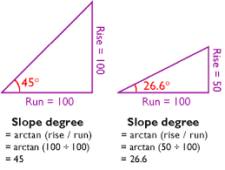
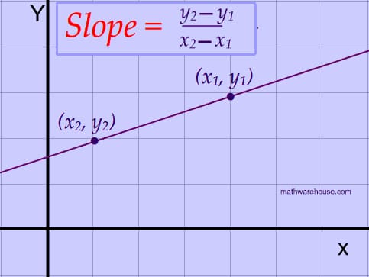
SLOPE
It helps in determining the changes produced in one variable with a change in another variable. Therefore, slope can be defined as the change occurs in dependent variable due to the change in independent variable. The relationship between a dependent and independent variable can be represented as a straight line on a graph.
Suppose a unit change in the independent variable x brings changes in the dependent variable y.
Slope = change in y/change in x

Slide 5
The shape of line determines the type of relationship between the two variables. This line is termed as the slope of line. If the slope is steeper, then the relationship between the two variables is weak and vice-versa.
If the slope of a line is positive, the line moves upward when going from left to right. On the other hand, if the slope is negative, then the line moves down when going from left to right.
In demand curve, the slope represents the ratio of the change in the independent variable price (P) to the change in the dependent variable that is demand (D). If the price of a product decreases (- AP), then the demand for that product would increase (AD).
In such a case, the slope of the demand curve would be as follows:
Slope = -∆P/∆D
Where, -∆P = change in price (independent variable)
∆D = change in demand variable (dependent variable)
The slope differs for linear and non-linear variables.

Slide 6
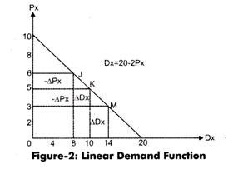
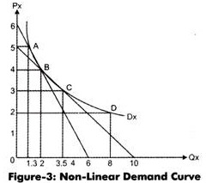
FUNCTION:-
A function shows the relationship between two or more variables. It indicates how the value of one variable( i-e dependent) depends on the value of the another (i-e Independent) variable.
C= f (Y)
Linear Function: variables have power 1.
example; Q= f (L ,K )
Dx = 20 – 2Px
Slope = ∆P/∆D, the slope is equal at all
points in the linear demand function.
Non-Linear Function: variables have
power more than 1.
Dx = 32Px-2
the slope of nonlinear demand function would be different between two different sets of points.

Slide 7
EQUATIONS
When the verbal expressions are transformed into algebraic form we get Equations. The term equation is a statement of equality of two expressions or variables. The two expressions of an equation are called the sides of the equation. Equations are used to calculate the value of an unknown variable. An equation specifies the relationship between the dependent and independent variables. Each equation is a concise statement of a particular relation
Functions can take different forms, example; Q= -bP
here, b I constant and has value less than 1 but greater than zero. In this case if price is zero Q=o,
Another form can be Q= a-bP , a is the vertical intercept shows quantity demanded at zero price. It has positive value and it is independent of price. When price is zero bP will be zero and Q=a.
Intercept:- is the point which the line or the curve crosses the vertical axis.
B measure the slope of demand curve, dQ/dP. The demand curve has negative relationship and hence, negative sign.

Slide 8
IDENTITIES
An identity explains an equilibrium condition or a definitional condition. A definitional identity explains that two alternative expressions have exactly the same meaning. For example, total profit is defined as the excess of total revenue over total cost, and we can denote as:
π ≡ TR - TC
Where π is total profit, TR is total revenue and TC is total cost.
Similarly, saving is defined as the difference between income and consumption expenditure and we can say;
S ≡ Y - C
You are required to note that an identity is denoted by a three - bar sign (≡).
The distinction between an identity and an equation is very subtle and important. An identity is a relation that is true for all values of the variables; no values can be found that will contradict it. For instance, (x + y)² = x² + 2xy + y² is an expression which is true for any numerical value of x and y. Identities are statements that are compatible with any state of the universe. In case of National Income accounting we have an important identity between National Income (Y) ≡ National Output (O) ≡ National Expenditur (E)
Hence; Y ≡ O ≡ E
Identities are mere “truisms”, they cannot form the basis of any theory.

Slide 9
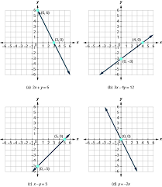
GRAPHS AND DIAGRAMS
Graph depicts the functional relationship between two or more economic variables. The use of graph provides a better understanding of the economic generalizations. Graph presents a visual picture of an abstract idea. Also it is useful for accuracy and precision.
.It represents the values of only two variables at a time. The common method of constructing a graph or a diagram is described below:

Slide 10
Optimization Techniques:
Optimization techniques are used to determine the value of independent variable that maximizes or minimizes the value of defendent variable. These techniques are useful for making various managerial decisions.
For example, generally, organizations strive to determine the level of output that would minimize the cost of production or maximize their profits. In this way, optimization techniques help in taking major decisions of an organization.
Maximizing Total Revenue:
Total Revenue (TR) can be determined by taking the product of price and quantity of a product that can be expressed a follows:
TR = P. Q.
Where, P= Price of product
Q = Quantity of product sold
Optimizing Output and Minimizing Average Cost:
Optimum output can be defined as the output level at which the average cost of production for an organization is minimum. It helps in determining the most efficient size of an organization.

Slide 11
Linear Programming:
Linear programming refers to the mathematical technique used for solving optimization problems, such as maximization and minimization problems, of businesses. These optimization problems include variables that have linear relationships. In other words, linear programming provides the best solution for the allocation of resources and for the optimization problem under specific conditions. However, economic application of linear programming is very rare as it provides less information regarding the working of an economy.
These assumptions are as follows:
i. Linearity:
Assumes a linear relationship between input and output of production. It is not only an assumption, but also a condition for linear programming.
ii. Continuity:
Assumes that all variables are measurable only if they are having a numerical value. According to this assumption, only numerical values bring continuity in the measurement of variables.
iii. Independence and Additively:
Assumes that variables and their numerical values are not dependent on other variables. This implies that variables are .selected randomly within limits. Another assumption is related to the additive nature of variables to be added together. If variables cannot be added together, they have no meaning in linear programming.
iv. Proportionality:
Assumes that there is a proportional relationship among variables. The proportionality between the variables remains same while finding out the solution of the problem. This implies that the proportional relationship among variables is same at every level of output. For example, if a product requires 5 units of input to produce one unit of output, then the production of 10 units of output would require 50 units of input.
v. Constant Price:
Assumes that the prices of input and output remain constant, regardless of the quantity sold and purchased.

