Slide 1
Thakur College of Science & Commerce
Department of Zoology
Welcomes
Academic Year – 2020-21
Dr. Vitthal T. Mohite
Head, Department of Zoology

Slide 2
Ethology – Animal Behaviour
Semester-III Paper –III Unit - I
Behaviour – Way organism respond to their environment and to the members of same of different species.
Ethology Definition : The branch of biology that deals with the animal behavior.
Is biological study of animal behavior.
Why to Study Animal Behaviour
Understand Behavioural action, Evolutionary trends, adaptation in surrounding.
Understand link between organism and environment.
Understand variation among the same species.
Understand status and the health of environment.

Slide 3
History : Animal Behaviour
Man is keen observers of animal behavior.
The origins of the scientific study of animal behaviour lie in the works of various European thinkers of the 17th to 19th centuries, such as British naturalists John Ray and Charles Darwin and French naturalist Charles LeRoy.
Edward L. Throndike (1911) conducted experiments on animal.
Niko Tinbergen and Karl Von Frish called it separate discipline called Ethology. They as considered as architects of modern ethology.

Slide 4
Significance of Animal behaviour
Explains why and how particular animal behavior occurs.
Help to understand communication, reproductive and social behavior of the animals.
Prey –predator system within the ecosystem.
It has also economic significance.
Help to increase breeding techniques for wild life conservation.
Studies Origin , development and adaptive value and evolutionary significance.

Slide 5
Types of Behaviour
Learned behavior
The behaviour of an organism resulting from the effects of the environment
  Acquired through learning.
  Repetitive similar stimuli are required.
  Examples
  Human Behaviour
  Police dogs
Innate Behaviour
Innate Behavior Overview. Behavior can be described as a reaction to a stimulus, which is an internal or external event that leads to a response
  By birth
  By gene without any influence
  Examples
Web making in spiders.
Nest building in birds.
Fighting among male stickleback fish.
Cocoon spinning in insects such as moths.
Swimming in dolphins and other aquatic species.

Slide 6
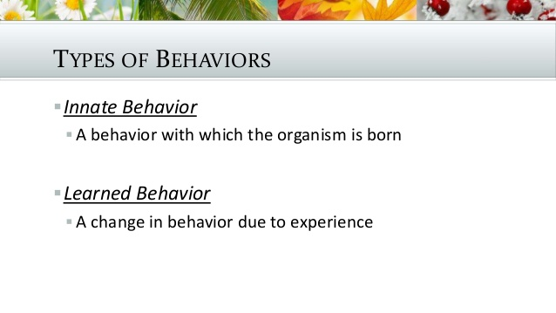
Genetically programmed behaviour e.g. Eating , sleeping crying
Learning how to attack and kill prey

Slide 7
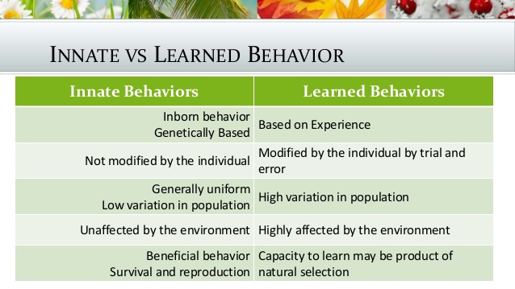

Slide 8
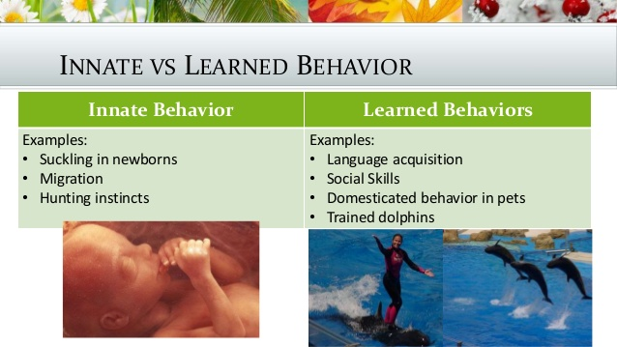

Slide 9
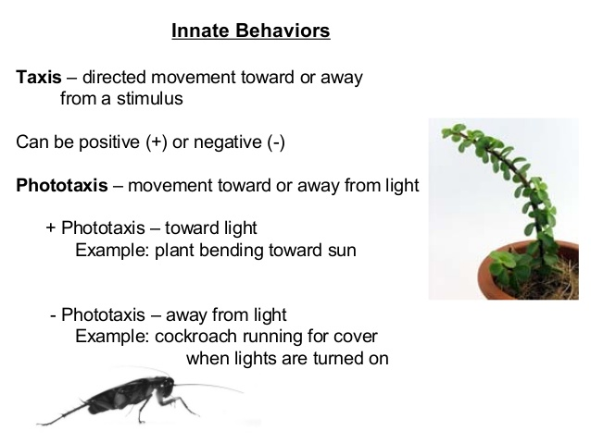

Slide 10
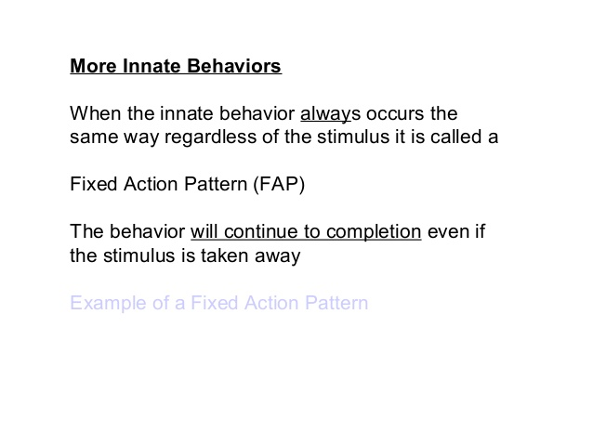
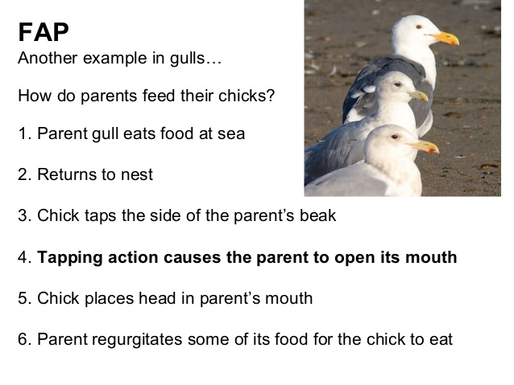

Slide 11
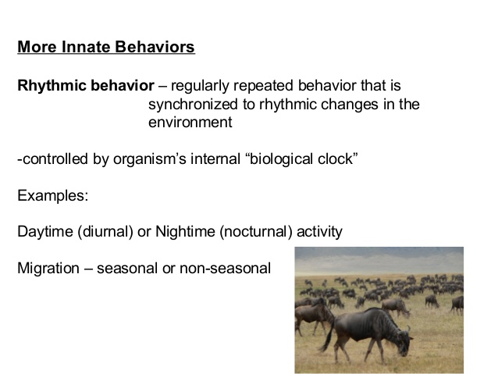

Slide 12
Learned Behaviour
Definition : is one that develops as result of experience.
Can not be performed without any prior training.
Learning and memory to together. Learning is change in behaviour and memory is result of change in behaviour.
Learning has adaptive value that enables to survive in change in environment.
e.g. child avoid going near the flame once it has experienced burning sensation.
https://www.youtube.com/watch?v=y-g2OmRXb0g&feature=emb_rel_end

Slide 13
Types of learned Behaviour
1.Habituation
2. Imprinting
3. Conditioning
4. Observational learning
5. Play as learned behaviour
6. Insight learning behaviour

Slide 14
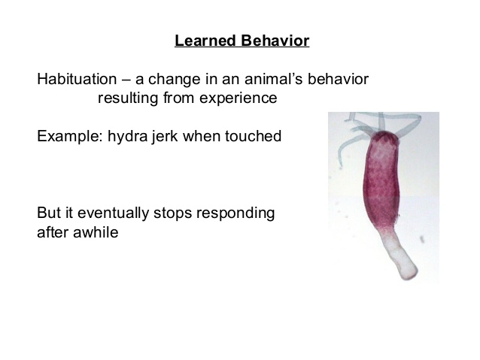
Forming a habit

Slide 15
Imprinting
Learning occurs in animals exposed to particular stimuli during critical period of early development.
Takes place after birth and results are strong and fixed attachment.
Almost impossible to change.
e.g. Goats and pandas.
The movie fly Away Home is about the imprinting.
Critical period is soon after the birth.
Types of Imprinting
a) Filial Imprinting b) Sexual Imprinting

Slide 16
Filial Imprinting
:Response to a mother figure
Visual stimuli : catch attention of young birds.
Auditory stimuli : Duckling sound is very important for mother to make sure that young ducklings are follow her.
Olfactory Stimuli : Odour is external stumuli.

Slide 17
Sexual Imprinting
Birds, certain animals select their sexual partner from population by colour, shapes and markings on the body.
Choice Sexual partner in later stage of life.
It also enables to identify members of their own species.
It also helps them to avoid inbreeding. E.g. Birds Saprow, Penguin

Slide 18
Biological Significance of Imprinting
Parent offspring bonding in early life.
Chioce of sexual partner in later life.
Enables organism to recognize members of their own species.
It also helps them to avoid inbreeding.

Slide 19
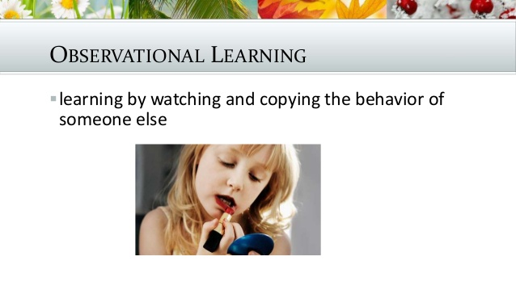
Attention : By paying attention
Retention : Memories information & Store in memory
Reproduction: Replicate another behaviour

Slide 20
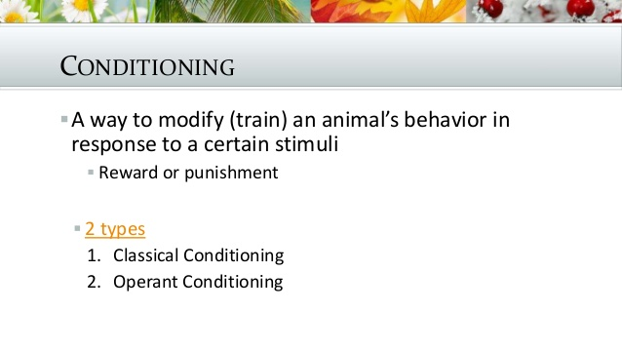

Slide 21
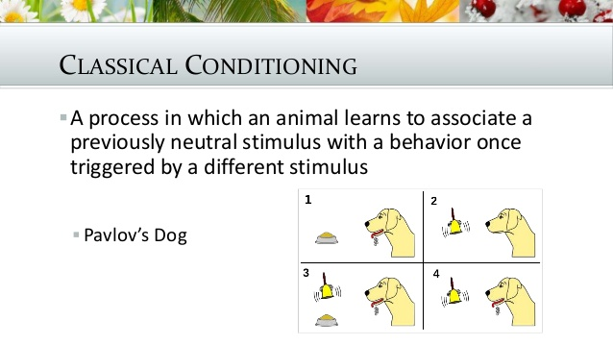

Slide 22
Instrumental Learning
Learning by trial and error method
Behaviour is increased by reinforcement.
Rewards or punishments could be obtained to get specific response.
Animals particularly learns about day to day happnings through trial and error methods

Slide 23
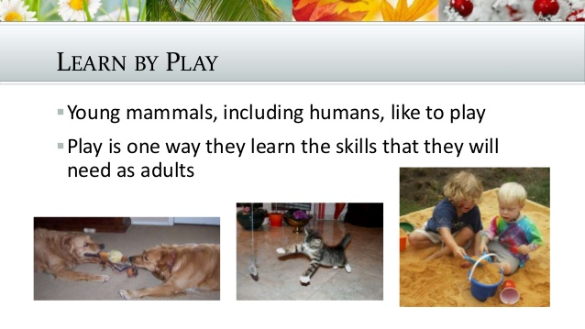

Slide 24
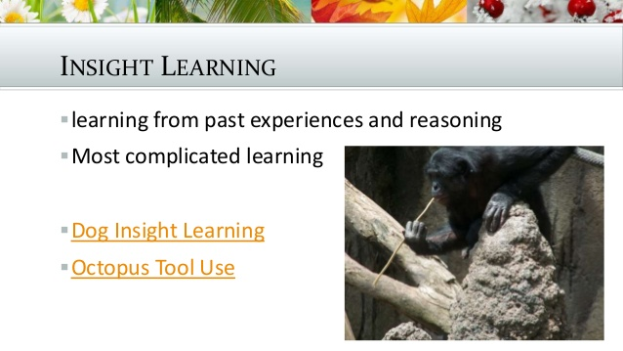

Slide 25
Aspects of Animal Behavior
Communication in bees
Honey Bee is Social Insect.
With different caste i.e. Queen, workers and drones.
Communicate through odor, antennal contact, taste samples of food
Sense of smell, color perception, position of sun, polarization pattern.
Also communicate by special dance pattern i.e. Round Dance and Waggle dance

Slide 26
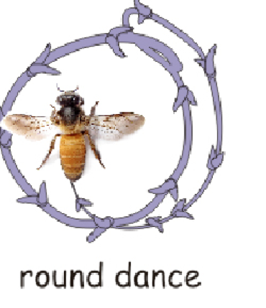
Round Dance
When the distance is less than 90 meters perform round dance called Rundtanz.
Provides information about distance and direction.
Circular movements alternatively first left and right for every second.
Round dance help others to search for the correct source of food.
Richness of food reflected in liveliness of dance.

Slide 27
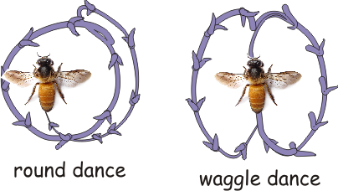
Waggle Dance
When distance is more than 90 meters called Schwanzeltanz.
Shaped in the formation of eight looping left to right.
Frequency indicates distance and directions.
During dance every worker bees tries to come in physical contact wit performing bees.
Olfactory receptor and photo receptor play crucial role.

Slide 28
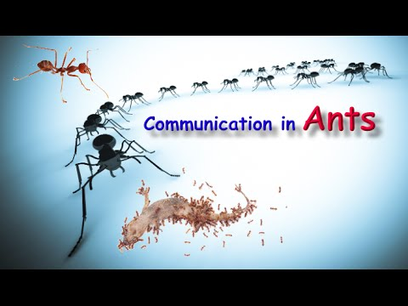
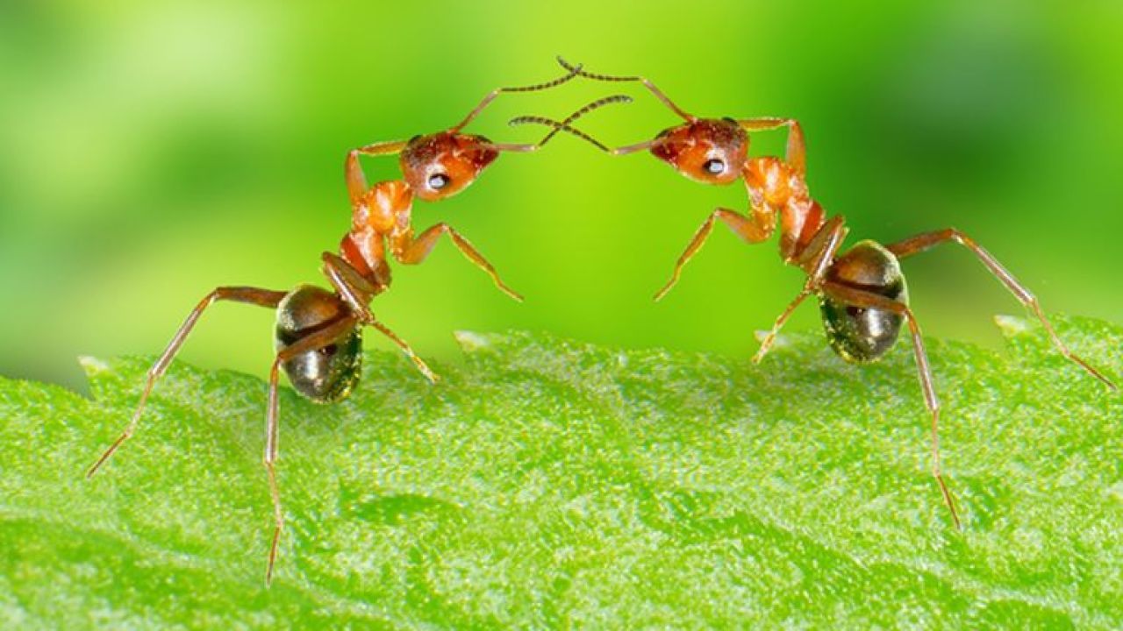
Communication in Ants
Communicates through pheromones, sounds, sensations like touch.
Long thin and active antenna gives direction and idea about food.
Most of ants leave pheromones during their trail so others can fallow.
Behavioral mechanism help ants to adopt in the environment.
Ants are able fallow successful paths.
Different types of pheromones been secreted by different bees.

Slide 29
Mimicry and Coloration
Mimicry : defense process in which organism copies another organism so that it can confuse third organism.
Types- Batesian mimicry, Mullerian mimicry, Self mimicry, Wasmannian mimicry.
Coloration : is defense adaptation of animals help them to avoid from the predators.
Types – Warning colouration Cryptic colouration

Slide 30
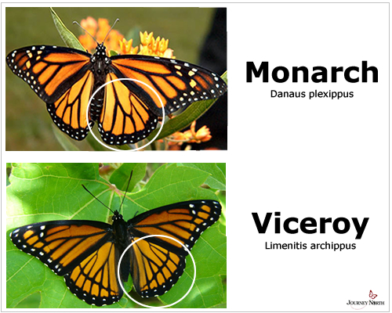
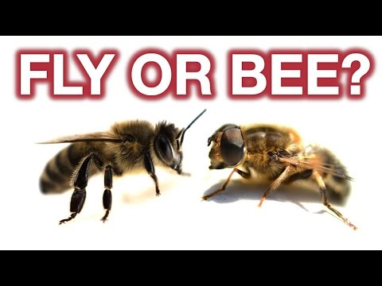
Batesian Mimicry
Is familiar similarity of unprotected species (mimic) with and protected species.
E.g. Hover flies similar color and skin pattern to that of bees.
Viceroy and monarch butterfly- Viceroy edible , monarch poisonous.

Slide 31
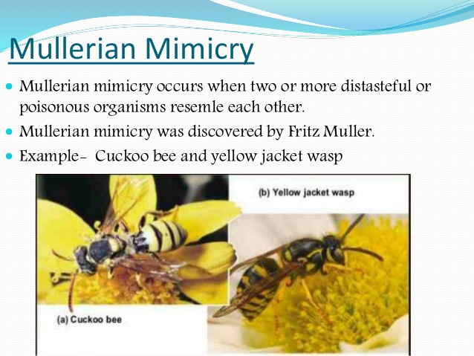
Mullerian Mimicry
Model is not defined and several unpalatable species will share colours to avoid predators.
In this both model and mimic are toxic.
Insects are will known for mimic.
Predators needs only on animal to attack

Slide 32
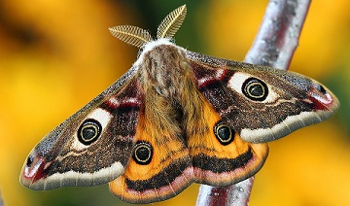
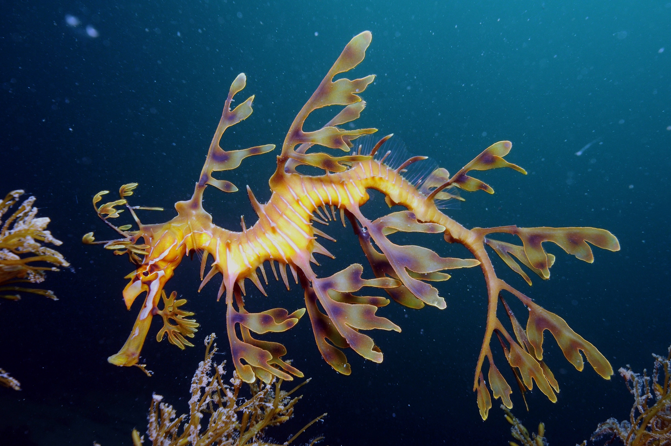
Self Mimicry
Art of displaying unusual mimic pattern to confuse the predator with color, sound and chemical in order to escape from and survival.
Predators gets confused.
E.g. Frightened eyespots and bright eye color markings on moth and butterfly.
The leafy sea dragoon is fish swims vary slow to make mimic like sea grass.

Slide 33
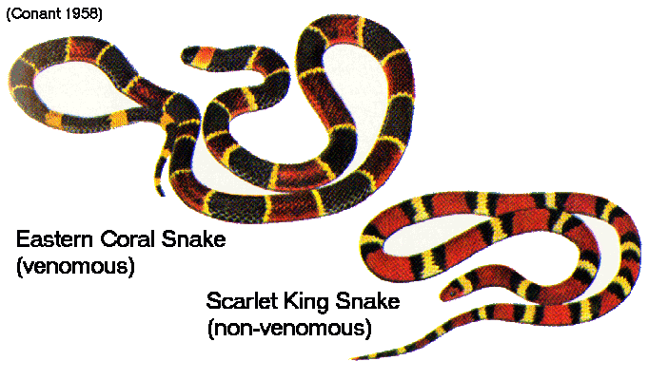
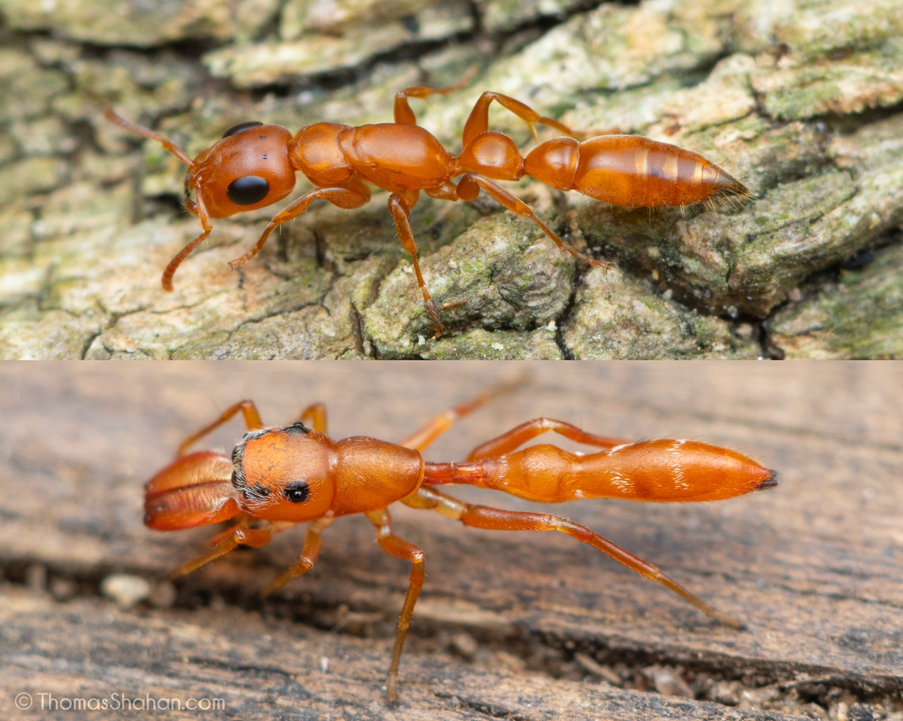
Wasmannian Mimicry
When mimic mimics the host it resembles so that they live in the same structure or nest.
Not only they mimic colour but also they behave like ants.

Slide 34
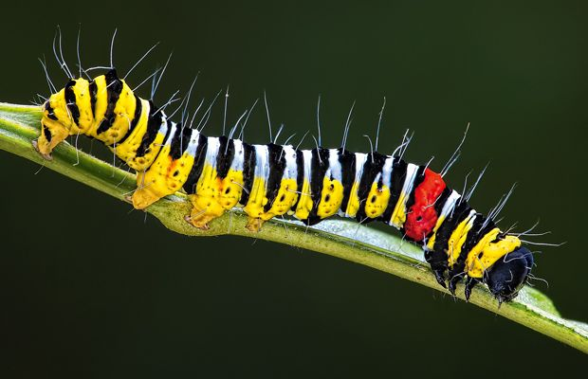
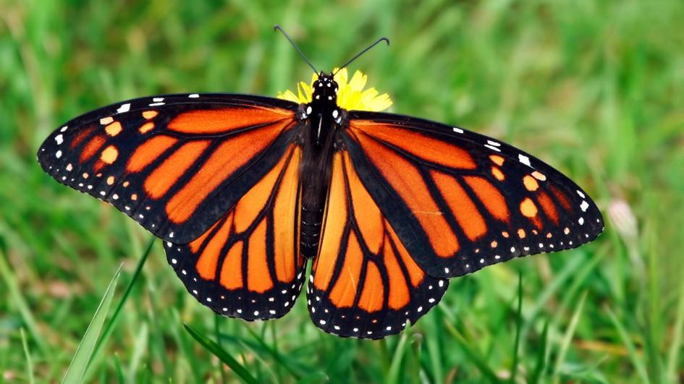
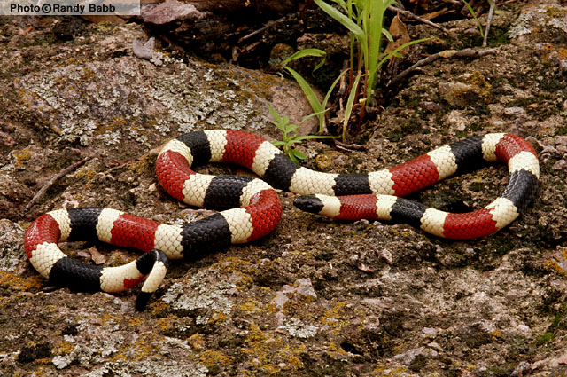
Warning Colouration
Striking body colour warns prey to predator that it is unpapatable.
Brighter colour indicate prey id more toxic.
Prominent colour is red yellow black and white.
Predator avoid eating prey.
e.g. Larva and adult butterfly
Coral shakes.

Slide 35
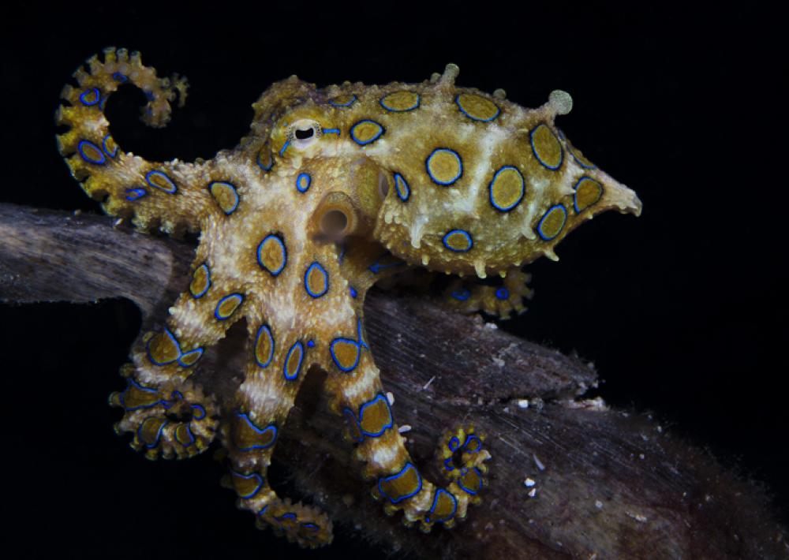
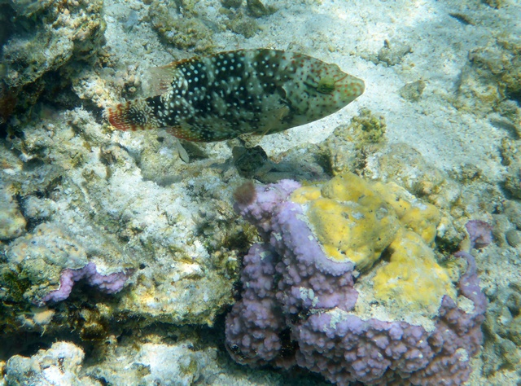
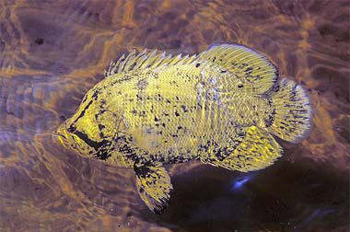
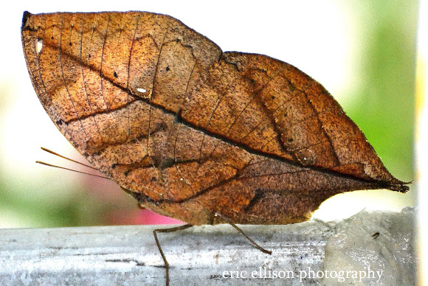
Cryptic Colouration
Animals can not detected easily by predator as they resembles like back ground.
Chance of survival get increase.
It also help to capture pary.
E.g.Head leaf butterfly
Chramotophore of cuttle fish
Lobotus surinamensis fish.

Slide 36
Role of Hormones in sexual behavior
Organizational Effects
Influences development of various organs leads sexual differentiation.
If male sex hormone during mid gestation period responsible to develop male gonads. Testes and male genitalia.
It also influences development areas of brain controlling sexual differentiation.
Lacking of testosterone relults in to development of ovaies and associated genitalia.

Slide 37
Activational Effects
Release aggressive behaviour to protect territory.
During breeding season develops aggressive behaviour.
Sex hormone plays important role during adulthood and modify reproductive behaviour.
Sexual Behavior Regulating Hormones- testosterone, estrogen –(Mating behaviour), progesterone – ( Sexual Motivation), oxytocin –(Social Bonding), vasopressin – ( Learning and Memory) and prolactin – ( Patental Behacior).

Slide 38
Pheromones - Secreted by exocrine gland
Oldest mode of communication and are species specific.
Secreted in the body and released into the environment which affects the behavior of other animals.
Secreted by unicellular to highly complex organism.
Use in insect is well documented.
E.g. ants termites, ants, honey bees
Types of pheromones- Aggregation, Alarm, Releaser, Signals, Primer, Territorial, Trail, Sex etc.

Slide 39
Releaser Pheromones
Causes alteration in the behaviour of recipients.
Some powerful attractant molecules to attract mate from two miles or more.
These pheromones present in urine or in faeces used to for marking territories.
Male tiger mark their territories by pheromones called “Tigramine”.
Some species of cockroaches female release pheromones to attractant for male.
Antenna of bomboyx female silk moth secrete pheromone help male to track female.

Slide 40
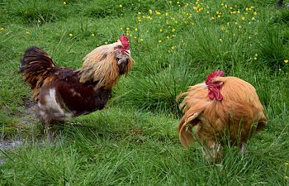

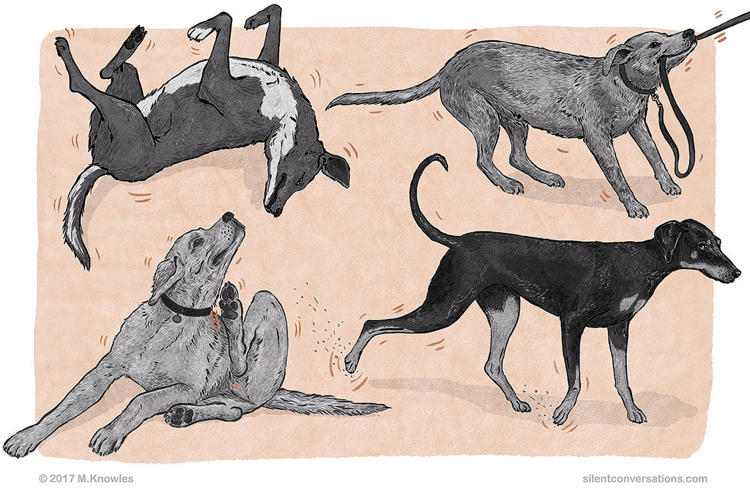
Displacement Activities
Type of behaviour related with decision making during the emotional conflict.
Body response when animals are under stress.
When animal is confused during stress this behavior is prolonged conflict between two opposing drives like attack & escape, hunger & escape, approach & Avoidance.
It is also way to bring back metabolic balance when body is under stress.
E.g. Man scratching head during stress.
Aggressiveness in fighting cocks.
Aggressive action in dogs.

Slide 41
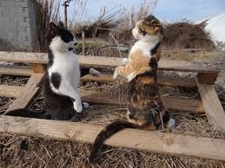
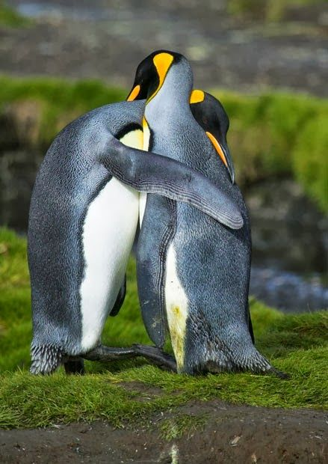
Ritualization
Concept by Julian Huxley 1914
Ritualization is a process by which non-signaling behavior patterns evolve to become communicative signals.
is a behavior that occurs typically in a member of a given species in a highly stereotyped fashion and independent of any direct physiological significance.
It is found, in differing forms, both in non-human animals and in humans.
It helps to send message easily in a noisy environment to discriminate it from other behavior.
The Great Crested grebes collects nest building material in its bill & swims towards its mate.
Both rise their crest and necks paddle towards each other rhythmically moving their head side by side.

Slide 42
Migration in fishes
Movement in animals from one area to another breeding and feeding purpose.
It is usually seasonal & occurs in response to change in temperature, food supply, light intensity and environment.
1. Feeding migration. – e.g. Bombay duck
2. Breeding migration-
  Anadromous- marine to freshwater e.g. Hilsa fish
  Catadromous - Freshwater to marine or deep sea. Eels fish.
3. Amphidromous migration - both types e.g. Chanos ( Asian milk fish)
4. Wintering Migration – e.g. Atlantic salmon

Slide 43
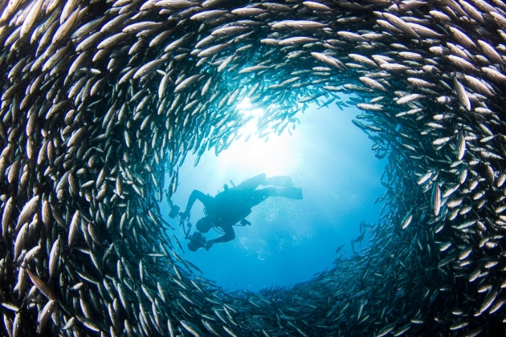
Schooling behaviour in fishes schooling fish are any group of fish that stay together and swim in the same direction in a coordinated manner.
Parr (1927)first studies schooling behaviour in fishes.
Movement in in synchronized manner, high accuracy in sensing.
High ability to respond by group to external stimuli.
No leader activities performed in coordinated manners.
  Advantages of Schooling
It reduces chance to predation when in the group.
Confuses predator and protecting with group dynamism.
Perform complicated movements changing direction with sudden turns to avoid danger.

Slide 44
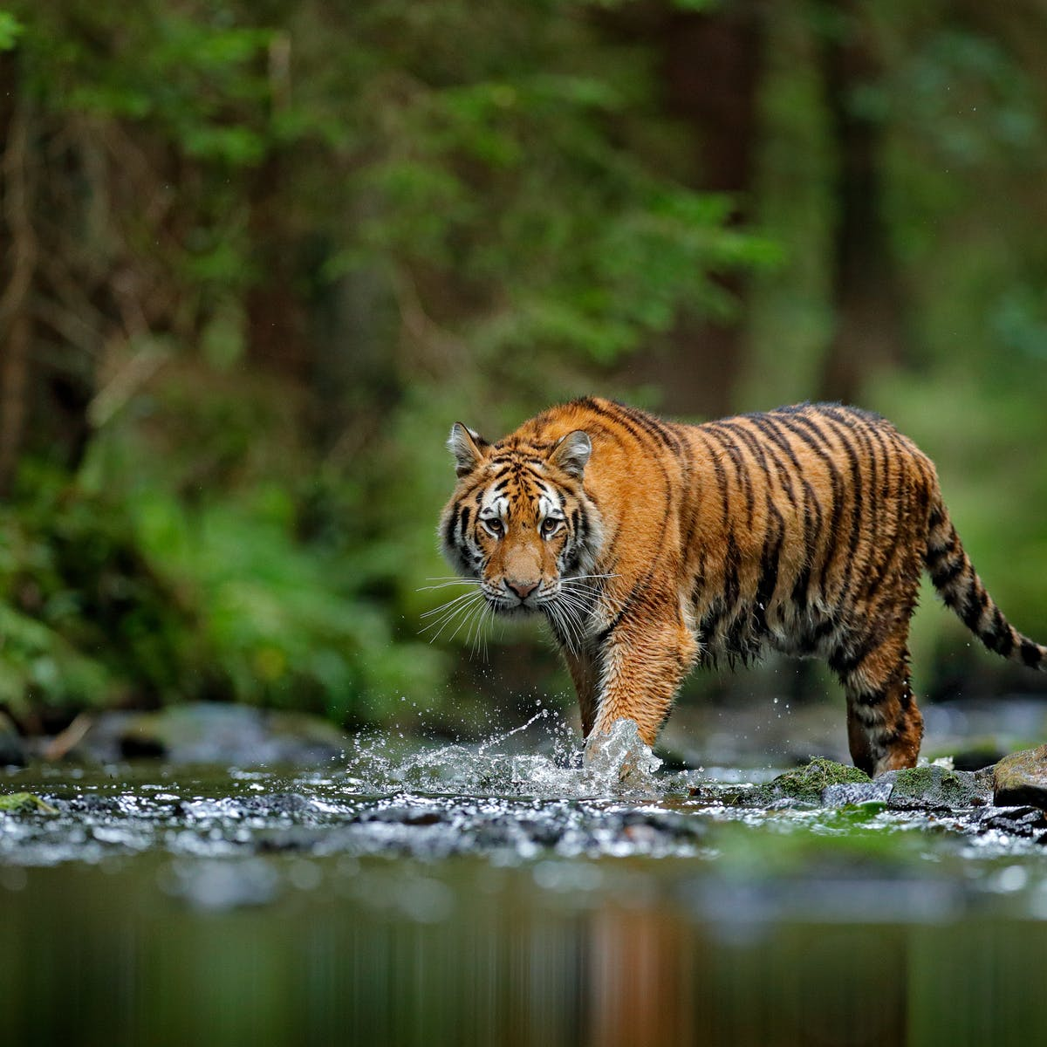
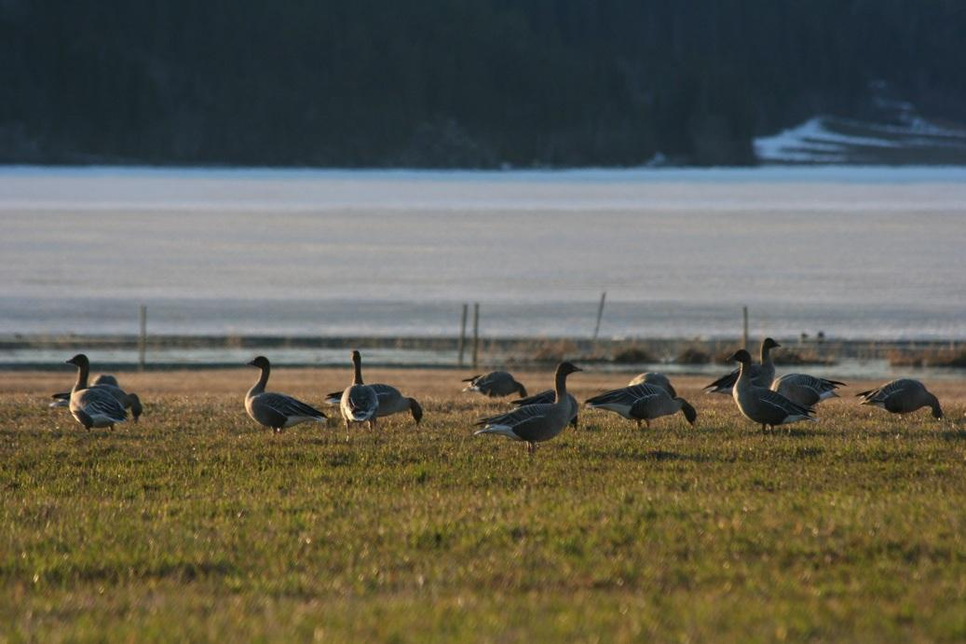
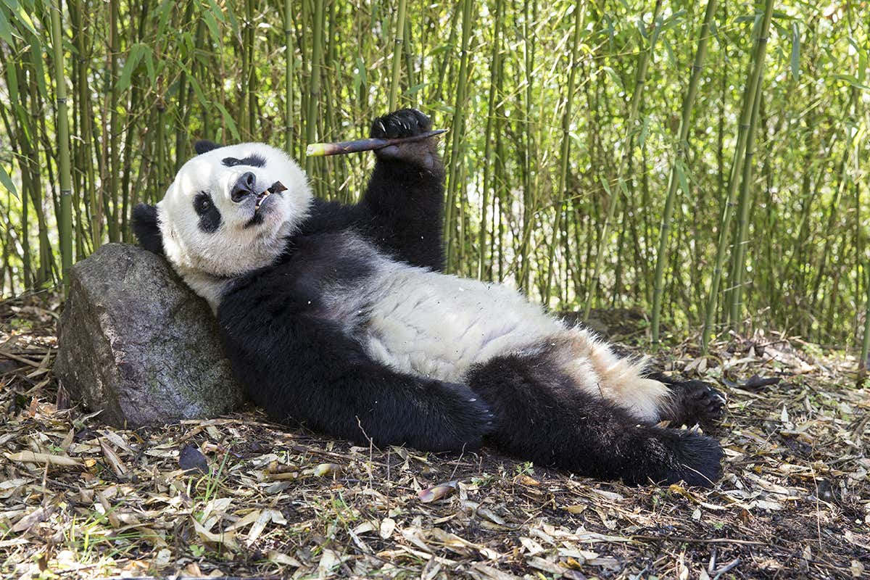
Habitat Selection-
Animal’s select place of living
Environmental factors determines habitat selection.
Many species still reside where they first live.
Good quality of habitat support high density of individuals of a species.
Some animal distributed as per the vegetation.
Habitat selection is affected by experience.
E.g. Gaint pandas live where bamboo grows.
Atlantic ocean is home for millions of crab eater seals.

Slide 45
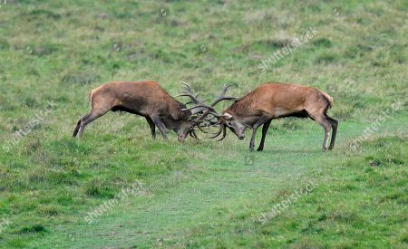
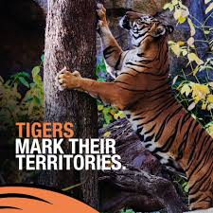
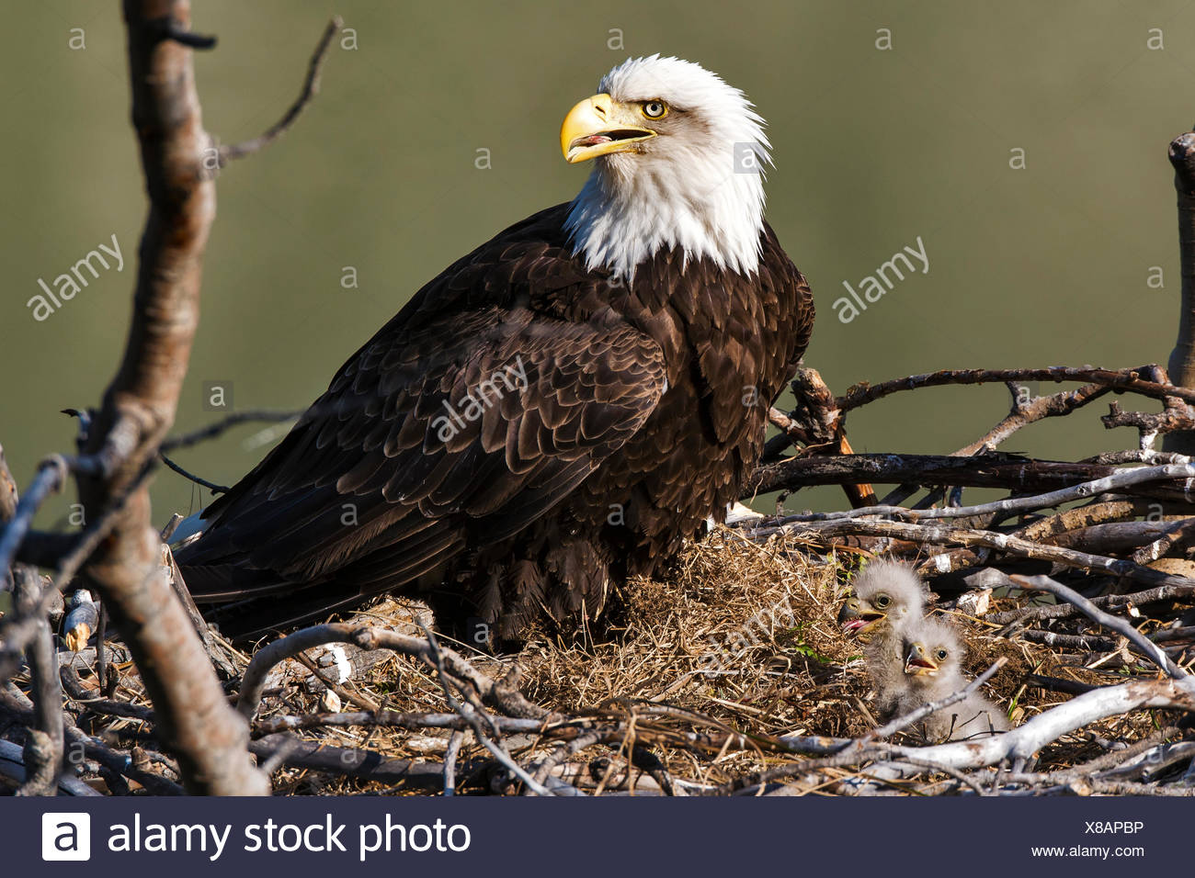
Territorial behaviour
It is adaptive behaviour by which animal protects its territory
Help animals to mate without interruption and raise young ones with little competition.
Mating , nesting and feeding territory- e.g. Golden wing sun bird
Mating and nesting territory- e.g.Red wing black birds.
Nesting territory- e.g. blad eagle
Pairing and nesting territory-e.g. Greater prairie chicken.

Slide 46
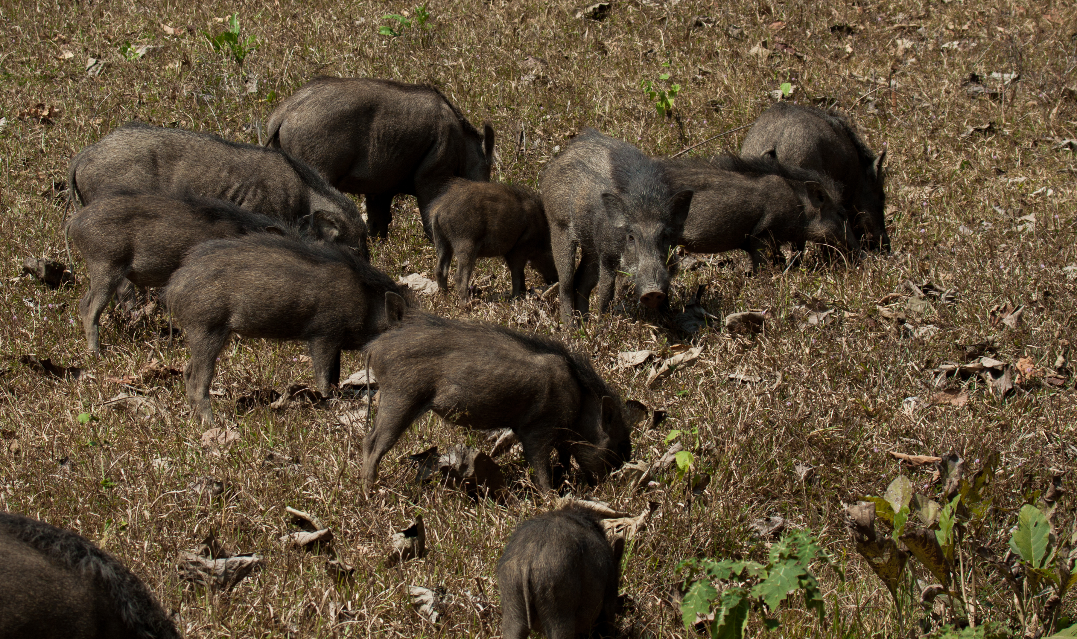
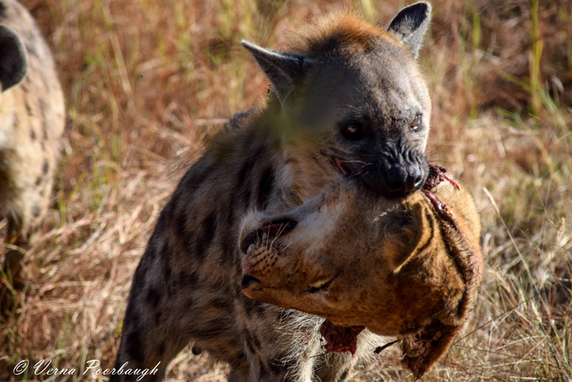
Food Selection-
Feeding behaviour, any action of an animal that is directed toward the procurement of nutrients.
Complex feeding behaviour seen in the animal kingdom.
There is a time management that animals feed.
Some animals generalized in food selection while some specialized.
Many animal store food when abundant used when famine.
Grazing animals eat large amount of food.
Predators often take lot of time and energy for selecting pray and they concentrate single animal in a group.

Slide 47
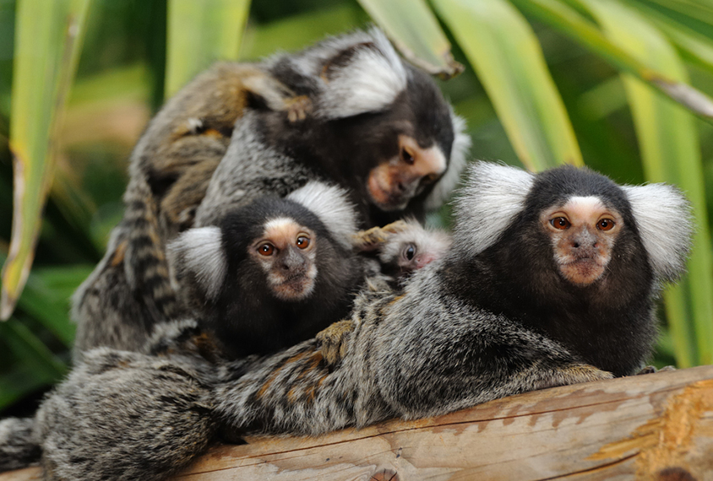
Social Behaviour
Interaction among the members of same species within the population
Marmosets
Social behavior is for parental care, mating pattern, territorial fights etc.
In ants, termites, honey bees, dolphins, elephant, apes, humans.
It provides increase in chance of propagation or reproductive success.
Protect from predator and territory.
There is potential of sharing information.
Young ones play in groups, learn skill & exhibit social bonding.
During extreme condition cooperative help protects individuals from natural elements.

Slide 48
Types of Social Behaviour
Social Behaviour in primates
Monogamous group- ( One male and one female) pair dominate group e.g. gibbons, tree shrews, lemurs.
Polygamous group- (One male several females) 25-100 individuals live together. Adult male coordinate activities of group. Gorilla, Spider monkey.
Polyandrous group( One female multiple males) – Marmosets, Tamarins.
Bisexual groups- ( Multiple group multiple females)- macaques.

Slide 49
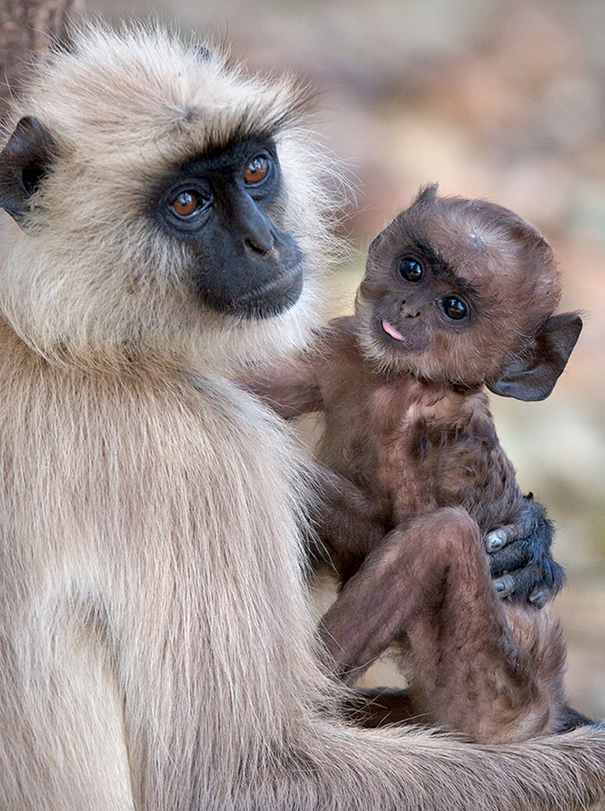
Social Behaviour in Hanuman Langur
(Presbytis entellus)
Semi terrestrial diurnal species found in Indian Subcontinent.
Grey and yellow color body with black face and ears.
Social behaviour depending on location.
Single male multi female or multi male multi female groups.
Male is responsible to defend territory.

Slide 50
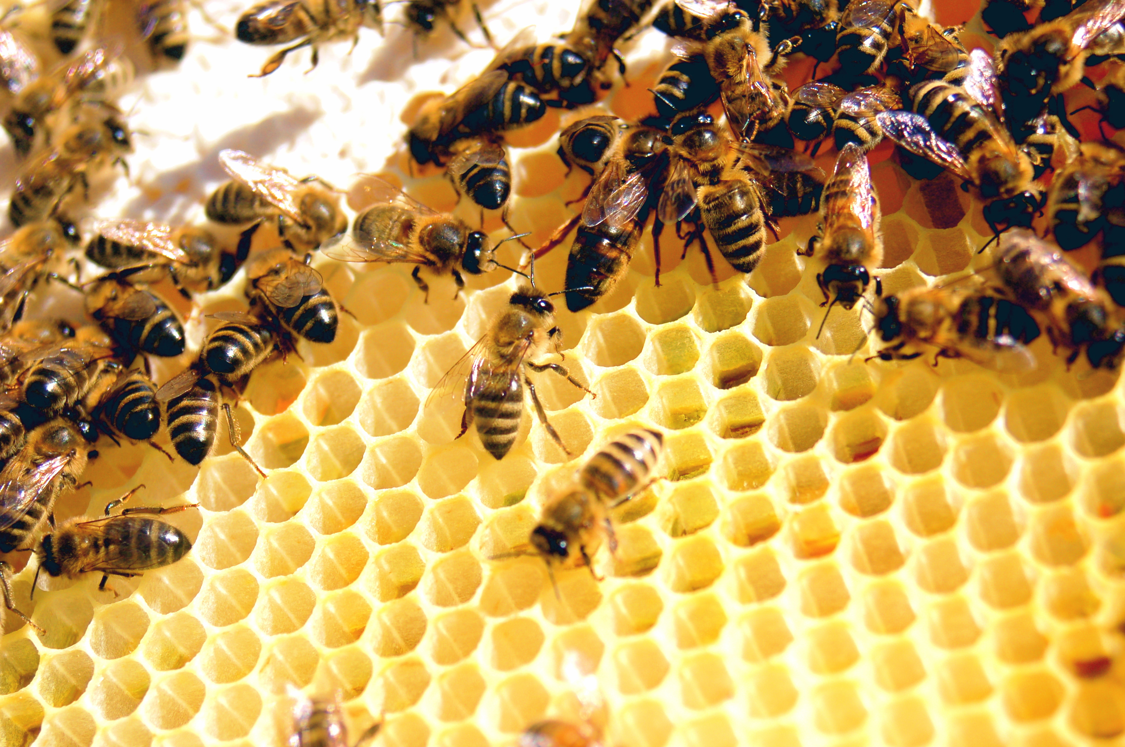
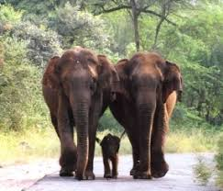
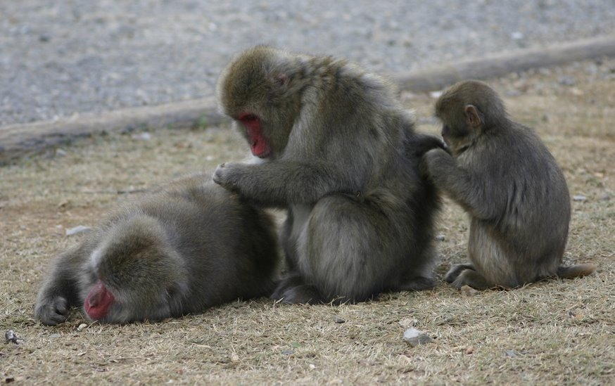
Elements of Socio-Biology
Selfishness – ants, Penguins, Cowbirds, cuckoo,
Cooperation – Cooperative hunting, protection,
Social Grooming – remove ectoparasite, reducing tension, social bonding
Group Hunting
Nest Building
Anti-predatory Behaviour.

Slide 51
Altruism disinterested and selfless concern for the well-being of others.
Cooperative behaviour individuals behaves in a such way benefits others than its own self.
Found in closely related individuals of group. E.g. social insects, humans and primates.
Some animals scarifies their lives in others benefit.
benefits, either directly or indirectly, another individual, without the expectation of reciprocity or compensation for that action.

Slide 52
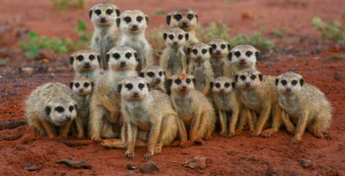




Kinship –
Is a family relationship or other close relationship.
(Proposed by W.D. Hamiltonin, 1963)
Taking care of individuals with strong bonding.
Blood relation plays important relation in kinship.
Also certain amount conflict occur in families
  1. Parent offspring conflict.
  2.Sibling-sibling conflict.
  3. Kin recognition – individuals recognition members of its gene.

Slide 53


Aggression
A type of behaviour intending to cause physical or mental harm.
It may occur either reactively or without provocation.
It is a destructive behaviour.
In humans, aggression can be caused by various triggers, from frustration.
Aggression can have adaptive benefits or negative effects.
Aggression may occur in response to non-social as well as social factors.
Aggression can involve bodily contact such as biting, hitting or pushing, but most conflicts are settled by threat displays.
This form of aggression may include the display of body size, antlers, claws or teeth; stereotyped signals including facial expressions; vocalizations such as bird song; the release of chemicals; and changes in coloration.

Slide 54


Forms of Aggression
Aggression can take a variety of forms, which may be expressed physically, or communicated verbally or non-verbally: including anti-predator aggression, defensive aggression (fear-induced), predatory aggression, dominance aggression, inter-male aggression.
Resident-intruder aggression, maternal aggression.
species-specific aggression, sex-related aggression, territorial aggression, isolation-induced aggression, irritable aggression, and brain-stimulation-induced aggression.

Slide 55

Aggregation in Animals an aggregation is any form of gathering of organisms and the process of coming together.
The primary functions of aggregation appear to be feeding and defense.
In some forms groups of unrelated species might form. e.g. Zebra and antelope aggregate during grazing.
Sometimes there might be some interaction, such as mixed flocks of birds that observe each other's foraging behaviour in searching for food.
Flocks of birds and heard of deer, buffalo.
security against predators, success in food location, wide range of mate choice, with concomitant increase of outbreeding opportunities,
Aggression may be temporary or after some intervals. Elephant and crows.

Slide 56


Images of aggregation

Slide 57
Inclusive fitness
in which an organism's genetic success is believed to be derived from cooperation and altruistic behaviour.
Inclusive fitness is the number of offspring equivalents that an individual rears, rescues or otherwise supports through its behaviour
Direct fitness and indirect fitness.
In inclusive fitness shows altruism behaviour.

Slide 58
Short review- Ethology
Definition – Ethology. Learned and Innate behaviour.
Types of learning – Habituation, Imprinting, Classical Conditioning, Instrumental learning,
Aspects of Animal behaviour- Communication in ants, bees, mimicry and colouration
Role of hormones and pheromones in animal behaviour.
Displacement activity, Ritualization, Migration in fishes, Schooling behaviour, Habitat selection, Territorial Behaviour, food selection, Social Behaviour,
Elements of Socio-biology, altruism, kinship aggression, aggregation, inclusive fitness.

Slide 59
Questions
Define Ethology
Explain Scope and History of Ethology.
Give difference between Innate and Learned behaviour.
Write note on Innate behaviour.
Write note on Learned behaviour.
Describe different types of learned behaviour.
Write note on habituation, Imprinting, Classical Conditioning, Instrumental learning.
Explain Communication in ants
Communication in bees..
Define mimicry and explain its types.
Describe warning colouration.
Write note on cryptic colouration.
Describe role of Hormones in animal behaviour.
Write note Pheromones and their role in animal behaviour.
Explain displacement activities with its significance

Slide 60
Questions
Describe ritualization with its significance.
Write note on migration in fishes.
Schooling behaviour in fhshes.
Write note on Habitat selection, Territorial Behaviour. Food Selection,
write note Social behaviour in primates.
Write note on social behaviour in Hanuman Langur.
Describe elements of Sociobiology
Write note on Altruism, Kinship, Aggression and Aggregation.

