Slide 1
HORTICULTURE

Slide 2
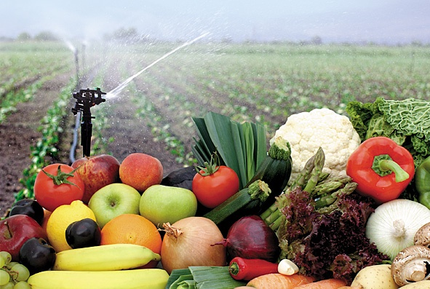
POST HARVEST TECHNOLOGY

Slide 3
What is Post Harvest Technology?
In agriculture, postharvest handling is the stage of crop production immediately following harvest, including cooling, cleaning, sorting and packing.
The instant a crop is removed from the ground, or separated from its parent plant, it begins to deteriorate.
Postharvest treatment largely determines final quality, whether a crop is sold for fresh consumption, or used as an ingredient in a processed food product.

Slide 4
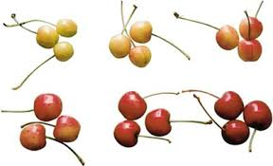
MATURITY
Maturity can be described as the attainment of the particular size or stage after which ripening takes place.
On the other hand, ripening means the qualitative changes in fruits after maturity of which it become edible.

Slide 5
Various Maturity Factors
i) Number of days from fruit set,
ii) Visual indicators,
iii) Size of fruits,
iv) Shape of fruit,
v) Colour of fruit ii) Visual ,
vi) Appearance (External)
vii) Texture
viii) Lenticel number
ix) Specific gravity
x) Starch Content
xi) Soluble solids
xii) Sugar acid ratio
xiii) Oil content

Slide 6
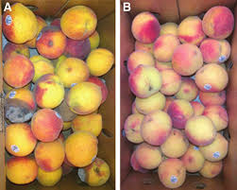
Methods Used for Harvesting and Delaying Ripening

Slide 7
  Fruit ripening process involve the action of a group of chemical substances produced by plant itself, plant hormone.
  Chemist have synthesized compounds which function as the natural plant hormones do and have achieved some success in controlling the vital process of ripening of fruits and vegetables.
The chemicals may be broadly classified into those that: i) hasten and those that ii) Delay ripening.
They include all categories of plant hormones, absorbents waxes and other substances.
Except C2H4 action of each is generally indirect.

Slide 8
HARVEST
The quality of fruits and vegetable cannot be improved but it can be presented when harvesting is done at proper stage of maturity.
Immature fruits when harvested will give poor quality and erratic ripening.
In some cases, if the produce is to shipped to distant markets, or stored, to wait for a better price, it should be picked in the mature but unripe stage.
Here lies the difficulty, because unlike the ripening stage, the boundary between pre maturation and maturation stage is hard to detect. No prominent changes in firmness or colour are evident often harvest indices becomes allitrary and subjective.

Slide 9
HARVEST HANDLING OPERATIONS
Post harvest management is pre requisite to value addition.
Pre-harvest maturity indication
Curing and harvest,
Sorting
Pre-cooling before storage,
Washing & removal of surface moisture,
Modified Atoms Packaging
Dehydration & Packaging
Crushing and packing
Value addition like ketchup, pickles.

Slide 10
STORAGE OF FRUITS AND VEGETABLES
Fruits and vegetables are highly perishable in nature.
To extend their post harvest availability, it is essential to store them under proper storage conditions. So as to increase the shelf life of fresh fruits and vegetables, they should be harvested at proper stage of maturity.
Pre-cooling and post harvest treatments such as application of fungicides, bactericides, growth regulators, wax immulsions, ethylene absorbents, anti-transpirants, senescence retardants are also of almost importance , to extend the marketable life of harvested horticultural commodities
. There are different types of storage as briefly detailed below:

Slide 11
AMBIENT TEMPERATURE STORAGE:
Storage at room temperature.
COLD STORAGE:
Storage of the fruits and vegetables at the temperature lower than ambient temperature.
The low temperature requirement varies from crop to crop.
If the fresh fruits and vegetables are stored at the temperature below their optimum low requirement, develop chilling injury and therefore, loose the marketability.
The fruits stored at low temperature exhibit more shelf life than those stored at ambient temperature. The cold storage requirement and storage life of fruits and vegetables are given in Table 1 a) and 1 b).

Slide 12
Table 1a. Cold Storage Requirement and Storage Life of Fruits:
Sr.No | Name of Fruit | Storage Temp | R.H% | Approximate Life
1 | Cashew apple | 0-1.5 | 85-90 | 4-5 Weeks
2 | Mangoes | 7-9 | 85-90 | 4-7 Weeks
3 | Oranges ( Mosambi) | 4-7 | 85-90 | 4 months
4 | Pomegranate | 0-1.5 | 80-95 | 4-6 weeks
5 | Sapota | 1.5-3.0 | 85-90 | 6-8 weeks

Slide 13
Table 1b: Cold Storage Requirement and Storage Life of Vegetables:
Sr.No | Name of Fruit | Storage Temp | R.H% | Approximate Life
1 | Cabbage | 0 -2.5 | 90-95 | 3-4 month
2 | Potato | 0 -2.5 | 85-90 | 4 months
3 | Peas | 0 -2.5 | 85-90 | 1 -3 weeks
4 | Okra | 7.5 | 90-95 | 7-10 days
5 | Tomato ripe | 4.5-10 | 85-90 | 4-7 days

Slide 14
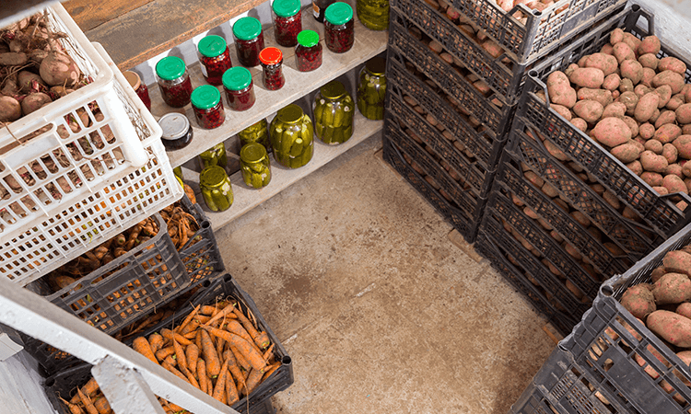
COLD STORAGE

Slide 15
Cold storage involves many physiological and biological problems.
In the storage of fruits, it is always described to prolong ripening for as long as long possible and to delay the breaking down processes.
Even after harvesting of the fruits the process of respiration continues and brings about ripening change in colour softening of flesh, increase in sugar content and development of flavour.
The successful cold storage of fruit and vegetables depends on a number of factors.
These changes occur more rapidly at higher temperatures.
This means that the lower the temperature of storage the longer would be the storage life of the fruit and vegetable but the fruit is disorganized resulting in physiological injuries such as development of pitting on the skin, change of colour and internal breakdown.

Slide 16
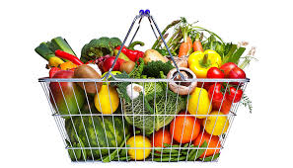
CONCLUSION

Slide 17
India produces around 150 million tonnes of fruits and vegetables, but the annual wastage is estimated at Rs.100 billion, according to a government task force.
To reduce wastage, fruits and vegetables have to be handled carefully and post harvest handling and packing facilities should be improved, the report states.
Post – harvest loss of fruits and vegetables can be considerably minimized and their storage life can be greatly increased by careful manipulation of these factors.
The loss can be minimized by adopting necessary cultural operations, careful handling and packaging.

Slide 18
The use of appropriate chemicals at pre and post-harvest stage, may extend the availability of fruits and vegetables over a long period by protecting them from microbial as well as environmental damage.
Quality cannot be improved after harvest. It is therefore important to harvest vegetables at optimum maturity.
Cleaning, sorting, grading, packaging , storing and transportation are the major post- harvest activities and that should be done appropriately and timely.

