Slide 1
Advance Technology in E-Commerce

Slide 2
E-Commerce (Electronic Commerce)
Electronic commerce, commonly known as E-commerce or e-commerce, is trading in products or services conducted via computer networks such as the Internet.
Electronic commerce draws on technologies such as Mobile Commerce, Electronic Funds Transfer (EFT), Supply Chain Management (SCM), Internet Marketing, Online Transaction Processing, Electronic Data Interchange (EDI), Inventory Management Systems, and Automated Data Collection systems.

Slide 3
Modern electronic commerce typically uses the World Wide Web at least at one point in the transaction's life-cycle, although it may encompass a wider range of technologies such as e-mail, mobile devices, social media, and telephones as well.
It also consists of the exchange of data to facilitate the financing and payment aspects of business transactions.
It is a Market entry strategy where the company may or may not have a physical presence.

Slide 4
E-Commerce under different perspective
There are several ways of looking at e-commerce which is given below:
Communication: It is the ability to deliver products, services, information, or payments via networks like the internet.
Interface: E-commerce means information and transaction exchange: (Business to business, Business to consumer, Consumer to consumer, and business to government.)
Business process: E-Commerce means activities that support commerce electronically by networked connections. For Example business processes like manufacturing and inventory etc.

Slide 5
Online: E commerce is an electronic environment that allows sellers to buy and sell products, services, and information on the internet. The Products may be physical like Cars, Computers, Books or services like news or consulting.
Structure: Ecommerce deals with various media: data, text, video, web pages, and internet telephony.
Market: E-commerce is a worldwide network. A local store can open a web storefront and find the world at doorstep- customers, suppliers, competitors, and payments services, Of course, an advertising presence is essential.

Slide 6
Architectural Framework of E-Commerce
The architectural framework for e-commerce consists of six layers of functionality or services as follows:
1.Application services.
2.Brokerage services, data or transaction management.
3. Interface and support layers.
4. Secure messaging, security and electronic document interchange.
5. Middleware and structured document interchange, and
6. Network infrastructure and the basic communication services.

Slide 7
1.Application services
In the application layer services of e-commerce, it is decided that what type of e- commerce application is going to be implemented.
There are three types of distinguished e-commerce applications i.e., consumer to business application, business to-business application and intra-organizational application.

Slide 8
2.Information Brokerage and Management Layer
This layer is rapidly becoming necessary in dealing with the voluminous amounts of information on the networks.
This layer works as an intermediary who provides service integration between customers and information providers, given some constraint such as low price, fast services or profit maximization for a client.
Another aspect of the brokerage function is the support for data management and traditional transaction services.
Brokerages may provide tools to accomplish more sophisticated, time-delayed updates or future-compensating transactions.

Slide 9
3. Interface and Support Services
The third layer of the architectural framework is interface layer.
This layer provides interface for e-commerce applications.
Interactive catalogs and directory support services are the examples of this layer.
Directory services have the functions necessary for information search and access.
The directories attempt to organize the enormous amount of information and transactions generated to facilitate e-commerce
The main difference between the interactive catalogs and directory services is that the interactive catalogs deal with people while directory support services interact directly with software applications.

Slide 10
4. Secure Messaging Layer
In any business, electronic messaging is an important issue.
The commonly used messaging systems like phone, fax and courier services have certain problems like in the case of phone if the phone line is dead or somehow the number is wrong, you are not able to deliver the urgent messages.
In the case of courier service, if you want to deliver the messages instantly, it is not possible as it will take some time depending on the distance between the source and destination places.
The solution for such type of problems is electronic messaging services like e-mail, enhanced fax and EDI.

Slide 11
5. Middleware services
The enormous growth of networks, client server technology and all other forms of communicating between/among unlike platforms is the reason for the invention of middleware services.
The middleware services are used to integrate the diversified software programs and make them talk to one another.

Slide 12
6. Network Infrastructure
The early models for networked computers were the local and long distance telephone companies.
The telephone company lines were used for the connection among the computers
As soon as the computer connection was established, the data traveled along that single path.
Telephone company switching equipment (both mechanical and computerized) selected specific telephone lines, or circuits, that were connected to create the single path between the caller and the receiver.
This centrally-controlled, single-connection model is known as circuit switching.

Slide 13
Classification of E-Commerce Applications
1. Electronic Market
It is a place where online shoppers and buyers meet.
E-market handles business transaction including bank-to-bank money transfer also.
In e-market, the business center is not a physical building.
But it is a network-based location where business activities occur.
In e-market, the participants like buyers, sellers and transaction handler are not only one different locations but even they do not know each other.

Slide 14
2. Inter Organizational Information System (IOS)
An IOS is a unified system with several business partners.
A typical IOS will include a company and its supplier and customers.
Through IOS buyers and sellers arrange routine business transactions.
Information is exchanged over communication network using specific formats.
So, there is no need for telephone calls, papers, documents or correspondence.

Slide 15
Types of IOS is given below:
- EDI (Electronic Data Interchange): It provide secure B2B connection over value added network(Van’s)
- Extranet: which provide secure B2B connection over internet.
- EFT (Electronic Fund Transfer): Electronic Transfer of money from one account to another.
- Electronic Forms: Online (web-pages) forms on internet.
- Shared Data Base: Information stored in repositories (collection of data) shared by trading partners
- Supply Chain Management: Co-operation between company and its suppliers and customers regarding demand forecasting, inventory management and order fulfillment.

Slide 16
Types of E-Commerce
E-commerce conducted between businesses differs from that carried out between a business and its consumers.
There are five generally accepted types of e-commerce:
- Business to Business (B2B)
- Business to Consumer (B2C)
- Consumer to Business (C2B)
- Consumer to Consumer (C2C)
- Business to Government (B2G)

Slide 17
1. Business to Business (B2B)
Business to Business or B2B refers to e-commerce activities between businesses.
An e-commerce company can be dealing with suppliers or distributors or agents.
These transactions are usually carried out through Electronic Data Interchange or EDI.
In general, B2Bs require higher security needs than B2Cs.
For example, manufacturers and wholesalers are B2B companies.

Slide 18
2. Business to Customer (B2C)
Business to Customer or B2C refers to e-commerce activities that are focused on consumers rather than on businesses.
For instance, a book retailer would be a B2C company such as Amazon.com and other companies that follow a merchant model or brokerage business models.
Other examples could also be purchasing services from an insurance company, conducting online banking and employing travel services.

Slide 19
3. Customer to Business (C2B)
C2B refers to e-commerce activities, which use reverse pricing models where the customer determines the prices of the product.
In this case, the focus shifts from selling to buying.
There is an increased emphasis on customer empowerment.
In this type of e-commerce, consumers get an opportunity to specify the range of prices they can afford or are willing to pay for a particular item, service or commodity.
As a result, it reduces the bargaining time, increases the flexibility and creates ease at the point of sale for both the merchant and the consumer.

Slide 20
4. Customer to Customer (C2C)
Customer to Customer or C2C refers to e-commerce activities, which use an auction style model.
This model consists of a person-to-person transaction that completely excludes businesses from the equation.
Customers are also a part of the business and C2C enables customers to directly deal with each other.
An example of this is peer auction giant, Ebay.

Slide 21
5. Business to Government (B2G)
It is a new trend in e-commerce.
This type of e-commerce is used by the government departments to directly reach to the citizens by setting-up the websites.
These websites have government policies, rules and regulations related to the respective departments.
Any citizen may interact with these websites to know the various details.
This also saves time of the employees as well as the citizens.
The concept of Smart City has been evolved from B2G e-commerce.

Slide 22
Benefits of E-Commerce
1. Faster buying process
2. Store and product listing creation
3. Cost reduction
4. Affordable advertising and marketing
5. Flexibility for customers
6. No reach limitations
7. Product and price comparison
8. Faster response to buyer/market demands
9. Several payment modes

Slide 23
Limitations of E-Commerce
  Lack of Awareness:
  Lack of Infrastructure:
  Lack of Confidence:
  Credit Cards Frauds:
  Absence of Tax Laws:
  Lack of system security, reliability, standards and communication protocols.
  Insufficient telecommunication bandwidth.
  The software development tools are still evolving and changing rapidly.

Slide 24
Introduction to Internet
The Internet, sometimes called simply "the Net," is a worldwide system of computer networks -- a network of networks in which users at any one computer can get information from any other computer
It was conceived by the Advanced Research Projects Agency (ARPA) of the U.S. government in 1969 and was first known as the ARPANet.
The original aim was to create a network that would allow users of a research computer at one university to "talk to" research computers at other universities.

Slide 25
Internet is defined as an Information super Highway, to access information over the web. However, It can be defined in many ways as follows:
Internet is a world-wide global system of interconnected computer networks.
Internet uses the standard Internet Protocol (TCP/IP).
Every computer in internet is identified by a unique IP address.
IP Address is a unique set of numbers (such as 110.22.33.114) which identifies a computer location.
A special computer DNS (Domain Name Server) is used to give name to the IP Address so that user can locate a computer by a name

Slide 26
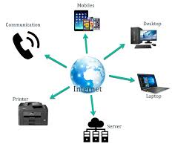
Internet is accessible to every user all over the world.

Slide 27
Advantages
Internet covers almost every aspect of life, one can think of.
Internet Banking
Matrimonial Services
Online Shopping
Online Ticket Booking
Online Bill Payment
Data Sharing
E-mail
Entertainment
Social networking sites
Information regarding various topics such as Technology, Health & Science, Social Studies, Geographical Information, Information Technology, Products etc can be surfed with help of a search engine.
Internet provides concept of electronic commerce, that allows the business deals to be conducted on electronic systems

Slide 28
Disadvantages
Identity theft, hacking, viruses, and cheating
Addiction, time-waster, and causes distractions
Spamming
Bullying, trolls, stalkers, and crime
Health issues and obesity
Social isolation
Buying things that you don't need

Slide 29
Internet Components
An Internet connected home/home office network, consists of a variety of hardware and software components.
The technologies, components and services used in small home networks are the same as those used in large corporate networks.
Some important network components are NIC, switch, cable, hub, router, and modem.
Depending on the type of network that we need to install, some network components can also be removed.

Slide 30
Network Interface Card (NIC)
Each computer in a network has a special expansion card called a network interface card (NIC).
The NIC prepares(formats) and sends data, receives data, and controls data flow between the computer and the network.
On the transmit side, the NIC passes frames of data on to the physical layer, which transmits the data to the physical link.
On the receiver's side, the NIC processes bits received from the physical layer and processes the message based on its contents.

Slide 31
Servers - Servers are computers that hold shared files, programs, and the network operating system. Servers provide access to network resources to all the users of the network. There are many different kinds of servers, and one server can provide several functions.
Clients - Clients are computers that access and use the network and shared network resources. Client computers are basically the customers(users) of the network, as they request and receive services from the servers.
Transmission Media - Transmission media are the facilities used to interconnect computers in a network, such as twisted-pair wire, coaxial cable, and optical fiber cable.

Slide 32
Local Operating System - A local operating system allows personal computers to access files, print to a local printer, and have and use one or more disk and CD drives that are located on the computer. Examples are MS-DOS, Unix, Linux, Windows 2000, Windows 98, Windows XP etc
Network Operating System - The network operating system is a program that runs on computers and servers that allows the computers to communicate over the network.

Slide 33
Hub - Hub is a device that splits a network connection into multiple computers. It is like a distribution center. When a computer requests information from a network or a specific computer, it sends the request to the hub through a cable. The hub will receive the request and transmit it to the entire network.
Switch - Switch is a telecommunication device grouped as one of computer network components. Switch is like a Hub but built in with advanced features. It uses physical device addresses in each incoming messages so that it can deliver the message to the right destination or port.

Slide 34
Router - When we talk about computer network components, the other device that used to connect a LAN with an internet connection is called Router. When you have two distinct networks (LANs) or want to share a single internet connection to multiple computers, we use a Router.
LAN Cable A local area Network cable is also known as data cable or Ethernet cable which is a wired cable used to connect a device to the internet or to other devices like computer, printers, etc.

Slide 35
What is World Wide Web?
World Wide Web, which is also known as a Web, is a collection of websites or web pages stored in web servers and connected to local computers through the internet.
These websites contain text pages, digital images, audios, videos, etc.
Users can access the content of these sites from any part of the world over the internet using their devices such as computers, laptops, cell phones, etc.
The WWW, along with internet, enables the retrieval and display of text and media to your device.

Slide 36
The building blocks of the Web are web pages which are formatted in HTML(Hypertext Markup Language) and connected by links called "hypertext" or hyperlinks and accessed by HTTP(Hypertext Transfer Protocol).
These links are electronic connections that link related pieces of information so that users can access the desired information quickly.
A web page is given an online address called a Uniform Resource Locator (URL).
A particular collection of web pages that belong to a specific URL is called a website, e.g., www.facebook.com, www.google.com, etc.

Slide 37
Difference between World Wide Web and Internet:
Some people use the terms 'internet' and 'World Wide Web' interchangeably.
They think they are the same thing, but it is not so.
Internet is entirely different from WWW.
It is a worldwide network of devices like computers, laptops, tablets, etc.
It enables users to send emails to other users and chat with them online.
For example, when you send an email or chatting with someone online, you are using the internet.

Slide 38
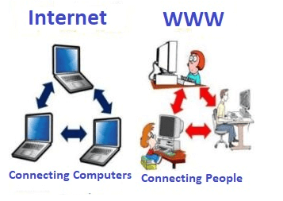

Slide 39
History
The development of the World Wide Web was begun in 1989 by Tim Berners-Lee and his colleagues at CERN, an international scientific organization based in Geneva, Switzerland.
They created a protocol, HyperText Transfer Protocol (HTTP), which standardized communication between servers and clients.
Their text-based Web browser was made available for general release in January 1992.

Slide 40
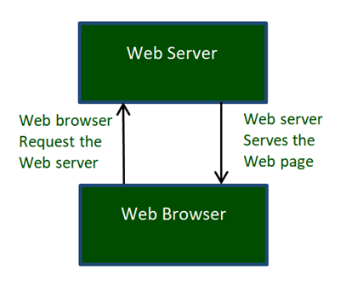
How the World Wide Web Works?
The Web works as per the internet's basic client-server format as shown in the following image.

Slide 41
The servers store and transfer web pages or information to user's computers on the network when requested by the users.
A web server is a software program which serves the web pages requested by web users using a browser.
The computer of a user who requests documents from a server is known as a client.
Browser, which is installed on the user' computer, allows users to view the retrieved documents.

Slide 42
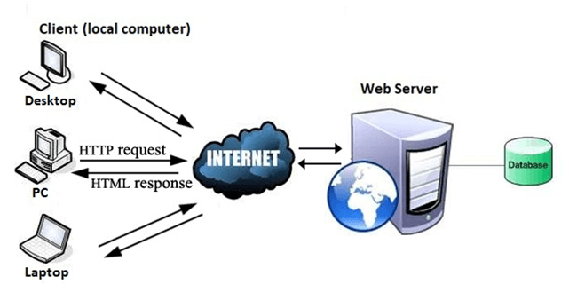
All the websites are stored in web servers.
Just as someone lives on rent in a house, a website occupies a space in a server and remains stored in it.
The server hosts the website whenever a user requests its Webpages, and the website owner has to pay the hosting price for the same.

Slide 43
Electronic Data Interchange (EDI):
Electronic Data Interchange (EDI) is the automated, computer-to-computer exchange of standard electronic business documents between business partners over a secure, standardized connection.
Computer-to-Computer
EDI replaces manual B2B communications, such as postal mail, fax and email.
Documents flow directly from the sender's computer application (e.g. a logistics system) to the receiver's computer application (e.g., an order management system).

Slide 44
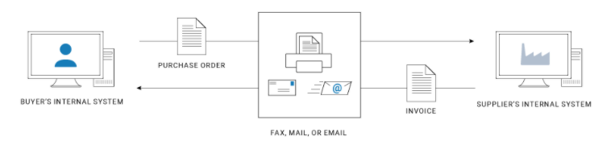
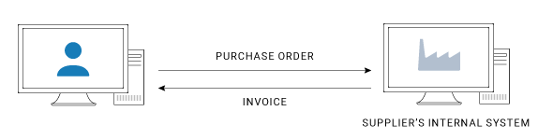
Traditional Manual Process
Automated EDI Process

Slide 45
Business Documents
1000s of standard business transaction documents can be sent automatically using EDI.
Some common examples include: purchase orders, invoices, shipping statuses, customs information, inventory documents and payment confirmations.
Business Partners
The exchange of EDI documents is typically between two different organizations, referred to as business partners or trading partners.
Example: Company A may buy goods from Company B. Company A sends Purchase Orders to Company B, which sends Invoices and Shipment Notices to Company A.

Slide 46
Standard EDI Format
EDI documents are processed by computers and use standard, computer-friendly formats.
Standards describe each piece of data and its format (e.g., type of document, parties involved, actions to take, mmddyy).
Standards eliminate company-to-company variations, allowing each business partner's computer system to speak a common language.
Popular standards include: ANSI X12 in the U.S., UN/EDIFACT globally and industry-specific standards, such as HIPAA

Slide 47
Secure, Standardized Connection
EDI uses a range of secure protocols to facilitate the secure exchange of EDI documents.
Partners must use the same, agreed-upon protocol to exchange EDI files or work with an intermediary who can facilitate exchanges if the partners use different protocols.
The protocols range from long-established technologies, such as FTP, to web-based EDI via AS2, API-based systems, such as AS4, and other options, such as mobile EDI.

Slide 48
Automation
EDI messages can be sent automatically using pre-configured workflows.
Businesses typically use EDI translators - either as software or via an EDI service provider - to translate EDI documents for use in internal applications, enabling automated processing.
Processes can be extended to work with data integration and workflows within an organization.
Example: once a company receives an EDI Purchase Order, the logistics system generates a task for warehouse staff to move goods from inventory to shipping.

Slide 49
EDI process:
The buyer's procurement system, which uses EDI, auto-generates and sends an EDI-formatted PO when inventory reaches a pre-specified level.
In minutes the vendor's sales order system, using EDI software, receives the EDI PO.
The supplier's system automatically notifies their shipping department to send goods.
Once the goods are packed and ready to ship, the shipping system generates an Advanced Ship Notices (ASN) to send to the buyer's receiving department
The vendor's ERP system then generates an EDI invoice to transmit to the buyer's accounts payable system

Slide 50
Benefits of EDI
Faster Processing
Lower operating costs
Reduce human error and improve record accuracy
Increase business efficiency
Enhance transaction security
Paperless and environmentally friendly
Better Relationships

Slide 51
How EDI Works
1. Document Preparation
  The buyer collects and organizes the data so it will work with EDI
There are several approaches, including:
Exporting computer-based data from spreadsheets or databases
Reformatted electronic reports into data files
Enhancing apps to create output files ready for EDI standard translation
Purchasing EDI software that can turn documents from your systems into EDI files
Human data entry

Slide 52
2. EDI Document Translation
The next step is to feed your document through EDI translation software to convert your internal data format into the EDI standard format using the appropriate segments and data elements.
Alternatively, you can send your data to an EDI service provider, who handles translation to and from the EDI format on your behalf.

Slide 53
3. Connect & Transmit EDI Documents
Once the PO is translated to the EDI purchase order format, it's ready for transmission to the supplier.
There are several ways to connect to a partner via EDI.
The most common of include:
Direct, point-to-point EDI connection via a secure Internet protocol, such as AS2
Connect to an EDI network provider, also referred to as a Value Added Network (VAN) provider
A combination of both Direct EDI and VAN, depending on the partners involved and the transaction volume

Slide 54
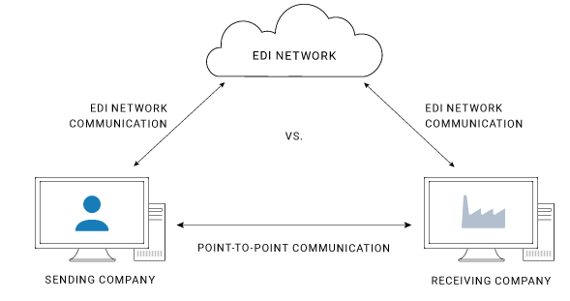
In the case of an EDI network provider, or value-added network (VAN), the buyer uses their preferred communications protocol, ensuring reliable, secure EDI transmission.

Slide 55
VANs can reduce setup and maintenance in some cases but tend to be more expensive than point-to-point integration for many use cases, as they charge a fee for each transaction or even line item.
Data security and control are maintained throughout the transmission process using passwords, user identification and encryption.
Both the buyer and vendor EDI applications automatically edit and check documents for accuracy.

Slide 56
Multimedia Technology
If a system presents, some information through more than two media, it is known as multimedia. For example, TV presents audio and video; book presents text, image, and graphs, computer, etc.
The information presented through multimedia has better quality and capability, as it can be understood easily.
The advanced computer system is a great example of modern multimedia.

Slide 57
Literal Meaning of Multimedia
Multi − it means more than one
Medium − it is singular and it means intermediary or mean
Media − it is plural and it means conveying the information
Likewise, Multimedia is the field of Computer Science that integrates different forms of information and represents in the form of audio, video, and animation along with the traditional media, i.e., text, graphics/drawings, images, etc.

Slide 58
Multimedia Computer System
Multimedia computer system has high capacity to integrate different media including text, image, graphics, audio, and video.
The multimedia computer system stores, represents, processes, manipulates, and makes available to users.

Slide 59
Significant Features of Multimedia Computer System
Its Central Processing Unit (CPU) is very fast, as it needs to process large amount of data.
It has huge storage capacity.
It has huge memory power that helps in running heavy data programs.
It has high capacity graphic card that helps in displaying graphics, animation, video, etc.
The sound system makes it easy to listen to audio.
With all these features (discussed above), a computer system is known as high end multimedia computer system.

Slide 60
Multimedia Components
1. Text
It contains alphanumeric and some other special characters.
Keyboard is usually used for input of text; however, there are some internal (inbuilt) features to include such text.
2. Graphics
It is technology to generate, represent, process, manipulate, and display pictures. It is one of the most important components of multimedia application.
The development of graphics is supported by a different software.

Slide 61
3. Animation
Computer animation is a modern technology, which helps in creating, developing, sequencing, and displaying a set of images (technically known as ‘frames’).
Animation gives visual effects or motion very similar to that of a video file
4. Audio
This technology records, synthesizes, and plays audio (sound).
There are many learning courses and different instructions that can be delivered through this medium appropriately.

Slide 62
5. Video
This technology records, synthesizes, and displays images (known as frames) in such sequences (at a fixed speed) that makes the creation appear as moving; this is how we see a completely developed video.
In order to watch a video without any interruption, video device must display 25 to 30 frames/second.

Slide 63
Multimedia Application
Presentation
E-Learning
E-Books
Digital Library
Movie making
Video games
Animated films
Multimedia conferencing
E-Shopping

Slide 64
Desktop Video Conferencing:
Desktop video conferencing is a form of video conferencing where all of the hardware and software platform components are contained in a desktop computer.
Instead of requiring a meeting room with dedicated video cameras and monitors, desktop systems provide full video conferencing capabilities in a package that fits in a typical office workstation.
Today’s powerful microprocessors and video monitor technology bring full high-definition video to the desktop at an extremely affordable price.

Slide 65
Desktop video conferencing enables professionals and individuals to attend meetings on short notice or to get in touch with stakeholders within a short span of time.
This helps by saving both time and money as opposed to traditional boardroom meetings.
Today the desktops used for desktop video conferencing come with features such as touch screen control, multi-conference options and other tools.
The collaborative tools that the desktops meant for video conferencing are often equipped with enable users to add notes and on-screen markup.

Slide 66
Secure Electronic Transaction (SET)
SET is a system which ensures security and integrity of electronic transactions done using credit cards in a scenario.
SET is not some system that enables payment but it is a security protocol applied on those payments.
It uses different encryption and hashing techniques to secure payments over internet done through credit cards.
SET protocol was supported in development by major organizations like Visa, Mastercard, Microsoft which provided its Secure Transaction Technology (STT) and NetScape which provided technology of Secure Socket Layer (SSL).

Slide 67
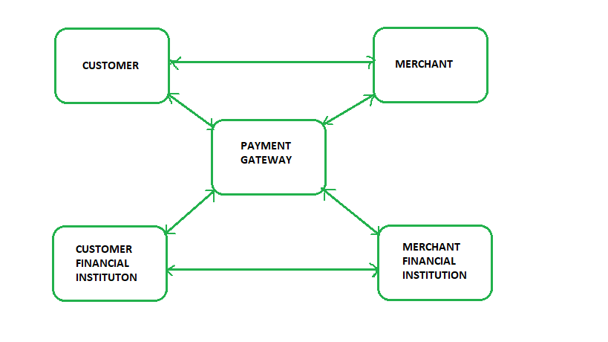
SET protocol restricts revealing of credit card details to merchants thus keeping hackers and thieves at bay.
SET protocol includes Certification Authorities for making use of standard Digital Certificates like X.509 Certificate.
Before discussing SET further, let’s see a general scenario of electronic transaction, which includes client, payment gateway, client financial institution, merchant and merchant financial institution.

Slide 68
Requirements in SET :
It has to provide mutual authentication i.e., customer (or cardholder) authentication by confirming if the customer is intended user or not and merchant authentication.
It has to keep the PI (Payment Information) and OI (Order Information) confidential by appropriate encryptions.
It has to be resistive against message modifications i.e., no changes should be allowed in the content being transmitted.
SET also needs to provide interoperability and make use of best security mechanisms.

Slide 69
Participants in SET :
In the general scenario of online transaction, SET includes similar participants:
Cardholder – customer
Issuer – customer financial institution
Merchant
Acquirer – Merchant financial
Certificate authority – Authority which follows certain standards and issues certificates(like X.509V3) to all other participants.

Slide 70
SET functionalities :
1. Provide Authentication
  Merchant Authentication – To prevent theft, SET allows customers to check previous relationships between merchant and financial institution. Standard X.509V3 certificates are used for this verification.
  Customer / Cardholder Authentication – SET checks if use of credit card is done by an authorized user or not using X.509V3 certificates.

Slide 71
2. Provide Message Confidentiality :
Confidentiality refers to preventing unintended people from reading the message being transferred.
SET implements confidentiality by using encryption techniques. Traditionally DES is used for encryption purpose.
3. Provide Message Integrity :
SET doesn’t allow message modification with the help of signatures.
Messages are protected against unauthorized modification using RSA digital signatures with SHA-1 and some using HMAC with SHA-1,

Slide 72
Cryptography
Cryptography is technique of securing information and communications through use of codes so that only those person for whom the information is intended can understand it and process it.
Thus preventing unauthorized access to information. The prefix “crypt” means “hidden” and suffix graphy means “writing”.

Slide 73
In Cryptography the techniques which are use to protect information are obtained from mathematical concepts and a set of rule based calculations known as algorithms to convert messages in ways that make it hard to decode it.
These algorithms are used for cryptographic key generation, digital signing, verification to protect data privacy, web browsing on internet and to protect confidential transactions such as credit card and debit card transactions.

Slide 74
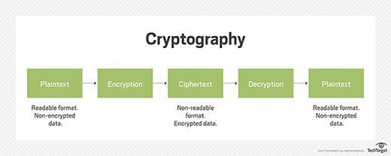
Techniques used For Cryptography:
In today’s age of computers cryptography is often associated with the process where an ordinary plain text is converted to cipher text which is the text made such that intended receiver of the text can only decode it and hence this process is known as encryption.
The process of conversion of cipher text to plain text this is known as decryption.

Slide 75
Features Of Cryptography are as follows:
Confidentiality:
Information can only be accessed by the person for whom it is intended and no other person except him can access it.
Integrity:
Information cannot be modified in storage or transition between sender and intended receiver without any addition to information being detected.
Non-repudiation:
The creator/sender of information cannot deny his or her intention to send information at later stage.
Authentication:
The identities of sender and receiver are confirmed. As well as destination/origin of information is confirmed.

Slide 76
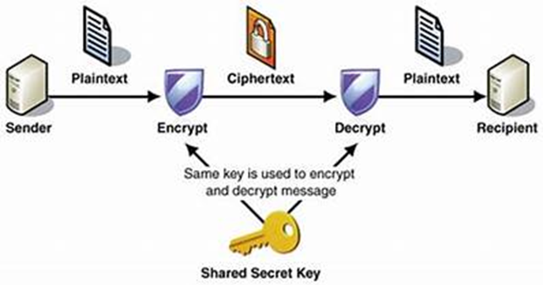
Types Of Cryptography:
In general there are three types Of cryptography:
1. Symmetric Key Cryptography:
It is an encryption system where the sender and receiver of message use a single common key to encrypt and decrypt messages.
Symmetric Key Systems are faster and simpler but the problem is that sender and receiver have to somehow exchange key in a secure manner.
The most popular symmetric key cryptography system is Data Encryption System(DES).

Slide 77
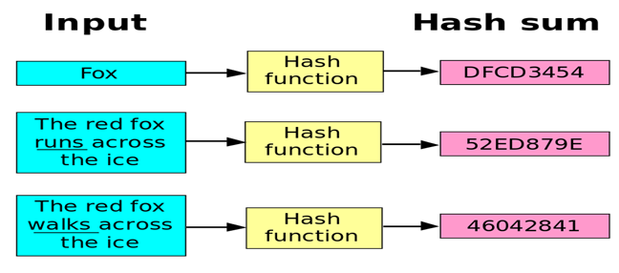
2. Hash Functions:
There is no usage of any key in this algorithm.
A hash value with fixed length is calculated as per the plain text which makes it impossible for contents of plain text to be recovered.
Many operating systems use hash functions to encrypt passwords.

Slide 78
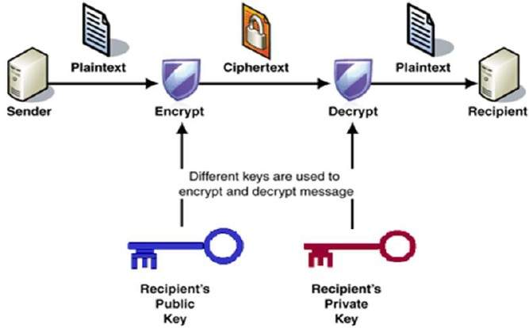
3. Asymmetric Key Cryptography:
Under this system a pair of keys is used to encrypt and decrypt information.
A public key is used for encryption and a private key is used for decryption.
Public key and Private Key are different.
Even if the public key is known by everyone the intended receiver can only decode it because he alone knows the private key.

Slide 79
Digital Signature
A digital signature is exactly what it sounds like a modern alternative to signing documents with paper and pen.
It uses an advanced mathematical technique to check the authenticity and integrity of digital messages and documents.
It guarantees that the contents of a message are not altered in transit and helps us overcome the problem of impersonation and tampering in digital communications.
Digital signatures also provide additional information such as the origin of the message, status, and consent by the signer.

Slide 80
The role of digital signatures
In many regions, including parts of North America, the European Union, and APAC, digital signatures are considered legally binding and hold the same value as traditional document signatures.
In addition to digital document signing, they are also used for financial transactions, email service providers, and software distribution, areas where the authenticity and integrity of digital communications are crucial.
Industry-standard technology called public key infrastructure ensures a digital signature's data authenticity and integrity.

Slide 81
How do digital signatures work?
Using a mathematical algorithm, digital signing solution providers such as Zoho Sign will generate two keys: a public key and a private key.
When a signer digitally signs a document, a cryptographic hash is generated for the document.
That cryptographic hash is then encrypted using the sender's private key, which is stored in a secure HSM box.
It is then appended to the document and sent to the recipients along with the sender's public key.

Slide 82
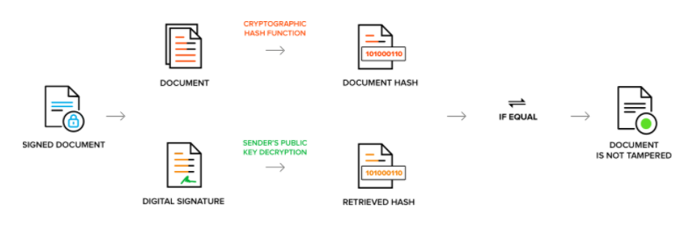
The recipient can decrypt the encrypted hash with the sender's public key certificate.
A cryptographic hash is again generated on the recipient's end.
Both cryptographic hashes are compared to check its authenticity.
If they match, the document hasn't been tampered with and is considered valid.

Slide 83
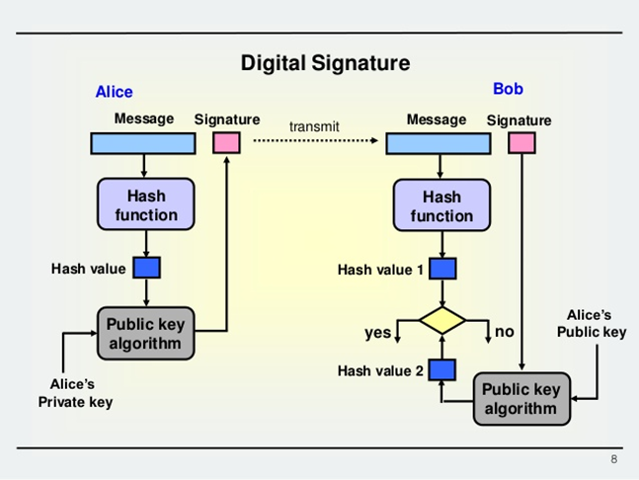
Digital Signature Working Example

Slide 84
E-Mail Security
Definition
Email security is a term for describing different procedures and techniques for protecting email accounts, content, and communication against unauthorized access, loss or compromise.
Email is often used to spread malware, spam and phishing attacks.
Attackers use deceptive messages to entice recipients to part with sensitive information, open attachments or click on hyperlinks that install malware on the victim’s device.
Email is also a common entry point for attackers looking to gain a foothold in an enterprise network and obtain valuable company data.

Slide 85
How Secure Is Email?
Email was designed to be as open and accessible as possible.
It allows people in organizations to communicate with each other and with people in other organizations.
The problem is that email is not secure.
This allows attackers to use email as a way to cause problems in attempt to profit.
Whether through spam campaigns, malware and phishing attacks, sophisticated targeted attacks, or business email compromise (BEC), attackers try to take advantage of the lack of security of email to carry out their actions.

Slide 86
Since most organizations rely on email to do business, attackers exploit email in an attempt to steal sensitive information.
Email security is a broad term that encompasses multiple techniques used to secure an email service.
From an individual/end user standpoint, proactive email security measures include:
  Data Encryption
  Image & Content Control
  Spam filters
  Desktop-based anti-virus/anti-spam applications

Slide 87
Data Encryption
Your email data is at its most vulnerable position when it is in transit.
Generally, it is transmitted in an open format. It allows cybercriminals to intercept these messages in transit and use them to lift confidential data.
The ideal solution is to encrypt the data sent through email.
It is one of the major topics of importance regarding email security in cryptography systems.
This security feature ensures that your outgoing emails are data encrypted in all respects, thereby not allowing any leeway for the hacker to infiltrate them.
Encrypting your emails entails that you make it difficult for hackers to access the contents of the emails

Slide 88
Image & Content Control
Hackers use emails for phishing purposes.
The email attachments can contain files, links, and even images.
There have been numerous phishing instances in recent times where cybercriminals managed to transmit malicious software through images.
Therefore, it becomes vital for email security services to protect the systems by scanning images, as well.
It is one of the most crucial aspects of email security in information security

Slide 89
Spam Filters
A significant proportion of emails that you receive daily are marketing emails.
These emails clog the email inbox in such a way that you almost miss out on some of the official or essential emails.
Secondly, cybercriminals take advantage of these marketing emails by pushing in their phishing emails, as well.
An unsuspecting user might open such emails and click on the malicious links provided in the phishing email.
Installing spam filters can help in separating these marketing and phishing emails by directing them to a distinctive email inbox.

Slide 90
Anti-virus Protection
Hackers send malicious content through such email attachments and spurious links in the messages.
If a user unwittingly clicks on such links or downloads such files, there are chances of viruses spreading to their information systems.
The right way to deal with such situations is to have robust anti-virus protection.
This software program scans each incoming and outgoing email for malicious content and blocks their entry or exit, as the case may be.
Hence, it offers better protection than the spam filters because it identifies and eliminates these viruses that can create havoc with the computer network systems.

Slide 91
ENTERPRISE EMAIL SECURITY BEST PRACTICES
Engage employees in ongoing security education around email security risks and how to avoid falling victim to phishing attacks over email.
Require employees to use strong passwords and mandate password changes periodically.
Utilize email encryption to protect both email content and attachments.
Implement security best practices for BYOD if your company allows employees to access corporate email on personal devices.

Slide 92
Ensure that webmail applications are able to secure logins and use encryption.
Implement scanners and other tools to scan messages and block emails containing malware or other malicious files before they reach your end users.
Implement a data protection solution to identify sensitive data and prevent it from being lost via email.

Slide 93
END USER EMAIL SECURITY BEST PRACTICES
Never open attachments or click on links in email messages from unknown senders.
Change passwords often and use best practices for creating strong passwords.
Never share passwords with anyone, including co-workers.
Try to send as little sensitive information as possible via email, and send sensitive information only to recipients who require it.
Use spam filters and anti-virus software.
When working remotely or on a personal device, use VPN software to access corporate email.
Avoid accessing company email from public wi-fi connections.

