Slide 1
Module 2
Business & Society

Slide 2
Business Ethics
Ethics describes minimum standards of behaviour towards others, such as not telling lies, not breaking promises, not stealing.
Ethics is not recent phenomenon .
Ethical codes have been prepared along with the development of human civilization
In olden days people might have found some of their action was wrong & others right.
The question what is right & what is wrong gave birth to ethical & unethical codes.

Slide 3
The word ethics is derived from Greek word Ethikos & Latin word Ethicus means character or custom
The concept of ethics deals with human beings.
So it is a social science
It is a branch of philosophy and it considered as normative science because it is concerned with norms of Human beings.
Definition
Ethics deals with right actions of individuals
Peter F. Drucker

Slide 4
Ethics includes the following
Well based standards : ethics refers to well based standards of right & wrong that prescribe what human ought to do
Study & development of one’s ethical standards: ethics refers to study & development of one’s ethical standards.

Slide 5
Nature of Ethics
Ethics refers to system of moral Principles – a sense of right & wrong and goodness & badness of actions and their motives & consequences.
Two theories are pertinent when one talks about the nature of ethics
The theory of moral unity:
This theory essentially advocates the principle that business action should be judged by the general ethical standards of society.
There exists only one ethical standard which applies to business & non –business situations.

Slide 6
The theory of amorality:
Opposed to theory of moral unity is the theory of amorality, which argues that business can be amoral, & actions of businessmen needs not be guided by general ethical standards.
Managers may act selfishly because the market mechanism distills their actions into benefits to shareholders & society at large.
However , this theory is not acceptable to anybody.
Everyone agrees that business actions should be subject to the same ethical stds as the one applicable to the society in general.

Slide 7
Business Ethics
Business ethics is nothing but application of ethics in business.
Business ethics is the application of general ethical ideas to business behaviour.
It facilitates & promotes good to society, improves profitability, foster business relations & employees productivity.
Generally it means what is right & what is wrong in the workplace and doing what Is right – this is in regard to effect of product/ services & in relationships with stakeholders
To be more specific, business ethics is the study of good & evil, right & wrong , just & unjust actions of businessmen.

Slide 8
According to Wheeler Business ethics is an art & science for maintaining Harmonious relationship with society, its various groups & institutions as well as reorganizing the moral responsibility for the rightness and wrongness of business conduct
According to Rogene A. Buchholz, “ business ethics refers to right wrong behavior in business decision
Business ethics or ethical standards are the principles , practices & philosophies that guide the business people in the day today business decision.
It relates to the behavior of a businessman in a business situation.
They are concerned with the impact of decision of the society within & outside the business organization or other groups who keeps interst in the business activities.
It can be said to begin where the law ends. It is primarily concerned with those issues not covered by the law or where there is no definite consensus on whether something is right or wrong.

Slide 9
Scope or Importance of Business Ethics
The power & influence of business in society is greater than ever before . Business ethics helps us to understand why this is happening , what its implications might be , & how we might address this situation.
Business has the potential to provide a major contribution to our societies, In terms of producing the products & services that we want, providing employment, paying taxes, & acting as an engine for the economic development & thereby increases the goodwill.
Business can prosper on the basis of good ethical standards & it helps to retain the business for long years

Slide 10
Business malpractices have the potential to inflict enormous harm on individuals, on communities & on the environment. Through helping us to understand more about causes & consequences of these malpractices, business ethics helps to create mutual trust & confidence in relationship
The dd being placed on the business to be ethical by its various stake holders are constantly becoming more complex & more challenging . Business ethics provides the means to appreciate & understand these challenges more clearly, in order that firms can meet these ethical expectation more effectively.
Business ethics can help to improve ethical decision making by providing managers with appropriate knowledge & tools that allows them to correctly identify , diagnose, analyse , & provide solutions to the ethical problems & dilemmas they are confronted with

Slide 11
Business ethics can provide us with the ability to assess the benefits & problems associated with different ways of managing ethics in organisations
In the age of complexity in business fields , competition is increasing day by day . Good ethical standard helps the business to face the challenges

Slide 12
Factors that influence Business Ethics
Four factors are responsible for encouraging ethical behavior or depressing standards of conduct .
The factors are: leadership, strategies & policies, organizational culture & individual characteristics.
Leadership
The single most impt variable that impacts the ethical conduct is leadership
If Reliance Industries , Tata Groups of companies, Ambani groups and the like are known for honest & fair dealings, credit should go to their founders & successive leaders.
Leaders set formal rules , & by their behavior can reinforce or undermine right behavior.
Subordinates are keen observers & quickly notice if standards are upheld or evaded.
Exemplary behavior Is a powerful tool available to all managers.
Leadership is about communicating values.

Slide 13
Strategies & policies
Management needs to formulate strategies that helps the company grow without compromising on ethical principles
In companies with declining fortunes managers have difficulty in meeting performance targets & may be tempted to blend ethical standards,
Even excellent overall strategies need to carried out with policies that support honest achievement .
Unrealistic performance goals can pressure those who must make them work.
Corporate culture
It is a blend of ideas, customs, practices & value that help define normal behavior for everyone who works in an organization.
Every company has a culture that wields considerable impact on employee behavior.

Slide 14
Corporate culture & ethical climate
This can put much pressure on the people to channel their actions in the directions desired by the company.
Individual characteristics
Behaviour is motivated by a mixture of internal disposition & situational incentive , in a corporation with cheerless ethical climate ,corrupt leader & high pressure to achieve numbers, Other wise honest individuals may be pushed to compromise.
All things being equal having employees who are internally disposed to right action is ideal.

Slide 15
Ethical Dilemmas.
An ethical dilemma is a conflict between alternatives where choosing any of them will compromise some ethical principle and lead to an ethical violation. A crucial feature of an ethical dilemma is that the person faced with it should do both the conflicting acts, based on a strong ethical compass, but cannot; he may only choose one.
Not choosing one is the condition that allows the person to choose the other. Thus, the same act is both required and forbidden at the same time. He is condemned to an ethical failure, meaning that he will do something wrong no matter what he does.
When people encounter these tough choices, an ethical failure rarely occurs because of temptation, but simply because choosing any of the conflicting actions will involve sacrificing a principle in which they believe.

Slide 16
The term ‘dilemma’ comes from the Greek : ‘di’ for two & ‘lemma’ for proof .
A dilemma is two proofs or reasoned arguments, which entail logically inconsistent courses of action. In the ideal example of a dilemma, there is an irresistible case for doing A, & also an irresistible case for doing B. But it is logically impossible to do A&B
In ordinary speech , we are inclined to use the dilemma for any decision where we are uncertain which alternative we should choose in other words, as synonymous for a ‘difficult decision’
In a dilemma, the difficulty arises from the very nature of the situation with which we are faced rather than our mere lack of wisdom or ethical knowledge.
The ethical dilemmas comes from three sources: face-to-face ethics, corporate policy ethics & functional area ethics.

Slide 17
Face to face ethics:
These arise mainly because there is a human element in most business transactions. For eg, a purchasing agent may develop personal relationship with the sales representative who sells supplies to a company; they frequently know one another on a first-name basis, have lunch together & talk often on the phone. A company‘s best customers may be well known to people in the production department; it helps to ensure that the company’s products fit the customer needs
Organisation policy ethics
Companies are often faced with ethical dilemmas that affect their operations across all departments and divisions.
The ethical burden of deciding corporate policy matter normally rests upon a company’s top management . The top managers & directors are responsible for making policies & implementing them too.

Slide 18
The ethical content of their policies can have enormous impact throughout the company.
It can set an ethical tone & send strong signals to all employees as well as to external stakeholders.
Functional area ethics
Functional area of ethics are likely to confront ethical issues. Accounting is a critical function of any business.
Accounting statement reveals to the managers & owners about financial soundness of a company. Managers , investors, regulating agencies , tax collectors & trade union rely on accounting data to make key decision .
Honesty , integrity & accuracy are absolute requirements of the accounting function.
Professional accounting organization have evolved generally accepted accounting standards whose purpose is to establish uniform stds for reporting accounting data

Slide 19
When they are followed, these stds ensure a high level of honesty & ethical accounting disclosure
How to resolve ethical Dilemmas?
To resolve ethical dilemmas following steps can be followed:
To study what is the problem
Who are involved in the problem?
Get the additional information which is needed to solve the problem.
To study conflicting views. Whether this points are ethical or not?
To find out possible solutions to resolve the conflicts solve the problem
To study outcome of each one of the solution.
To evaluate solutions by considering organisational values.
Eliminate solution which is harmful to any individual or which is violating organizational value.
Select & implement best solution to solve the problem.

Slide 20
Role of Corporates Culture in Ethics
Corporate culture represents the common perception shared by members of an organization.
Individuals with different backgrounds in corporate altogether have a tendency to describe the corporate culture in almost similar terms.
The strength of corporate culture has an influence on the ethical behavior of managers.
If the culture is strong & supports high ethical standards, it should have a very powerful positive influence on a manager’s ethical behavior.
In a weak culture managers are more likely to rely on sub cultural norms to guide their behavior.
An effective corporate culture should encourage ethical behavior & discourage unethical behavior .

Slide 21
The corporate culture of a firm is evolved by its people imbibing values, good or bad which its top executives have an ethical & social conscience, than they will by their thought & deeds, inspire their subordinates to exhibit these values, both inside & outside their workplace.
Advantages of managing ethics in workplace:
Significant improvement to society: Application of business ethics helps to avoid many evils from the society. It includes child labour, pricing fixing, harassment of employees, poverty & starvation of employees. Etc
Cultivate strong team work & productivity: Ethical programme helps to tune employee behavior in accordance with the values by leaders of the corporate. It helps to build openness , integrity & a sense of oneness among all. Employees feel strong alignment between their values & those of the corporate & they react with strong motivation & performance.

Slide 22
Support employees growth: Ethics programme help employees to face reality , both good & bad in the corporate and themselves . They feel full confidence to admit & deal with whatever comes their way.
Human Resource policies : Ethical programs helps to ensure that policies are legal. Ethical principles are often applied to current , major ethical issues & becomes legislation. A major intent of well designed human resource policies is to ensure ethical treatment of employees
Avoid Penal action: ethical programs helps to detect issues & violation early so that they can be reported or addressed which helps to avoid subsequent penal actions & lower fines.
Helps in quality management, Strategic planning & diversity management: Ethical programme identify favorite values & ensures organizational behaviors which are associated with those values . This complex efforts can be aligned with values ,including quality management, strategic planning and diversity management.

Slide 23
Development of Business Entrepreneurship

Slide 24

Entrepreneur

Slide 25
Entrepreneur
The word entrepreneur itself derived from the 17th century French word ‘entreprendre’ that refers to individuals who undertake the risk of new enterprise.
Many French, British & Austrian economist have written enthusiastically about entrepreneurs as the ‘change agents’ of progressive economies.
An entrepreneur is a business owner.
An entrepreneur is a person who willing to accept a high level of personal & financial risk in a new venture or enterprise & accepts full responsibility for the outcome.
An entrepreneur is an innovative personality.

Slide 26
Definitions
“Enterpriser” is an individual who undertake the formation of an organization for commercial purpose- Adam Smith
Entrepreneur is a person who assumes both the risk & the management of a business – John Stuart Mill
The entrepreneur always searches for change ,responds to it and exploits it as an opportunity – Peter Drucker
An entrepreneur is someone who commercializes his or her innovation – Ronald May

Slide 27
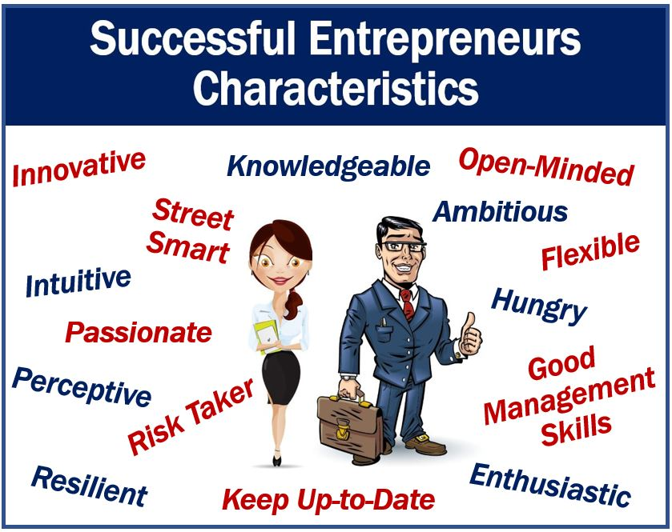
Characteristics of entrepreneur

Slide 28
Characteristics of entrepreneur
Need for achievement:
The urge to achieve or to excel others is the forceful psychological factors which is an essential characteristics found in almost all the individuals with enterprising quality.
Entrepreneur belongs to that category of people who are willing to work hard & achieve something excellent despite of the challenges & threats in the evnt.
Under such challenging & threatening forces many people would lose or give up & would not care at all for achieving something better.
But high need of achievement present in the entrepreneurs drive them to excel others.

Slide 29
Mental Ability
An entrepreneur must be intelligent & should have creative thinking & must be able to engage in the analysis of various problems & situation in order to deal with them.
Risk Taking
Risk taking is another attribute of entrepreneurs . Entrepreneur like to take risk which are calculated and not extreme ones. They undertake challenging risk which are difficult to overcome but are not impossible. In this process The risk involved are calculated risks.
Need for clear objectives
A entrepreneur should keep clear objectives for productions, to make profit or to render social service.

Slide 30
Maintains business secrecy
An entrepreneur should maintain business secrecy & he has to take care that his business confidential data should not be leaked to his competitors. To maintain secrecy he should able to make proper recruitment & selection of his employees.
Ability to maintain business relation
An entrepreneur who maintains good relation with customers employees, suppliers creditors & community is much more likely to succeed in his business than the one who does not invest in maintain these relation
Effective communication skill
An entrepreneur who can effectively communicate with customers, employees, suppliers & creditors will be more likely to succeed than the entrepreneur who can’t communicate effectively.

Slide 31
Social consciousness
Good entrepreneur will always thinks for social & economic development. As result he will always lookout for new methods of production or developing new products that would create jobs for many . Such business activities are directed to achieve social goals on larger interest than personal goals of individual interest
Optimistic
The entrepreneur have the quality of being optimistic & hoping to succeed rather than experiencing failure. This hope will boost their confidence in carrying out the task successfully . As a result of self confidence they are more successful in their efforts .

Slide 32
Open minded
Entrepreneur develops the habit of learning from experience. They modify the goals according to the environmental challenges & threats. A successful entrepreneur is open to constructive criticisms. A successful entrepreneur is willing to learn from his past experience & mistake & moulds himself for better future
Decision making skill
To be successful a person should have the ability to take & implement right decisions quickly. He has to take major & minor decisions. A successful entrepreneur is one who takes a right decisions at right time & implement it efficiently & effectively.
He should have good personality
Technical knowledge
Human relations

Slide 33
Entrepreneurship
Meaning of entrepreneurship
“Entrepreneurship” describes the capacity & willingness to develop , to organize & manage a business venture along with any of its risks in order to make a profit.
Best eg of entrepreneurship is the establishment of new organisations. It is also referred as a startup company.
Entrepreneur within an existing firm or large organization has been refered to as intrapreneurship & may include corporate ventures where large entities spin off subsidiary organisations.
‘Entrepreneurship is the process of creating something new & assuming the risks & rewards’ – Robert Hisrich

Slide 34
Need for Entrepreneurship
Employment generation
Balanced development
Innovation potential
Capital formation
Reduction in income inequalities
Revenue to government
Improves standard of living

Slide 35
Factors influencing Entrepreneurship
Individual factors
Environmental factors
Economic environment
Political environment
Cultural environment
Social environment

Slide 36
Entrepreneurship & Career option in India
Traditionally , Indians have engaged in small private businesses much out of necessity than out of choice.
Eg unemployment for illiterate people pushes them to start small businesses just to earn their basic livelihood.
Overall low income of a family also drives them to have a small business on the side .
Quite often, these small ventures are run by the women in the family.
On the similar lines, women with very low outside exposure, try to earn by setting small home-based business. Availability of cheap labor, at times in the family itself, makes these ventures easy to run. However, a developing country like India really needed entrepreneurs competent to perceive new opportunities & willing to incur the necessary risk in exploiying risk in exploiting them.

Slide 37
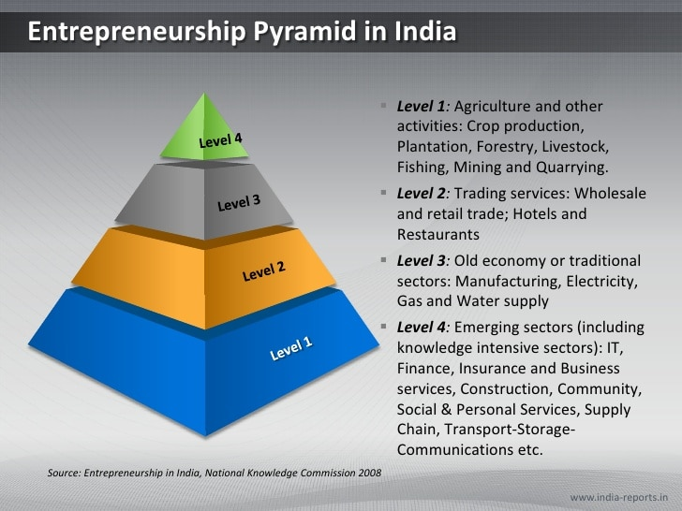
Entrepreneurship pyramid in India

Slide 38
Emerging Sectors in India
After LPG policy , in India, doors are opened for many business sectors to increased foreign investment & grow internationally . There are many business opportunity in different sectors in India.
To refer one sector as emerging sector , sector must satisfy following two conditions:-
1) Sector has established its presence but it has yet fully developed sector or not yet reached to growth stage.
2) Sectors is currently growing or developing fast & it will become one of the important sectors of the economy in near future.
Following are Indian Sectors are fulfilling above 2 condition:

Slide 39
Infrastructure
India has many business opportunities in infrastructural development . India needs to develop infrastructure like roads , ports, airport, power generation projects , railways , new cities & towns.
As this sectors is growing rapidly, following are related businesses of this sector. These businesses are also growing like building finishing contractors. They are providing services like laying marbles, tiles, painting the walls, plastering , wooden works & other interior work are also in demand.
Utility system constructions like construction of sewage pipes, water lines, gas line, electricity wiring .
Real estate agent & brokers services are also growing
Architectural , engineering & related services are also booming.

Slide 40
Food processing sectors
It is another growing sectors in India.in this sectors FDI is increasing rapidly.
Govt has also concentrated more on this sector by taking steps to increase the growth of this sectors. In indi food processing industries need advance technology. This sector provides business opportunities like fast food production, packed food production, cultivation & marketing of vresh fruits & food grains.

Slide 41
Tourism
India is major attraction for tourist all over the world .India has 29 states and each state is different in culture and that increase curiosity of the tourists. Whenever tourists visit India they bring foreign currency in India. Through their spending in India they are contributing to FDI inflow in India. In India there are new terms of tourism opportunities like rural tourism, eco-tourism, and medical tourism.

Slide 42
ENERGY SECTOR
Electricity is one of the life necessities for everyone . But in India, electricity is not reached every corner of the country. More number of power generation projects like hydro, nuclear, solar energy is indeed in India
ANIMATION SECTOR
There is another booming sector in India. Now-a-days there is increasing use of 3D technology in movies and many new animation technologies are being used in the market at different places. New and creature animators are needed in this sector

Slide 43
Automobile Sector
Indian automobile sector is one of the largest sectors in the world. India produced 3-9 million units of passengers cars and commercial vehicles in 2011. It is projected that India’s automobile sales will reach 4 million units in 2015. So this sector needs more number of manufacturers to produce different automobile parts

Slide 44
Textile sectors
This is another highly important sector in India. This sector contributes 14% industrial production & also contributes 4% to INDIA’S GDP . This sector also shares 17% of India’s export. This sector generates more number of employments in India.
RETAIL SECTOR
In this sector 100% FDI is not allowed. But in spite of FDI restrictions in retail sector, there are opportunities for single brand retailers ,food and drink producers etc

Slide 45
Education Sector
Highly qualified and skilled peoples are needed, that is possible only after improving quality of education. Innovation in higher education curriculum pedagogy, examination, assessment is needed. This is possible only when more and more expert people will work for education sector.
Biotechnology
This is one of the emerging sectors in India. More than 300 laboratories and universities are working for biotechnology in India. There are many opportunities in this sector as there is more and more demand for biotech products. This sector is more focus on research and development so people who are interested in research can work in this sector.

Slide 46
Organic Farming
India’s biggest population is involved in agriculture activities. India is producing many certified organic products like rice, pulses, oilseeds, sugarcane, fruits, cotton etc. Because of huge demands for organic products, this sector has more number of business opportunities

