Slide 1

UNIT 4
Dr Rupal Shroff

Slide 2
Business Research Methods
Unit IV - Advanced Techniques in Report Writing
Report Writing
Ethics & Research
Objectivity, Confidentiality and Anonymity in Research
Plagiarism

Slide 3
Research report writing
It is the concluding part of the research activity on the part of the researcher.
Features
It is a complete, compact systematic and self explanatory document.
Useful for solving marketing and business problem
pre[pared as per standard format
Submitted to the sponsoring agencies
Act as a base for policy decision
Need detailed scrutiny
Act as permanent record and has reference value.
Research report talks about the experience, maturity and calibre of a research team.

Slide 4
Characteristics of a RESEARCH report
Logical Arrangement
References
Drafting in Impersonal style
Proper format
Date and Signature
Objectivity
Reliability
Accuracy
Clarity
Concise

Slide 5
Functions of a research report
It serves as a means for presenting the problem studied, methods and techniques used for collecting and analysing data, the findings, conclusions and recommendations in an organised manner.
It helps to judge quality of the research.
It can evaluate the researcher’s ability and competence to do research.
It provides factual base for formulating policies
It serves as reference material for future research.
It provides systematic knowledge on problems and issues analysed.

Slide 6
Types of report
Technical report
Popular report
Interim report
Summary report
Research abstract
Research article

Slide 7
Preferred format for research paper format
Abstract - 300 to 400 words
Introduction
Literature Review
Research Methodology
  Objectives of the Study
  Hypothesis
  Research Design
  Sampling Design
  Sampling Frame & Unit
  Sampling Size
Data Analysis & Inferences
Conclusions & Recommendations (if any)
Limitations
Bibliography

Slide 8
Format for Research Report
A] Title Pages
Name of the Project
Name & Address of the Client for whom Research is done
Name of the Research Agency / Individual
Project Identification Number
Date of Preparation & Submission
Letter of Transmittal & Authorisation
B] I. The Main Text
Introduction of the Study
Theoretical Framework
Industry / Company Profile
Statement of Problem
Objectives of the Study
II. Literature Review

Slide 9
III. Research Methodology
Scope of Study
Research Design
Sampling Framework, Design & Size
Period of Study
IV. Data Analysis
Analysis of Data
Interpretation
Presentation of Findings & Tentative Conclusions
V. Conclusions, Suggestions & Limitations
Conclusions
Suggestions
Limitations
VI. Appendices
Bibliography
Webliography
Questionnaire

Slide 10
ADVaNTAGES OF RESEARCH REPORT
Helps in communicating findings.
Keeps the researcher fully informed about latest development in their field.
Helps in further research study
The report communicate to research scholar all researches done so far.
It keeps all researchers united
It generate hypothesis, which lead to further research.
Through research report, various small segments of research can be coordinated and consolidated.

Slide 11
Principles of writing research report
Length
Interesting
Simple
Graphical presentation
Layout
Grammatical accuracy
Analysis
Solution to a problem
Implication

Slide 12
Continued….
Appendices and index
Bibliography
Appearance
Conclusion

Slide 13
Research ethics
the National Commission (1979) identified six norms to guide research: (1) use of a valid research design; (2) evidence of researcher competency; (3) identification of consequences of the research in terms of keeping participants' identification confidential; (4) maximizing benefits, minimizing risks; (5) appropriate sample selection and voluntary informed consent; and (6) informing participants of compensation for potential harm. Research Ethics include:
Honesty
Objectivity
Integrity
Carefulness
Openness
Respect for intellectual property
Confidentiality
Responsible publication
Responsible mentoring
Respect for colleagues

Slide 14
Dos and Don’ts of Research Ethics
Do’s | Don’ts
Maintaining a good record of all your research activities and report your data as carefully and objectively as possible. | Fabrication, manipulation or misrepresentation of data.
Disclose financial or personal interests that may directly/indirectly affect your work. | Deceiving research sponsors, colleagues, or ethical committees by having bias in data interpretation, peer review, or personnel decisions.
Treat animals with care and respect when studying them in your research and adhere to ethical guidelines. | Use any external research data (published or unpublished) without permission.
Respect intellectual property, privacy, and confidentiality and give proper credit for any contributions from other researchers. | Support irresponsible publication practices. Your main goal should be to advance science and share your knowledge within the community.

Slide 15
ETHICAL CODE OF RESEARCH
Reporting researches honestly without any manipulation of data and others
Avoiding all kind of bias in research including design, data, analysis, interpretation and also peer review
Avoiding mistakes by reviewing the research thoroughly and carefully
Safekeeping of all the information regarding the research for future reference
Having an openness to share data and any new tools and techniques developed during the research
Being aware of the legalities concerned with the research area

Slide 16
Plagiarism
Plagiarism is unacceptable and constitutes a serious breach of recognised norms of research ethics.
A plagiarist undermines not only his or her own reputation as a researcher, but also the credibility of the research. Both researchers and research institutions are responsible for preventing plagiarism.
Plagiarism in research ethics is taking something from someone else and presenting it as one's own without correctly citing their sources. Plagiarism violates the duty of truthfulness in science, and the requirement of originality, humility and collegiality. Researchers who build on the work of others must cite their sources in accordance with good practice.
The most obvious type of plagiarism is pure duplication. Plagiarism can nonetheless take other forms, for example the use of ideas, hypotheses, concepts, theories, interpretations, designs, illustrations, results etc. Citing another work early in one's own text and then making extensive further use of it without subsequent citation may also be plagiarism.
It is important to distinguish between direct quotes and paraphrasing in footnotes and endnotes as well as in the text. Paraphrasing must not be so close to the original text that it in reality constitutes a quote. If several paraphrases are connected, the entire interpretation and argumentation may be based on the work of others. If so, this may also constitute plagiarism.

Slide 17
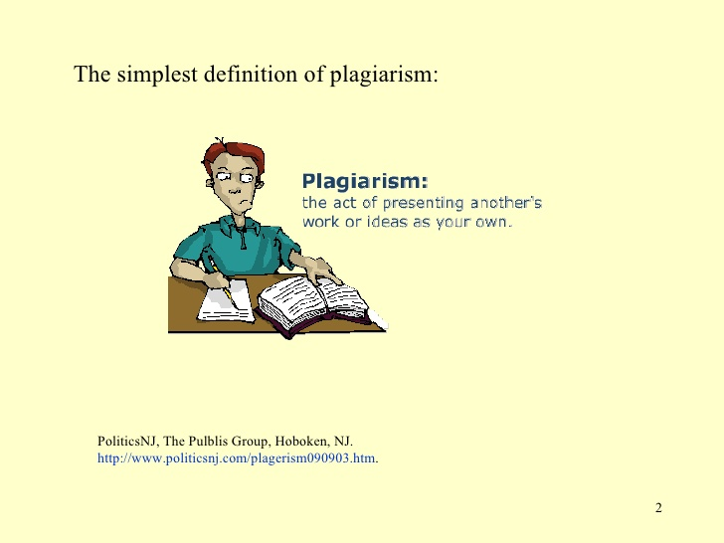

Slide 18
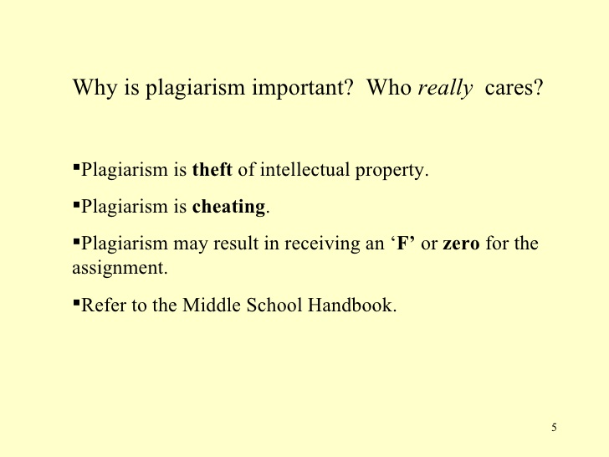

Slide 19
PLAGIARISM
Alive or dead, it does not matter. If it is not your own idea, you must cite your source.
If you translate or paraphrase something, you must still give a citation
Paraphrasing requires a citation
Quotation should be used sparingly and must be cited appropriately.
Using someone else’s paper, art work without proper citation is plagiarism
Own work also need to be cited.
Even free stuff on website should also be cited.
Whenever in doubt it is better to use citation.

Slide 20
REFERENCE OR CITATION METHOD

Slide 21
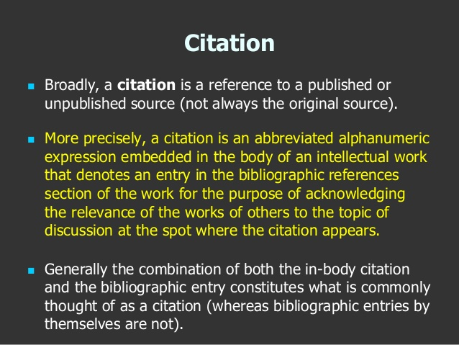

Slide 22
IMPORTANCE OF CITATION
To uphold intellectual honesty
To avoid plagiarism
It allow the reader to determine independently whether the referenced material supports the author’s argument
To help the reader gauge the strength and validity of the material the author has used.

Slide 23
Ways to avoid Plagiarism
Paraphrasing
Citation
Quoting
Citing Quotes
Referencing

Slide 24
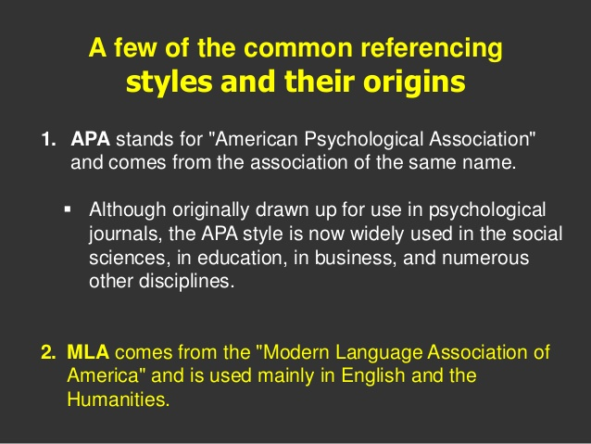
There are different style of citation:
Different academic disciplines have different priorities of what is important to the subsequent reader of an academic paper and different publishing houses have different rules about the citation of sources

Slide 25
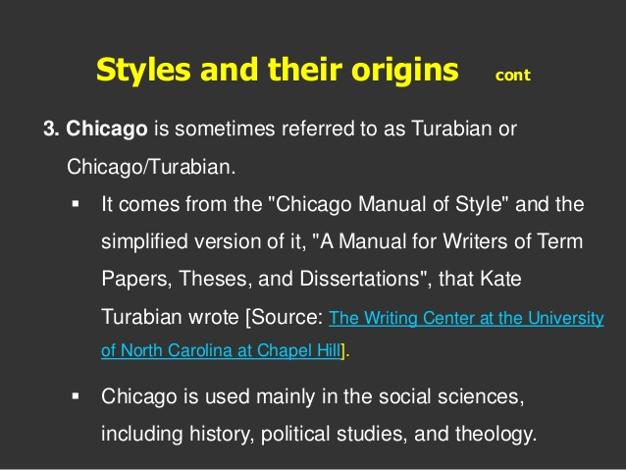

Slide 26
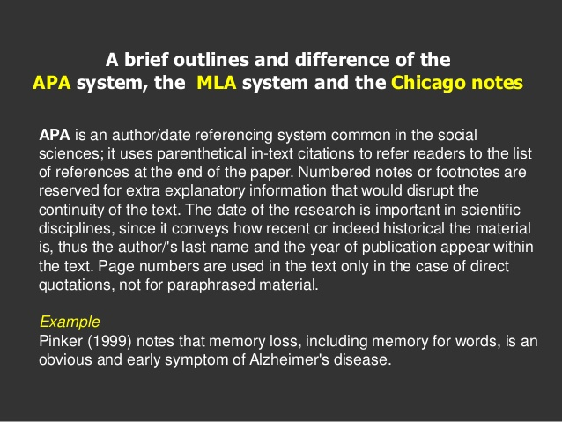

Slide 27
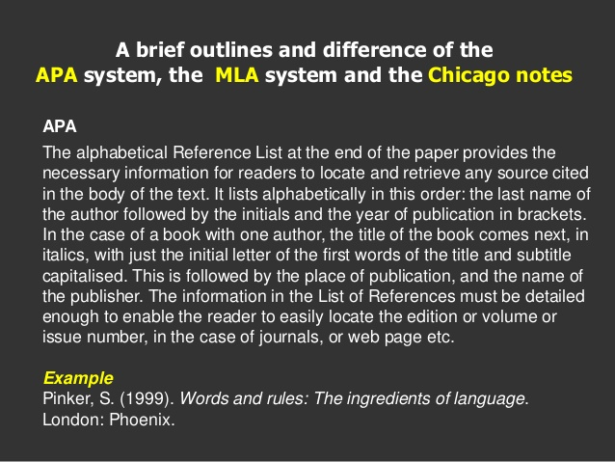

Slide 28
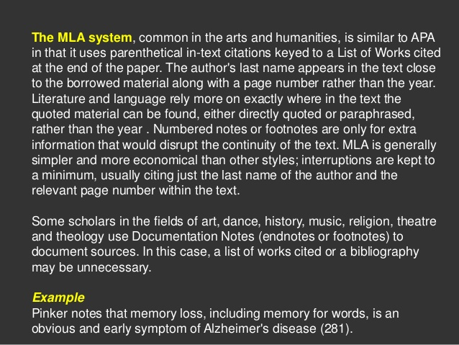

Slide 29
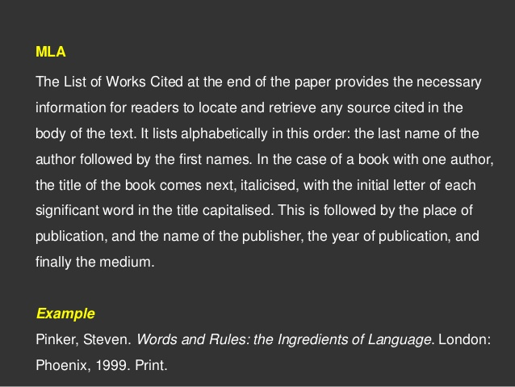

Slide 30
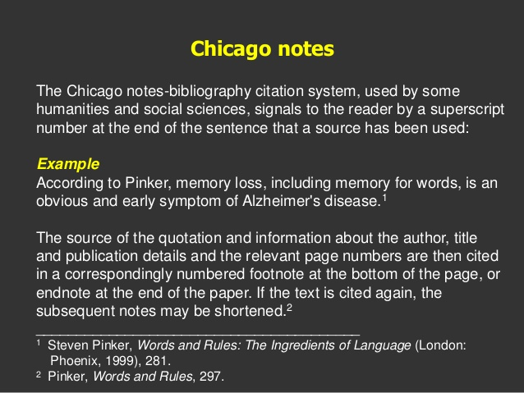

Slide 31
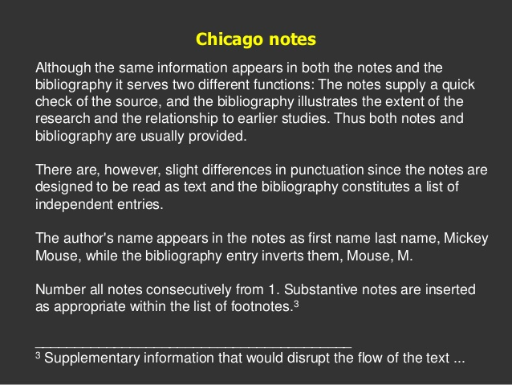

Slide 32
FOOTNOTE AND BIBLIOGRAPHY

Slide 33
FOOTNOTE
The ethics of scholarship require proper acknowledgement of material sourced by the author while doing research and writing report. Credit for borrowed words, ideas, symbols or other form of expression should be given and their sources should be stated in the text and footnotes.
Even while reviewing literature all the sources referred to need to be properly documented. This is known as footnotes
There are two kind of footnote:
Content notes which contain explanatory material
Reference note are documentation of sources

Slide 34
FOOTNOTE:
It relate to books, journals etc referred to while drafting report
It is written in the form of superscripted number just after paraphrased information, quotation.
They are given at the end of the research report.
They are useful to researcher for reference purpose.
Due credit for borrowed words, statements, ideas and quotations should be given and their sources of origin should be acknowledged in the report in a footnote.
It is in the form of a superscripted number just after a paraphrased information.
https://www.slideshare.net/marimar27/footnote-and-bibliography

Slide 35
DETAILS OF FOOTNOTE
Basic Format: details required for footnotes are:
Author’s name, title of the work and place of publication
Page number of the book/report from which reference is taken
Publisher’s name and year of publication.
Placement of footnote
A footnote citation is indicated by placing an index number at the point of reference. This should be followed by an author’s name and other details.
Footnotes are single spaced with double spacing between two consecutive citations

Slide 36
PURPOSE OF FOOTNOTES
To clarify the information given in the text of the reports.
To establish validity of evidence.
To enable readers to refer to original source of information.
To provide cross reference to various parts, sections of the research report
To acknowledge indebtedness.

Slide 37
BENEFITS OF USING FOOTNOTES
It offer convenience to readers as regards to references used in research report.
Interested readers can refer to the page easily where the details of the reference is available.
Footnotes are directly included while printing the pages of research report
It satisfy the ethics of report writing which requires proper acknowledgement of all sources of material.

Slide 38
DISADVANTAGES OF USING FOOTNOTES
Lengthy footnotes occupy large area or pages of research report.
Footnotes are not directly related to research reports.
Footnotes are becoming outdated and are getting replaced by end notes.

Slide 39
BIBLIOGRAPHY
It lists in alphabetical order all published and unpublished references used by the writer while writing the report.
In a bibliography all books, articles, reports and articles are presented in the alphabetical order.
It can be classified into 3 or 4 sections, books, articles, reports and other documents.
It gives list of materials relating to the topic under study as a ready reference to the reader.

Slide 40
DIFFERENCE BETWEEN
FOOTNOTES
The purpose of footnote found at the bottom of the respective pages cite the exact sources and pages.
It cite authority for specific statement quoted or paraphrased
Footnotes have page number of its source
BIBLIOGRAPHY
It gives list of materials relating to the topic under study as a ready reference to the reader.
It lists in alphabetical order all references used in the research
it does not have any page number

