Slide 1
SECURITY ANALYSIS & PORTFOLIO MANAGEMENT
MODULE 2

Slide 2

PORTFOLIO ANALYSIS- MEANING
In terms of securities, a portfolio analysis is one in which the investment portfolio is checked, in order to optimise the allocation of holdings.
Portfolio Analysis is the process of reviewing or assessing the elements of the entire portfolio of securities or products in a business.
The analysis also helps in proper resource/asset allocation to different elements in the portfolio.

Slide 3

COMPONENTS OF PORTFOLIO ANALYSIS
Return
Risk
Liquidity
Tax benefits
Convenience
Safety
Growth
Marketability
Purchasing power stability

Slide 4
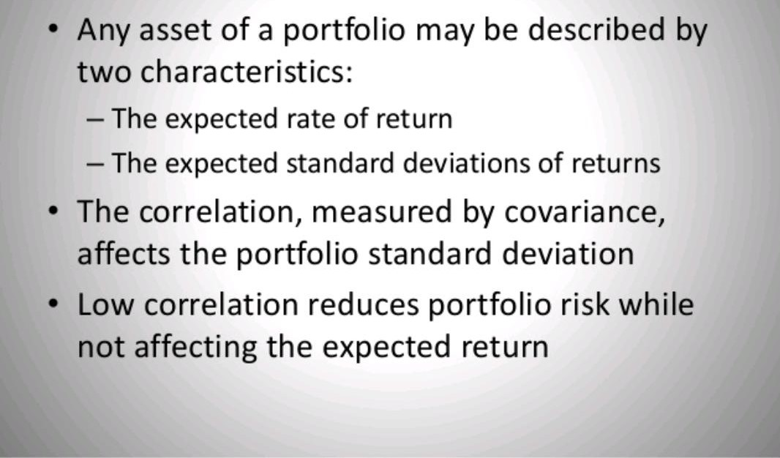
STANDARD DEVIATION

Slide 5
CO-VARIANCE
To calculate the beta of a security, the covariance between the return of the security and return of the market must be known, as well as the variance of the market returns.
Covariance measures how two stocks move together.
Covariance is used to measure the correlation in price moves of two different stocks.

Slide 6
BETA
Beta is important because it measures the risk of an investment that cannot be reduced by diversification.
In the CAPM beta risk is the only kind of risk for which investors should receive an expected return higher than the risk- free rate of interest.

Slide 7
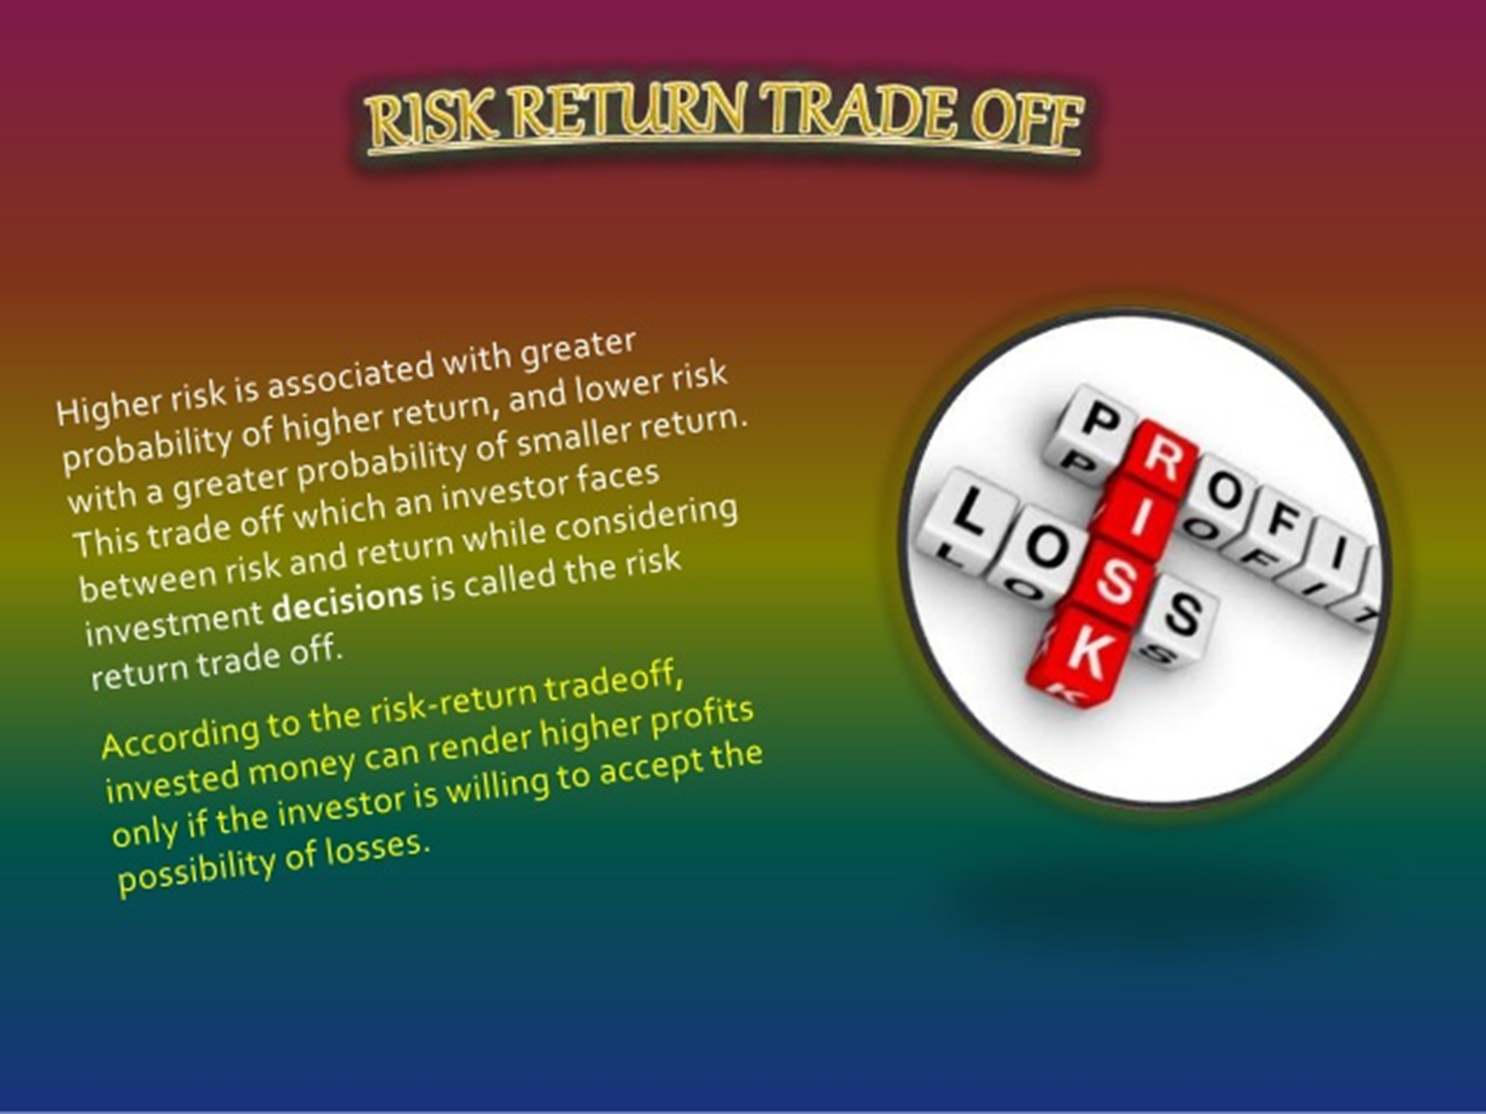
RISK RETURN TRADE OFF

Slide 8
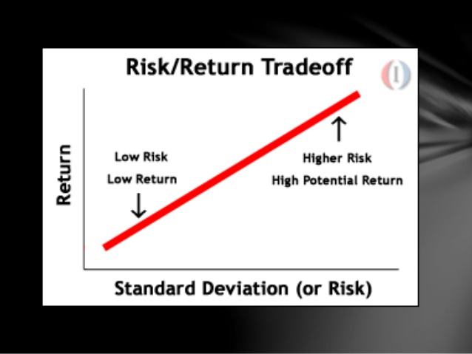

Slide 9

PORTFOLIO SELECTION-MEANING
The process of finding the optimal portfolio is described as portfolio selection
Portfolio selection involves collection of risky assets combined with different weights to provide an acceptable trade-off between return and risk to an investor.

Slide 10
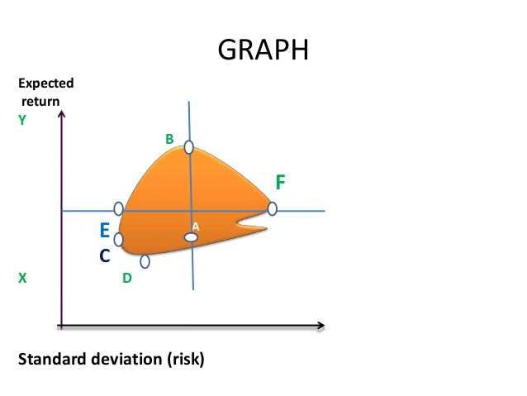
FEASIBLE SET OF PORTFOLIO
Feasible set of portfolio is defined as a possible set of investment chosen from the available alternatives within the limit of the investor’s capital resources, risk tolerance & investment objective.
Each feasible portfolio has its own risk and reward profile and its not necessarily an efficient portfolio.

Slide 11
MARKOWITZ MODEL
Markowitz approach determines for the investor the efficient set of portfolio through important variables i.e return , standard deviation and coefficient correlation.
Through this method the investors can ,with the case of computer , find out the efficient set of portfolio by finding out the trade-off between risk and return.
According to this theory, the effects of one security purchase over the effect of the other security purchase are taken into consideration and then the results are evaluated.

Slide 12
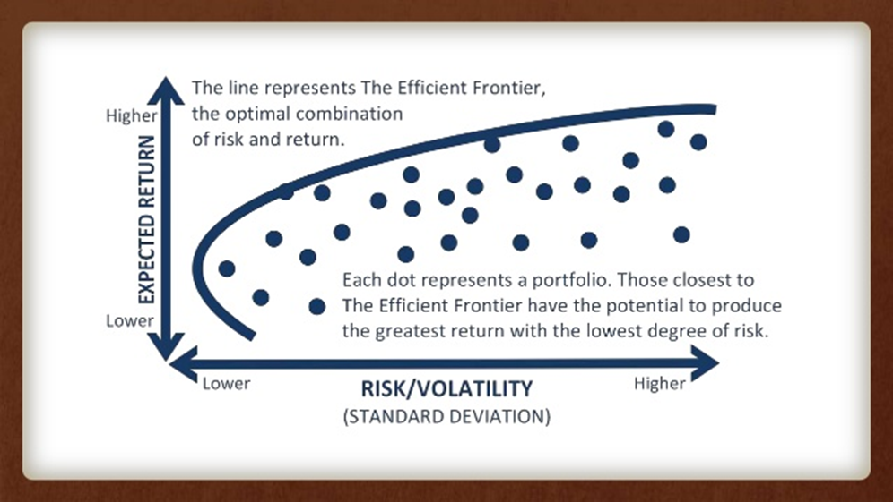
MARKOWITZ MODEL

Slide 13
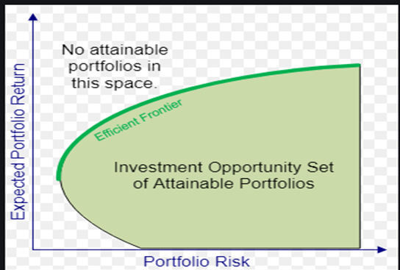
EFFICIENT SET OF PORTFOLIO
The efficient frontier is the set of optimal portfolios that offers the highest expected return for a defined level of risk or the lowest risk for a given level of expected return.
Portfolio that lie below the efficient frontier are sub-optimal, because they do not provide enough return for the level of risk.
Portfolio that cluster to the right of the efficient frontier are also sub-optimal, because they have higher level of risk for the defined rate return.

Slide 14
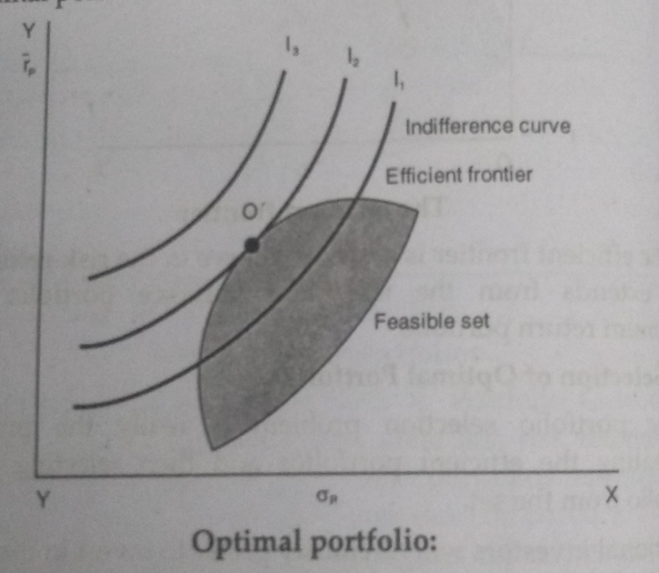
SELECTION OF OPTIMAL PORTFOLIO
The portfolio selection problem is really the process of delineating the efficient portfolios and then selecting the best portfolio from the set.
The selection of optimal portfolio depends on the investors risk, aversion, or conversely on his risk tolerance.
This can be graphically represented through a series of risk return utility curve or indifference curves.
Each curve represent different combinations of risk and return.

Slide 15
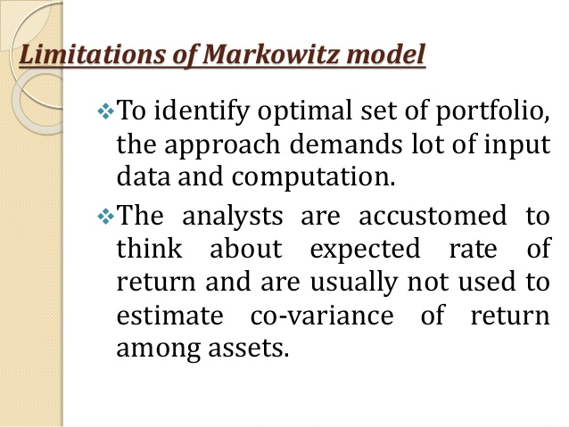
LIMITATIONS OF MARKOWITZ MODEL

Slide 16
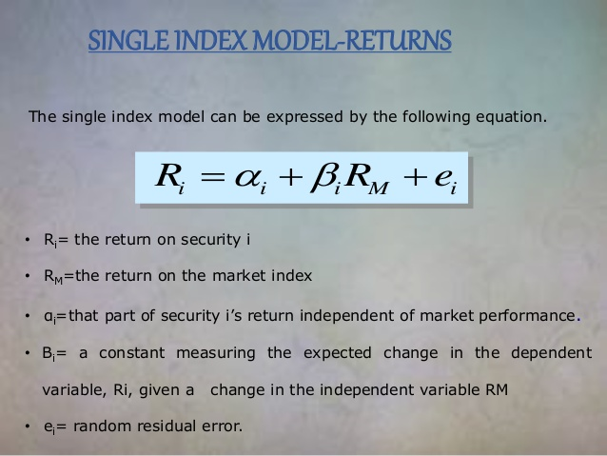
MEASURING SECURITY RETURN AND PORTFOLIO RETURN UNDER SINGLE INDEX MODEL

Slide 17
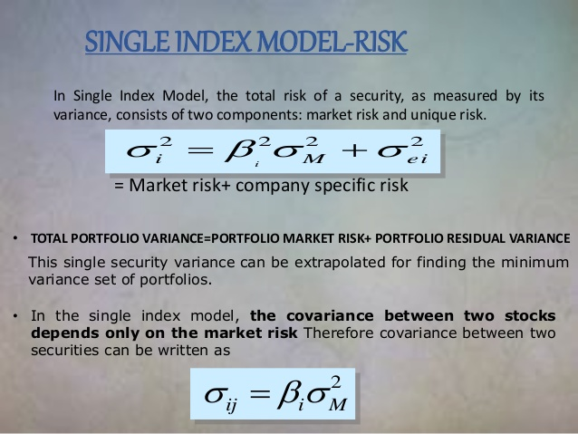
RISK UNDER SINGLE INDEX MODEL

Slide 18
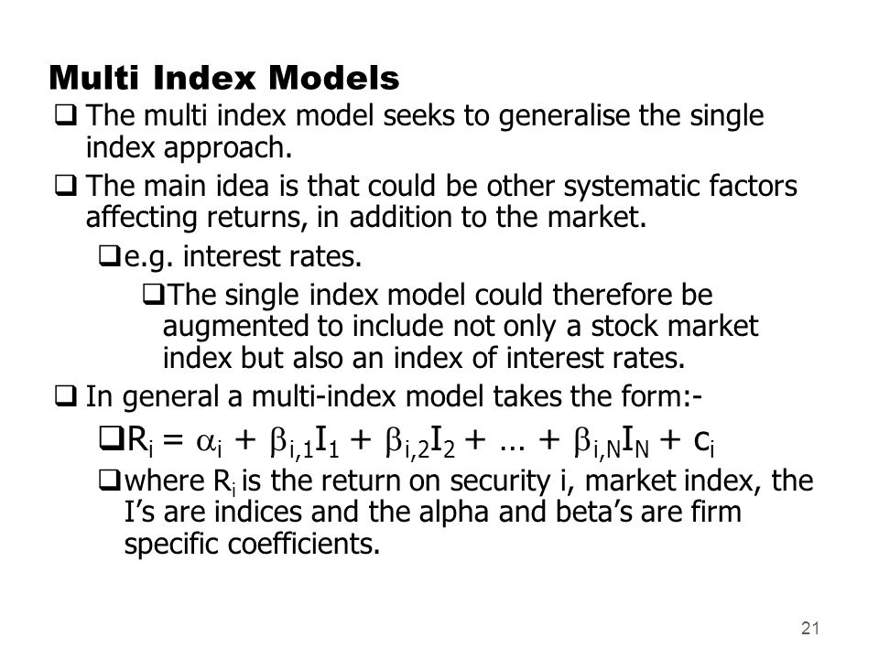
MULTI INDEX MODEL

Slide 19


