Slide 1
Thakur College of Science & Commerce
Department of Zoology
Academic Year – 2020-21
T.Y.B.Sc. Zoology
Semester – VI
Paper – IV Unit - I
Environment Management
Dr. Vitthal T. Mohite

Slide 2
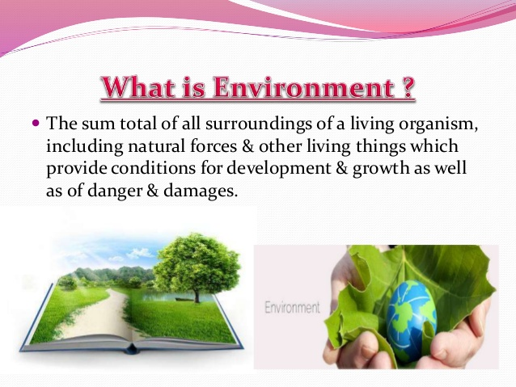

Slide 3
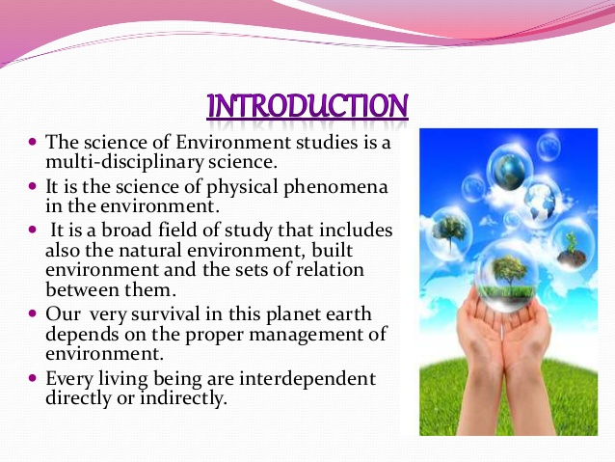

Slide 4
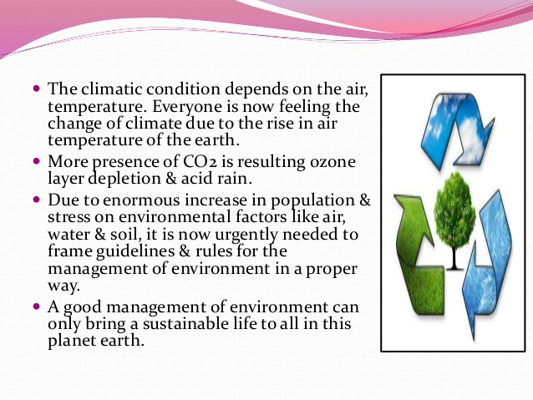

Slide 5
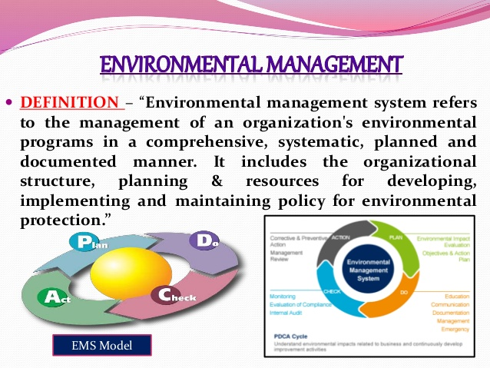

Slide 6
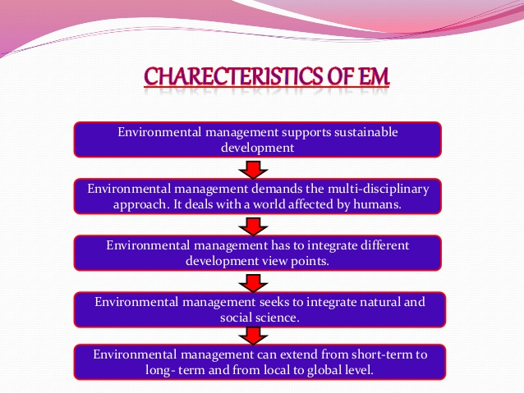

Slide 7
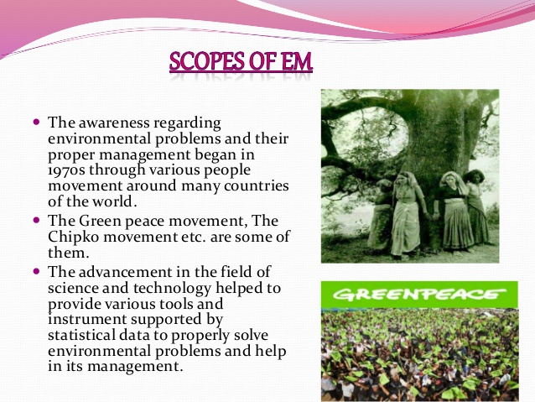

Slide 8
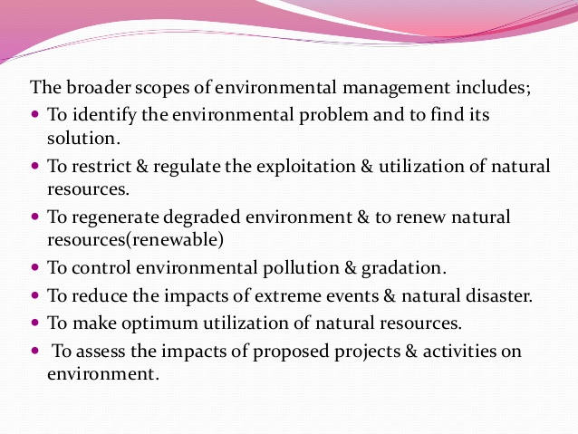

Slide 9
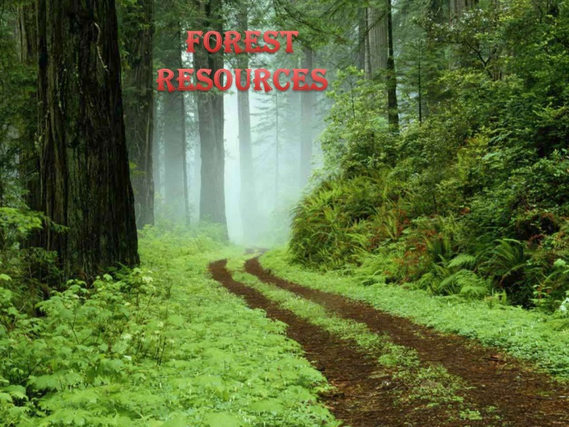

Slide 10
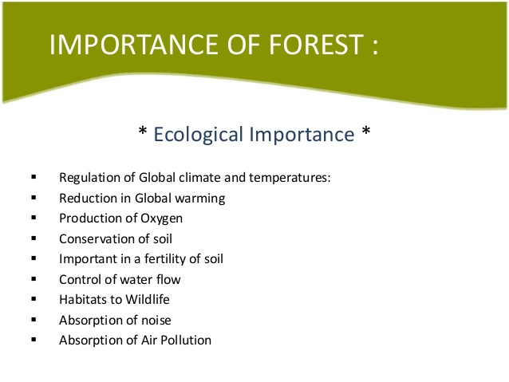

Slide 11
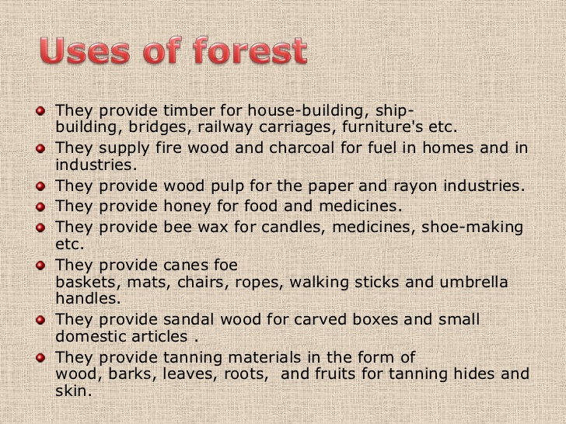

Slide 12
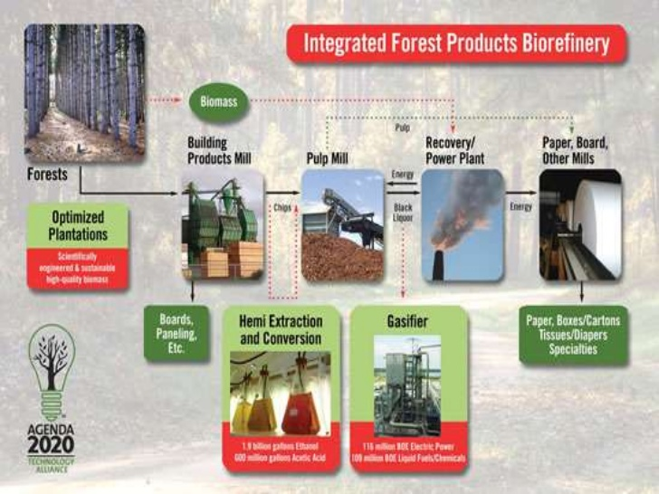

Slide 13
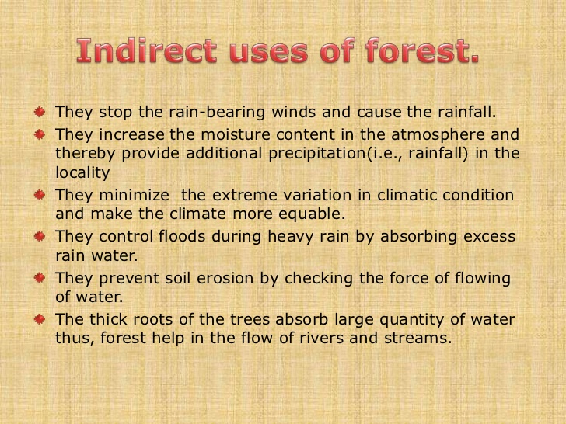

Slide 14
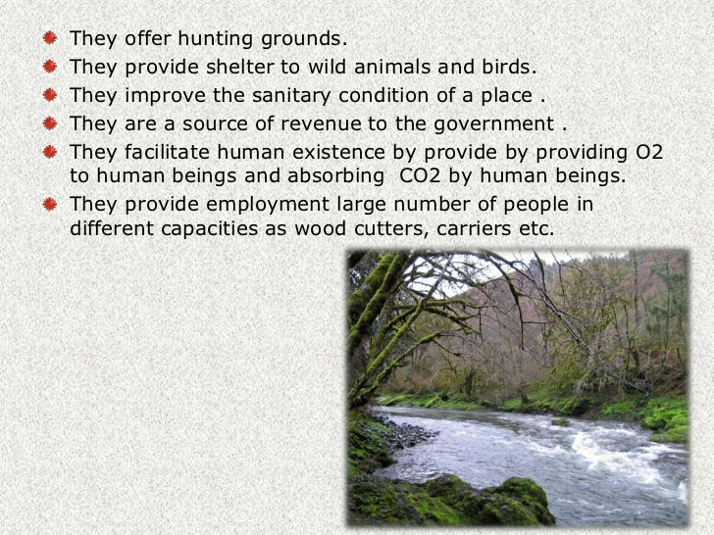

Slide 15
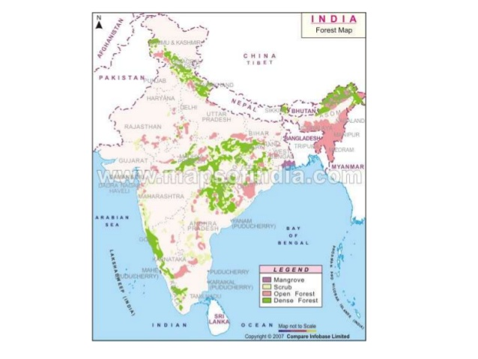

Slide 16
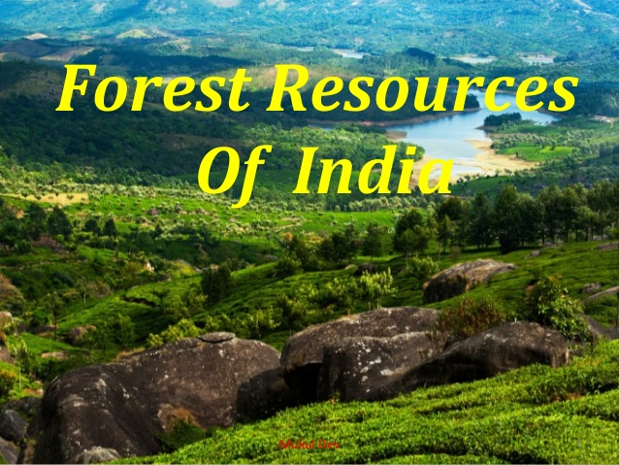

Slide 17
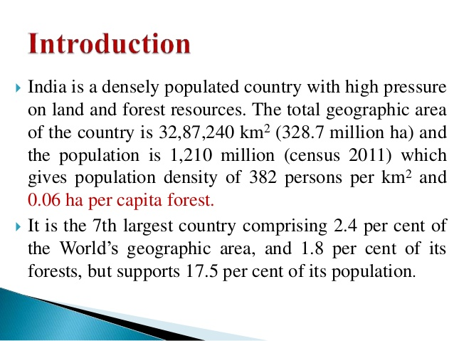

Slide 18
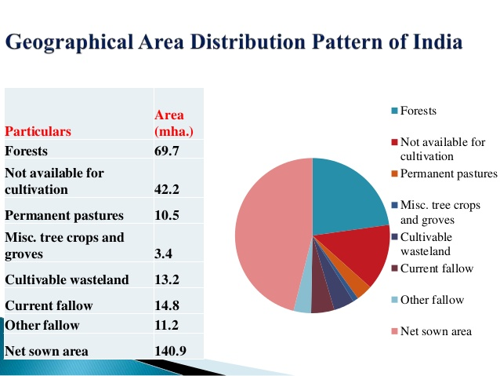

Slide 19
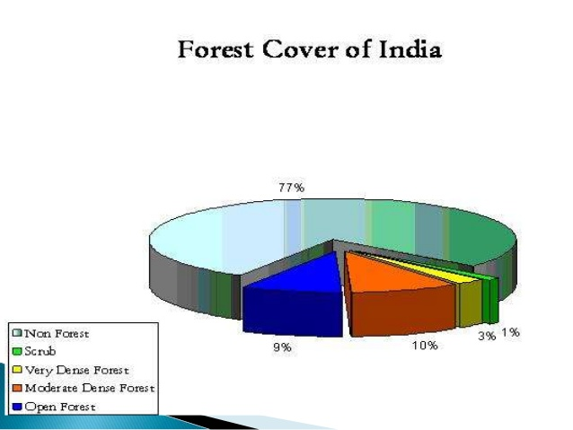

Slide 20
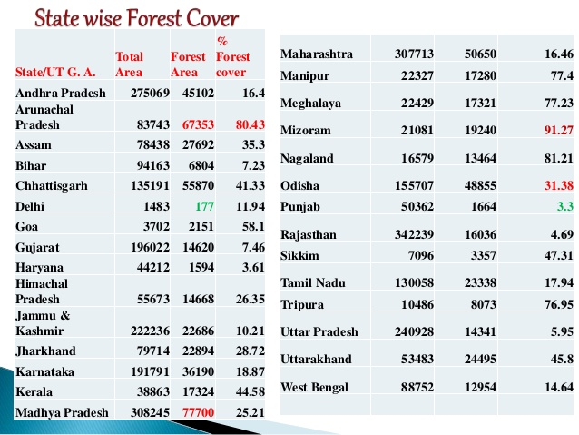

Slide 21
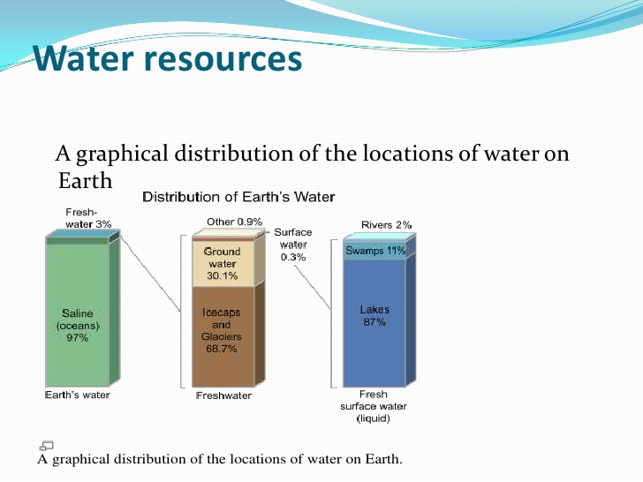
WATER AS A RESOURE

Slide 22
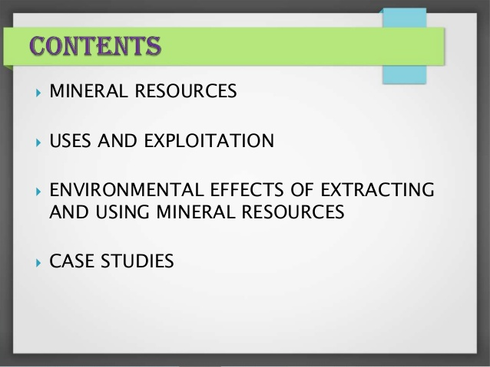
Mineral as Resources

Slide 23
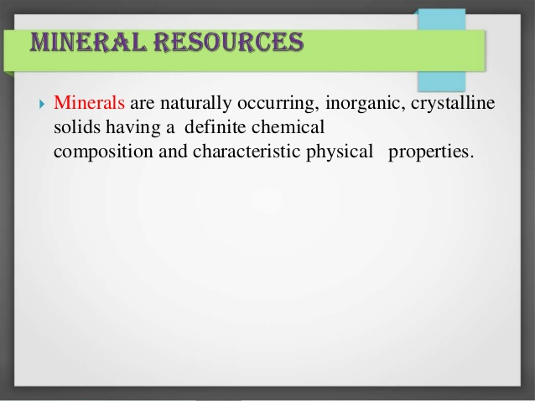

Slide 24
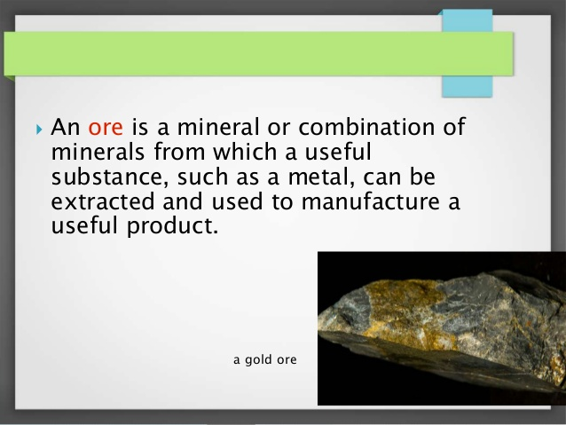

Slide 25
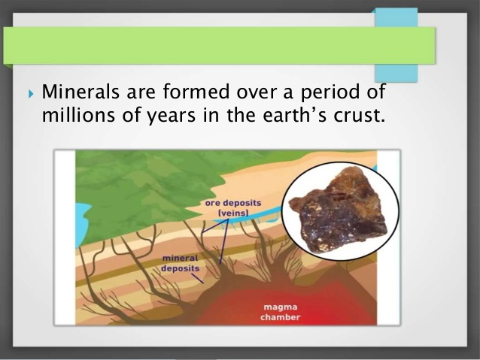

Slide 26
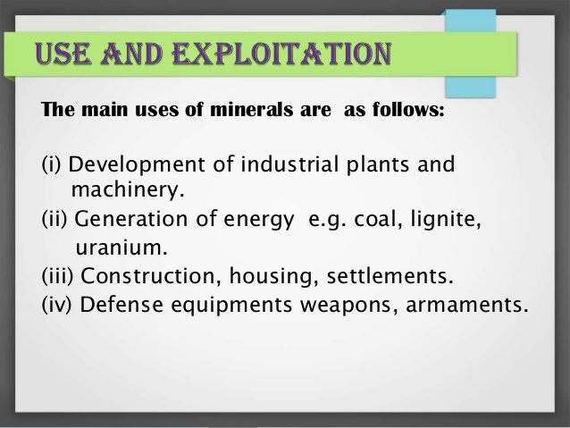

Slide 27
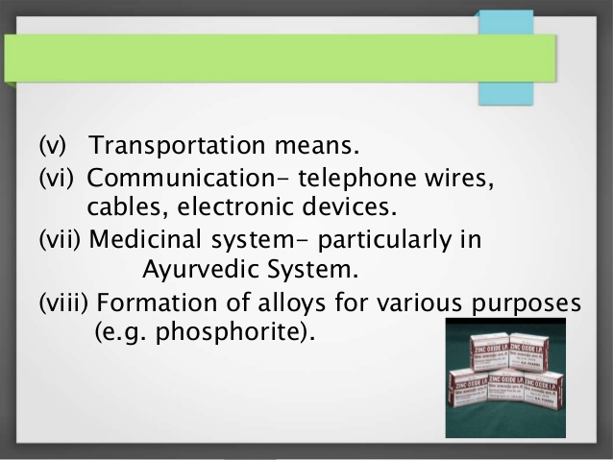

Slide 28
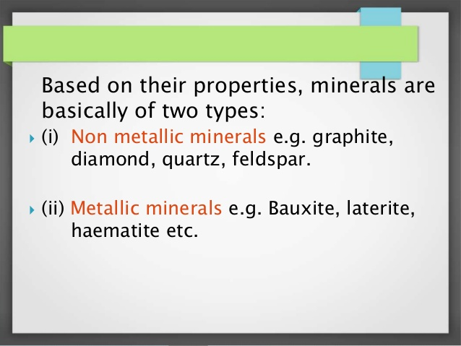

Slide 29
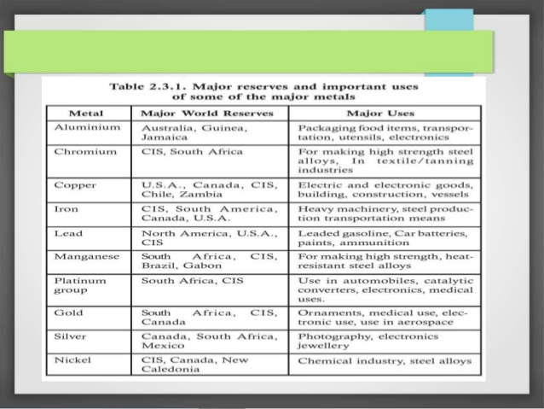

Slide 30
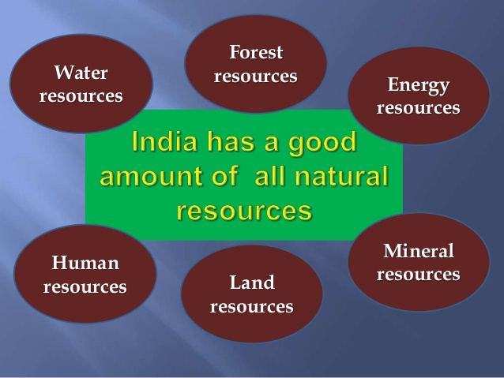

Slide 31
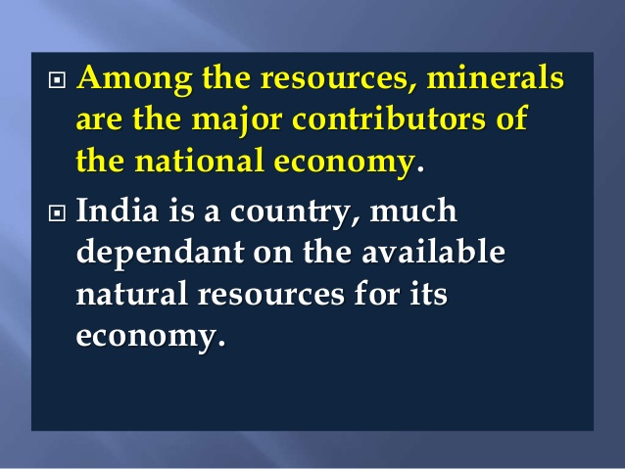

Slide 32
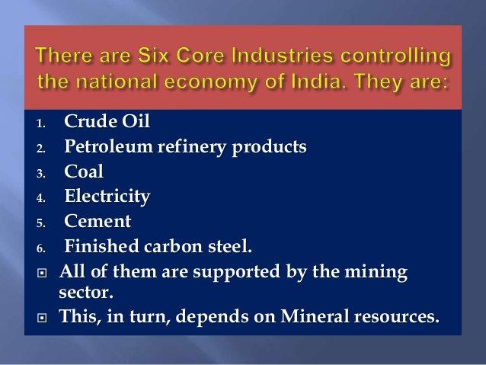

Slide 33
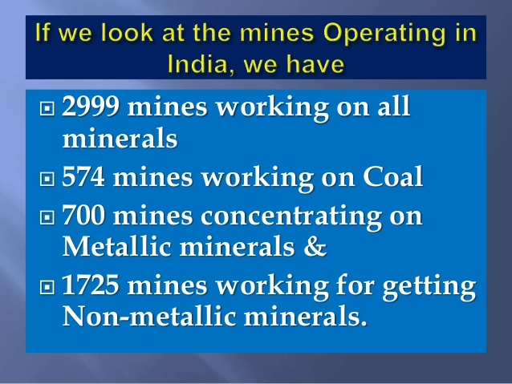

Slide 34
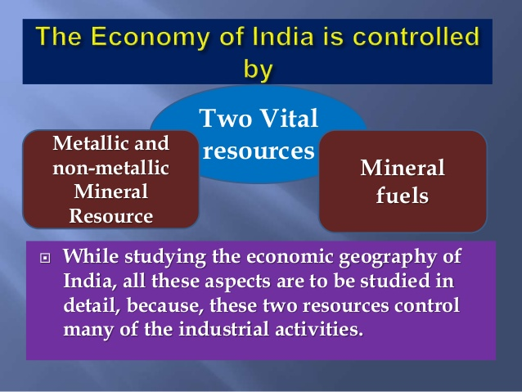

Slide 35
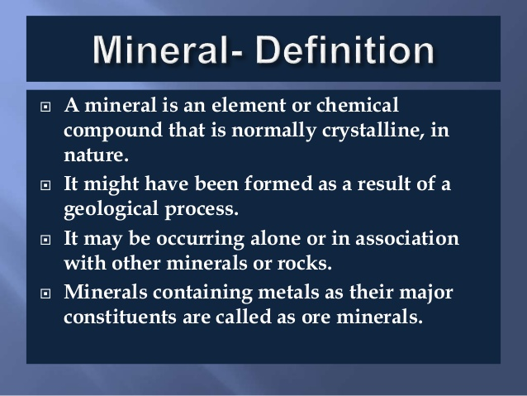

Slide 36
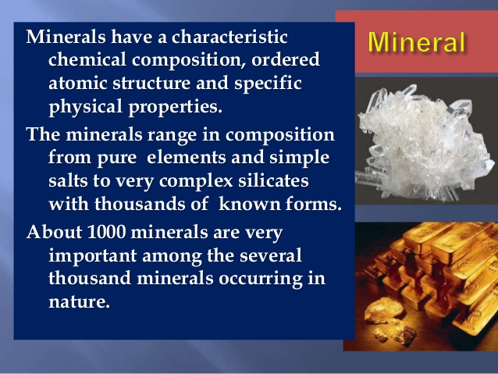

Slide 37
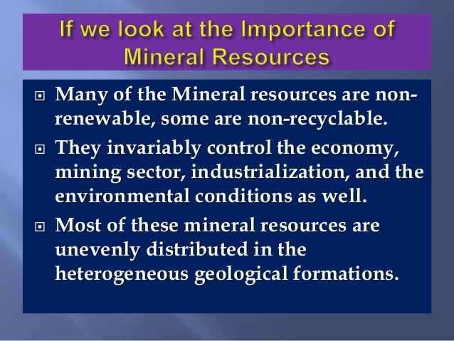

Slide 38
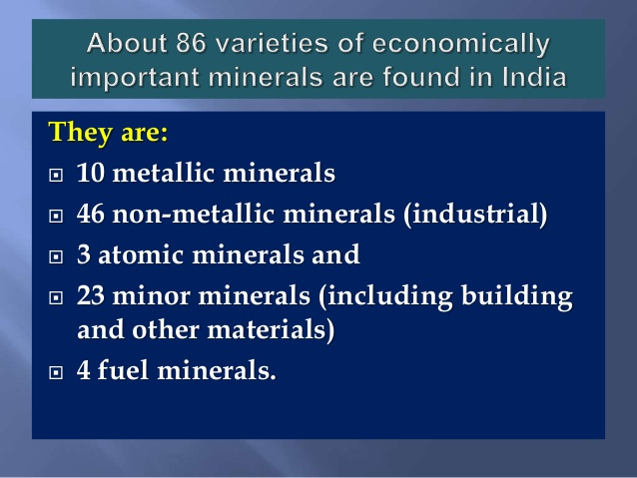

Slide 39
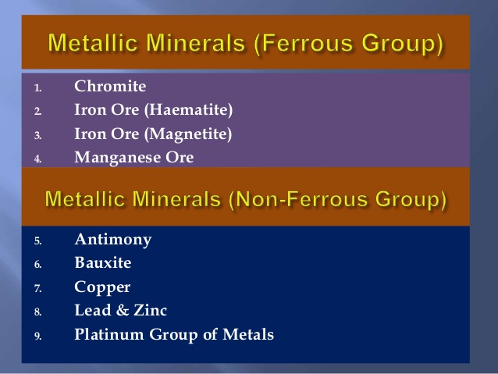

Slide 40
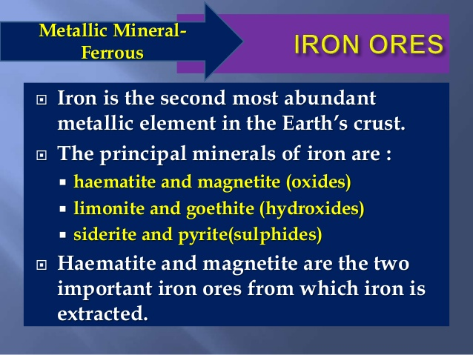

Slide 41
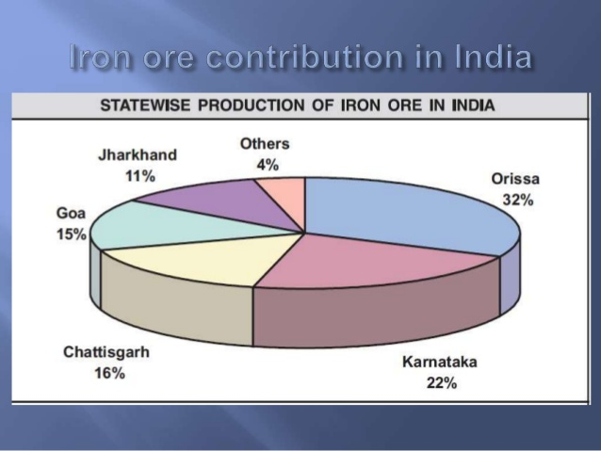

Slide 42
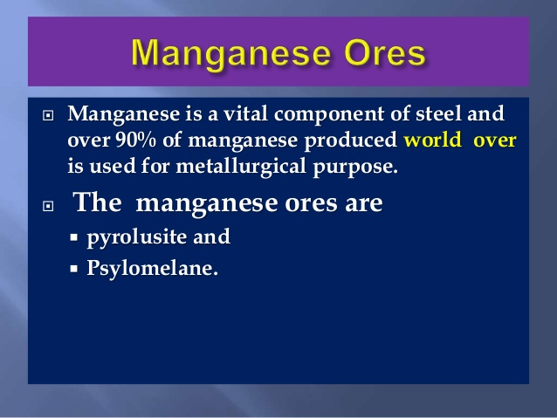

Slide 43
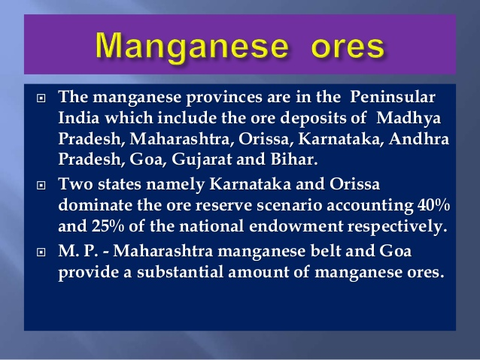

Slide 44
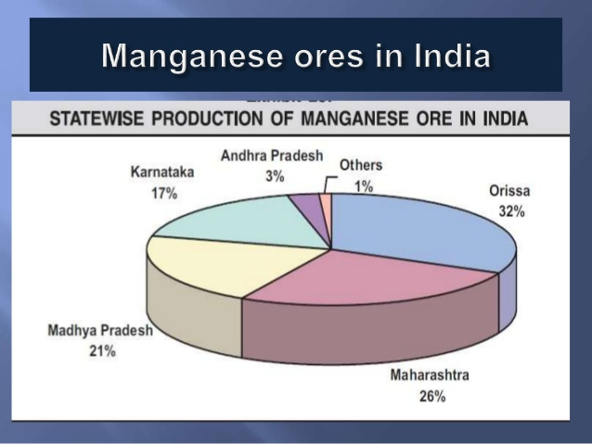

Slide 45
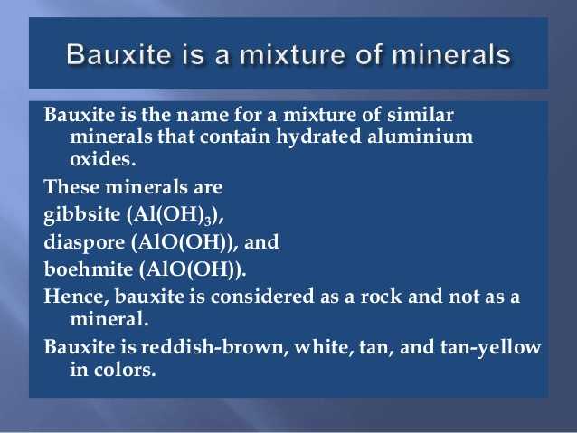

Slide 46
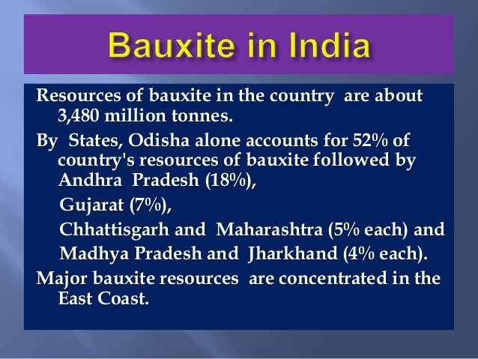

Slide 47
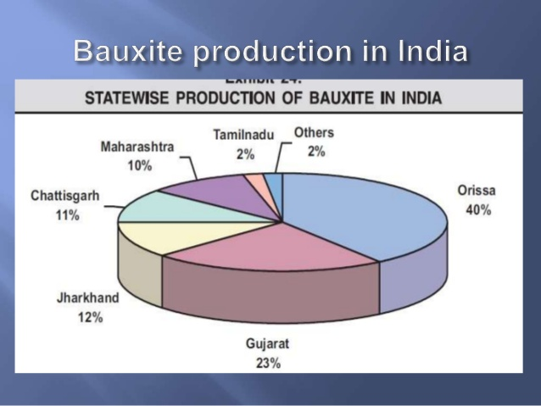

Slide 48
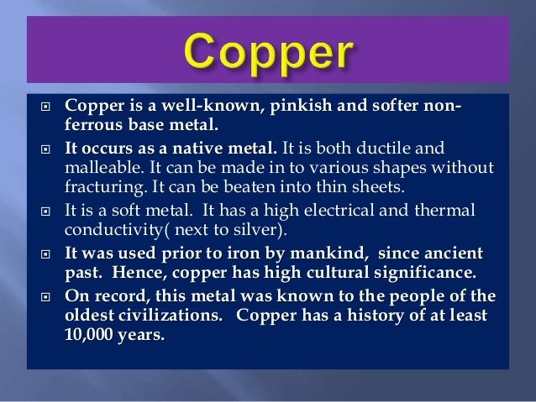

Slide 49
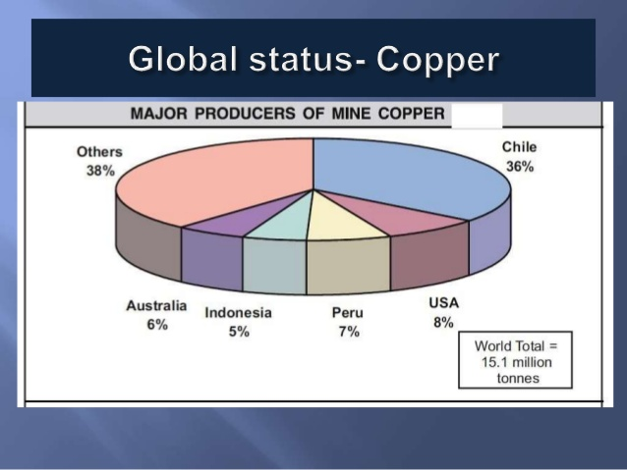

Slide 50
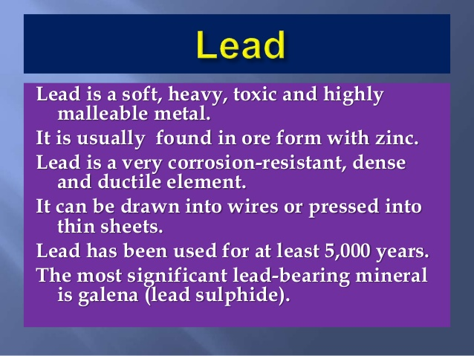

Slide 51
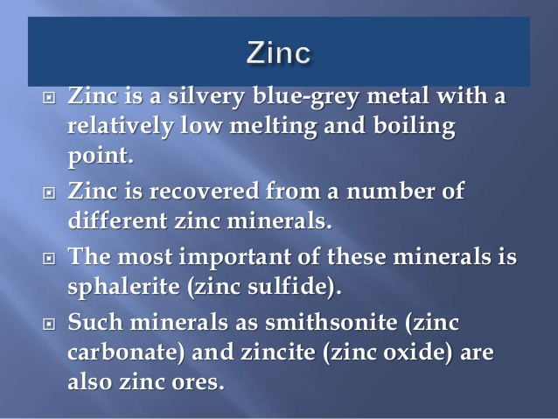

Slide 52


Slide 53


Slide 54


Slide 55


Slide 56


Slide 57


Slide 58


Slide 59


Slide 60


Slide 61


Slide 62


Slide 63


Slide 64


Slide 65

Energy Resources

Slide 66


Slide 67


Slide 68


Slide 69


Slide 70


Slide 71


Slide 72

Solar Energy

Slide 73


Slide 74


Slide 75


Slide 76

Wind Energy

Slide 77


Slide 78


Slide 79


Slide 80


Slide 81


Slide 82


Slide 83


Slide 84


Slide 85


Slide 86


Slide 87


Slide 88


Slide 89


Slide 90


Slide 91


Slide 92


Slide 93


Slide 94


Slide 95


Slide 96


Slide 97


Slide 98

Biofuels

Slide 99


Slide 100


Slide 101


Slide 102


Slide 103

Impact of Exploitation of Natural Resources on Climate

Slide 104


Slide 105


Slide 106


Slide 107


Slide 108


Slide 109


Slide 110


Slide 111


Slide 112


Slide 113
Waste Management
Solid Waste management
West Prevention
Reduce
Reuse
Recycle
Benefits of 3 R’s Principle

Slide 114


Slide 115


Slide 116


Slide 117


Slide 118


Slide 119


Slide 120


Slide 121


Slide 122


Slide 123


Slide 124


Slide 125


Slide 126


Slide 127

Watershed management practices

Slide 128


Slide 129


Slide 130


Slide 131


Slide 132


Slide 133


Slide 134


Slide 135


Slide 136



Slide 137


Slide 138


Slide 139


Slide 140


Slide 141

Contour, gully control

Slide 142

stone bunds

Slide 143

Integrated Watershed Manaement

Slide 144


Slide 145


Slide 146
Integrated Watershed Manaement
Is community approach that works towards improving life of people in that area.
Optimum use of land
Improving employment.
Economic development.
Main aim is to harnessing, conserving and developing degraded natural resources soil, Vegetation cover and water.
Increase productivity of Crops.

Slide 147


Slide 148


Slide 149


Slide 150


Slide 151
Ice-stupa artificial glaciers by Sonam Wangchuk
Ladakh is a trans-Himalayan mountain desert in the extreme north of India with villages located at 2,700m to 4,000m altitudes.
It is a cold desert with winter temperatures touching -30° C, and an average annual rain/snow fall of only 100 mm.
Human settlements are almost always located around glacial streams which feed into the Indus and other rivers as tributaries.
The key to human settlement in this cold desert is the art of diverting water from the streams through meticulously built canals toward deserts to grow crops like barley, wheat, vegetables and trees like apricots, apples, willow and poplar.
Most villages face acute water shortage, particularly during the two crucial months of April and May when there is little water in the streams andall the villagers compete to water their newly planted crops.
By mid-June there is an excess of water and even flash flooding due to the fast melting of the snow and glaciers in the mountains.
By mid-September all farming activities end, and yet a smaller stream flows throughout the winter steadily but wastefully going into the Indus river without being of use to anybody.

Slide 152


Slide 153
Sonam Wangchuk
Ice Stupa is a form of glacier grafting technique that creates artificial glaciers, used for storing winter water (which otherwise would go unused) in the form of conical shaped ice heaps.
During summer, when water is scarce, the Ice Stupa melts to increase water supply for crops.
Ice Stupa was invented by Sonam Wangchuk in Ladakh (India) and the project is undertaken by the NGO Students' Educational and Cultural Movement of Ladakh.
Launched in October 2013, the test project started in January 2014 under the project name The Ice Stupa project.
On 15 November 2016, Sonam Wangchuk was awarded the Rolex Awards for Enterprise for his work on Ice Stupa.

Slide 154


Slide 155


Slide 156


Slide 157


Slide 158

Air Prevention Act- 1981

Slide 159


Slide 160


Slide 161


Slide 162


Slide 163


Slide 164


Slide 165


Slide 166


Slide 167


Slide 168


Slide 169


Slide 170


Slide 171


Slide 172


Slide 173
Role of NGO in Environment Conservation

