Slide 1
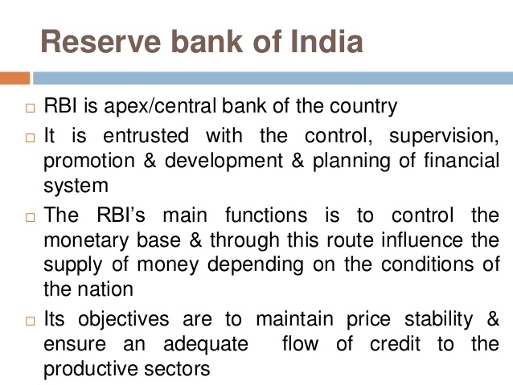

Slide 2
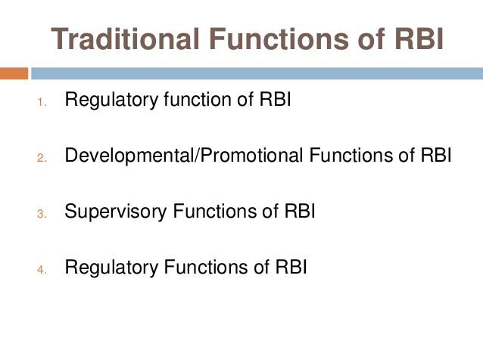

Slide 3
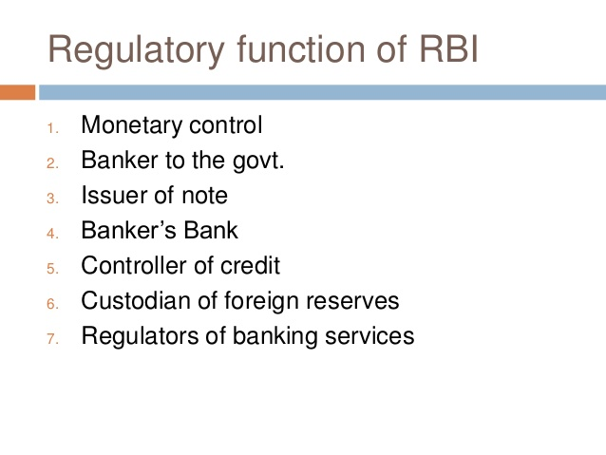

Slide 4
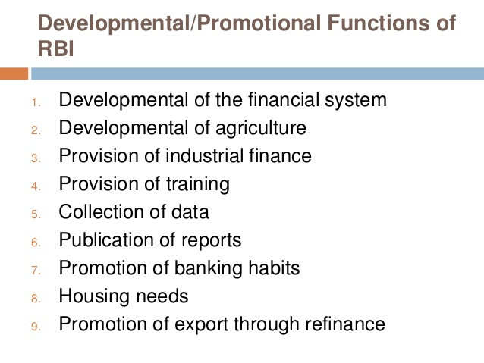

Slide 5
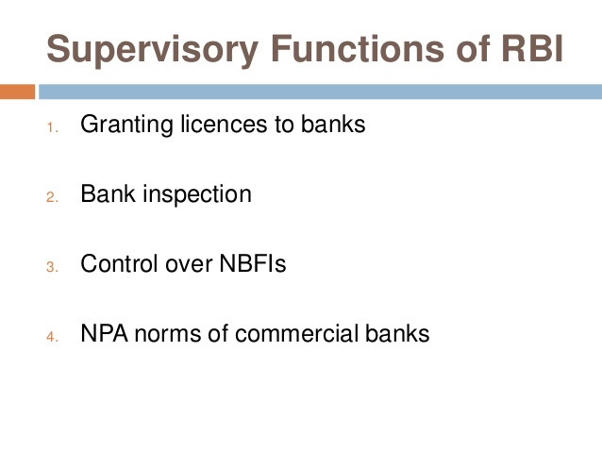

Slide 6
Credit control is an important tool used by Reserve Bank of India, a major weapon of the monetary policy used to control the demand and supply of money (liquidity) in the economy. ... Such a method is used by RBI to bring "Economic Development with Stability".
Quantitative or traditional methods of credit control include banks rate policy, open market operations and variable reserve ratio. Qualitative or selective methods of credit control include regulation of margin requirement, credit rationing, regulation of consumer credit and direct action.

Slide 7
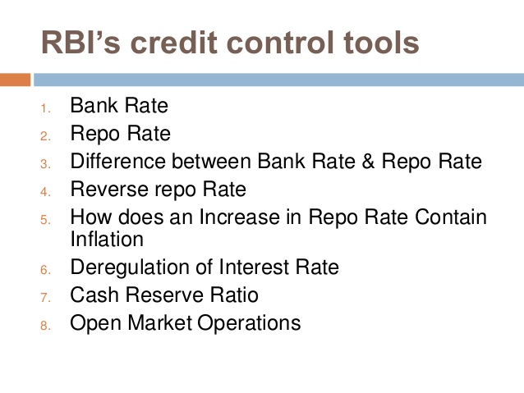
https://www.youtube.com/watch?v=_uomnO0TL6k&feature=youtu.be

Slide 8
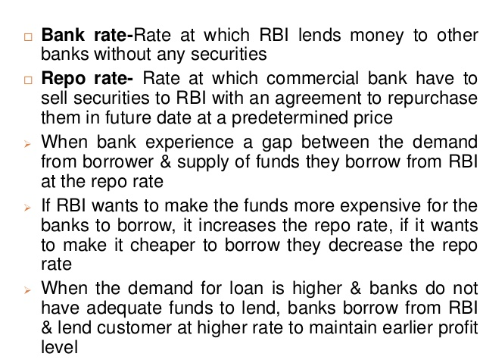

Slide 9
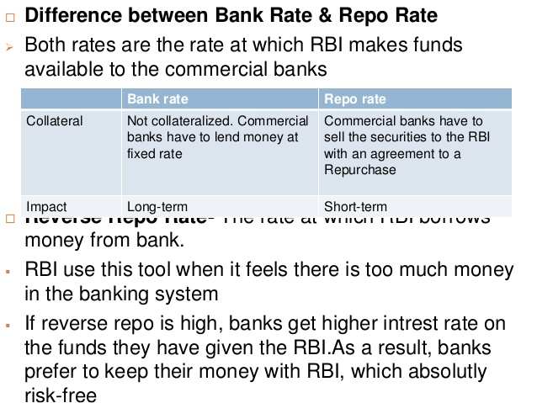

Slide 10
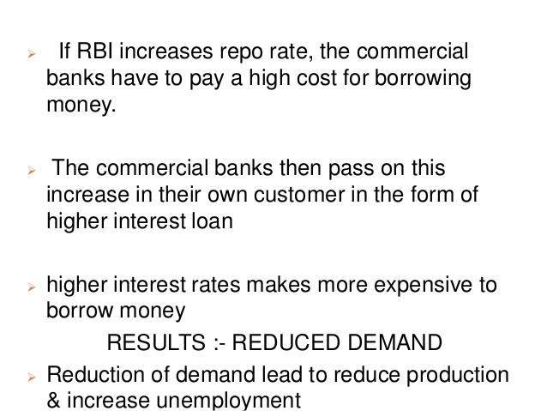

Slide 11
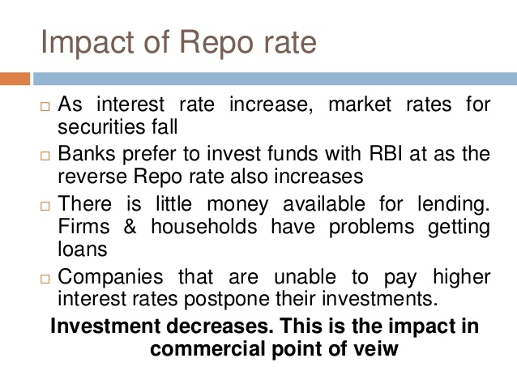

Slide 12
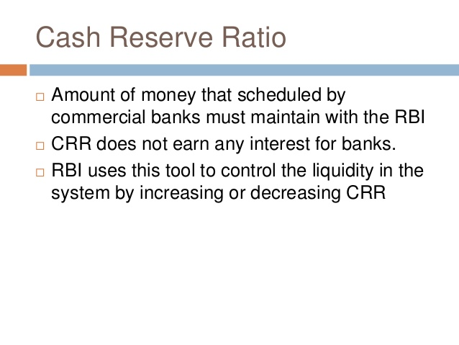
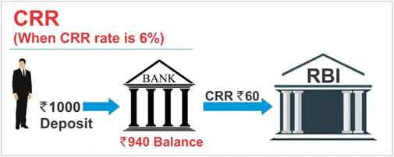
The current CRR is 4%. If RBI cuts CRR in its next monetary policy review then it will mean banks will be left with more money to lend or to invest. So, more money can be released into the economy which may spur economic growth.

Slide 13
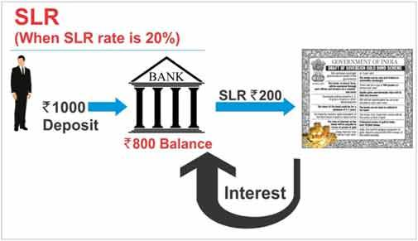
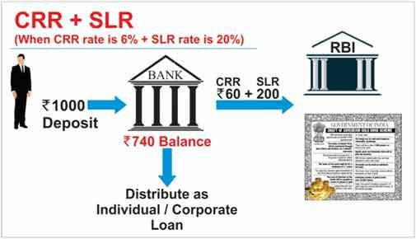
So to meet both CRR and SLR requirements, bank have to earmark Rs 260 (Rs 60 + Rs 200).

Slide 14

What is Repo Rate?
When we need money, we take loans from banks. And banks charge certain interest rate on these loans. This is called as cost of credit (the rate at which we borrow the money).
Similarly, when banks need money they approach RBI. The rate at which banks borrow money from the RBI by selling their surplus government securities to RBI is known as "Repo Rate." Repo rate is short form of Repurchase Rate. Generally, these loans are for short durations up to 2 weeks.
It simply means Repo Rate is the rate at which RBI lends money to commercial banks against the pledge of government securities whenever the banks are in need of funds to meet their day-to-day obligations.
Banks enter into an agreement with the RBI to repurchase the same pledged government securities at a future date at a pre-determined price. RBI manages this repo rate which is the cost of credit for the bank.
Example - If repo rate is 5% , and bank takes loan of Rs 1000 from RBI , they will pay interest of Rs 50 to RBI.
So, higher the repo rate higher the cost of short-term money and vice versa.
Higher repo rate may slowdown the growth of the economy.
If the repo rate is low then banks can charge lower interest rates on the loans taken by us.

Slide 15
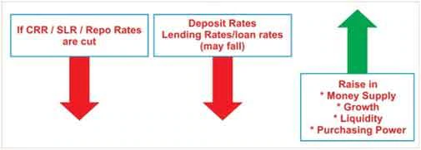
What is Reverse Repo Rate?
Reverse repo rate is the rate of interest offered by RBI, when banks deposit their surplus funds with the RBI for short periods. When banks have surplus funds but have no lending (or) investment options, they deposit such funds with RBI. Banks earn interest on such funds.
Current CRR, SLR, Repo and Reverse Repo Rates:
The current rates are (as of last week of December 2015) - CRR is 4 % , SLR is 21.50%, Repo Rate is 8% and Reverse Repo Rate is 7%.
RBI website has repository of all CRR, SLR & Base Rates
Impact of Repo Rate /CRR/SLR rate cut :
(A term called as "Basis Points" is often used in monetary policy reviews. What is Basis Point? …. 1% is equivalent to 100 basis points.e.g. If Repo Rate is 7.75% and RBI increases it by 25 basis point, then new rate will be 8% as 25 basis point will be equal to 0.25%)

Slide 16
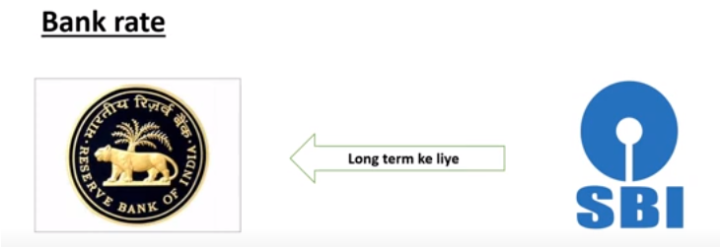
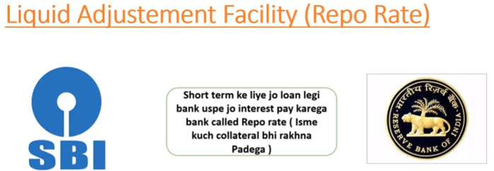

Here are some points on 'how the RBI's rate cuts impact homeloans-
The RBI's rate cuts does not necessarily mean that the borrowers benefit immediately. The landing bank has to reduce its Base Lending rate for EMI to decrease.
These rate cuts will not have any impact on fixed rate home loans or fixed rate consumer loans. The rate of interest is fixed with respect to fixed loans.
The existing bank customers (who have taken loans) can see either their Loan tenures or EMIs coming down. By default the banks reduce the loan tenure instead of loan EMI. That means your monthly EMI installment amount remains the same. The rate cut will make a substantial difference if the remaining loan term/tenure is very long.

Slide 17
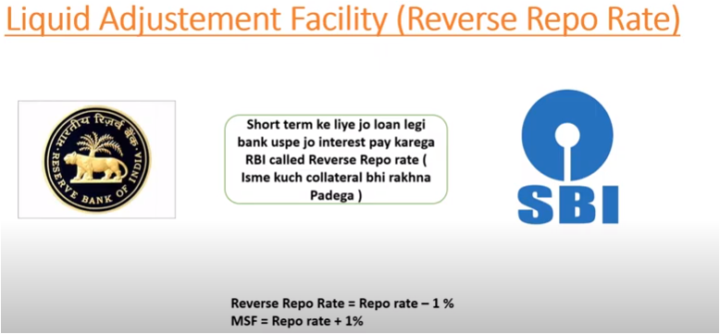
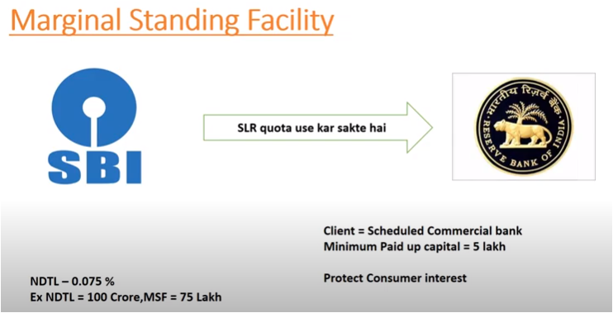

Slide 18
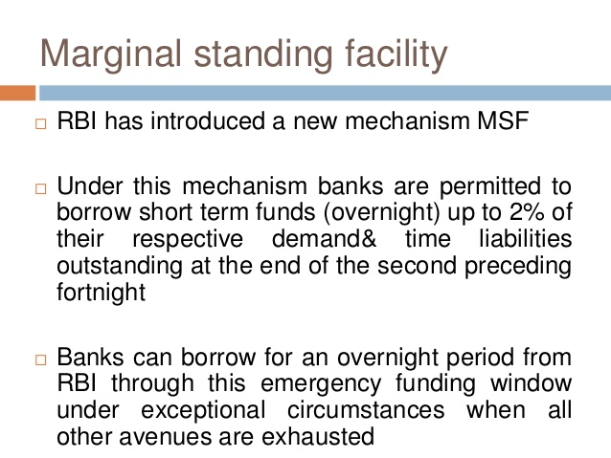

Slide 19
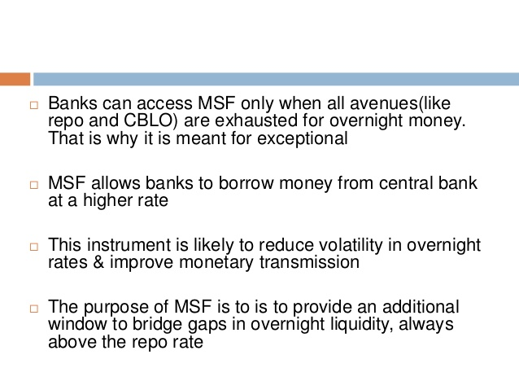
collateralized borrowing and lending obligations

Slide 20
