Slide 1
Thakur College of Science & Commerce
Academic Year – 2020-21
F.Y.B.Sc. Zoology
Semester – I Paper –II
Molecular Basis of Life
Dr. Vitthal T. Mohite

Slide 2
Biomolecules:
Carbohydrates- General classification and functions of: monosaccharides (glucose, ribose and deoxyribose), disaccharides (maltose, lactose and sucrose), polysaccharides (glycogen, starch, cellulose, inulin, and chitin).
Proteins- Amino acids – (structure: glycine, alanine, serine); amino acids as zwitter-ion; examples of acidic, basic, neutral, sulphur containing amino acids; essential and nonessential amino acids; levels of protein structure (primary, secondary, tertiary and quaternary); functions of proteins.
Lipids – classification, structure and functions of fats and oils ​
​
Nucleotides and nucleic acids – structure and functions of DNA, types of RNA. Differences between DNA and RNA

Slide 3
Basics of biochemistry
A. Common elements
Oxygen (O), carbon (C), hydrogen (H), and nitrogen (N) make up 96% of most living organisms.
Trace elements are elements that are necessary, but present in very small quantities.(1% of the body weight)
Sulphur: an important element in some amino acids.
Calcium: used during nerve impulses
Iron: found in hemoglobin (oxygen transport protein)
Sodium: needed for a nerve impulse
Phosphorus: in cell membrane structures and DNA

Slide 4
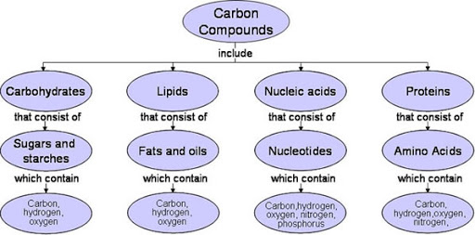

Slide 5
Introduction
Micromolecules. A molecule that is relatively smaller (than a macromolecule), or of low molecular weight that may regulate a biological process. Supplement.
Macromolecules are large molecules composed of thousands of covalently connected atoms. Carbohydrates, lipids, proteins, and nucleic acids are all macromolecules.
Macromolecules are formed by many monomers linking together, forming a polymer.

Slide 6
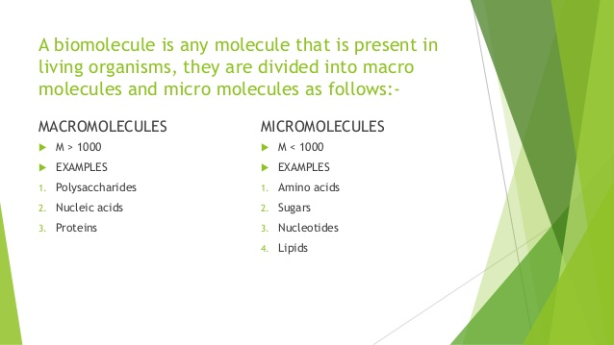

Slide 7
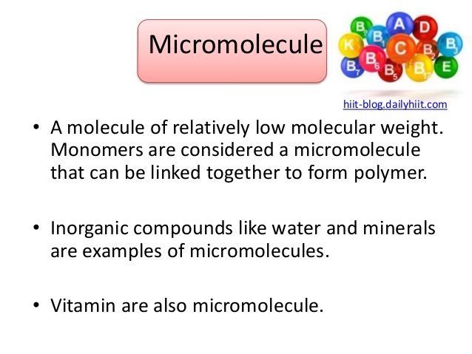

Slide 8
Monomers
A monomer is a molecule that forms the basic unit for polymers, which are the building blocks of proteins.
Monomers bind to other monomers to form repeating chain molecules through a process known as polymerization.
Monomers may be either natural or synthetic in origin.
Monomer, a molecule of any of a class of compounds, mostly organic, that can react with other molecules to form very large molecules, or polymers.
The essential feature of a monomer is polyfunctionality, the capacity to form chemical bonds to at least two other monomer molecules.
Examples
Nucleic acids, amino acids, α&β glucose, fructose, fatty acids and glycerol are all examples of monomers.

Slide 9
Polymers
Polymers are materials made of long, repeating chains of molecules.
The materials have unique properties, depending on the type of molecules being bonded and how they are bonded.
Some polymers bend and stretch, like rubber and polyester.
Others are hard and tough, like epoxies and glass.

Slide 10
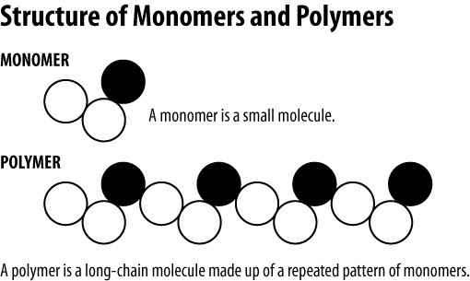

Slide 11
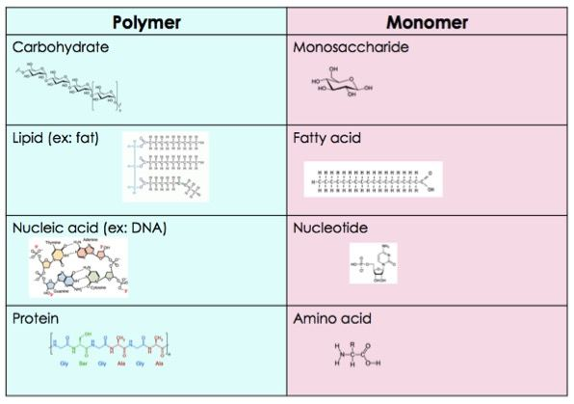

Slide 12
Examples of Polymeres
Examples of naturally occurring polymers are silk, wool, DNA, cellulose and proteins.
In our previous section on network polymers, we mentioned vulcanized rubber and pectin.
Vulcanized rubber is a synthetic (man-made) polymer, while pectin is an example of a natural polymer.

Slide 13
Significance of Carbon
A compound found mainly in living things is known as an organic compound.
Organic compounds make up the cells and other structures of organisms and carry out life processes.
Carbon is the main element in organic compounds, so carbon is essential to life on Earth.
Without carbon, life as we know it could not exist.
Energy: by breaking down carbon molecules, energy is released which can drive various cellular processes.
Production: carbon molecules consumed are restructured to form useful biomolecules for the organism to thrive and grow.
A compound is a substance that consists of two or more elements.
A compound has a unique composition that is always the same.
The smallest particle of a compound is called a molecule.
Consider water as an example.
A molecule of water always contains one atom of oxygen and two atoms of hydrogen.
The composition of water is expressed by the chemical formula H₂O.

Slide 14
Proteins
Proteins are macromolecules formed by amino acids.
Proteins are large size molecules (macromolecules), polymers of structural units called amino acids.
A total of 20 different amino acids exist in proteins and hundreds to thousands of these amino acids are attached to each other in long chains to form a protein.
Proteins perform a vast array of functions within organisms, including catalysing metabolic reactions, DNA replication, responding to stimuli, providing structure to cells and organisms, and transporting molecules from one location to another.
Proteins differ from one another primarily in their sequence of amino acids, which is dictated by the nucleotide sequence of their genes, and which usually results in protein folding into a specific 3D structure that determines its activity.

Slide 15
Amino Acids
Amino acids are organic compounds that contain amine (–NH₂) and carboxyl (–COOH) functional groups, along with a side chain (R group) specific to each amino acid.
The key elements of an amino acid are carbon (C), hydrogen (H), oxygen (O), and nitrogen (N), although other elements are found in the side chains of certain amino acids.
Amino acids are organic compounds that combine to form proteins.
Amino acids and proteins are the building blocks of life.
When proteins are digested or broken down, amino acids are left.
The human body uses amino acids to make proteins to help the body: Break down food.

Slide 16
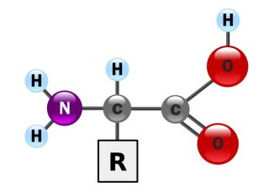
Amino Acid Structure

Slide 17
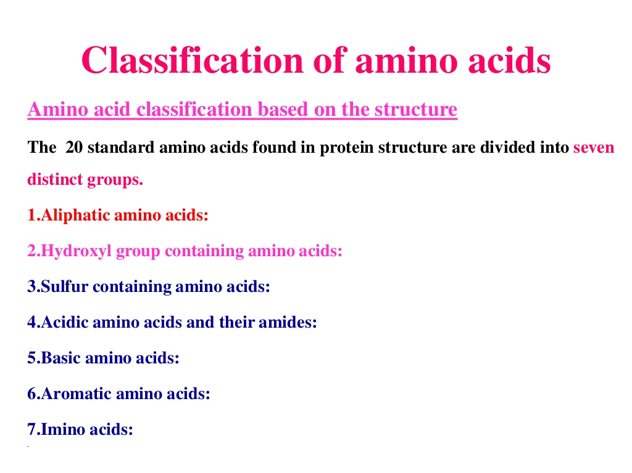

Slide 18
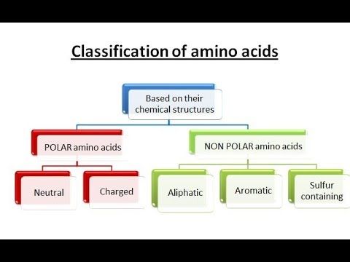

Slide 19
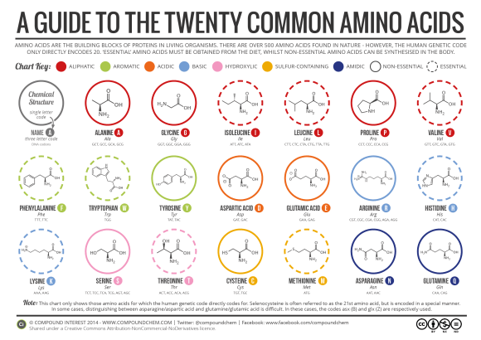

Slide 20
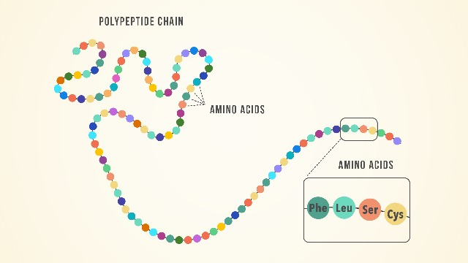

Slide 21
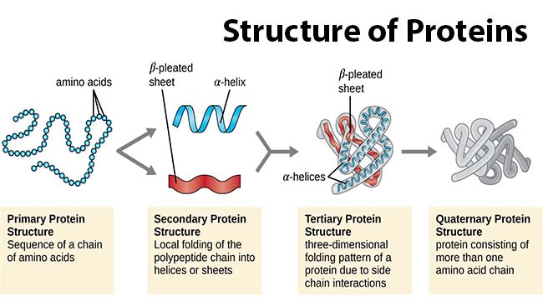

Slide 22
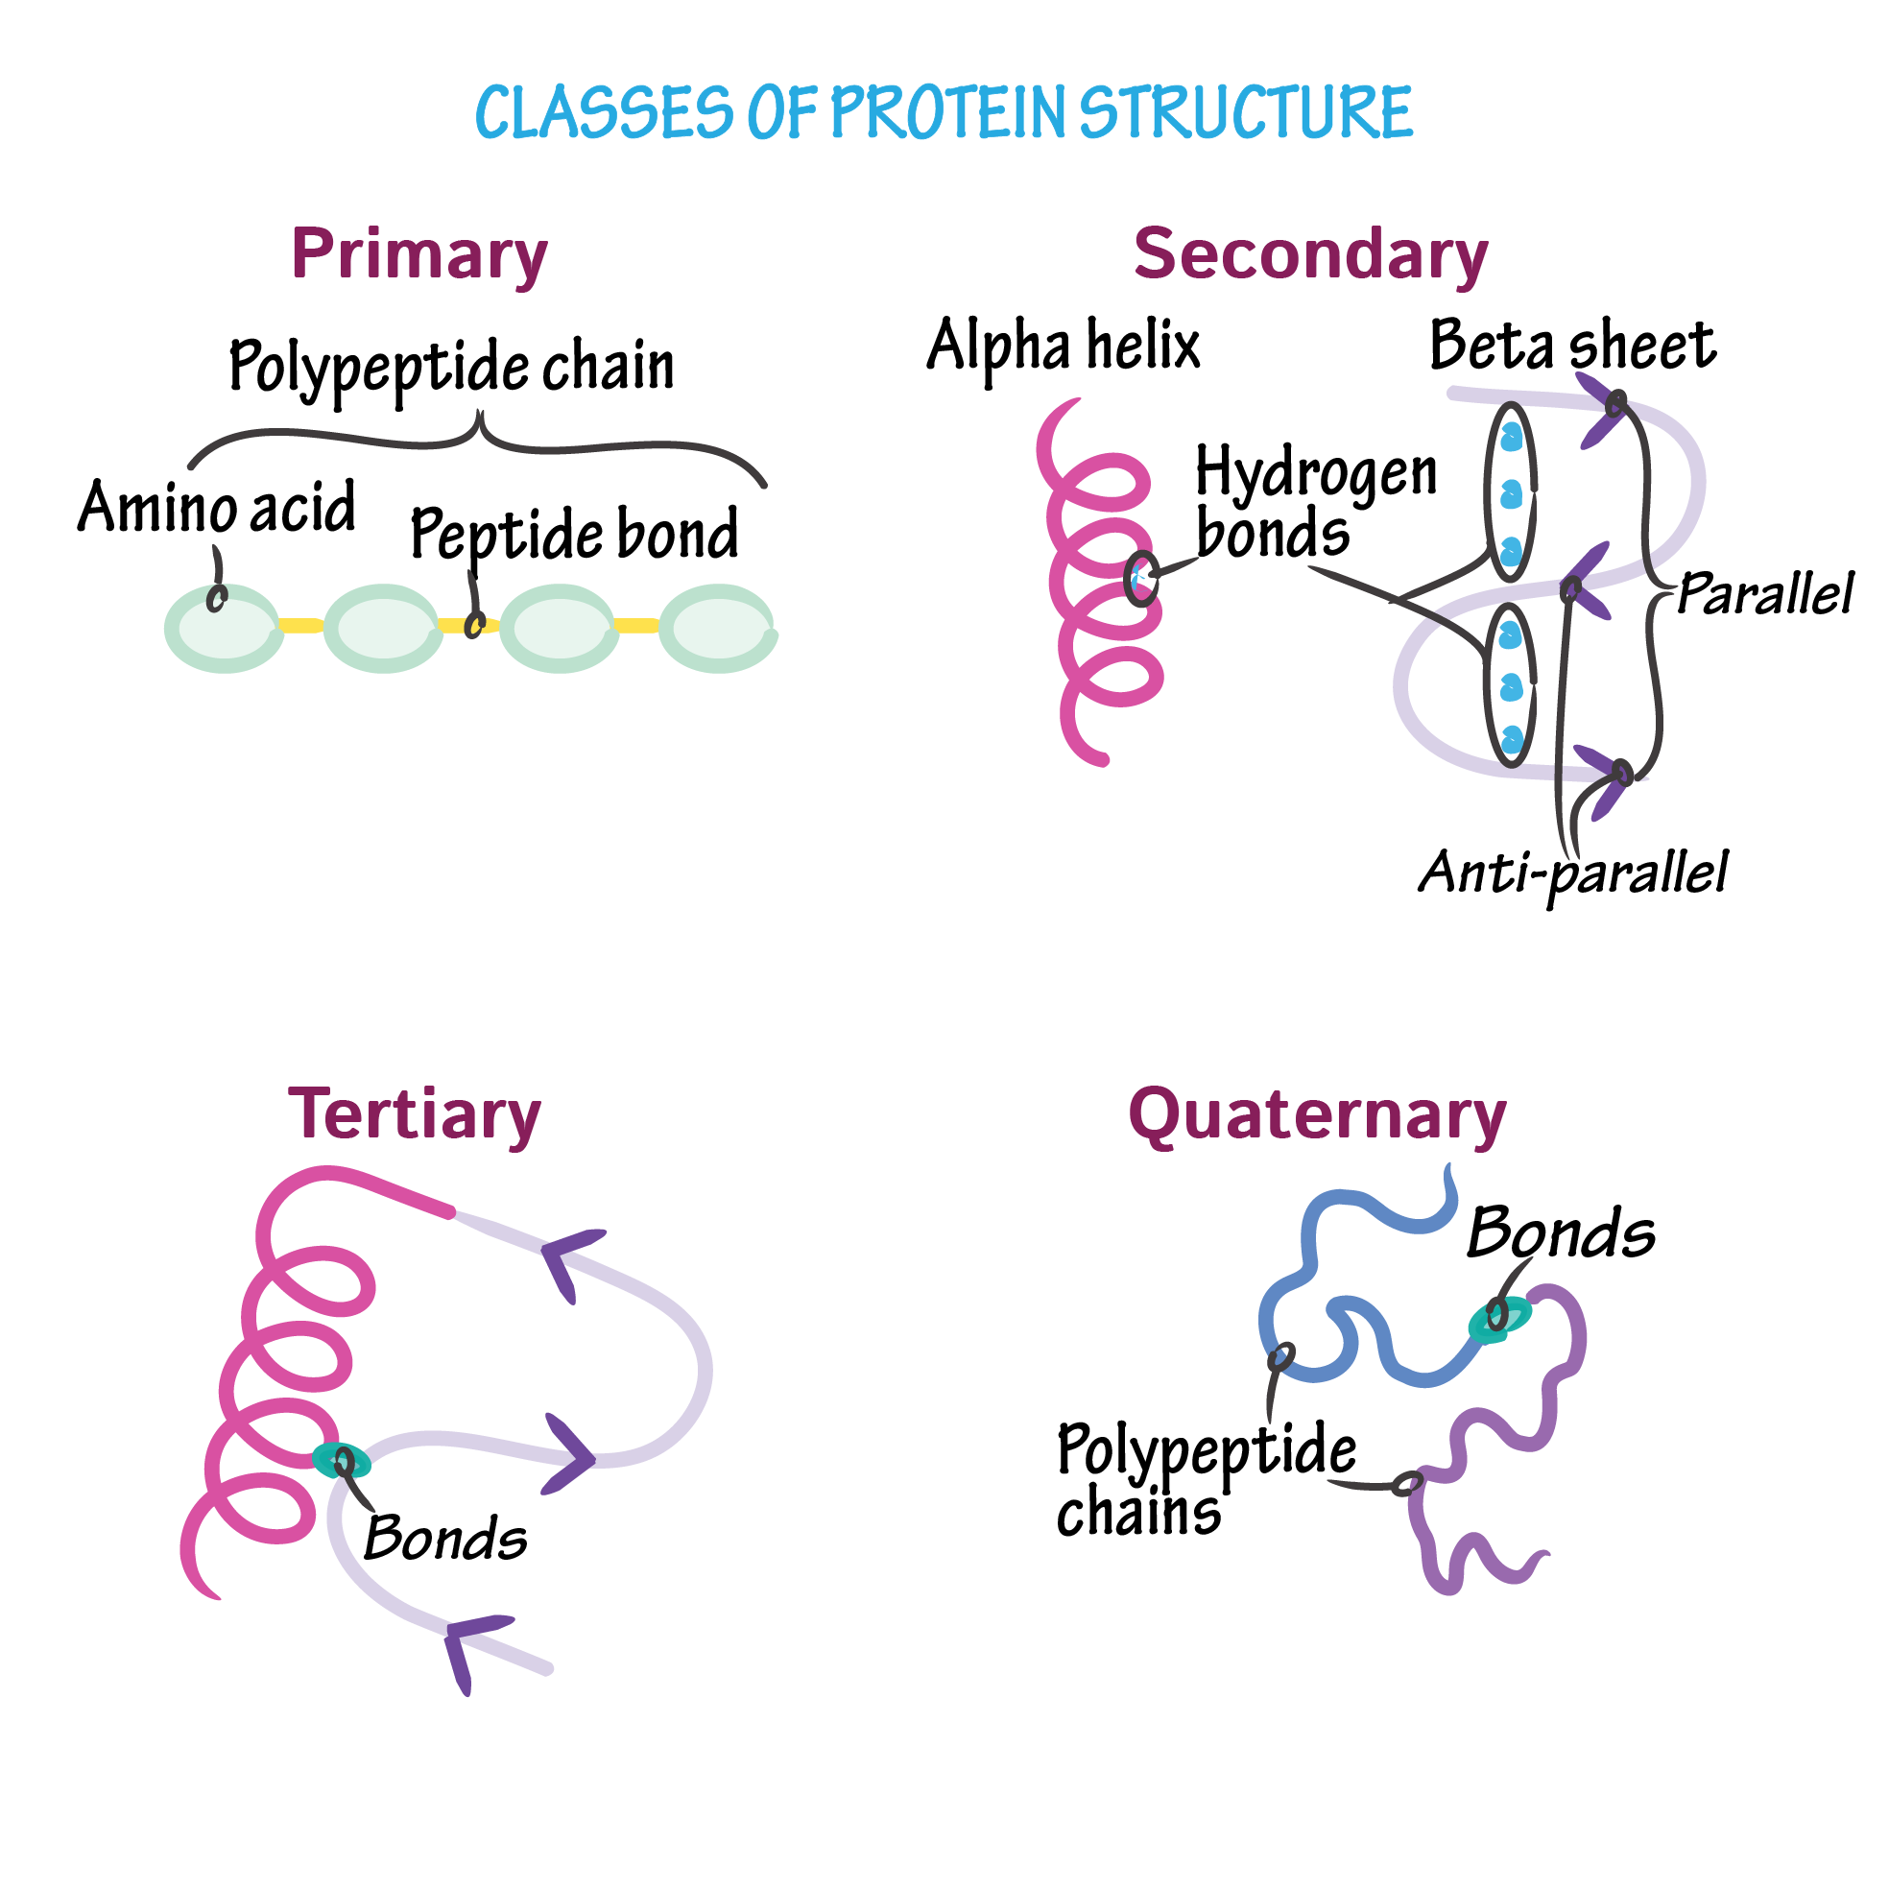

Slide 23
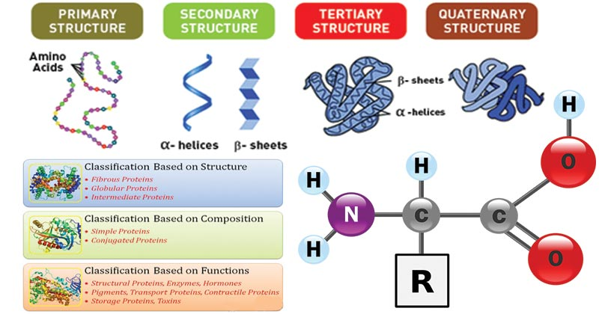

Slide 24
Peptide bond
A peptide bond is a chemical bond formed between two molecules when the carboxyl group of one molecule reacts with the amino group of the other molecule, releasing a molecule of water (H2O).
The bond that holds together the two amino acids is a peptide bond, or a covalent chemical bond between two compounds.
It occurs when the carboxylic group of one molecule reacts with the amino group of the other molecule, linking the two molecules and releasing a water molecule.
The peptide bond is also referred to as the isopeptide bond where the amide bond forms between the carboxyl group of one amino acid and the amino group of another amino acid at other positions than the alpha.
The process of formation of the peptide bond is an example of a condensation reaction resulting in dehydration (removal of water).
Peptide bonds are covalent bonds that exist between any two amino acids resulting in a peptide chain.
A partial double bond exists between carbon and nitrogen of the amide bond which stabilizes the peptide bond.

Slide 25
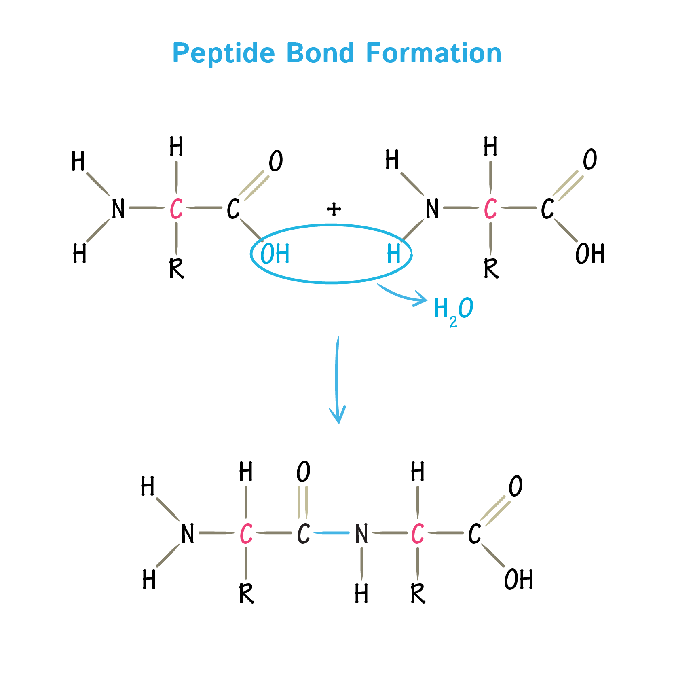
Peptide Bonds

Slide 26
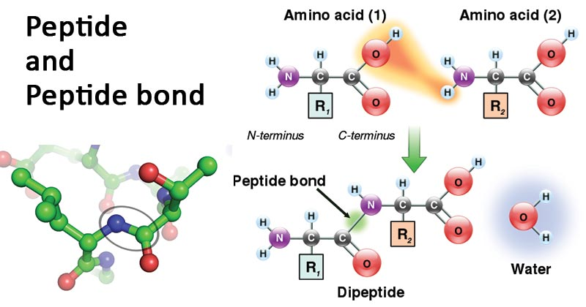

Slide 27
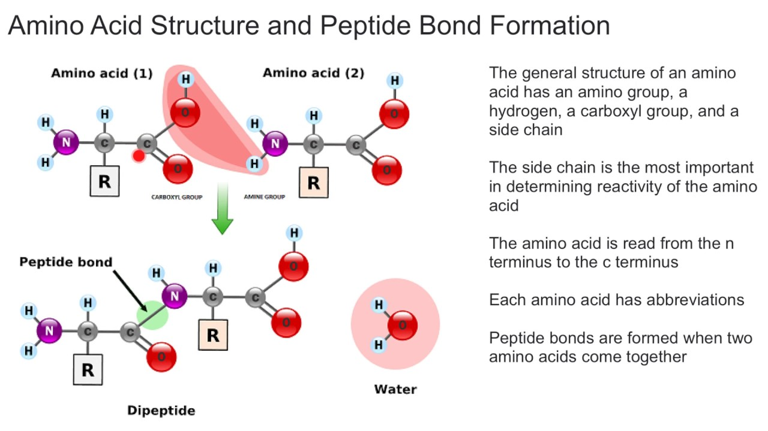

Slide 28
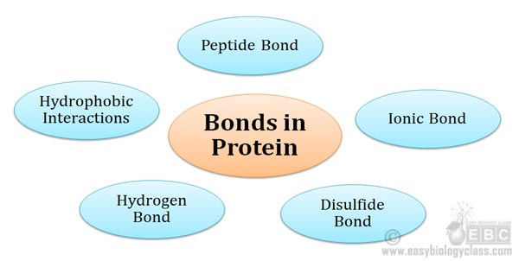

Slide 29
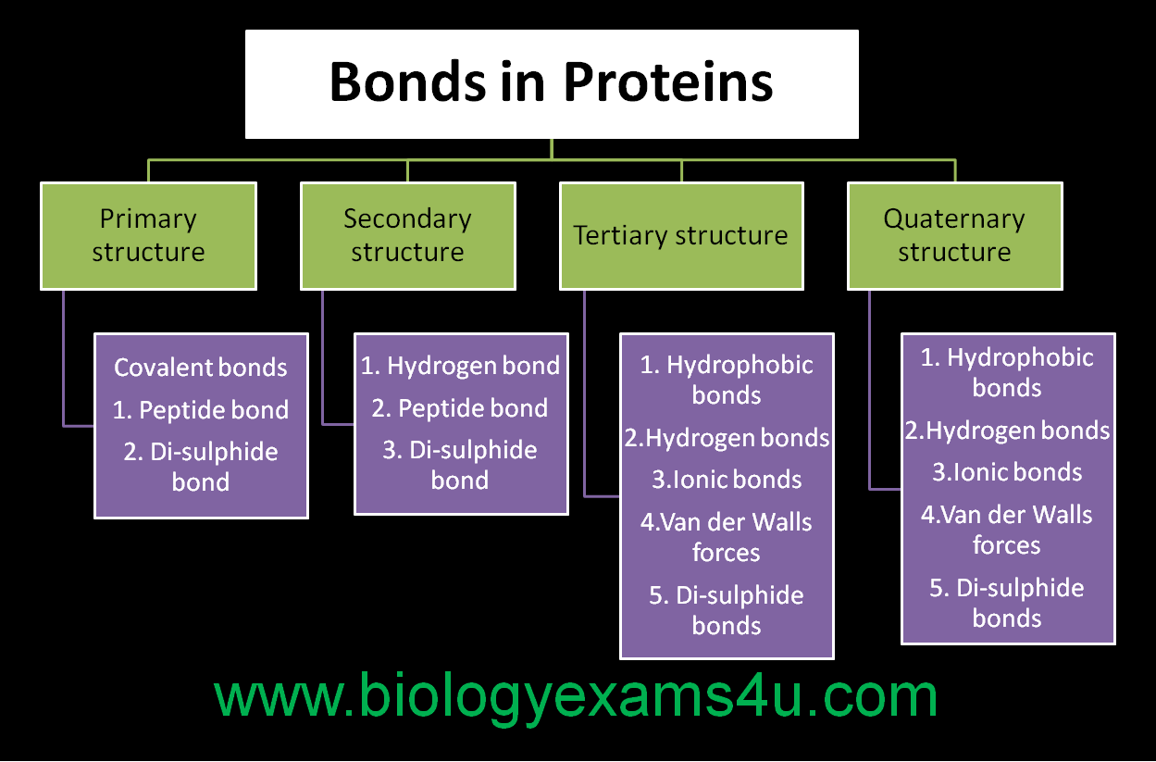

Slide 30
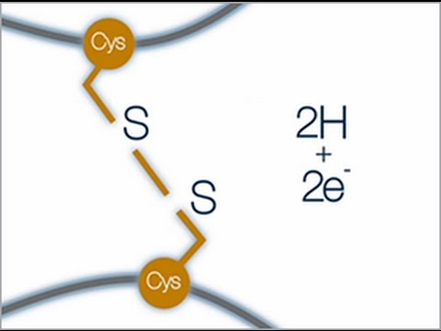

Slide 31
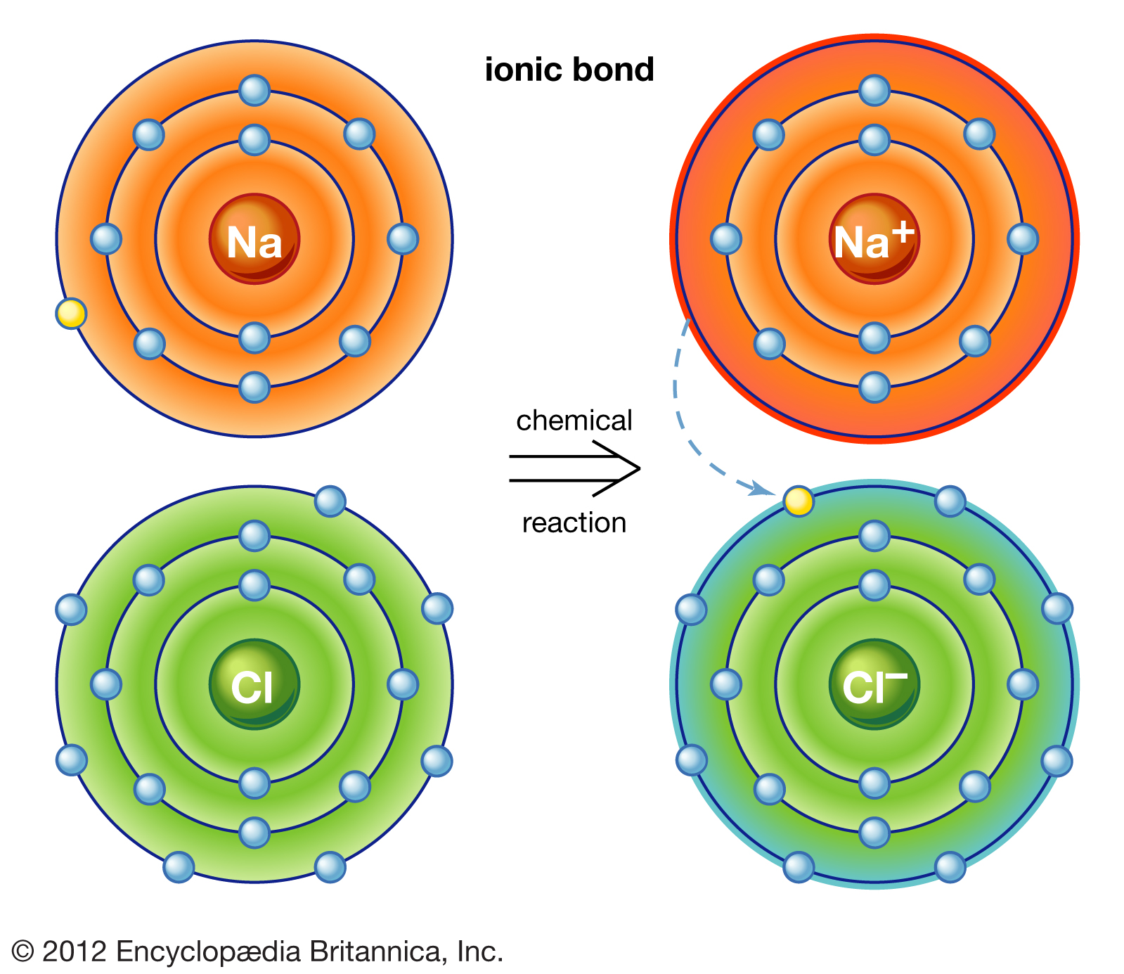

Slide 32
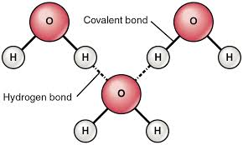

Slide 34
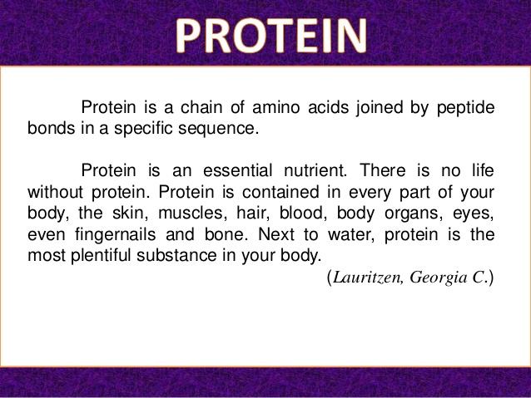

Slide 35
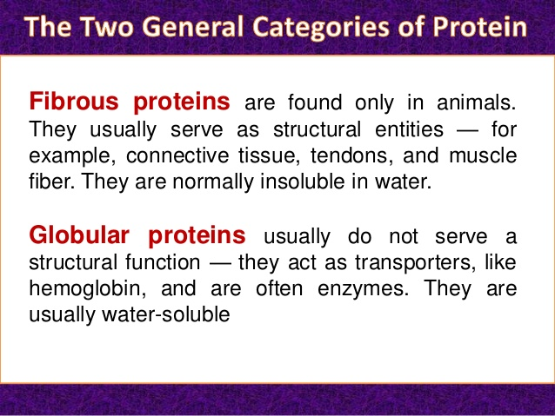

Slide 36
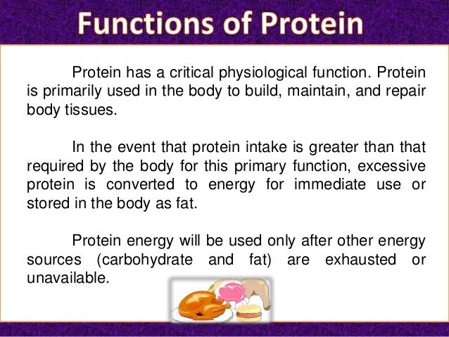

Slide 37
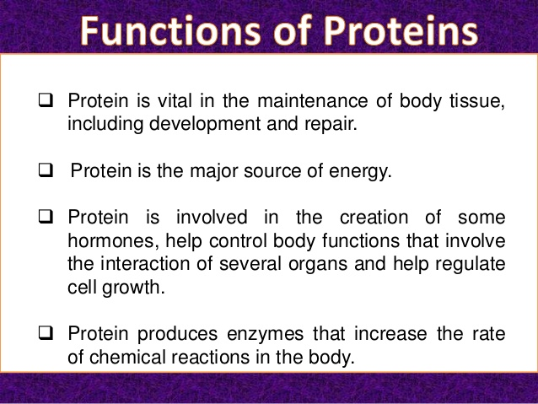

Slide 38
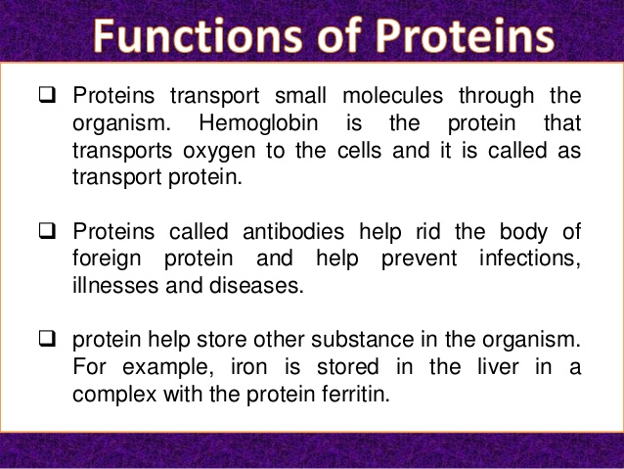

Slide 39
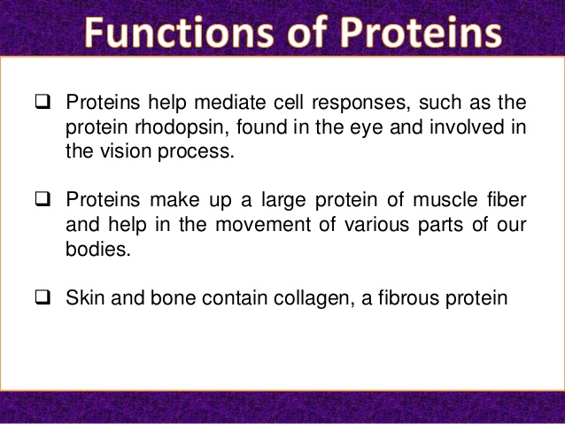

Slide 40
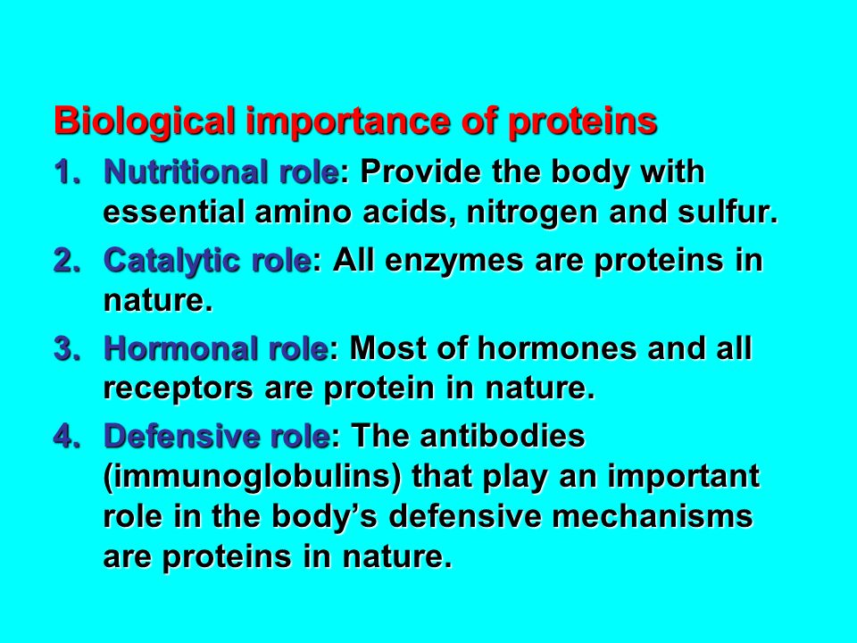

Slide 41
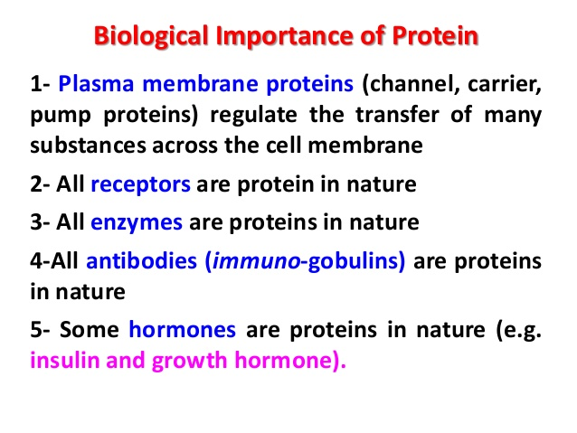

Slide 42
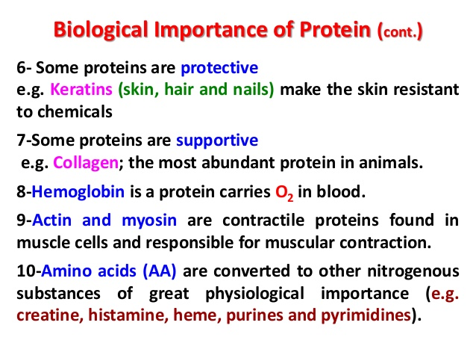

Slide 43
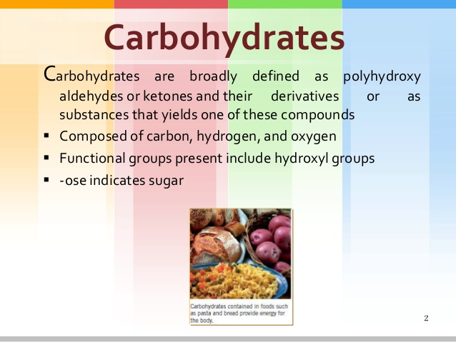

Slide 44
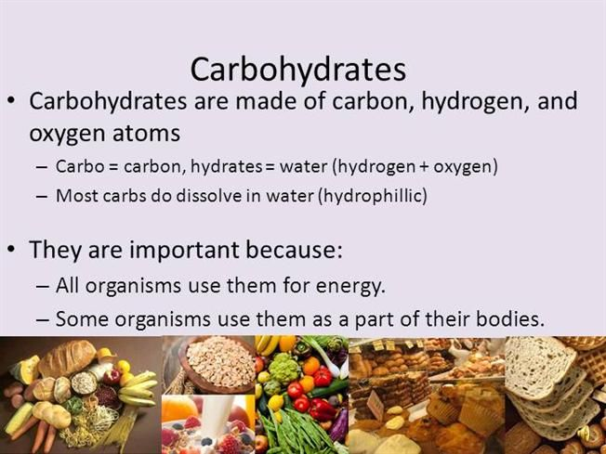

Slide 45
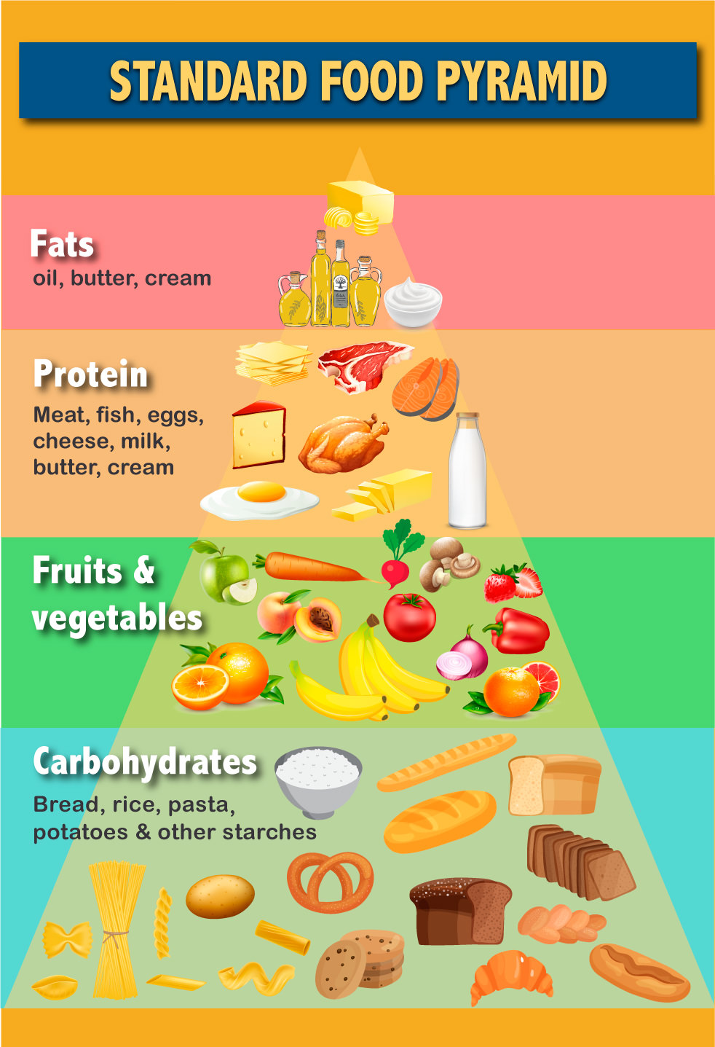

Slide 46
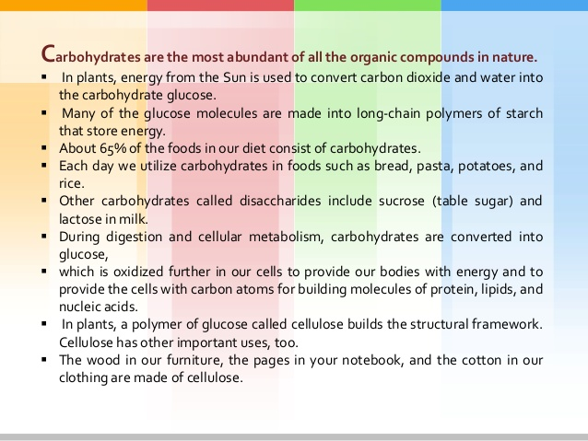

Slide 47
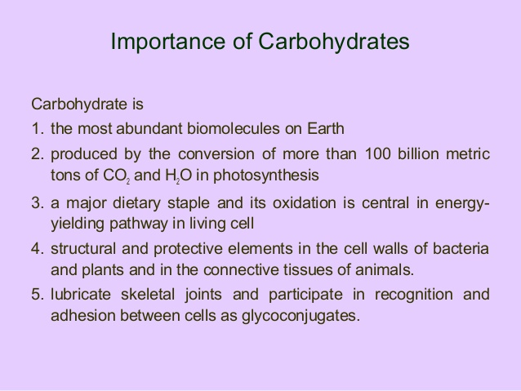

Slide 48
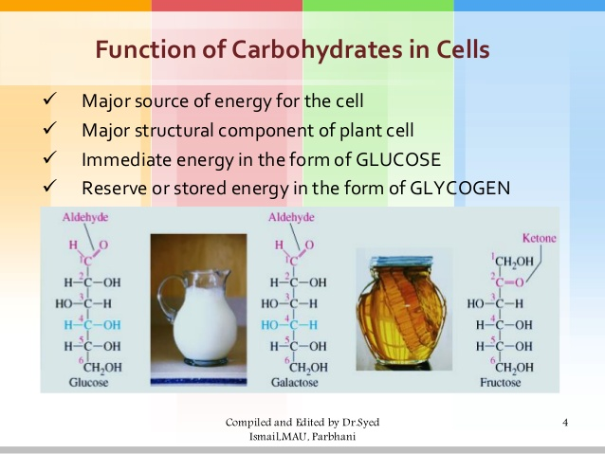

Slide 49
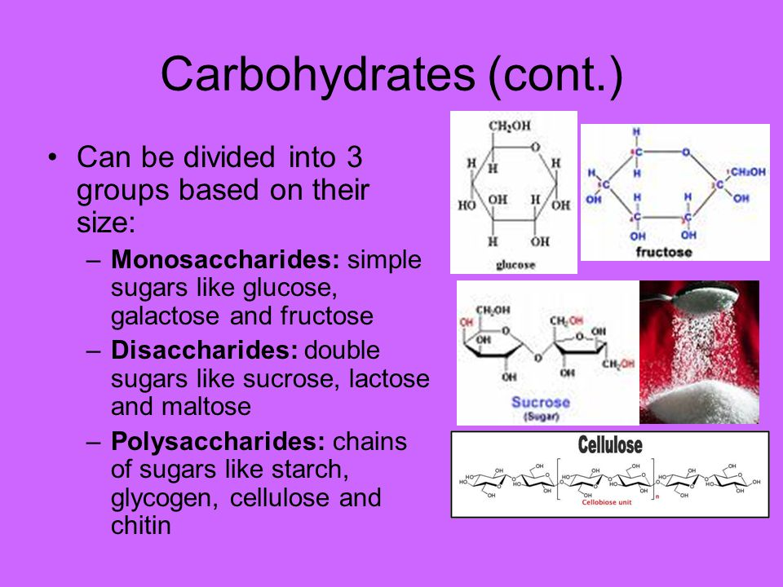

Slide 50
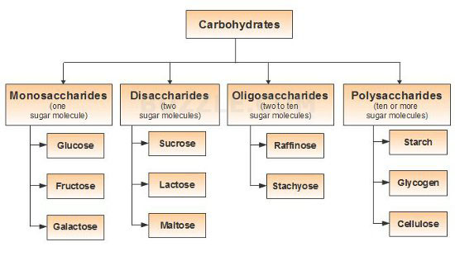

Slide 51
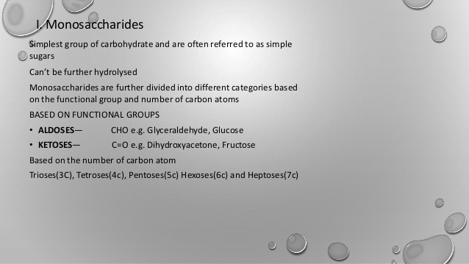

Slide 52
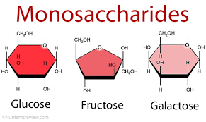
Examples

Slide 53
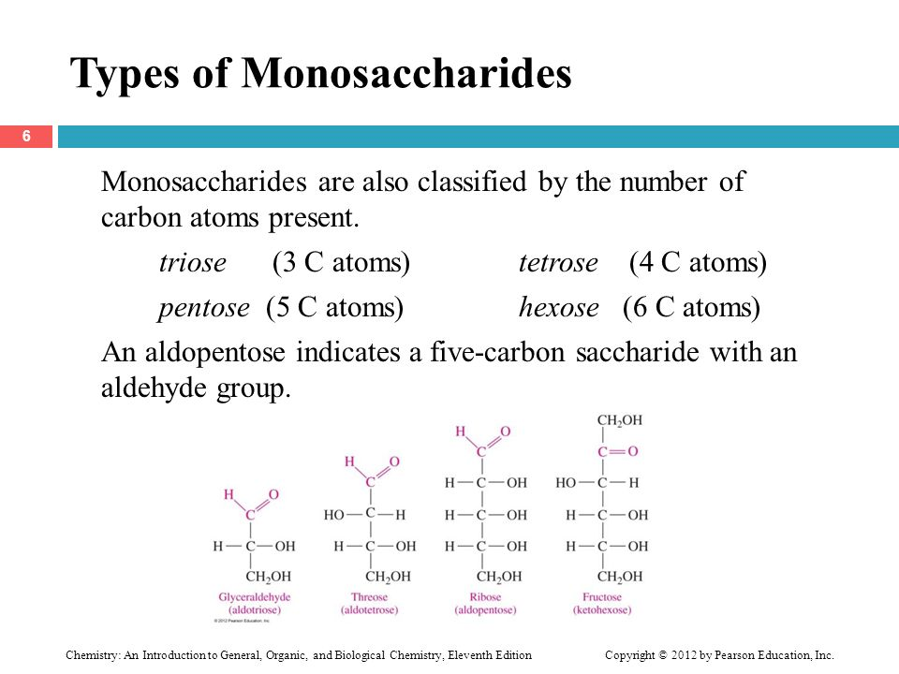

Slide 54
Disaccharides
A disaccharide is the sugar formed when two monosaccharides are joined by glycosidic linkage.
Like monosaccharides, disaccharides are simple sugars soluble in water.
Three common examples are sucrose, lactose, and maltose.
In your body, a disaccharide function is to provide your body with a quick source of energy.
Because they're only made up of two sugar molecules, they're easily broken down by enzymes in your digestive system into their respective monosaccharides and then absorbed into your bloodstream.

Slide 55
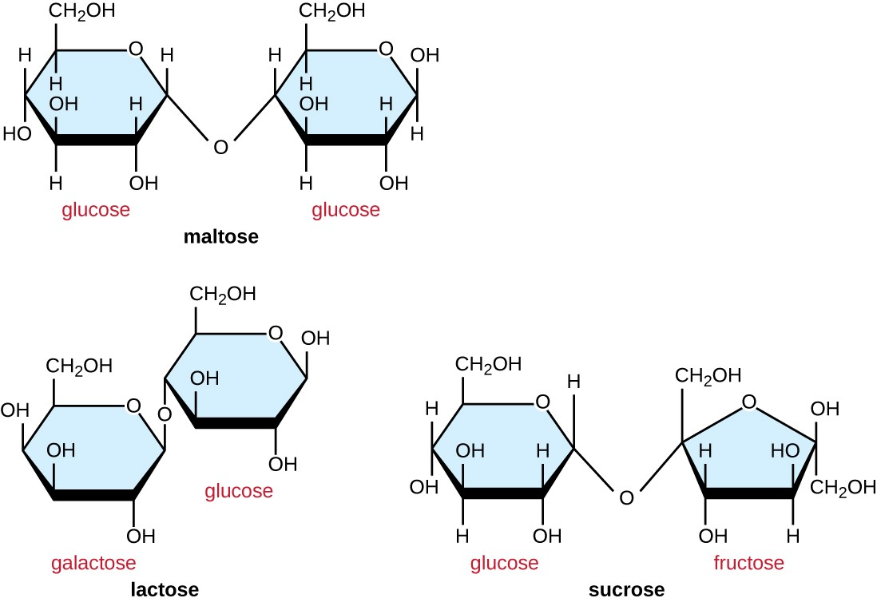

Slide 56
Oligosaccharide
Oligosaccharides are a type of carbohydrate formed when three to 10 simple sugars are linked together.
1﻿ Small amounts occur naturally in many plants, but chicory root and Jerusalem artichokes (the root of a member of the sunflower family) have the most oligosaccharides.

Slide 57
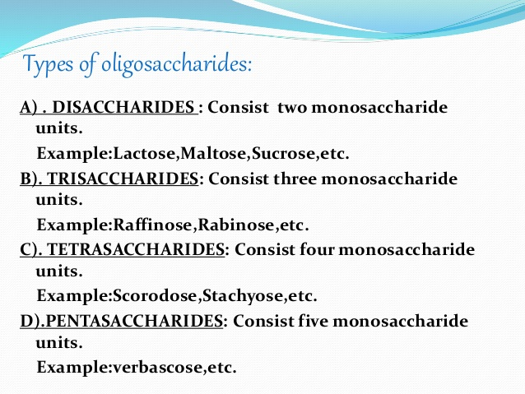

Slide 58
Polysaccharide
A polysaccharide is a large molecule made of many smaller monosaccharides.
Monosaccharides are simple sugars, like glucose. Special enzymes bind these small monomers together creating large sugar polymers, or polysaccharides.
A polysaccharide is also called a glycan.

Slide 59
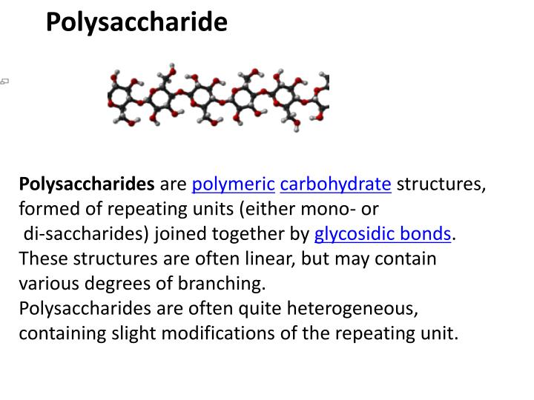

Slide 60
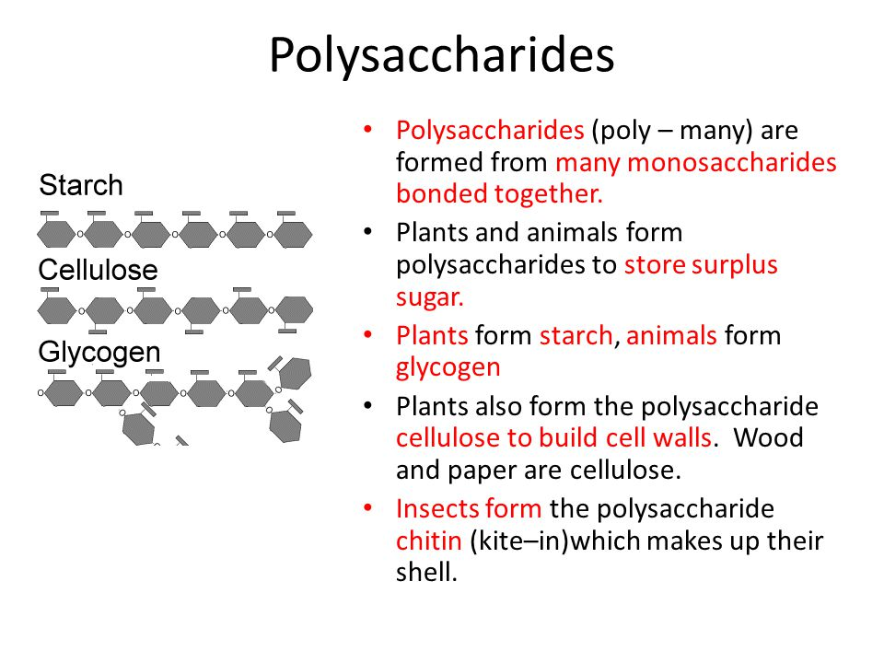

Slide 61
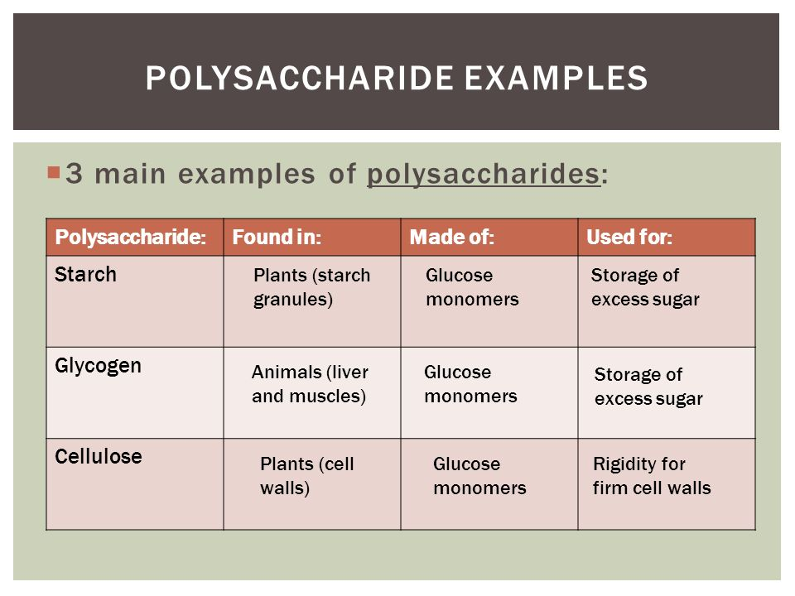

Slide 62
Isomers
Isomers are molecules or polyatomic ions with identical molecular formulas — that is, same number of atoms of each element — but distinct arrangements of atoms in space. Isomerism is existence or possibility of isomers.
Isomers do not necessarily share similar chemical or physical properties.

Slide 63
