Slide 1
TQM

Slide 2

Total – made up of the whole.
Quality – degree of excellence a product or services provides.
Management – act, art or manner of planning, organising, directing & controlling.
Therefore, TQM is the art of managing the whole to achieve excellence.

Slide 3




The concept of TQM

Slide 4
TQM - DEFINATION
ACCORDING TO INTERNATIONA ORGANIZATION FOR STANDARDS DEFINED TQM AS, “TQM is a management approach for an organization, centered on quality, based on the participation of all its members and aiming at long- term success through customer satisfaction and benefits to all members of the organisation and the society”

Slide 5
IMPORTANCE OF TQM
Provide customer satisfaction
Improves quality
Absence of additional investments
Raise competitiveness
Facilitate expansion and diversification
Provide highly trained and motivated employees

Slide 6
PRINCIPLES OF TQM
CUSTOMER FOCUS
CONTINUOUS IMPROVEMENT
INVOLVEMENT OF EMPLOYEES
QUALITY MANAGEMENT SYSTEM
TRAINING AND EDUCATION

Slide 7
PRINCIPLES OF TQM
COST OF QUALITY
QUALITY IMPROVEMENT TEAMS
KEEP PRODUCTION PROCESS FAULT-FREE
REMOVE HUMAN ERRORS
MEASUREMENT OF PERFORMANCE

Slide 8
FEATURES OF TQM
STRESS ON QUALITY MANAGEMENT
CONTINUOUS PROCESS
STRESS ON QUALITY ASSURANCE SYSTEM
LINKAGE OF QUALITY AND PRODUCTIVITY
GRADUAL PROCESS
EMPLOYEE’S INVOLVEMENT
FORMATION OF QUALITY IMPROVEMENT TEAMS
MANAGEMENTS INVOLVEMENT

Slide 9
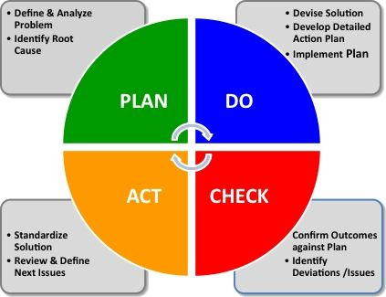

Slide 10
CASE STUDY
A QUALITY EDUCATION: RAMAIAH INSTITUTE OF MANAGEMENT STUDIES

Slide 11
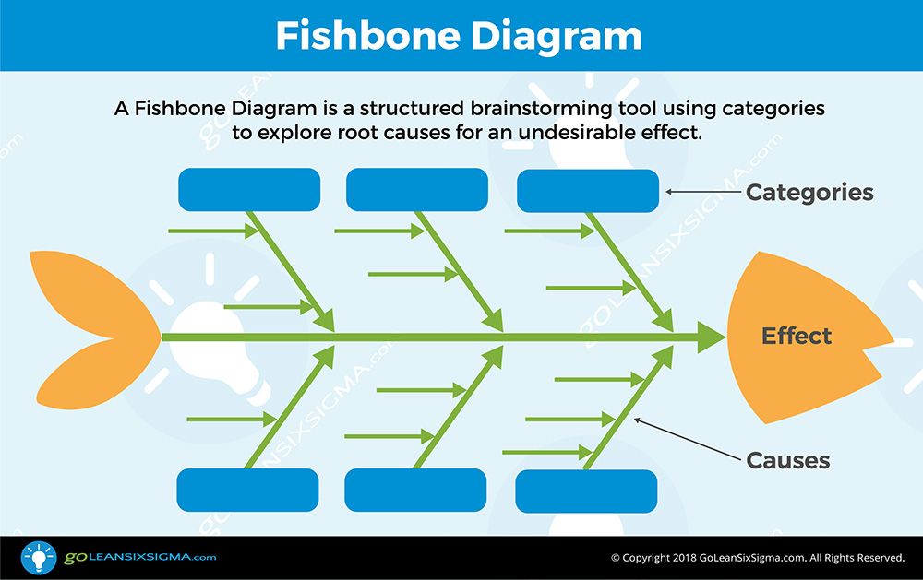

Slide 12
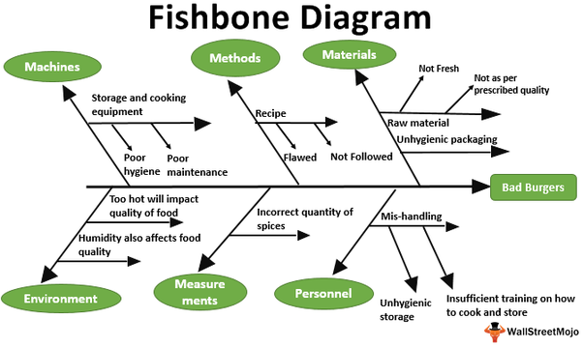

Slide 13


Slide 14


