Slide 1
Thakur College of Science & Commerce
Department of Zoology
Welcomes
Academic Year – 2020-21
(Paper – III Unit- III)
Dairy Science
Dr. Vitthal T. Mohite
Head, Department of Zoology

Slide 2
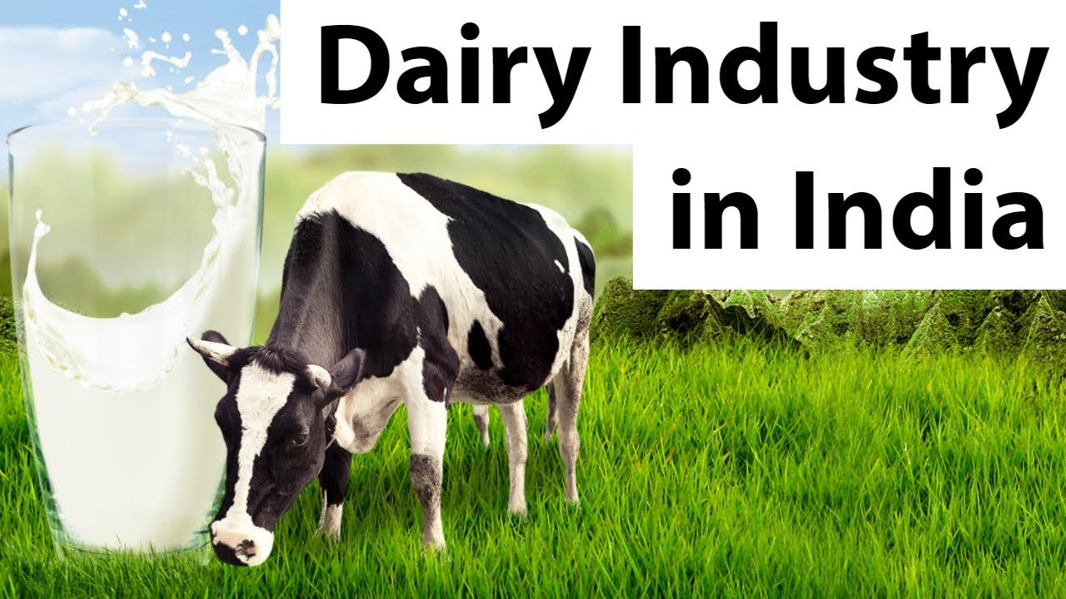
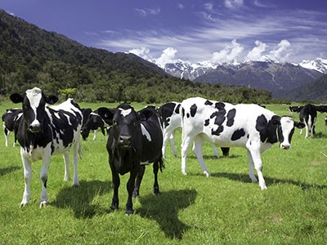
Introduction
Dairy Science – production & marketing milk & milk product.
Great economic importance in India.
Majority of population depend on milk for their protein supplement,.
Milk id used as complete diet.
Cattle production worldwide – 877 millions.
Asia-278 & in India 178 million in 1955.
Presently Milch animals ( Cow & Buffalo ) 118.59 millions.
Earlier it was subsidiary income source to agriculture.
Now it is considered as Industry.
Dairy industry flourishing due to advanced technology.

Slide 3
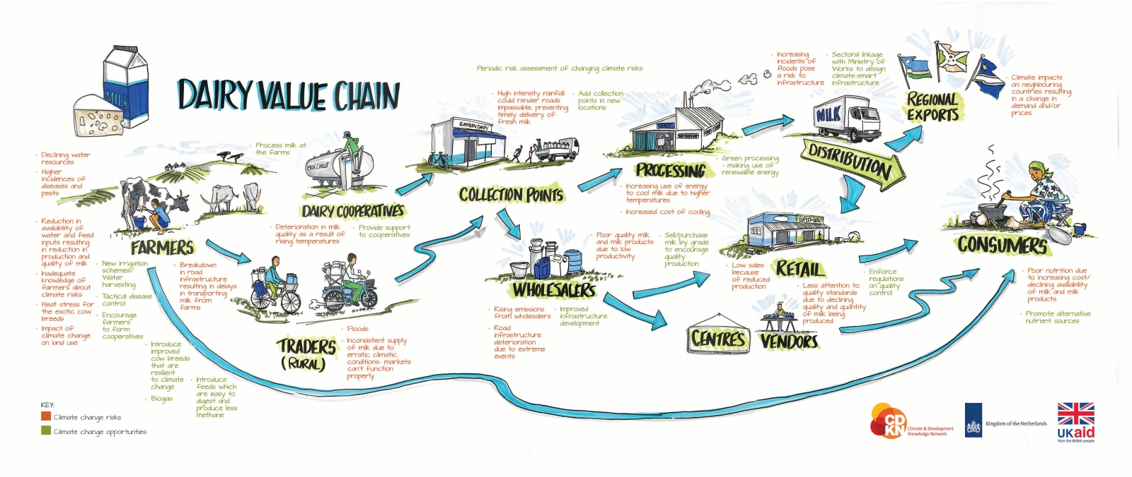

Slide 4
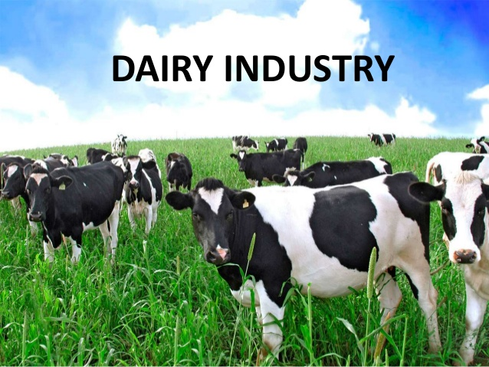
Dairy Development in India
Milk is produced in rural area by the farmers.
Large number of byproducts are produced.
90% of Milk is processed.
Large amount of milk powder is used for toned milk.
Dairy industry gives employment opportunities to the youth of India.
Dairy sector has been instrumental in bringing socio-economic transformation.
There exists a symbiotic relationship between agriculture and livestock farming.
The agriculture byproducts provide feed and fodder for cited whereas cattle provides manure, draught power for various agricultural operations.
It is the back-bone of India’s economy in the form of income, employment and foreign exchange earning.

Slide 5
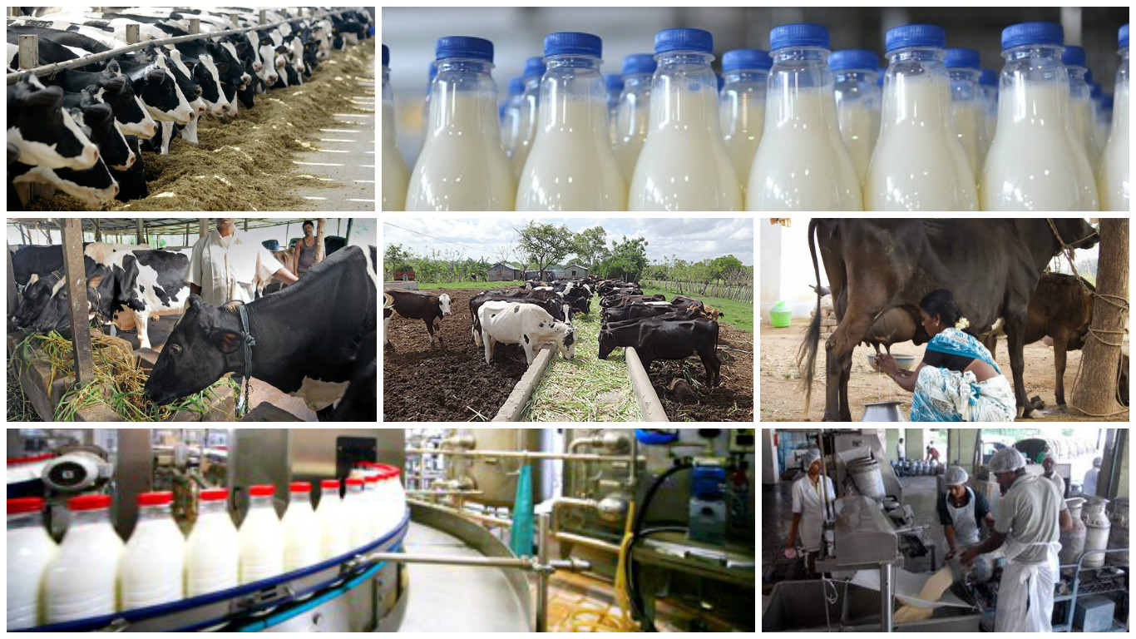
White Revolution in India
Began in India with the efforts by Dr. Verghese Kurien in Gujarat in 1946.
Largest Co-operative Amul dairy enterprise in Asia.
Name Gujarat Co-0perative Milk Marketing Federation ( GCMMF)
Turn over in 2015-16 is 23005 Cr , planned to increase by double in 2020.
Per day processing capacity is 281 lakh liters per day with 60 processing plants.
36 lakh farmers from 18600 villages are involved in this business.
They are having their plants in Haryana, U.P., M.P., W.B., Maharashtra, & Rajasthan.
Milk production in India 187.9 million tones.

Slide 6
Role of Institutions in Dairy Development
National Dairy Research Institute, Karnal
National Dairy Development Board (NDDB), Min. of Agriculture.
Every State having separate Ministry Dairy Development & Animal Husbandry.
Developed Excellent cattle breed like Sahiwal, Rathi, Gir, Red Sindhi.
Buffalo Murrah, Mehsana and Jaffarabadi.
Exotic breeds also tried Jarsi, Hostelian.
India’s milk production in 2019-20 is 187.9 million tones.

Slide 7
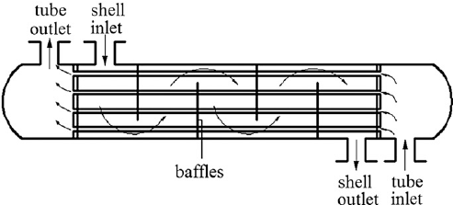
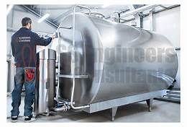

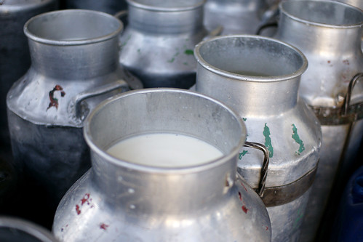
Dairy Processing
Filtration – Removed suspended particles by straining
It just filtration of milk by using different layered filter.
Cooling – Inhibiting bacterial growth by lowering temperature.
  Shell & Tube Cooler
  Bulk milk cooler
  Surface & Plate cooler
Chilling – rapid cooling of raw milk at 2 to – 4 ºc.
  Immersion Tank
  Roto freeze

Slide 8
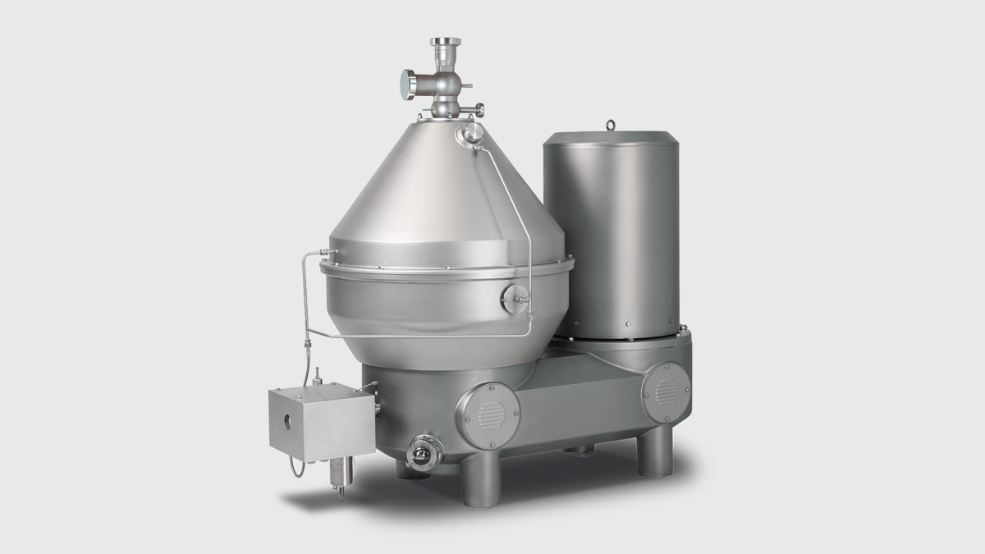
Processing of Milk
Clarification –removal of suspended particles by centrifugal sedimentation.
Improve appearance & price
Pasteurization - the partial sterilization of a product, such as milk or wine, to make it safe for consumption and improve its keeping quality.
  Holding Method
  HTST method
  UHTT method
Freezing : Freezer temperature in below

Slide 9
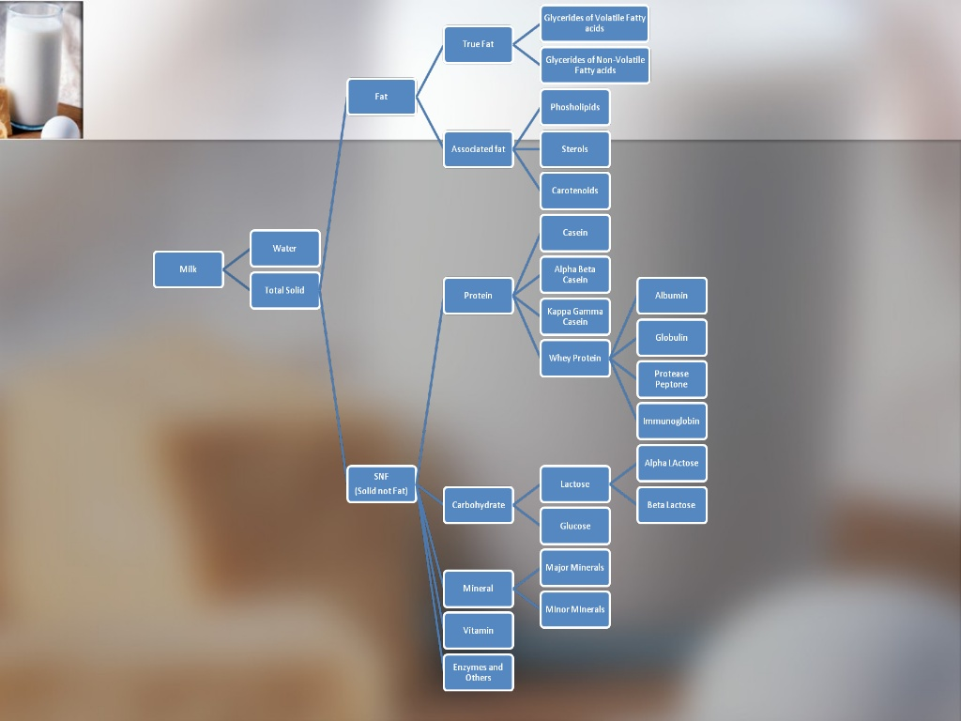
Composition of Milk

Slide 10
Composition of Milk
Milk is secretion of mammary gland.
Obtained from cow or buffalo after 72 hrs of calving.
Milk is balance mixture of protein, fats, carbohydrates, salts, water is always aqueous in form.
Oily phase is fat known as butter fat.
Aqueous phase casein, lactose sugar, mineral salts & vitamins.
Milk is divided in to two parts
1) Fat
2) Solid but not fat (SNF)

Slide 11
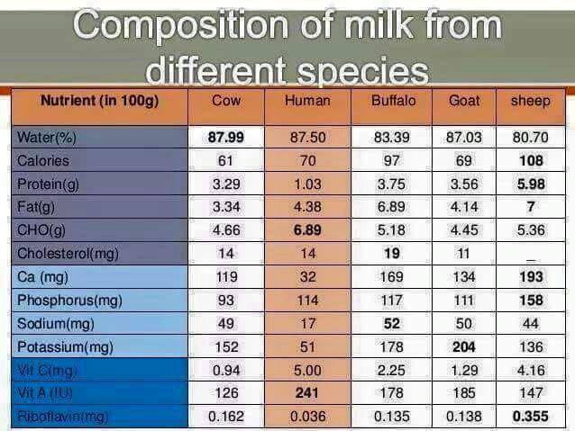

Slide 12
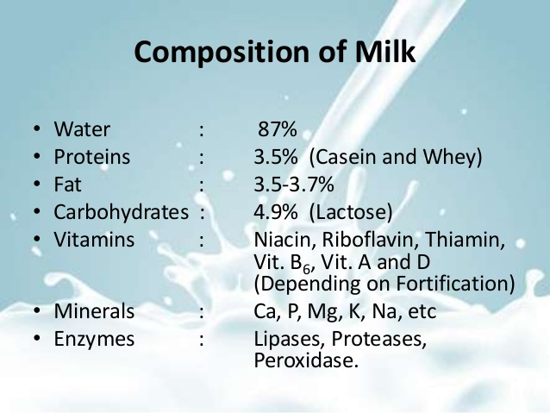

Slide 13
Water:
80-90 % of water depending upon species & breed.
Serve as carrier for other constituents of milk.
Mostly found in free form, small quantity found in bound with phospholipid & protein.
Fats :
Most important part of milk presents in globules of different form og glycerides.
It is with numerous triglycerides as many as 64 fatty acids.
Also shows cholesterol & 0.2 to 1 % of phospholipids serves as antioxidants.
Protein :
Mainly casein, lactoglobulin, lactalabumin.
Casein is 78.5 % serum protein 12.5 %.
Albumin is about 10% of total nitrogen content in milk.
Globulin is with 0.1 %

Slide 14
Non protein Nitrogen Substances :
Lactose Sugar :
Lactose content is 4.5 to 4.8 % in cow & buffalo milk.
Composed with glucose & galactose, is source of lactose in milk.
Lactose is 1/6 as sweet as cane sugar responsible for sweetening of milk.
Lactose is essential is production of cheese, curd & buttermilk.
Minerals(Ash) :
1% of milk source of calcium.
Buffalo milk contains more Ca, Mg & P than cow.
Very less quantity of Fe, Cu, Al, Br, Mn, Ni, iodine, fluorine, lithium, nickel etc.
Enzymes :
Contain lipase, oxidase, peroxidase, protease, amylase, catalase, lactase, alkaline phosphatase, Acid phosphatase.
Vitamins :
Good source of vitamins like thiamine, riboflavin, B-vitamins ( B1, B2, B6, B12), Vitamin A and Vitamin D.
Flavors :
Sweet flavors due to lactose, fats & proteins. Growth of bacteria gives fruity, barny, & malty flavor.
Processing gives cardboard & Ghee is metallic flavors.

Slide 15
Types of Milk
Recombined Milk.
Soft –Curd Milk
Skim Milk Powder
Toned Milk
Artificial Milk
Yogurt
Cheese

Slide 16
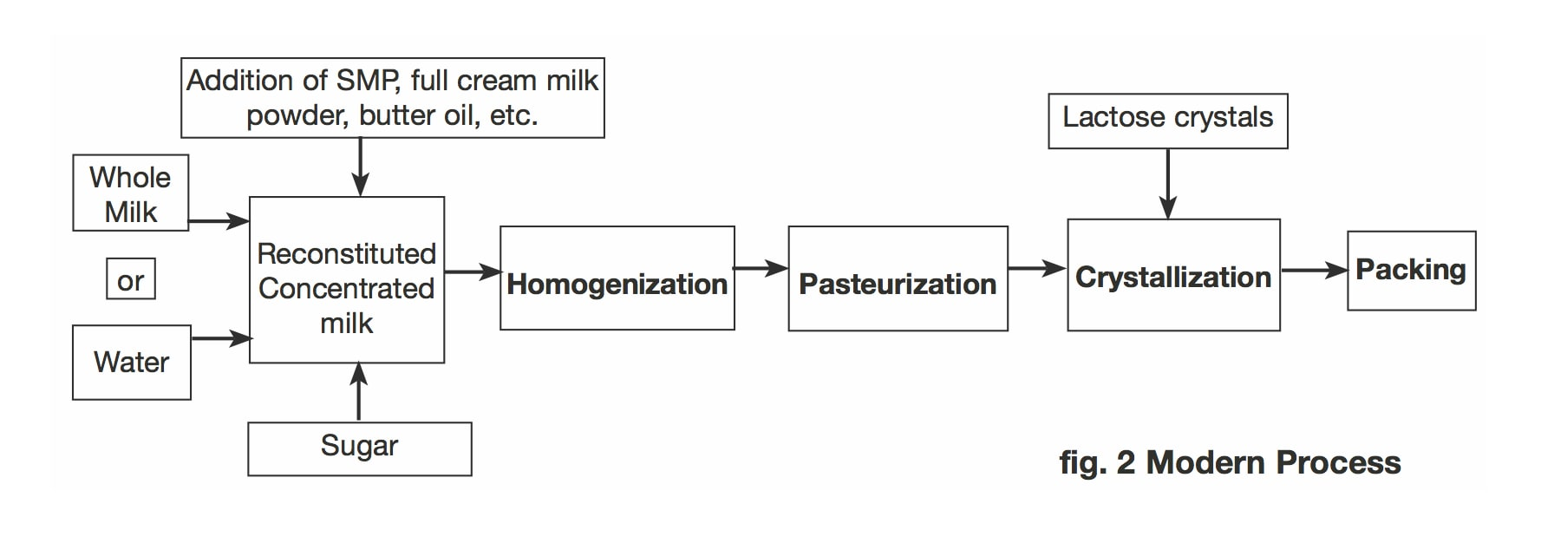
Recombined of Milk

Slide 17
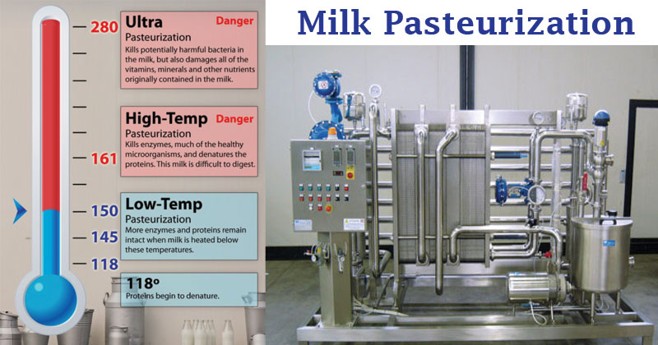

Slide 18
Soft – curd Milk

