Slide 1
TRP-Television Rating Points
Divya Narang Tinna
AP, TCSC

Slide 2
TRP
TRP- Television Rating Points
It is the tool that tells us which channel and the program are viewed most
It also indicates the popularity of a TV channel or a program
It shows how many times people are watching a channel or a particular program
TRP enables advertisers and investors to understand the mood of the people
According to the TRP of a TV Channel or program advertisers decide where to display their advertisements

Slide 3
How to calculate or check TRP?
TRP was calculated by Indian agencies namely INTAM and DART (now BARC)
INTAM-Indian Television Audience Measurement
Earlier, DART that is Doordarshan Audience Research TV Ratings was used to calculate these ratings
As that time the only channel available was only Doordarshan
Still, DART exists and is an agency that takes the TV viewing pattern of rural people into consideration.

Slide 4
How to calculate or check TRP?
They randomly pick people and question them about the various channels and TV programs
They also use electronic methods to get viewership statistics.

Slide 5
Methods to calculate TRP
1. People meters-
This device is installed in some places or set in selected homes to calculate the TRP
In this way, some thousand viewers are surveyed in the form of justice and sampling
These gadgets record data about the channel or program watched by the family members or selected people
Through this meter, the information of TV channel or program for one minute is carried out by the INTAM a monitoring team i.e. Indian Television Audience Measurement

Slide 6
Methods to calculate TRP
After analyzing the information, the team decides what is the TRP of the channel or program
Or we can say that this data is later analyzed by the agency to create a national TRP data of various TV channels and TV programs

Slide 7
Methods to calculate TRP
2. Picture Matching-
People meter records a small portion of the picture that is being watched on the TV
This data is collected from a set of homes in the form of pictures and later on is analyzed to calculate the TRPs

Slide 8
What happens when TRP increases or decreases?
It directly affects the income of that TV channel
If the TRP of a program or channel is low, it means not many people are watching it
So, advertisers will give fewer advertisements and pay less
But, if the TRP is high- then more advertisements and money
https://thewire.in/media/trp-controversy-barc-credibility-overhaul-republic-times-now
https://thewire.in/media/back-story-indian-media-sushant-singh-rajput-coverage

Slide 9
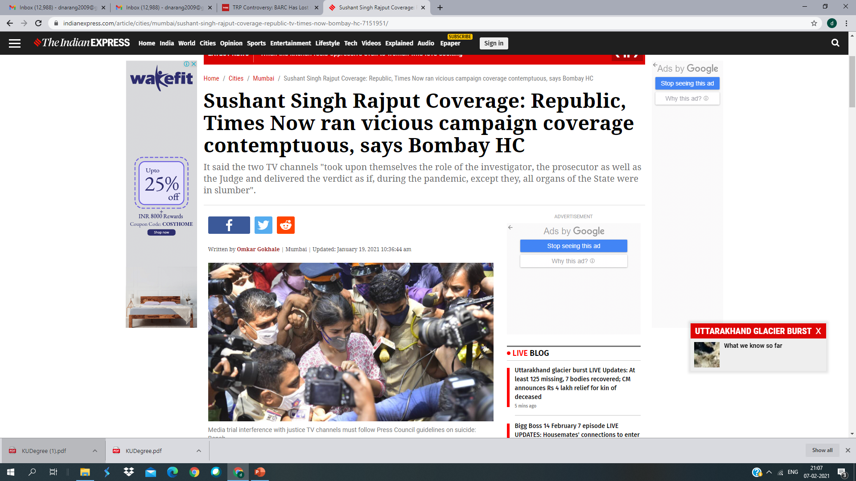

Slide 10
CASE-STudy
Ruling that “trial by media” of cases under investigation is an “interference with administration of criminal justice,”
This was said by the Bombay High Court
About the reportage of Republic Television and Times Now in the Sushant Singh Rajput case was
Both the channels were running a “vicious campaign” playing the roles of “the investigator, the prosecutor as well as the judge”.

Slide 11
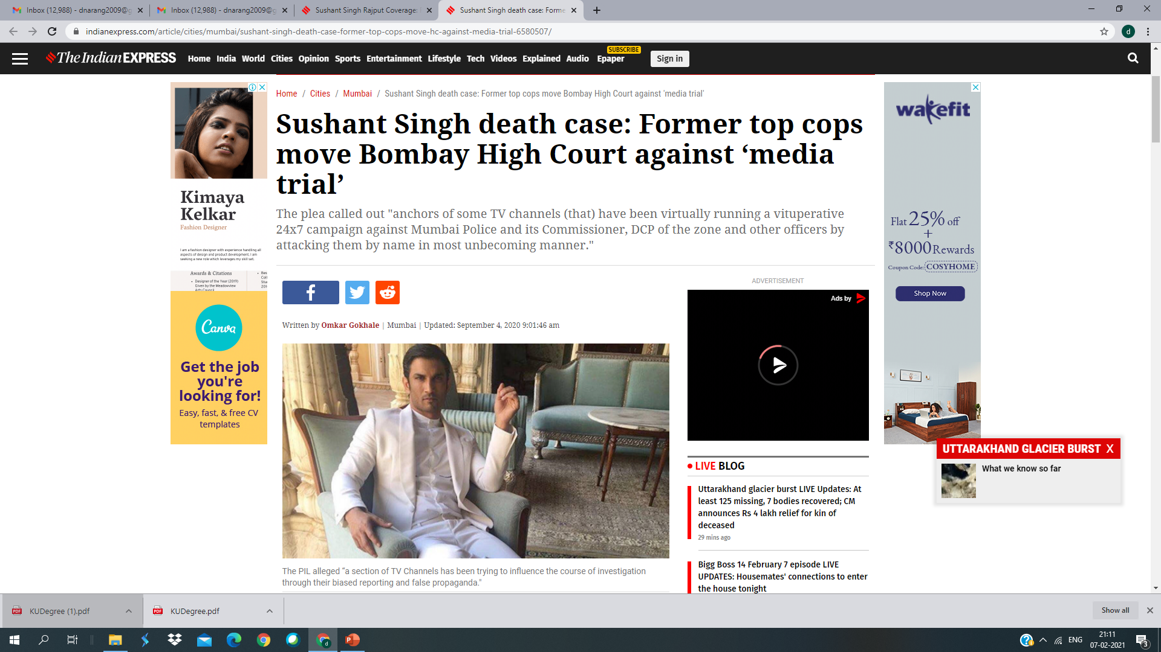
Case study

Slide 12
Case study
Eight former top police officers of Maharashtra
Including the ex Director General of Police (DGP) of Maharashtra and former commissioners of Mumbai Police moved a public interest litigation (PIL) before the Bombay High Court
Seeking restraining orders against ‘media trial’ in the Sushant Singh Rajput Death case

Slide 13
Case study
The petitioners included
Former DGPs P S Pasricha,
K Subramaniam,
D Shivanandan
Sanjeev Dayal, Satish Chandra Mathur,
Former Commissioners of Mumbai Police Mahesh N Singh, Dhananjay N Jadhav and former Anti-Terrorism Squad (ATS) chief K P Raghuvanshi.

Slide 14
Case study
The PIL stated, “A section of TV Channels has been trying to influence the course of investigation being done by Central Agencies through their biased reporting and false propaganda. This has created an air of suspicion in the minds of the general public as to the facts of the case under investigation and also about the Mumbai Police, health services and other support services of the state.”

Slide 15
Case study
Right to be presumed innocent until proven guilty
This is also violated
“Irresponsible” coverage is affecting Mumbai Police’s image in the minds of the public
It stated that the “media trial” has resulted in a “parallel investigation”

Slide 16
Case study
PIL sought various directions to the Central Government
Press Council of India
News Broadcasters Association
News Broadcasting Standards Authority
And state government to issue guidelines to media houses
To refrain from publishing and circulating any false, derogatory and scandalous comments, social media posts, news stories, which would allegedly jeopardize reputation of the Police.

Slide 17
Case study
The PIL also sought the reporting of crimes and criminal investigations to be carried out in a balanced and objective manner
And not to turn it into a media trial and “vilification campaign” against the Police and investigators

Slide 18
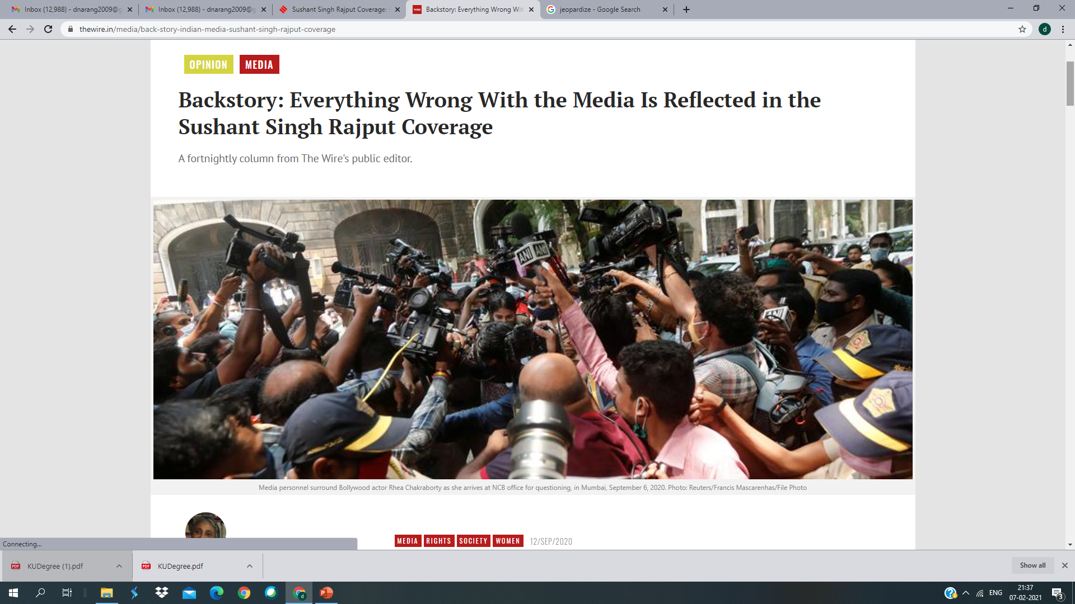

Slide 19
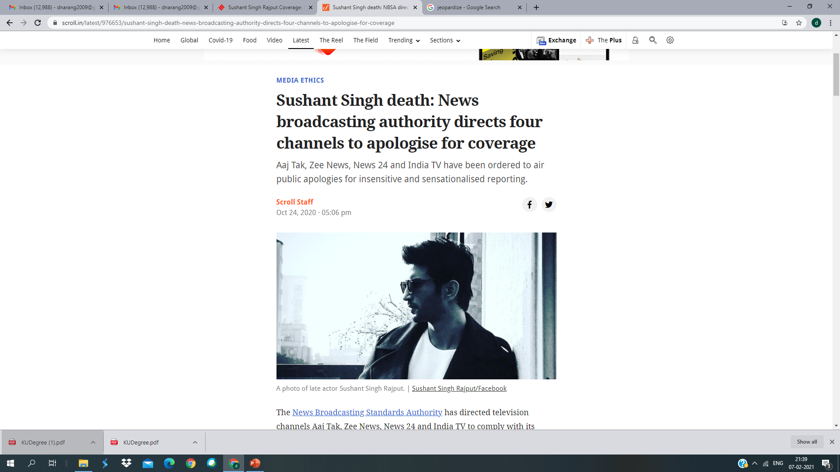

Slide 20
TRP Manipulation
https://economictimes.indiatimes.com/industry/media/entertainment/media/trps-manipulation-how-channels-use-fraudulent-data-misleading-ads-to-rig-viewership/articleshow/78613343.cms

