Slide 1
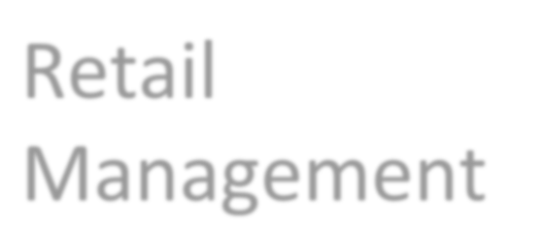

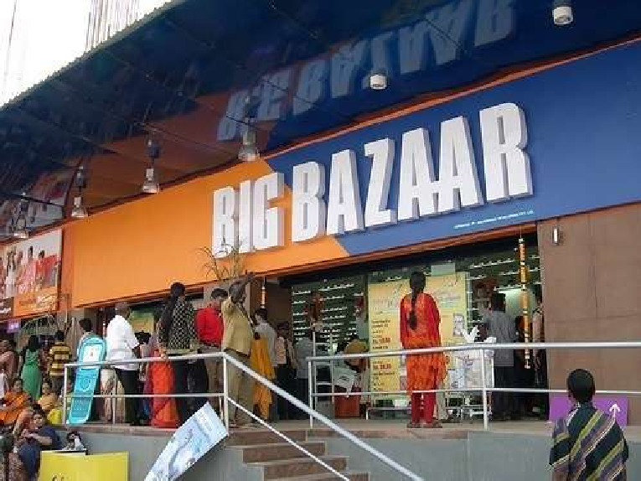
Retail Management

Slide 2
Syllabus
Unit I – Retail Management – An Overview
Unit II – Retail Consumer & Retail Strategy
Unit III - Merchandise Management & Pricing
Unit IV – Managing & Sustaining Retail

Slide 3
Unit I – Retail Management – An Overview
Retail Management :
Introduction & Meaning & Significance
Factors influencing Retail Management,
Scope of Retail Management
b) Retail Formats : Concept of Organised Retailing
Factors responsible for growth of Organised Retail in India,
Multichannel Retailing - Meaning & Types,
E-tailing – Meaning, Advantages & Limitations
c) Emerging Trends in Retailing
Impact of Globalisation on Retailing
IT in Retailing
FDI in Retailing
Franchising
Green Retailing
Airport Retailing

Slide 4
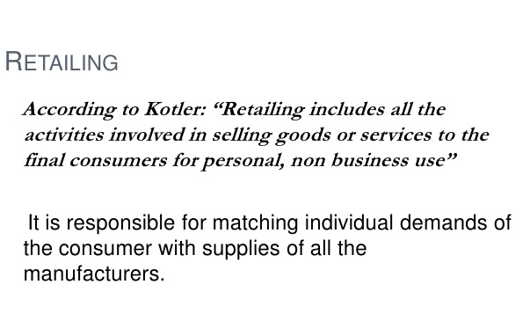

Slide 5
What is Retail Management?
Retailing encompasses the business activities involved in selling goods &
services to consumers for their personal, family, or household use.
It includes every sale to the final consumer – ranging from cars to apparel to meals at restaurants to movie tickets.
Key issues that retailer must resolve:
How can we best serve our customer while earning a fair profit?
How can we stand out in a highly competitive environment where customers have so many choices?
How can we grow our business while retailing a core of loyal customers?

Slide 6
Retail is the end or final stage of any economic activity. The word “retail” comes from the old French word “retaillier”, which means to cut off or to break bulk.
Retailer may be defined as a dealer or trader who sells goods/ services in small quantities to consumers for personal or family use.
According to Philip Kotler “Retailing includes all the activities involved in selling goods or services directly to final consumers for personal, non business use”.
Retailer or retail store is any business enterprise whose sale volume comes primarily from retailing.
Retailing is a set of business activities that adds value to the products and services sold to consumers for their personal or family use.
Retailing may be understood as the final step in distribution of merchandise, for consumption by the end consumers.

Slide 7
Any organization selling to final consumer is retailing , whether they are:
A Manufacturer
A Wholesaler
A Retailer
It does not matter how they sell or serve by -
Person
Mail
Telephone
Vending Machine or
Internet
Or
Where these are sold - A store, street or Consumer’s House

Slide 8
Retail Management is a process of promoting greater sales and customer satisfaction by gaining a better understanding of the consumers of goods and services produced by a company.
It includes all the steps required to bring the customers into the store and fulfill their buying needs
It is an art as it requires a number of management tools for a complete end user satisfaction.

Slide 9












Retail Functions in Distribution
Final
consumer
Manufacturer
Wholesaler
Retailer
A Typical Channel of Distribution
Manufacturer
Brand A
Brand A customers
Brand B customers
Brand C customers
Brand D customers
Manufacturer Brand B
Wholesaler
Manufacturer Brand C
Retailer
Manufacturer Brand D
Wholesaler
Retailers role in sorting process

Slide 10
Functions of a Retailers in India
Creating Time / Place / Ownership Utiity
Offer a variety of Services like Grading / Sorting / free home delivery
Breaking Bulk
Folllow-up on Complaints
Give Information about product to Customers
Give credit for payment
Arrange an Assortment of merchandise
Feedback from Customers
Manages Transportation & Packaging
Display merchandise

Slide 11
Advantages of Retailing
Better Quality for Customers
Build & maintain Awareness about Brands
Targeted Promotions
Generate Customer Loyalty
Offer varied choice for Customers

Slide 12
Limitations of Retailing
Huge Maintenance
Just a part of the entire profit wheel
Sales are unpredicatable
Deals with varied Customers

Slide 13
Retail Functions in Distribution contd..
Retailers often act as the contact between manufacturers, wholesalers, & customers.
Retailers collect an assortment (variety) from various sources, buy in large quantity, & sell in small amount. This is sorting process.
Retailers communicate with customers, wholesalers & manufacturers.
Shoppers learn about the availability & characteristics of goods & services, store hours, sales etc., from retailers advt., sales people & displays.
Manufacturers & wholesalers are informed by their retailers with regard to sales forecast, delivery delays, customer complaints, defective items, inventory turnover and so on..
Many goods & services have been modified due to retailer feedback.
For small suppliers, retailers provide assistance by transporting, sorting, marketing, advertising, & pre-paying for the products.
Retailers also complete transactions with customers i.e., having convenient locations, filling order promptly & accurately, & processing credit purchase.
Some retailers also provide customer services such as gifts wrapping, delivery, &
installation.
To be more appealing, many firms engage in multi-channel retailing i.e., multiple point of contact like physical stores, websites, mail-order catalogs etc.

Slide 14
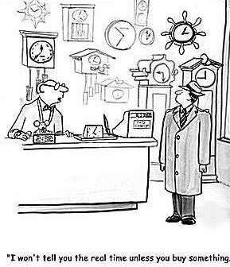

Retail Functions in Distribution contd..
Benefits
Reach more customers Reduce costs
Improve cash flow
Increase sales more rapidly Focus on area of expertise
Manufacturers also do operate retail facilities (besides selling at conventional retailers). In running their stores, these firms compete the full range of retailing functions & compete with conventional retailers.

Slide 15
Factors influencing Retail Management
Range of Merchandise
Offer Shopping Convenience
Travel Time – search for product
Suit Socio-economic background and Culture
Suit every stage of Family Life Cycle

Slide 16
Scope of Retail Management
Category Management
Customer Relationship Management
Store Management
Supply Chain Management
Inventory Management
Vendor Management

Slide 17
Merchandising: Merchandising and buying is the key function of any retailer as this department is responsible for the procurement of merchandise to be sold in the stores by sourcing it from vendors or manufacturers
Marketing: In retail marketing, functions may be centralized and may include different departments like advertising, sales promotion, public relations etc.
Store Operations: Retail professionals in the store operations area have to monitor the overall store operations and profits. They may occupy positions including Head of Store Operations, Regional Manager and District Manager.
Sales: Areas in sales include responsibilities of a sales associate, cashier, store stock associate and stock receiver.

Slide 18
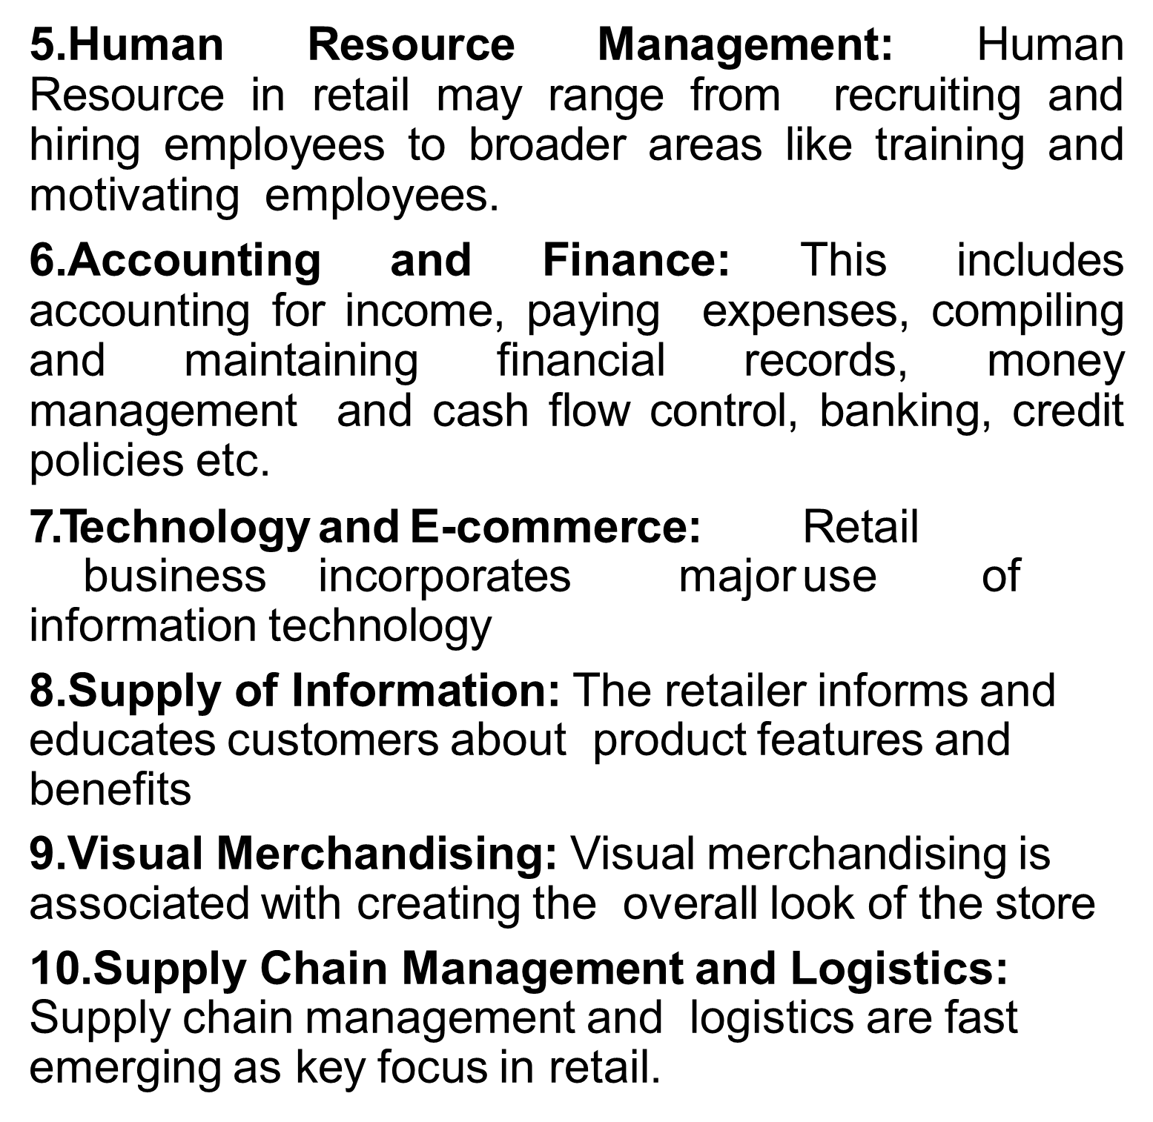

Slide 19
Economic and Social Significance of Retailing
Social Responsibility
(E.g.: A retailer might reduce the energy consumption of his store, use paper bags)
Retail Sales
Employment
Supply of Information
Economic Development
Creation of Utilities
Form Utility
Time Utility
Place Utility
Ownership/ Possession Utility

Slide 20
Economic and Social Significance of Retailing
7. Creates Value
Providing an assortment of products and services
Breaking Bulk
Holding Inventory
Providing Services

Slide 21
Retail Formats
Retail Formats
Organised Retail
Unorganised Retail

Slide 22
The Indian Retail scape
The retail industry in India is mainly divided into:-
Organised and
Unorganised Retailing
Organised retailing refers to trading activities undertaken by licensed retailers, that is, those who are registered for sales tax, income tax, etc. These include the corporate-backed hypermarkets and retail chains, and also the privately-owned large retail businesses.
Modern trade can be defined as any organised form of retail or wholesale activity (both food and non-food, under multiple formats), which is typically a multi-outlet chain of stores or distribution centres run by professional management.

Slide 23
Organized and Unorganized Retail
Unorganised retailing, on the other hand, refers to the traditional formats of low- cost retailing, owner manned general stores etc., E.g. the local kirana shops, paan/beedi shops, convenience stores, hand cart and pavement vendors.
According to the National Accounts Statistics of India, the 'unorganised sector' includes units whose activity is not regulated by any statute or legal provision, and/or those, which do not maintain regular accounts. In the case of manufacturing, this covers all manufacturing units using power and employing less than 10 workers or not using power and employing less than 20 workers.
The Indian retail sector is highly fragmented with large majority of its business being run by the unorganized retailers.
The Indian distribution systems are characterized by small stores operated by relatively small firms and a large independent wholesale industry.
Retail has become the largest source of employment and has deep penetration into rural India.

Slide 24
Factors affecting Growth of Organised Retail Sector in India
Increase in Per Capita Income
Demographical changes
High Standard of Living
Change in Consumption pattern
Availability of low cost consumer credit
Improved Infrastructure
FDI & entry of foreign players
Media awareness

Slide 25
Product Line – category
Variety – no of categories
Assortment - no of items in merchandise catogories
SKU – each one unit
Category Captian

Slide 26
Classification of Retailers
The most basic characteristics used to describe the different types of retailers is their retail mix.
Type of Merchandise/ Service Sold
Variety and Assortment of Merchandise Sold
Variety (breadth of merchandise) : number of merchandise categories a retailer offers
Assortment (depth of merchandise) : number of items in different merchandise category
Stock Keeping Unit (SKU) : Each different item of merchandise
Services Offered
Price of Merchandise

Slide 27
Classification of Retailers
Retailers can be classified under three broad heads:
Store Based Retailing
Non Store based Retailing

Slide 28




Classification of Retail Institutions
Store-based retail strategy mix
Nonstore-based retail strategy mix & nontraditional retailing
Ownership
Mom & Pop Stores
Convenience store
Supermarket
Box (limited line) store
Departmental Stores
Warehouse store
Specialty store
Off-price Discount Stores
Factory outlets
Membership club
Flea (louse) market
Direct marketing
Direct selling
Vending machine
World wide web (WWW)
Kiosks
Teleshopping
Catalogue Shopping
Vending Machines

Slide 29
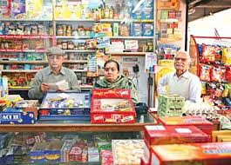
Mom & Pop Stores

Slide 30
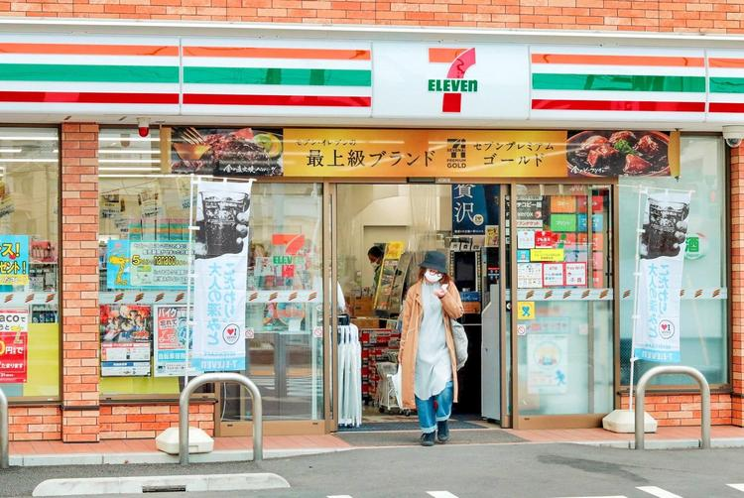
Convenience Stores

Slide 31
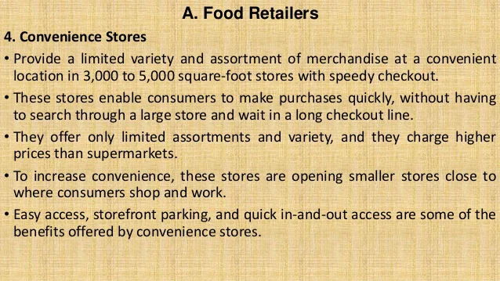
Mom & Pop / Convenience Stores

Slide 32
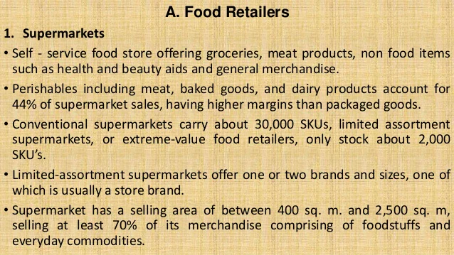

Slide 33
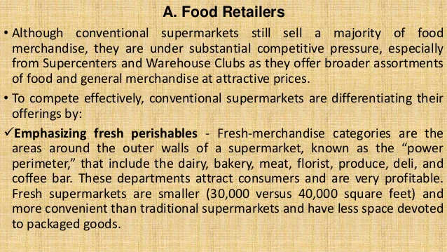

Slide 34
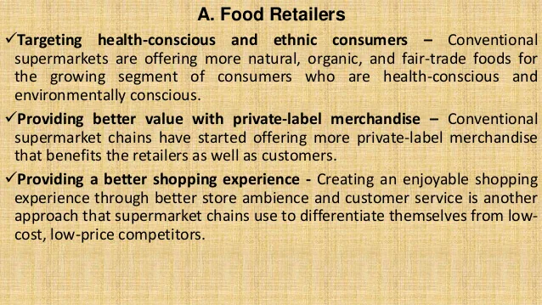

Slide 35
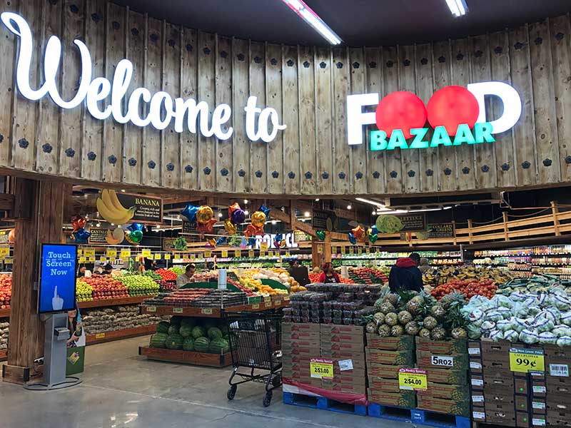
Supermarket

Slide 36
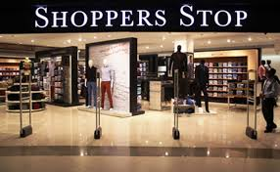
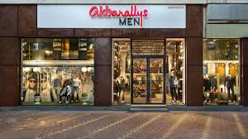
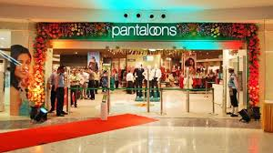
Departmental Stores

Slide 37
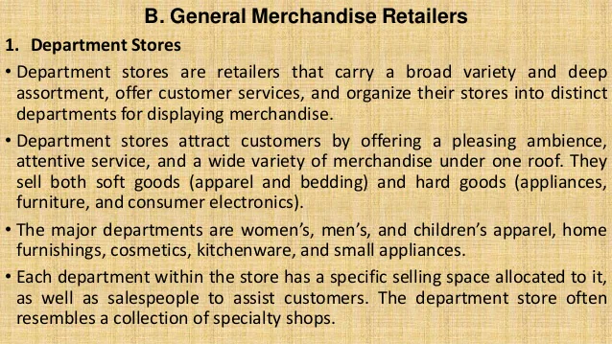
Departmental Stores

Slide 38
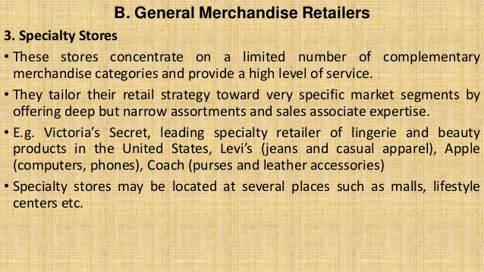
Speciality Stores

Slide 39
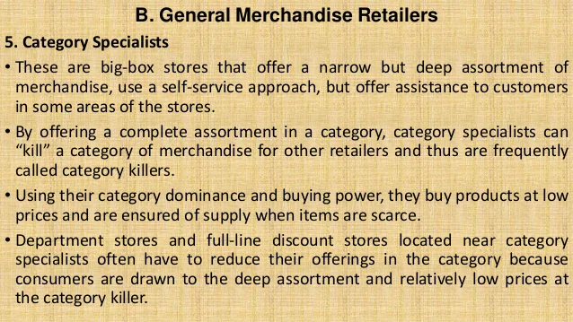
Category Specialists

Slide 40
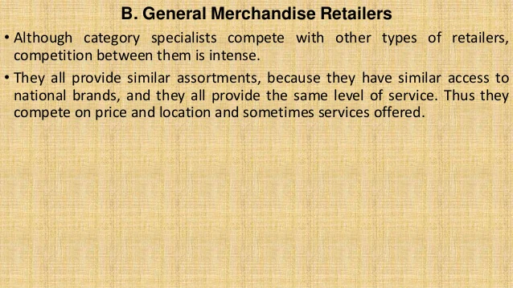

Slide 41
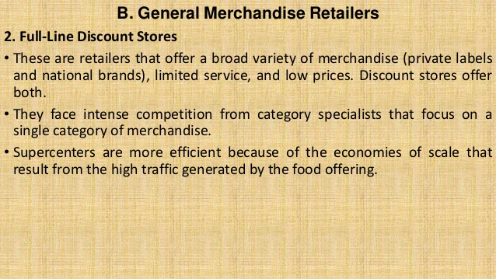
Full Line Discount STores

Slide 42
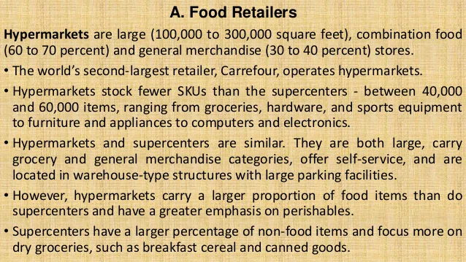
Hypermarkets

Slide 43
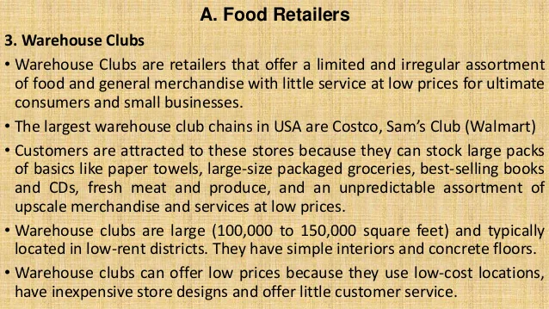
Warehouse Clubs

Slide 44
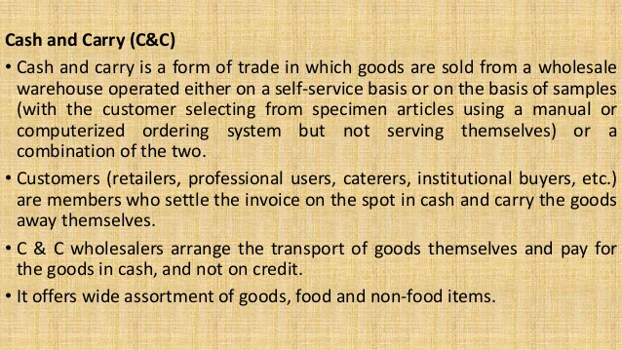
Cash & Carry Stores

Slide 45
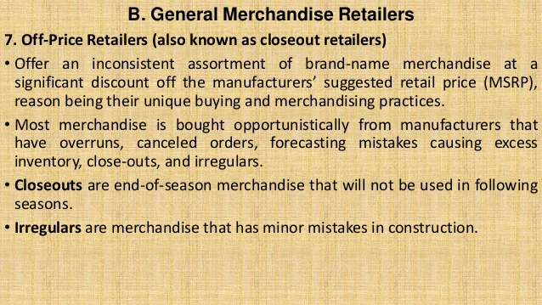
Off Price Retailers / Factory Outlets

Slide 46
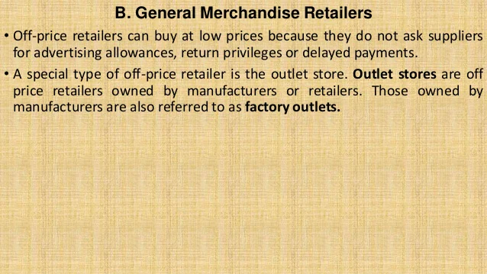

Slide 47
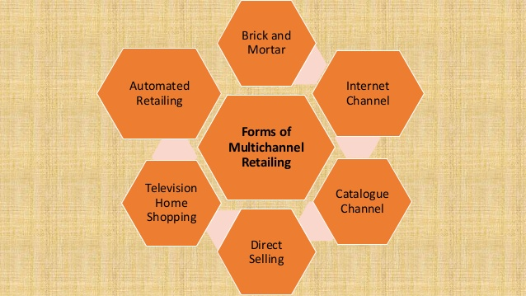
Multi-Channel Retailing

Slide 48
MultiChannel Retailing
A retail channel is the way a retailer sells and delivers merchandise and services to its customers.
The most common channel used by the retailer is a store, however, today the retailers use a variety of non-store channels including the internet, catalogue, direct mail, television home shopping, automated retailing etc.
Multichannel retailers are retailers that sell merchandise or services through more than one channel.

Slide 49
Multi Channel Retailing
1. Brick and Mortar/ Store Channel
Stores offer several benefits to customers that they cannot get when they shop through non-store channels such as catalogues or the Internet. The benefits include:
Touch and feel products
Personal service
Risk reduction
Immediate gratification
Entertainment and social experience
Physical Browsing
Cash payment

Slide 50
Multi Channel Retailing
2. Internet Channel
Internet retailing, also called online retailing, electronic retailing and e-tailing, is a retail channel in which the offering of products and services for sale is communicated to customers over the Internet. The benefits of internet channel include:
Broader and deeper assortment
No time constraints
More timely information for evaluating merchandise
Personalization

Slide 51
Multi Channel Retailing
3. Catalogue Channel
Catalogue channel is a non-store retail channel in which the retail offering is communicated to customers through a catalogue mailed to customers.
The merchandise categories with the greatest catalogue sales are drugs and beauty aids, computers and software, clothing and accessories, furniture and housewares, and books, music, and magazines.

Slide 52
4. Direct Selling
A retail channel in which salespeople interact with customers face-to-face in a convenient location, either at the customer’s home or at work.
Salesmen demonstrate merchandise benefits, explain services; take an order; and deliver the merchandise etc.
It is a highly interactive channel involving face-to-face discussions.
Two special types of direct selling are:
Part Plan System: Here the salesmen encourage customers to act as hosts and invite friends/ coworkers to a party, where the merchandise is displayed and attendees place orders.
Multilevel System: Here independent businessmen serve as master distributors, recruiting other distributors in their network.

Slide 53
5. Television Home Shopping
A retail channel in which customers watch a television program that demonstrates merchandise and then place orders for that merchandise, usually by telephone, via the Internet, or via the TV remote.
Three forms of TV home shopping retailing:
Cable channels to television shopping
Infomercials – 30 to 60 minutes programs, that mix entertainment with product demonstrations and solicit orders placed by telephone.
Direct Response Advertising – 1 or 2 minute advertisements on television and radio that describe products and provide an opportunity for consumers to order them.

Slide 54
Most of the purchases are made by a relatively small proportion of viewers.
The major advantage of TV home shopping is that customers can see the merchandise demonstrated either on their television screens or through streaming videos on the internet.
6. Automated Retailing (Vending machines)
A retail channel in which merchandise or services are stored in a machine and dispensed to customers when they deposit cash or use a credit card.
Vending machines are placed at convenient and high – traffic locations.
It is mainly used for cold beverages, candy and snacks.

Slide 55

Direct Selling

Slide 56
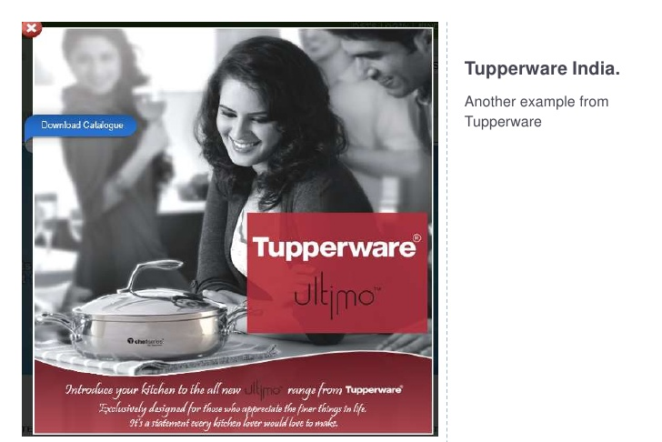

Slide 57
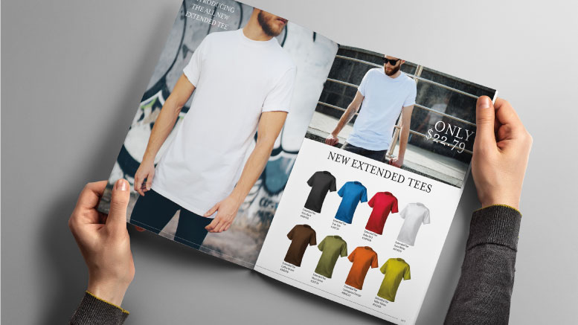

Catalogue Retailing

Slide 58
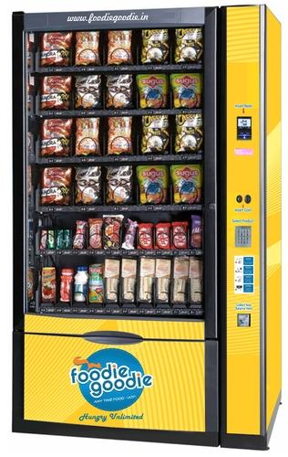
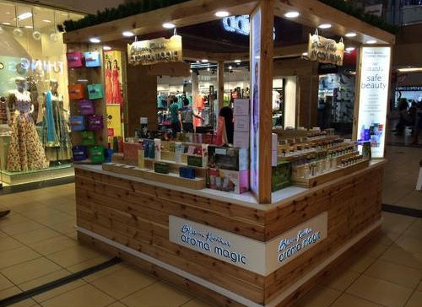
Vending Machines
Kiosks -

Slide 59
Need for Multi-Channel Retailing
Increase market audience & market share
Offer convenience to customers
Achieve Cost reductions through economies of scale
Increase customer feedback & customer analytics
Increase Brand Image & Valuation
Reduce cycle time between order & Delivery
Improve Demand Planning
Increase Geographic sale areas

Slide 60
Benefits of Multichannel Retailing
Wide Coverage
Increase in Revenue & profits
Customer retention & loyalty
Multi-channel integration

Slide 61
Challenges of MultiChannel Retailing
Some retailers/ customers are Resistance to Change
Integration of the Delivery logistics system
Evaluation of alternate channels is difficult and unpredicted
Lack of IT Infrastructure
Mode of Payment
Difficulty in cross channel targetting
Inventory mismanagement
Poor forecasting
Integration of all promotional schemes
Cost of selling products through the different channels

Slide 62
E-Tailing
Sale of Goods over Internet
B2B, B2C, C2C

Slide 63
Advantages of E-tailing

Slide 64
Disadvantages of E-tailing

Slide 65
Global Retailers
Retailing is a global industry. Many retailers are pursuing growth by expanding their operations to other countries.
Globally, Walmart remains the undisputed leader in the retail industry, with sales that are more than three times greater than those of Carrefour, the second - largest retailer.
In the Global scenario, it is seen that retailers that focus on hard lines such as consumer electronics, appliances, and furniture experience better financial performance than FMCG and apparel retailers.
The nature of retailing and distribution channels around the world differs.

Slide 66
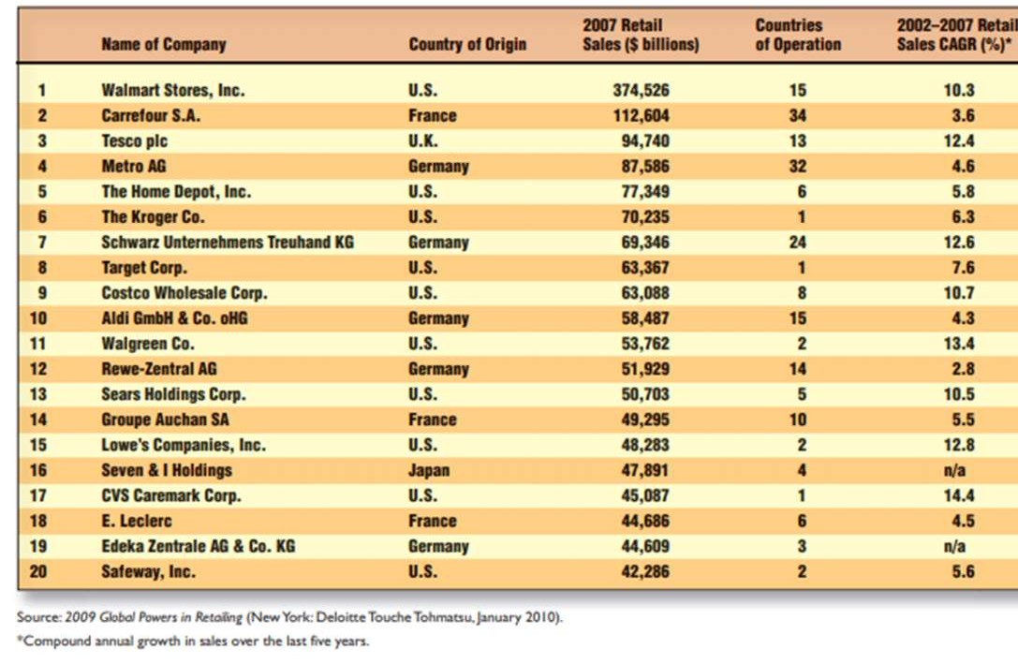
Global Retailers
Retailing is a global industry.
Many retailers are pursuing growth by expanding their operations to other countries.
List of 20 largest retailers in the world. Walmart remains the undisputed leader in the retail industry, with sales that are more than three times greater than those of Carrefour, the second - largest retailer.

Slide 67
Positive Impact of Globalisation on Retail
Corporates take benefits of the Host country
Free Trade
Helps developing country – increasing liquidity
Business across borders
Nation’s prosperity

Slide 68
Negative Impact of Globalisation on Retail
Local Brands suffer and cannot survive competition
Increasing Imports by global players
Global Retailers usually charge lower prices compared to Host country
International funds are at lower interest rates

Slide 69
Role of IT in Retail
Data Management
Electronic Data Interchange
Supply Chain Management
Billing through BarCode
Customer Relationship Management
Inventory Management
Electronic Payments

Slide 70
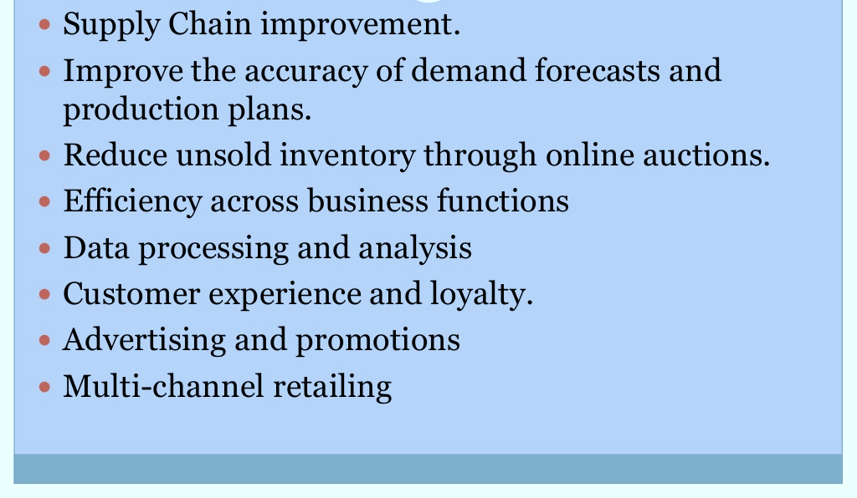
Why IT in Retail ??

Slide 71
Applications of IT in Retail
Electronic Data Interchange
RFID Tags
Bar Coding
Electronic Surveillance
Electronic Shelf Labels

Slide 72
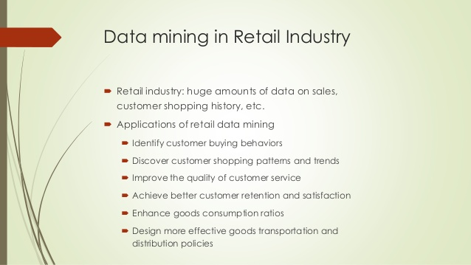

Slide 73
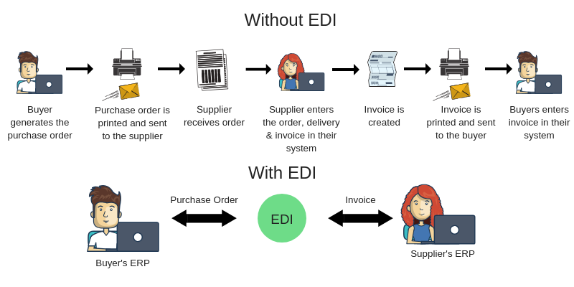
Electronic Data Interchange

Slide 74
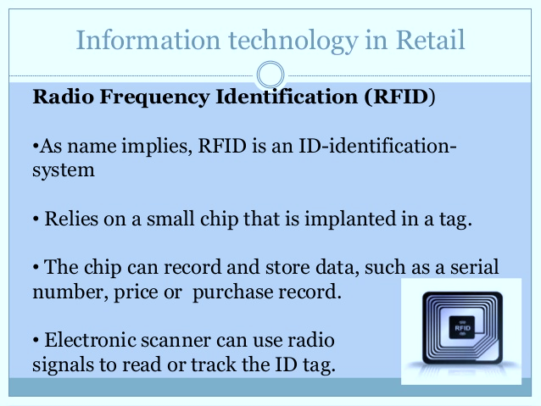

Slide 75
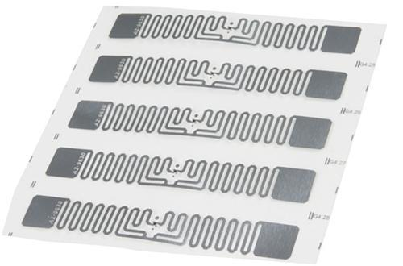
RFID – Radio Frequency Identification Tags

Slide 76
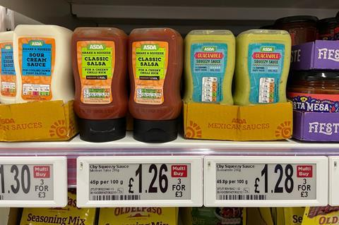
Electronic Shelf Labels

Slide 77
Advantages of IT in Retail
Electronic Data Interchange
Electronic Identification of Products – RFID
Data Mining
Linkage with Manufacturers
Development of Markets
Inventory Management
Supply Chain Maanegement
IT helps in Demand forecasting

Slide 78
Limitations of IT in Retail
Expensive to the store
Thefts & Security Concerns
Internet Security Issues
Job Eliminations
Privacy of the Customers is invaded

Slide 79
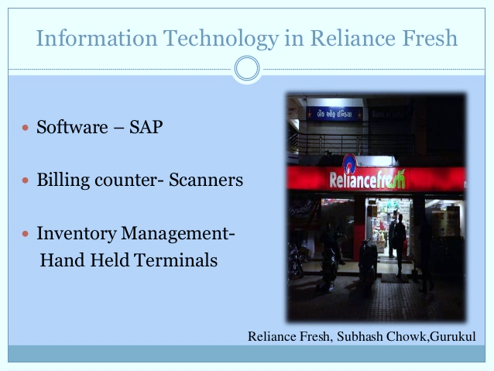

Slide 80
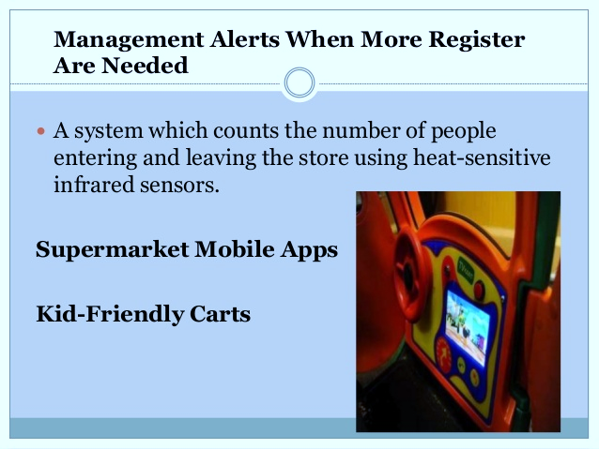

Slide 81
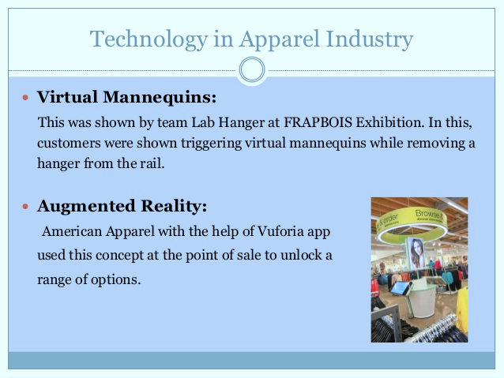

Slide 82
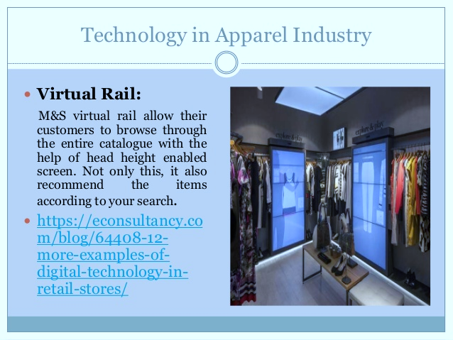

Slide 83
FDI in Retail Sector in India
FDI – Foreign Direct Investment is a form of foreign investments which comes in form of physical set up of plant in the country where investor wishes to invest.
Foreign Direct Investment means “cross border investment made by a resident in one economy in an enterprise in another economy, with the objective of establishing a lasting interest in the investee economy.
Investment done by citizens and Government of one country (home country) invest in industries of another country (host country)

Slide 84
FDI in Retail in India
Single Brand
(100%)
Multi Brand (51%)

Slide 85
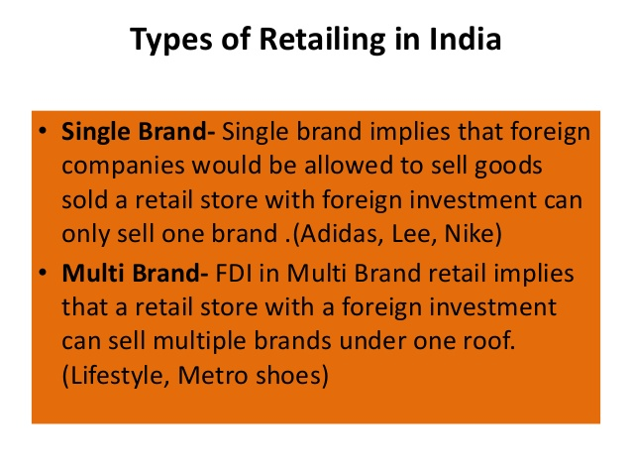
FDI in Retail in India

Slide 86
Single Brand Retail
Conditions for Single Brand Retail:
Should be a single brand
Should be sold under the same brand internationally
It would only cover products branded during manufacture

Slide 87
Multi-Brand Retail
Conditions for Single Brand Retail:
Sale of multiple brands under one brand
Multi-brand retail comes in different formats like supermarket, hypermarket, compact hyper and the ubiquitous mall.
Foreign investments upto the tune of 51% in this sector.

Slide 88
Need for FDI in Retail
Increase competition in local markets to improve efficiency
High Quality standards to reach customer expectations
Tax revenue to Government
Increasing Competition will benefit consumers with low proices
Agriculture – Farmers will benefit due to elimination of middlemen
Infrastructure improvement
Economic expansion and benefits

Slide 89
Positive Impact of FDI in Retail in India
Advanced Knowledge to deliver better Productivity
Inventory Management, Merchandising, New Technology
Consumers – access to some of the major global brands.
Improved quality and variety of products.
Increase competition and expand manufacturing, eliminate middlemen and benefit producers
It gives consumers competitive advantage.
Better Shopping experience to Consume and Influences the consumers standard of living.
6. Capital Inflow in the country
7. Improved infrastructure development
8. Movement towards Organised Retailing

Slide 90
Positive Impact of FDI in Retail in India
9. Foreign Retailer would spread their operations across India, then the Indian Domestic
Retailers would
- Develop their Supply chain
- Strategies
- Operations to counter competition
10. Increase employment opportunity in backend sectors
11. Increasing modernisation

Slide 91
Negative Impact of FDI in Retail in India
Job Losses: Retail industry in India is the second largest employer after agriculture, Any game changing situation can lead to heavy job losses particularly in rural areas and small cities
Power of Scale: Unfair competition and abilities of big retailers to sustain losses can lead to large scale exit of domestic retailers, especially the small family managed outlets.
Prefer Localization: Indian retail sector including organized sector is still at an infancy and nascent stage. It is critical that the retail sector is allowed to grow and consolidate first, before opening to foreign investors
The fallout in Thailand and China: Government, opened its door to invite the large retailers. Government now forced to give financial assistance as local entities forced to lay off staff because Wal-Mart and others has been ruthlessly pressing down on the supplier’s margin.
Market Power: Market dominance by foreign players may exert severe competition for domestic retail outlets.

Slide 92
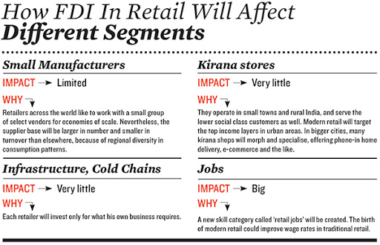

Slide 93
Routes of FDI in Retailing
Manufacturing & Local Sourcing
Franchising
Test Marketing
Cash & Carry Operations

Slide 94
INDIAN RETAIL : FOREIGN PLAYERS EVINCING INTEREST
STARBUCKS – TATA: Already commenced operations in India in Tier I cities and select outlets have opened up, and based on the success propose to open more outlets
BURGER KING: Huge expansion plans across India, China, and Indonesia as the management perceives that prospects are highly encouraging in emerging nations.
BHARTI – WALMART: Currently, the Joint venture terms have not been finalized and the exit of top management on account of bribery charges has affected the brand identity of WALMART. The Cash and Carry Model continues to exist for the time being.
UNIQLO and H & M: Japan’s Uniqlo and Sweden’s Hennes and Mauritz (H&M) are set to be among the next global apparel labels that will have their own stores in India, although they are wary about high real estate prices and other constraints.

Slide 95
IKEA: Swedish Furniture Chain – Unique retail model – proposes to invest sizeable capital and operate independently. The business model is zero inventory carrying costs, DO IT YOURSELF APPROACH
TESCO: One of UKs biggest supermarket chain and operates In various European Countries – Proposes to commence operations once policy guidelines are clearer and political uncertainties are diluted.
RELIANCE – HAMLEY: An innovative super specialty retail venture between Reliance Group and HAMLEY’s of UK for setting up a retail venture in sports goods, toys, etc
DECATHLON – One of the largest French Sport Retailer had shown interest in opening up stores in India, but have deferred their immediate plans due to policy uncertainties and high inflation trends

Slide 96
Airport Retailing
https://www.youtube.com/watch?v=mtC3skArSkA

Slide 97
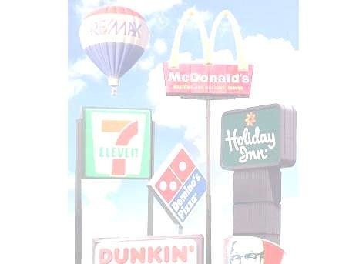
Franchising
Franchising involves a contractual arrangement between a franchisor (a manufacturer, wholesaler, or service sponsor) & a retail franchisee, which allows the franchisee to conduct business under a established name & according to a given pattern of business.
The franchisee pays an initial fees & a monthly %age of the gross sales in exchange for the rights to sell goods & services in an area.
A franchisee operates autonomously in setting store hours, chooses a location, &
determines facilities & displays.
Three structural arrangements dominate retail franchising
Manufacturer-retailer – A manufacturer gives independent franchisees the right to sell goods & related services through licensing agreement. (Eg., Auto/truck dealers like GM, Petroleum products dealers like IOC).
Wholesaler-retailer
Voluntary - A wholesaler sets up a franchise system & grants franchises to individual retailer. (Eg., Auto accessories stores, Consumer electronics stores).
Cooperative – A group of retailers sets up a franchise system & shares the ownership & operations of a wholesaling organization. (Eg., Food stores).
Service sponsor-retailer – A service firm licenses individual retailers so they can offer specific service packages to customers. (Eg., McDoland‘s).

Slide 98
Franchising contd..
Advantages of Franchisees
They own a retail enterprise with a relatively small capital. They acquire well-known names & goods/services lines.
Standard operating procedures & management skills may be taught to them.
Cooperative marketing efforts (like national advt.) are facilitated.
They obtain exclusive selling rights for specified geographical territories.
Their purchases may be less costly per unit due to the volume of the overall franchise.
Disadvantages of Franchisees
Oversaturation could occur if too many franchisees are there in one geographical area. Due to overzealous selling by some franchisors, franchisees‘ income potential, required
managerial ability, & investment may be incorrectly stated.
They may be locked into contracts requiring purchases from franchisors or certain vendors.
Cancellation clauses may give franchisors the right to void agreement if provisions are not satisfied.
In some industries, franchise agreements are of short duration.
Royalties are often a %age of gross sales, regardless of franchisee profits.

Slide 99
Franchising contd..
Advantages of Franchisors
A national & global presence is developed more quickly & with less franchisor investment. Franchisee qualification for ownership are set & enforced.
Agreement require franchisees to abide by stringent operating rules set by franchisors.
Money is obtained when goods are delivered rather than when goods are sold.
Because franchisees are owners & not employees, they have greater initiative to work hard.
Even after franchisees have paid for their outlets, franchisors receive royalties & may sell products to the individual proprietors.
Disadvantages of Franchisors
Franchisees harm the overall reputation if they do not adhere to company standards. Lack of uniformity among outlets adversely affects customer loyalty.
Intra-franchise competition is not desirable.
The resale value of individual units is injured if franchisees perform poorly. Ineffective franchised units directly injure franchisors‘ profitability.
Franchisees, in greater number, are seeking to limit franchisors‘ rules & regulations.

Slide 100
Types of Franchising
Product Franchising
Manufacturing Franchising
Business Format Franchising

Slide 101
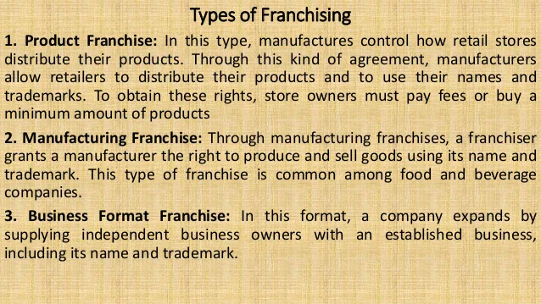

Slide 102
Green Retailing

Slide 103
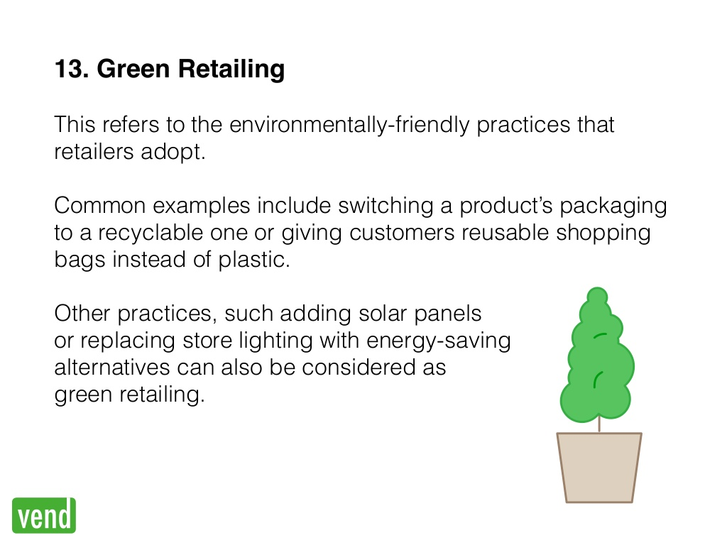

Slide 104
Green Retailing Initiatives by Retailers
Green Design
Design keeping environment in mind
Not using toxic substance
Green Packaging
Biodegradable packaging
Packaging Recyclable
Green Sourcing
Supplier Compliance
Material Selection
Assesment of carbon emissions during PLC
Reusable packaging
Organic Farming

Slide 105
Green Retailing Initiatives by Retailers
Green Logistics
Optimise Transport Mode
Use Alternate Fuel
Green Infra Structure
Green Store Design
Reduce Energy Consumption
Green CRM Recycling
Waste Collection
Use of IT in CRM
Consolidating Shipment
Avoid plastics/ PVC in store equipments
e-waste recycle

Slide 106
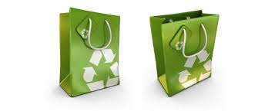
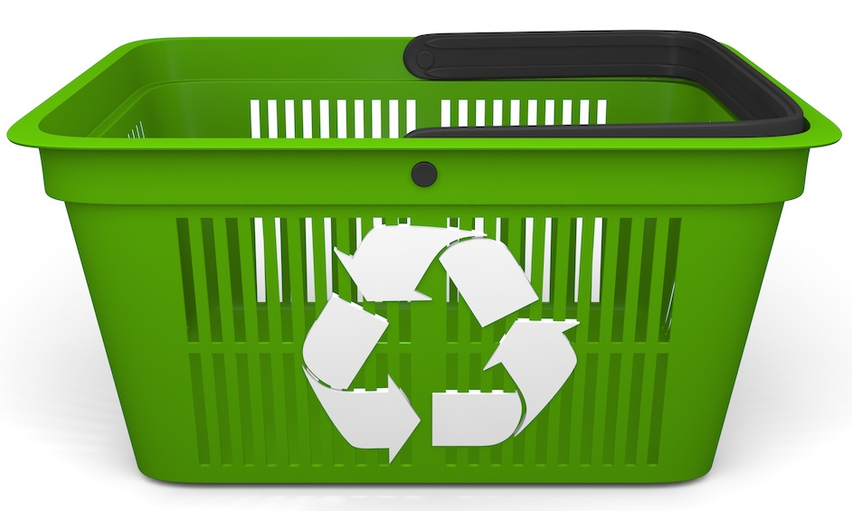

Slide 107
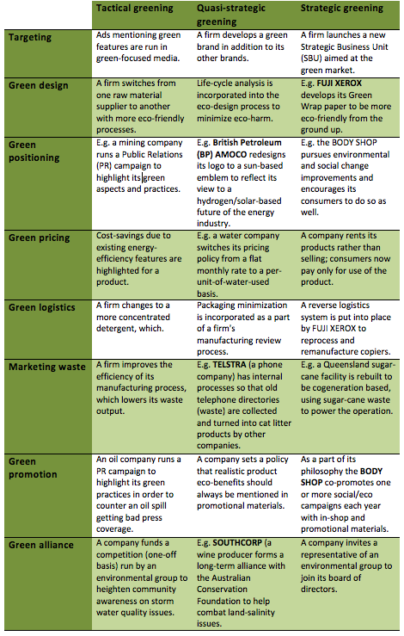

Slide 109
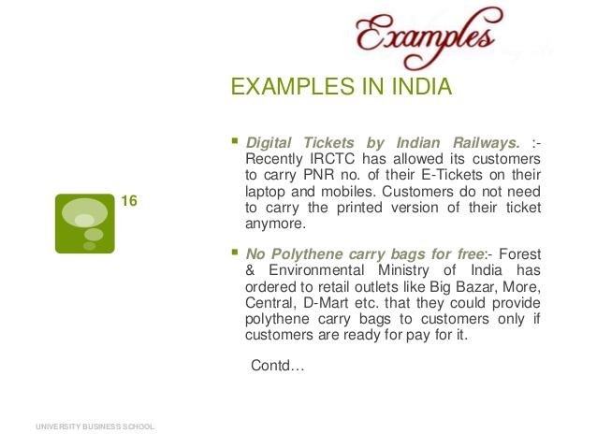

Slide 110


Slide 111


