Slide 1
Thakur College of Science & Commerce
Department of Zoology
Academic Year – 2020-21
T.Y.B.Sc. Zoology
Semester – V
Zoology Paper -IV Unit – I Practical
Study of Integumentary System
Dr. Vitthal T. Mohite

Slide 2
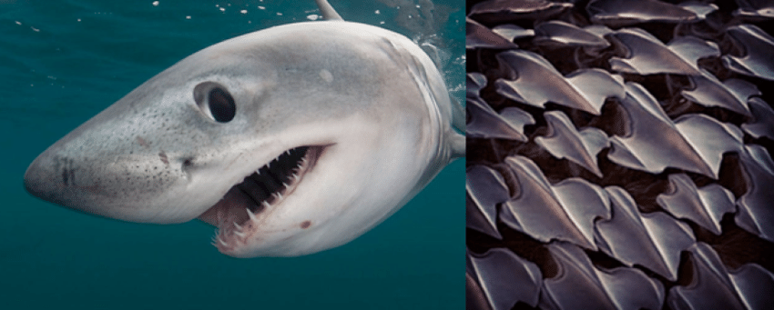
Skin of Shark
The skin of the shark is unique in many ways.
It is characterised by its grey colour and the contrast between its slippery appearance and its rough tactile texture.
Dermal denticles are present on the shark’s skin and give it the rough texture that has earned it its primary human function as sandpaper.
These are small structures that resemble hard, grooved teeth but are actually placoid scales.
Shark skin is usually grey in colour, with the top of the body being darker than the underneath.
This means that the shark’s body camouflages with the dark depths of the ocean when viewed from above as well as the lighter surface of the water when viewed from below.

Slide 3
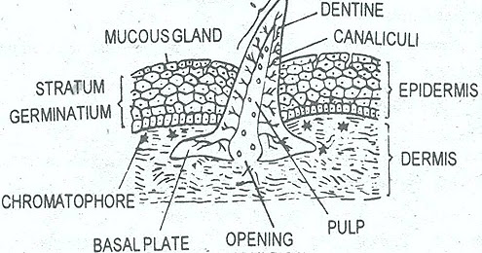
V. S. of Skin of Shark
hh

Slide 4
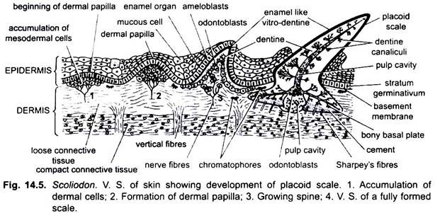

Slide 5
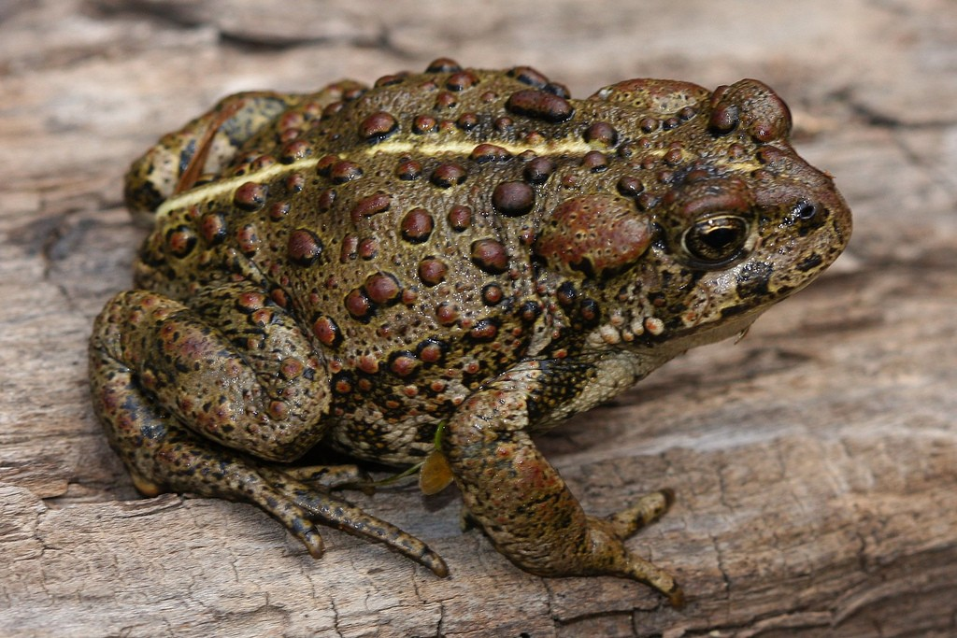
Skin of Frog
Frogs and toads have a 'lycra' type skin that protects them from from injury and disease.
It comes in wonderful variations of colour and patterns.
Frog skin is water permiable, this means it can let water in and out.
Frogs don't often drink with their mouths, they absorb water through their skin.
They have a 'seat pouch', an area on their bellies which is designed for water absorbtion.
They absorb through capillary action from water or a moist surface.
In many species glands are modified to produce toxins and other substances that will repel predators.
Some frog skin toxins are being researched as potential pain medications.
Frogs have a huge variety of skin colous and patterns.
Colours can help warn preditors that the frog may be poisonous.
And many frogs change the colour of thier skin to change their heat absorbtion rate so controling their temperature.
Also water and other secretions help sustain temperature.

Slide 6
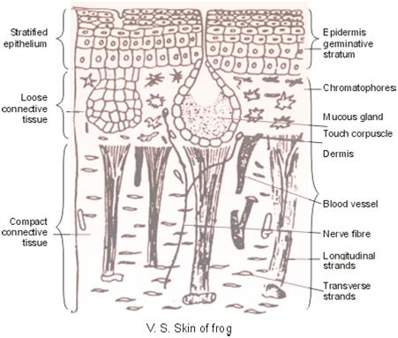
V. S. of Frog Skin
nn

Slide 7
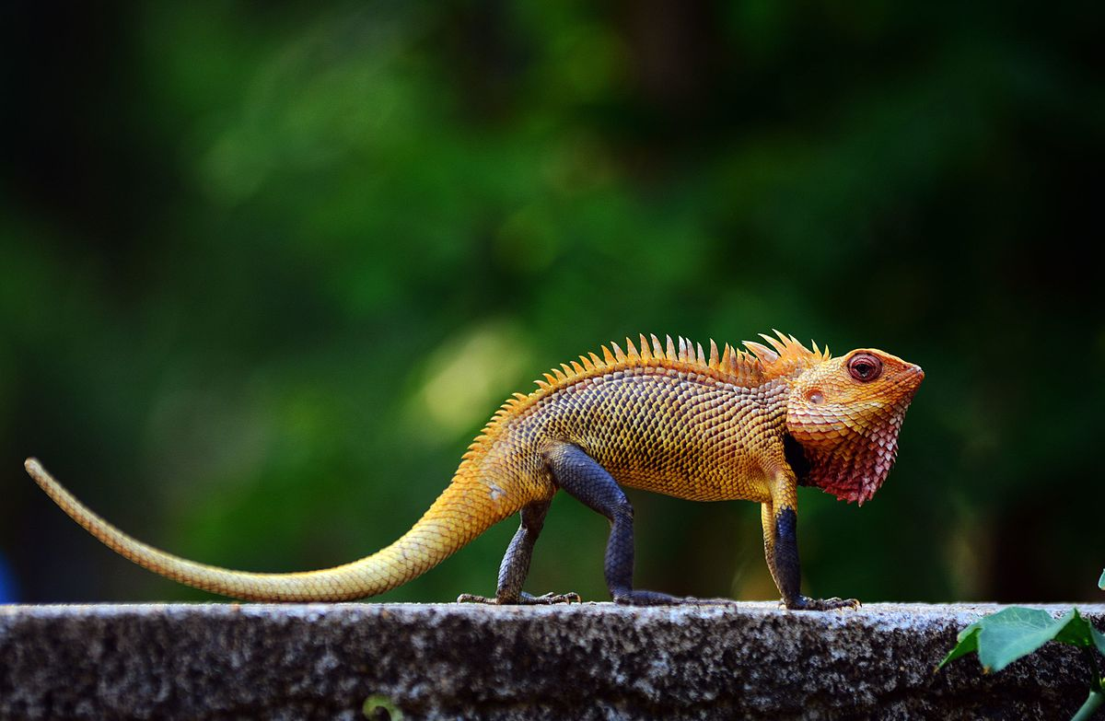
Skin of Calottes
It is an insectivore and the male gets a bright red throat in the breeding season.
It measures over 10 cm (3.9 in) in length snout-to-vent.
Total length including the tail is up to 37 cm (14.5 in).
Two small groups of spines, perfectly separated from each other, above each tympanum.
Dorsal crest moderately elevated on the neck and anterior part of the trunk, extending on to the root of the tail in large individuals, and gradually disappearing on the middle of the trunk in younger ones.
No fold in front of the shoulder, but the scales behind the lower jaw are much smaller than the others; gular sac not developed.

Slide 8
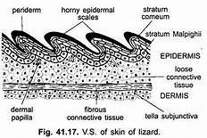
V.S. Calottes Skin

Slide 9
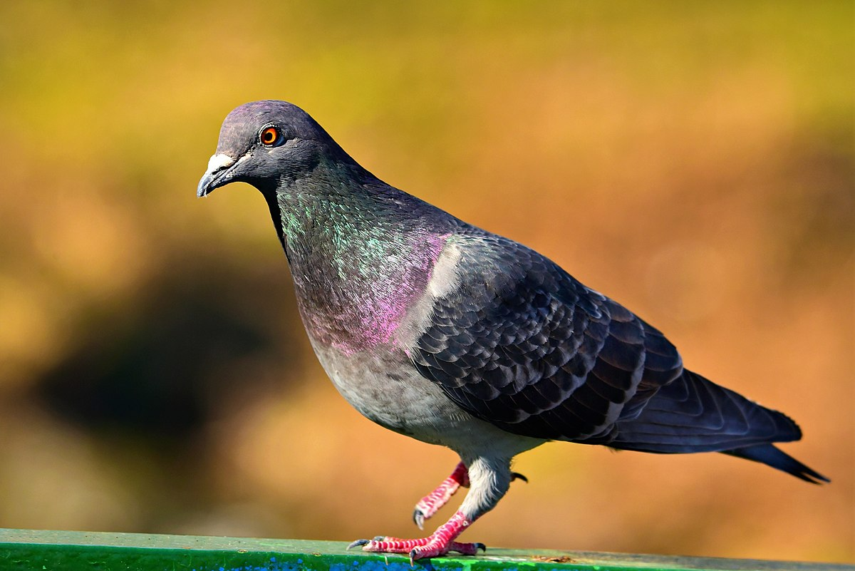
Pigeon Skin
The skin of pigeon is dry, thin and loose in texture.
Skin glands are rare.
The uropygial gland is the only integumentary gland.
All over the skin numerous free nerve endings remain scattered.
Near the base of the upper beak these nerve endings form specialised organ for touch in the cere.
It is represented by a patch of naked swollen skin.
In spite of its thin appearance, the skin has great ability to pro­duce keratin, which is used largely in the for­mation of various integumentary derivatives.

Slide 10
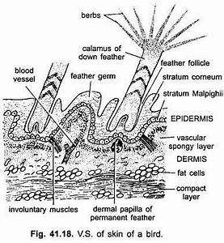
V.S. of Pigeon Skin

Slide 11
Human Skin
The skin is the largest organ of the body.
In humans, it accounts for about 12 to 15 percent of total body weight and covers 1.5-2m² of surface area.
The human skin (integument) is composed of at least two major layers of tissue: the epidermis and dermis.
The epidermis is the outermost layer, providing the initial barrier to the external environment.
It is separated from the dermis by the basement membrane.
The epidermis contains melanocytes and gives color to the skin.
The deepest layer of epidermis also contains nerve endings. Beneath this, the dermis comprises two sections, the papillary and reticular layers, and contains connective tissues, vessels, glands, follicles, hair roots, sensory nerve endings, and muscular tissue.
deepest layer, the hypodermis, is primarily made up of adipose tissue.
Substantial collagen bundles anchor the dermis to the hypodermis in a way that permits most areas of the skin to move freely over the deeper tissue layers.

Slide 12
Structure of Skin
Skin consists of two principle tissue layers: the outer epidermis and the deeper dermis.
A hypodermis is situated below the skin, deep to the dermis.
It is composed of subcutaneous adipose tissue, it varies throughout the body and among individuals.
Thick skin found in palms of the hands soles of feet.
In total four layers from deep to superficial
  1. Stratum Basale
  2. Stratum spinosum
  3. Stratum granulosum
  4. Stratum corneum.
  Fifth layer stratum lucidum is present in between stratum corneum & S. granulosum.

Slide 13
