Slide 1
UNIT 2 -
Principles of Management
Dr Rupal Shroff

Slide 2


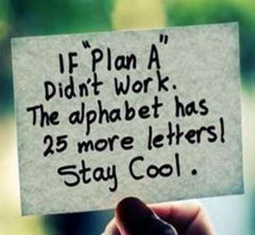
Planning (also called forethought) is the process of thinking about and organizing the activities required to achieve a desired goal.

Slide 3
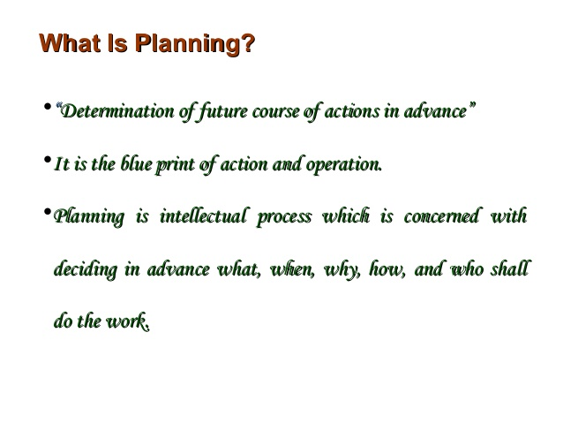

Slide 4
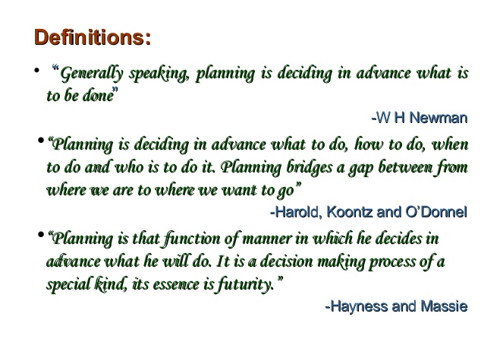

Slide 5


Slide 6
https://www.youtube.com/watch?v=50zBtcoScxw
https://www.youtube.com/watch?v=dTzSkz9yrWo

Slide 7
Nature/ Features/ Characteristics of Planning
Goal Oriented
Primary Function
Intellectual - Thinking Process
Pervasive
Continuous Process
Selective Process
Objective & Rational
Integrated Process – Involves procedures, policies and strategies
Focusses on Objectives

Slide 8

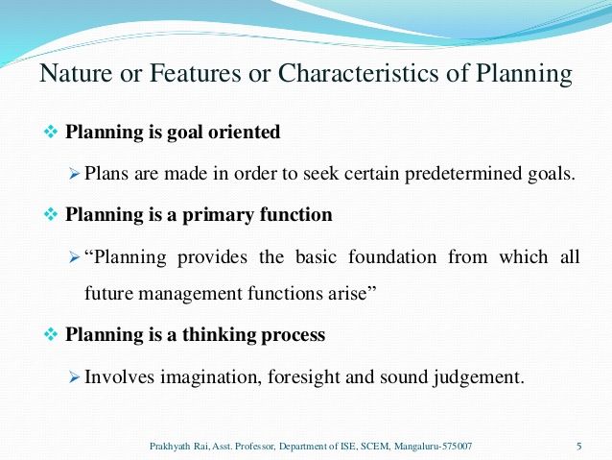
NATURE AND CHARACTERISTICS OF PLANNING

Slide 9
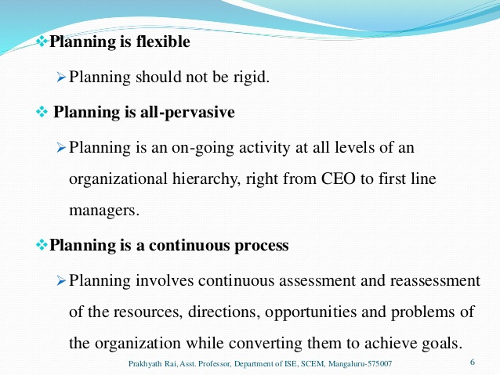
Continued…..
Planning is flexible

Slide 10
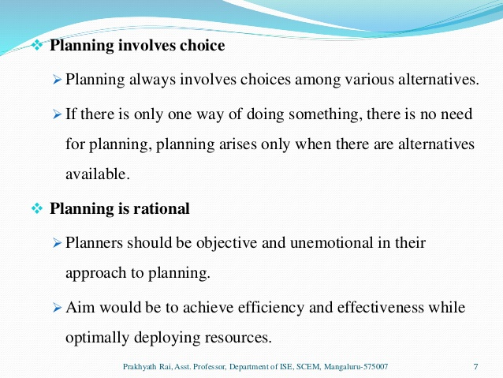
Continued….

Slide 11
Importance of Planning
Provides Direction
Facilitates innovation
Facilitates Co-ordination
Facilitates Organising
Helps
Decision-making
Facilitates Control
Eliminates wastages & overlapping
Risk & Uncertainity Minimisation
Generates Efficiency

Slide 12
IMPORTANCE AND PURPOSE OF PLANNING
Planning provides direction
  Planning provides clear sense of direction and purpose of activities of an organization.
Planning minimizes risk and uncertainty
  In fast changing organizations, planning based on hard facts and data help managers to reduce risk and uncertainties.
Planning ensures co-ordination
  Planning helps to establish co-ordinated efforts from various divisions, departments and people

Slide 13
Continued……
Planning leads to economy
  Planning helps accomplish an optimal utilization of physical and human resources, leading towards cost reduction, higher efficiency and productivity which lead to better economy.
Planning facilitates decision-making
  Planning helps in providing guidelines and thus facilitate decision-making.
Planning reduces overlapping and wastage of efforts
  Planning avoids duplication of efforts, and overlapping of tasks and responsibilities, reducing wastage.

Slide 14
Continued…..
Planning encourages innovation and creativity
  Planning helps to remain competitive.
  Innovation and creativity are like ‘trump cards’ in
competitive world.
Planning facilitates control
  Control is key to success of any organization, and in order to
control there has to be a plan.
Planning improves morale
  If Employees participate in planning process it boosts their morale and develops a broad mentality and thinking of achieving organizational goals.

Slide 15
Effective utilization of resources
  Planning involves deciding in advance of the business activities
Avoiding business failure
  Planning includes the selection of the best objectives, economy in operation, co- ordination and avoiding the business failure
Better utilization of resources
  Planning decides what to produce and how to produce

Slide 16
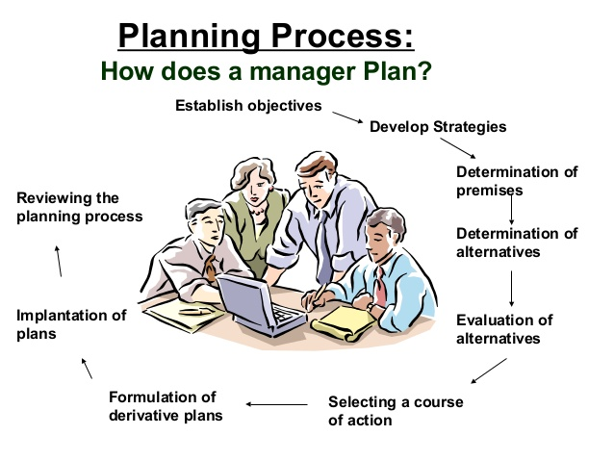

Slide 17
Planning Process
Internal Environment Analysis
External Environment Analysis
To establish objectives which are verifiable
To establish a Planning Premise
To determine alternative course of action
To establish and select best Alternative
To formulate derivative plan.
To secure co-operation and participation of all employees.
To measure and control the progress through follow up

Slide 18
Steps in Planning
Internal Environmental Analysis – consider Manpower, Machines, Management philosophy, Manpower, Management Money, Materials Strength & Weakness
2. External Environmental Analysis – consider Consumer preferences, political influences, socio-cultural considerations, Government policies, competition, supplier considerations
Opportunities & Threats
3. To establish objectives which are verifiable
Identify goals of the organization
SMART – Specific, Measurable, Achievable, Realistic, Time Bound

Slide 19

4. To establish planning premises
Planning premises are assumptions of future market conditions which become the basis for current planning process.
Planning premises usually relate to cost and availability of raw materials, labour, power, product demands, population trends, technology growth, government policies etc.

Slide 20
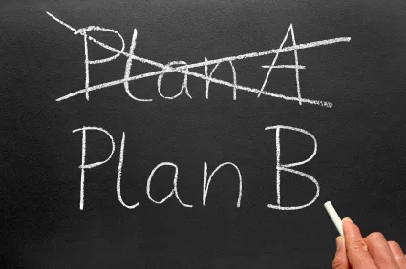
5. To determine alternative course of action
Search and list all possible alternatives in order to be compared and analytically evaluated
Plan I/ Plan II/ Plan III

Slide 21

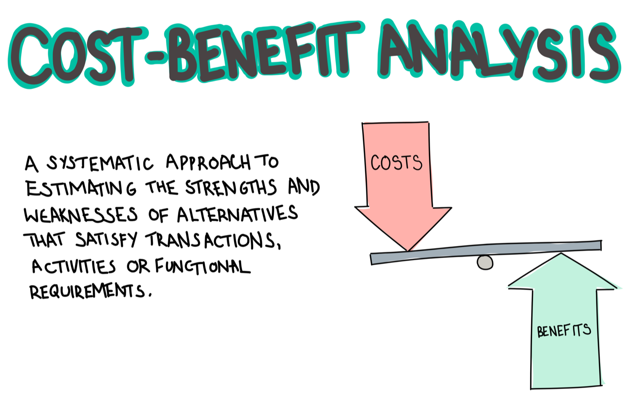
6. To evaluate the alternatives and select the best
Select most suitable and best course of action.
Alternatives have to be compared and evaluated with respect to their expected contribution to organizational goals. - Cost Benefit Analysis
Evaluation and selection is often done with the help of quantitative techniques and operations research.

Slide 22
7. To formulate derivative plans
Management has to formulate derivative plans or secondary plans to support the basic plan.
Derivative plans are sub plans or departmental plans.
For Example, if the production plan of Maruti Motors is to produce a million of Wagon R in the next five years, the derivative plans would be plans for various departments like fabrication, forging, casting, purchase, assembly etc.

Slide 23
To secure co-operation and participation of all employees
Involving employees in planning process enhances their co- operation and participation.
Continuous suggestions, complaints and criticisms must be solicited from the employees.
9. To measure and control the progress through follow-up
Continuous evaluation of plans help in identifying recurring mistakes and avoiding them in future.

Slide 24
Types of Plans
Plans
Standing Plans
Single Use Plans
Mission
Objectives
Strategies
Policies
Procedures &
Rules
Programmes Schedules Projects Budgets
https://www.youtube.com/watch?v=QzmyvAdweHk

Slide 25
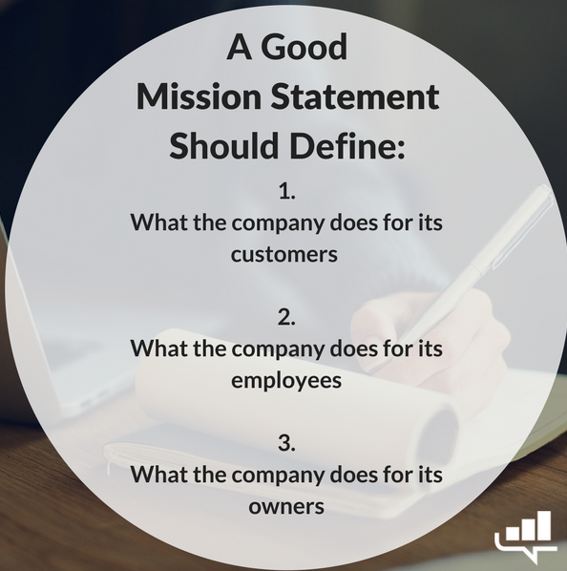
Mission
The basic purpose and philosophy of the organisation
Talks about the Business the Organisation is into.
Gives a clear idea of the long-run commitment of an
Organisation

Slide 26
Examples of Mission statements
Uber: We ignite opportunity by setting the world in motion.
Google: To organize the world's information and make it universally accessible and useful.
Microsoft - Microsoft says that it believes in what people make possible:
Our mission is to empower every person and every organization on the planet to achieve more.

Slide 27
Objectives
Objectives, goals, aims, purposes, missions are the terms with same meaning.
Objectives are goals or end-points towards which all business activities are directed.
Objectives or goals are the desirable end results planned by the management or administration and expected to be achieved by the organization.
Objectives are the products of specific, concrete thinking, they commit employees and organization to verifiable accomplishments.

Slide 28
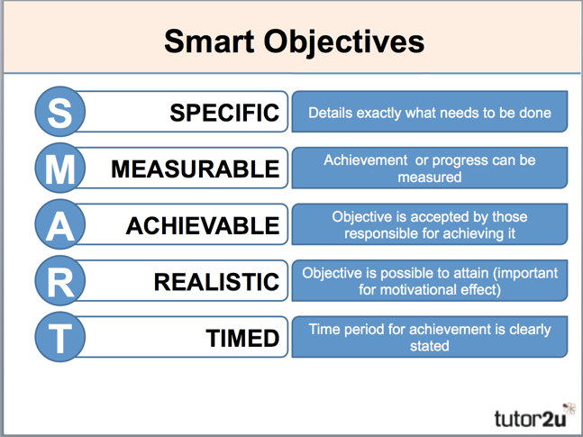

Slide 29
STRATEGY
It refers to the firm’s overall plan for dealing with and existing in the environment.
Features
It is a general program of action – an action plan of every organisation
More concerned with external problems rather than internal
It includes tactics used by the opponents
They need to be changed as per the requirements
Formulated only at the top level

Slide 30
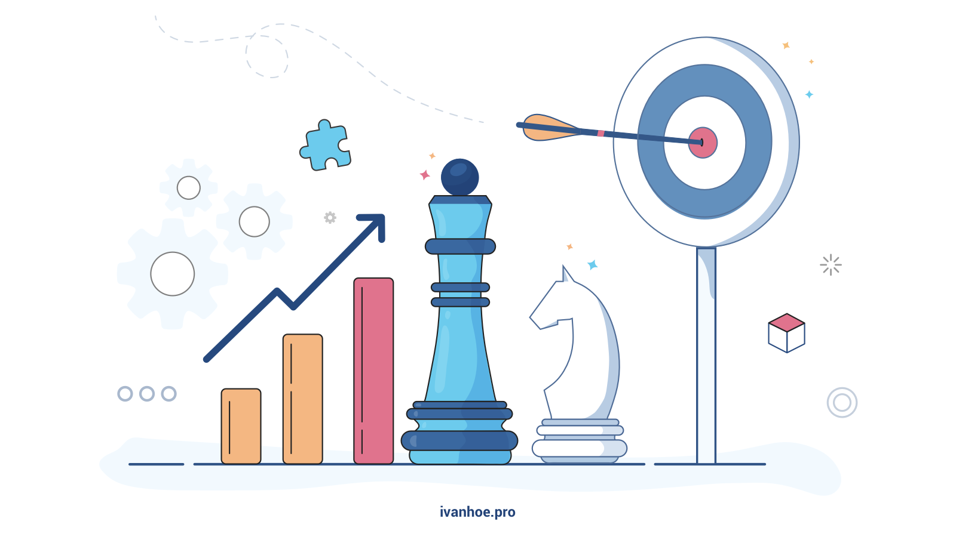
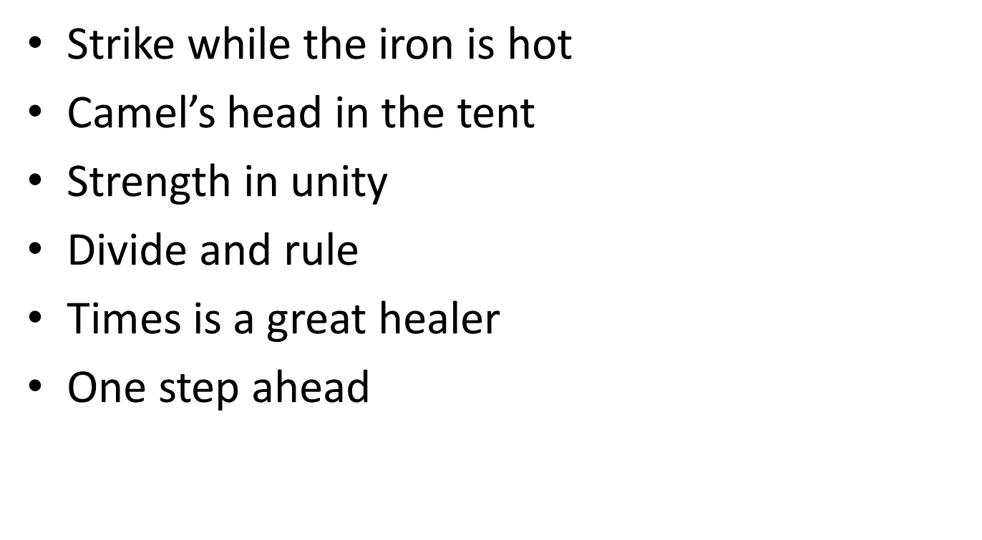

Slide 31
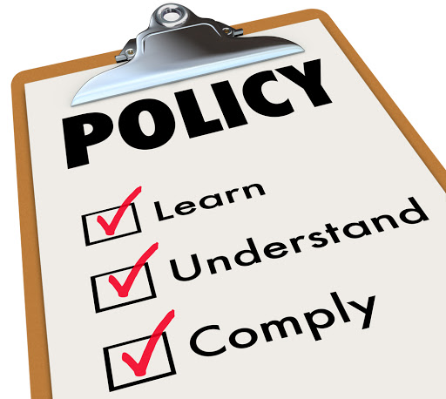
Policies
Policies are the framework/ statements that guide decision making,
Policies provide the boundaries within which the decision makers are expected to operate while making decisions related to an organization
Eg.
Credit Period cannot be extended beyond 30 days
Policy of No Credit, Only Cash
Policy of Salary Increments to be done at 10% per annum

Slide 32
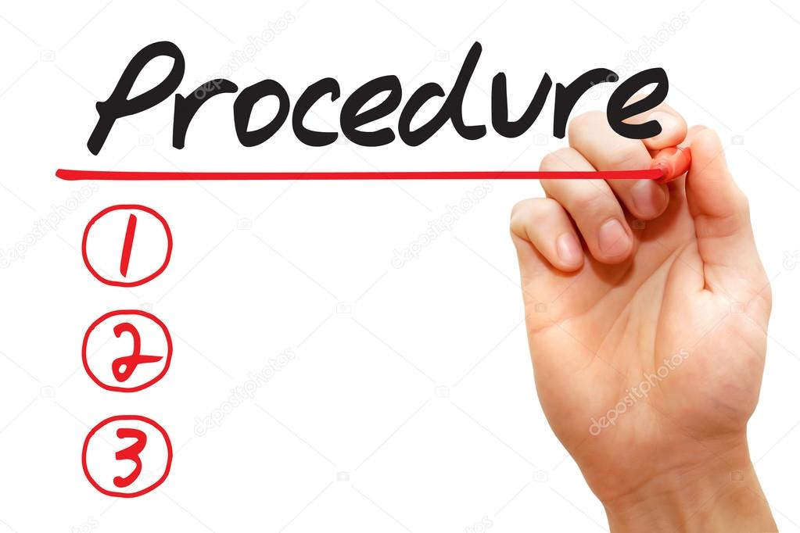
Procedures
Procedures are plans that establish proper method for undertaking activities
AN established methodology / series of steps to perform the task
Eg.
Registration Procedure
Sales Procedure

Slide 33

Rules
Rules are specific statements of what should be done/ should not be done in certain situations in an organisation.
Eg.
No Smoking in the Company premises
No Bribery in Company premises

Slide 34
Programmes
A comprehensive plan designed to implement the policies and achieve objective of the organisation.
Goals + Policies+ Procedures + Rules ====== Achieve Organisation Objectives
Eg.
Training Programme
Marketing Programme
Recruitment Programme

Slide 35

Budget
Budget is a statement expressed in financial terms the expected results from all the costs including labour, machine etc.
It is a plan which expresses anticipated results in numerical terms.
Eg.
Cash Budget
Sales Budget
Production Budget

Slide 36
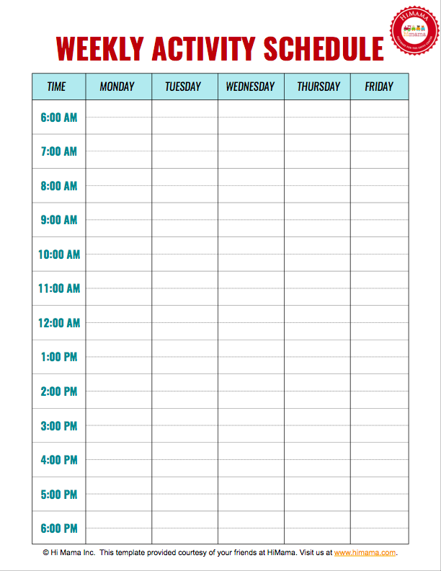
Schedules
A Schedule is time-table for activities.
It indicates the start time, completion time for each and every activity

Slide 37
Projects
A single activity/ work of special nature requiring expertise from different departments.
Eg.
Market Research Project
Product launch project

Slide 38
Essentials of a Good Plan
Simple
Clarity of Objectives
Flexible & Adaptive
Continuity
Unity of purpose & direction
Comprehensive & complete
Utilisation of resources & opportunities
Focused on Organisational Goals
Realistic & acceptable
Beneficial to Organisation

Slide 39
Advantages of Planning
Quick achievement of Organisation Objectives
Raises Managerial efficiency
Competitiveness efficiency
Brings Unity of purpose
A guiding force to next level of activities
Ensures full utilisation of resources
Ensures economies in operations
Ensures effective control of operations
Uncertainties are taken care of

Slide 40
Limitations of Planning
Time-consuming
Expense to the Organisation
Limited Practical Value – planning for long term
Changes in Environmental factors/ situations make planning ineffective
Difficult to source accurate information / data
Causes frustration with deviations
Delays work actions
Too much paper-work
Unsuitable for small firms
Employees may not be involved

Slide 41
Management By Objectives (MBO)

Slide 42


Slide 43
Definition
Management By Objectives (MBO) can be defined as a process whereby the employees and the superiors come together to identify common goals, the employees set their goals to be achieved, the standards to be taken as the criteria for measurement of their performance and contribution and deciding the course of action to be followed.

Slide 44
MBO – most widely accepted management philosophy of management
Coined by Peter Drucker in 1954 in his book “The Practice of Management”
Management by Objectives (MBO) is a process of agreeing upon objectives within an organization so that management and employees agree to the objectives and understand what they are in the organization

Slide 45
Main Concept
The principle behind Management by Objectives (MBO) is to make sure that everybody within the organization has a clear understanding of the aims, or objectives, of that organization, as well as awareness of their own roles and responsibilities in achieving those aims.
The complete MBO system is to get managers and empowered employees acting to implement and achieve their plans, which automatically achieve those of the organization.

Slide 46
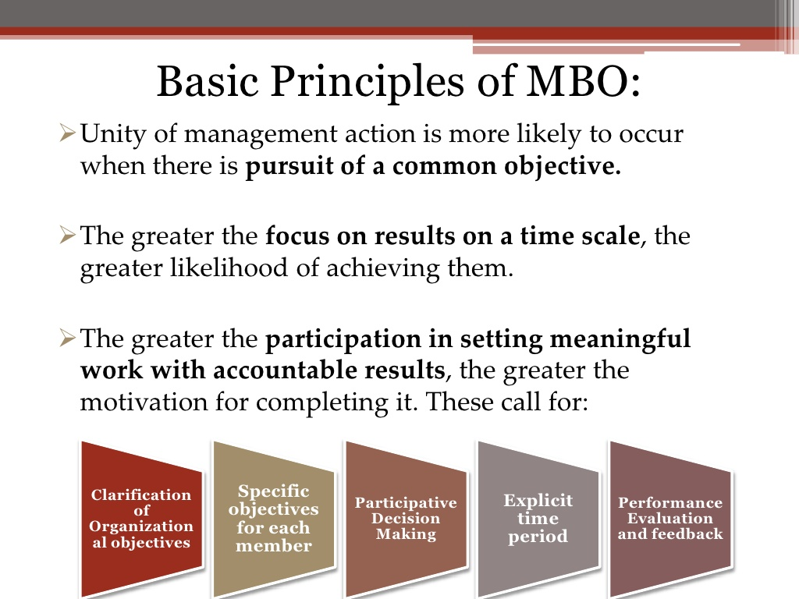

Slide 47
FEATURES OF MBO
Joint goal setting
Superior-subordinate participation
Joint decision on methodology
Review of performance
Easy to attain maximum result
Support from superior

Slide 48








The MBO Process
Define Organizational Goals
Performance Appraisals
Define Employee Objectives
Continuous Monitoring Of Employee Performance And Progress
Providing Feedback
Performance Evaluation/R eviews

Slide 49
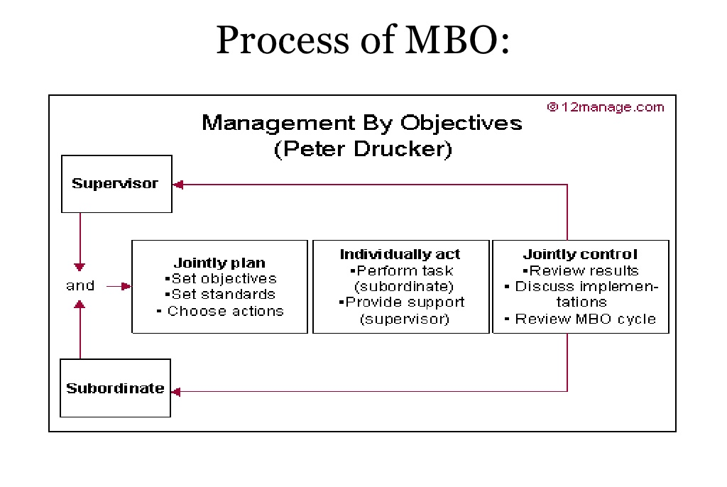

Slide 50
MBO Process
1. Define Organizational Goals –
Mission ----- Vision ------ of the organisation
Objectives are set by management team
Internal Analysis – Resources available, management
philosophy, employee relations
SWOT
External Analysis – Govt. policies, economic conditions,
competitors, demographics, international factors

Slide 51
2. Define Employee Objectives
Employee Individual Goals are determined
Subordinates & Managers collectively fix the objectives
GOALS are SMART
3. Continuous monitoring performance and progress
Periodic evaluation serves as a checkpoint as a performance measure.
This performance is compared to pre-determined targets
Find deviations

Slide 52
4. Performance Evaluation
Done by concerned superiors to measure & document every step
5. Providing feedback
Continuous feedback is given to employees regarding their performance & individual goals
Monitor, Correct & improve their skills & actions
Achievement of goals

Slide 53

6. Performance Appraisal
- Systematic evaluation of the performance of employees
- Performance rewards are given to employees based on successful achievement of objectives

Slide 54
Advantages of MBO
Facilitates Planning
Clarity of structure & goals
Facilitates effective control
Motivation to employees
Assign responsibilities to employees
Raises employee morale
Facilitates Leadership
Framework of Organisational Change and Development

Slide 55
Limitations of MBO
Time-consuming
Emphasis is on short term goals
Subordinates are under pressure to get along with management
Difficult to set verifiable realistic goals
Dominance of Management
Too much paper work
Difficult to achieve group goals
Managers may not be efficiently skilled in interpersonal skills

Slide 56
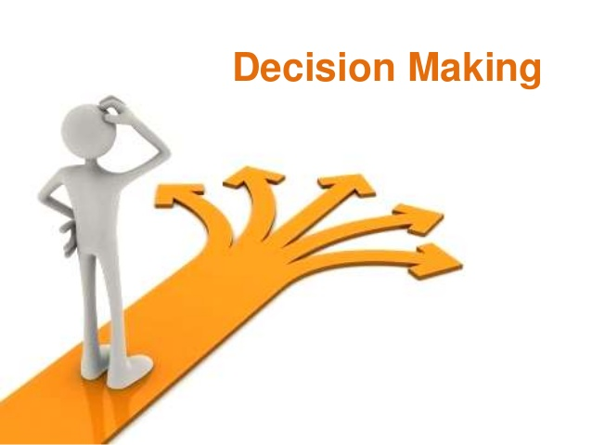

Slide 57

Decision Making
A decision is one when there are different things you can do and you pick one of them. You make lots of
decisions everyday!

Slide 58
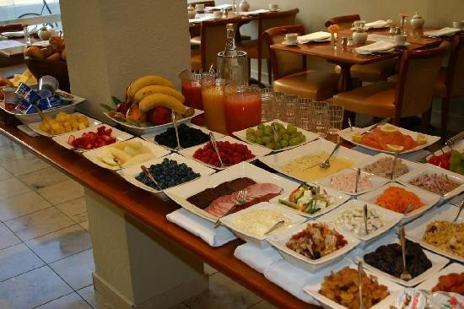
Some decisions are easy like.......
What to eat in breakfast????

Slide 59

What to wear????

Slide 60

Some decisions are difficult like.......
Choosing a career

Slide 61

Choosing good friends

Slide 62

Changing a job

Slide 63

In every situation you have to search for...

Slide 64
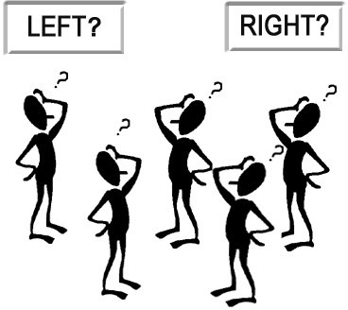
How to make right decisions???

Slide 65
Definition…..
“Decision-making involves the selection of a course of action from among two or more possible alternatives in order to arrive at a solution for a given problem”.
The process of identifying and selecting a course of action to solve a specific problem.

Slide 66
Decision Making Process
Definition of Problem
Define the Objectives
Diagnose the problem
Develop Alternatives
Evaluate Alternatives
Choose Best Alternative
Implementation
Periodic Review

Slide 67
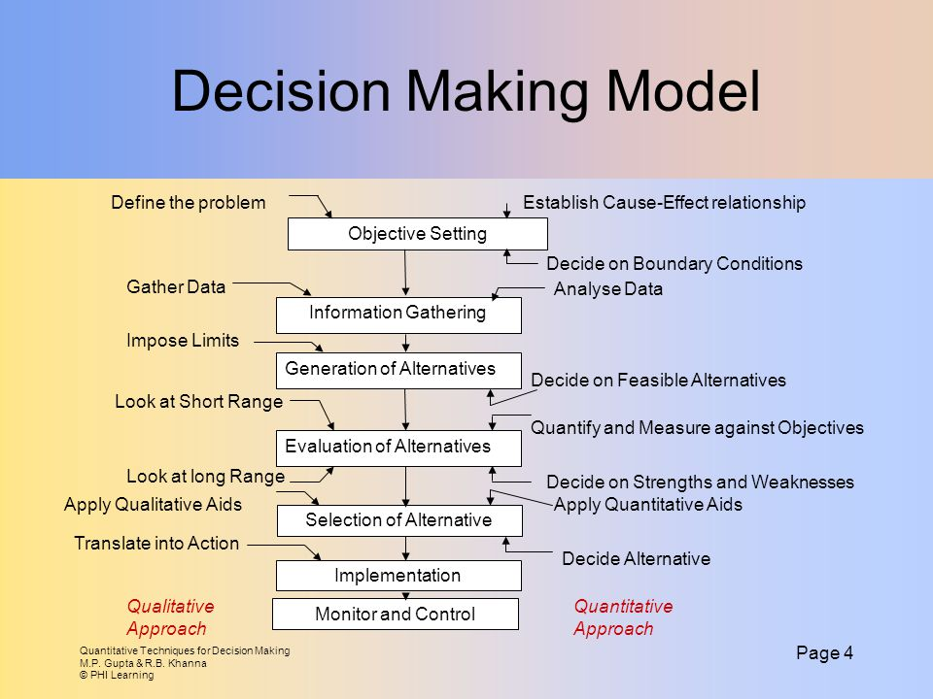

Slide 68
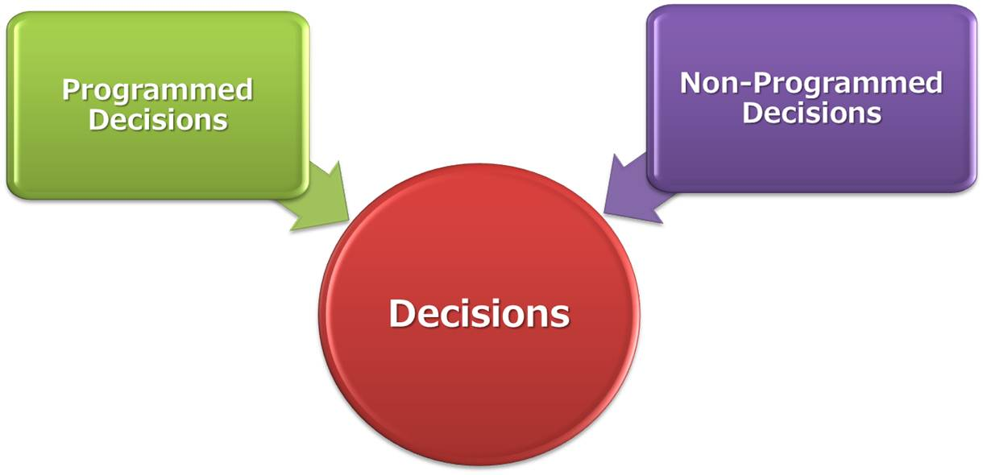
Decision-Making
https://www.youtube.com/watch?v=8rhEHPixPFU

Slide 69
Techniques of Decision Making
Programmed Decisions
Game Theory
Decision Tree
Linear Programming
Network Techniques
Queuing Technique
Non Programmed Decisions
Brainstorming
Delphi
Heuristics
Nominal Group
Quality Circles

Slide 70
Programmed Decision-Making
A decision that is repetitive and routine
A definite method for its solution can be established
Does not have to be treated a new each time it occurs
Procedures are often already laid out
Examples: pricing standard customer orders, determining billing dates, recording office supplies etc.

Slide 71
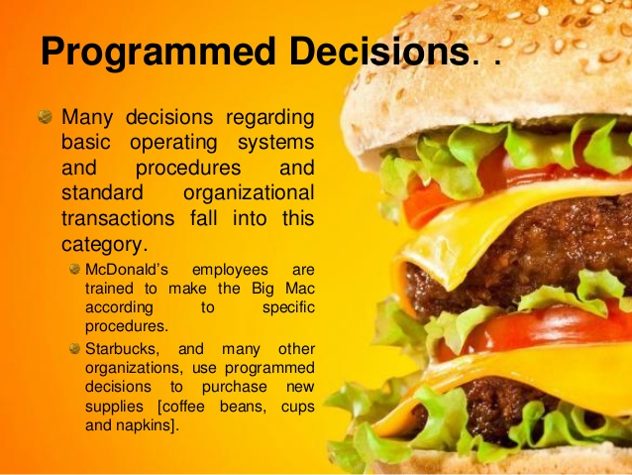

Slide 72
Non-programmed Decisions
A decision that is novel (new or unique) or Ill structured
No established methods exist, because it has never occurred before or because
It is too complex
Are “tough” decisions that involve risk and uncertainty and
call for entrepreneurial abilities
Such decisions draw heavily on the analytical abilities of the manager
Examples: Moving into a new market, investing in a new unproven technology, changing strategic direction
7

Slide 73
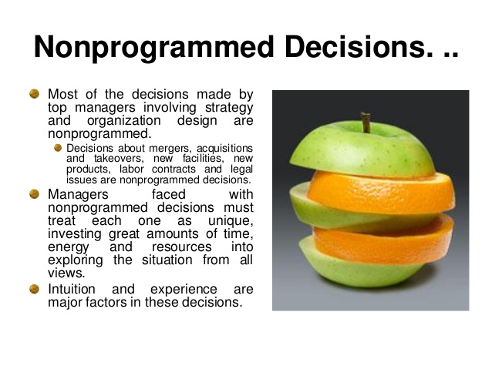

Slide 74
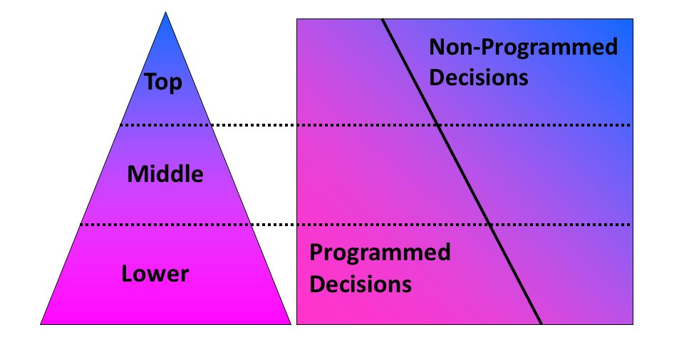
Decision Types & Managerial Levels

Slide 75
Programmed vs. Non-programmed Decisions
Characteristics | Programmed decisions | Non-programmed decisions
Type of problem | Structured | Unstructured
Managerial level | Lower level | Upper level
Frequency | Repetitive | New,unusual
Information | Readily available | Ambiguous or incomplete
Time frame for solution | Short | Relatively long
Solution relies on | Procedures,rules, and policies | Judgment and creativity

Slide 76
TYPES OF PROBABILITY TECHNIQUE OF DECISION MAKING
PROBABILITY THEORY
This theory predicts that certain things would happen and certain things won’t.
---The prediction is done based on the past experience. Even if there is a deviation from the presumption, the deviation won’t be much to influence the decision.
GAME THEORY
Here a problem is given to various teams. The problem may be pertaining to marketing, finance, production etc. Each team is told to devise strategies, techniques in order to solve the given problem. The objective is to win the game by giving the best solution with the given constraint.

Slide 77
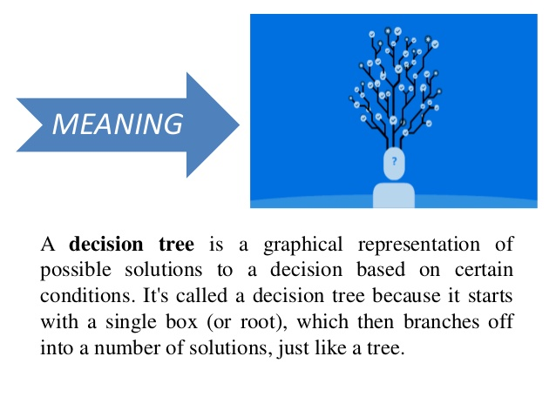
DECISION TREE

Slide 78
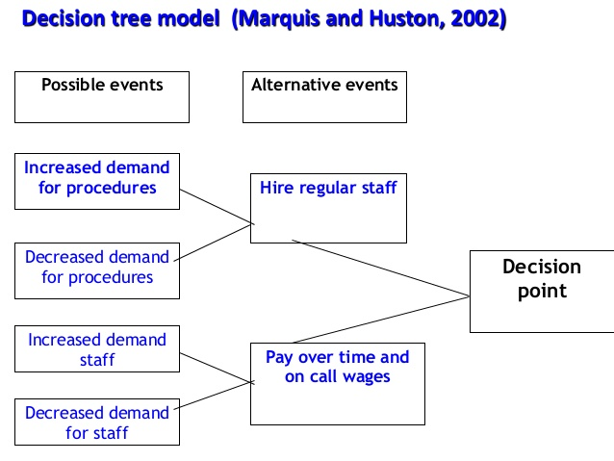

Slide 79
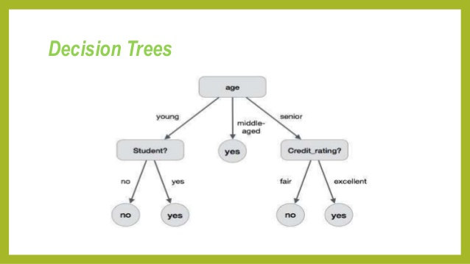

Slide 80
QUEING THEORY
This technique is useful to solve problems relating to waiting line or waiting list in the case of railway reservations, cash collection counters in shopping centres, admission to college etc.
Example at the time of college admission, more counters can be set up for receiving applications and for collection of fees.
The objective of this technique is to determine the optimum number of service facilities required and the cost of such services.

Slide 81
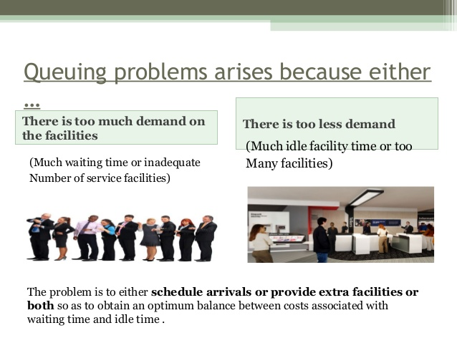

Slide 82
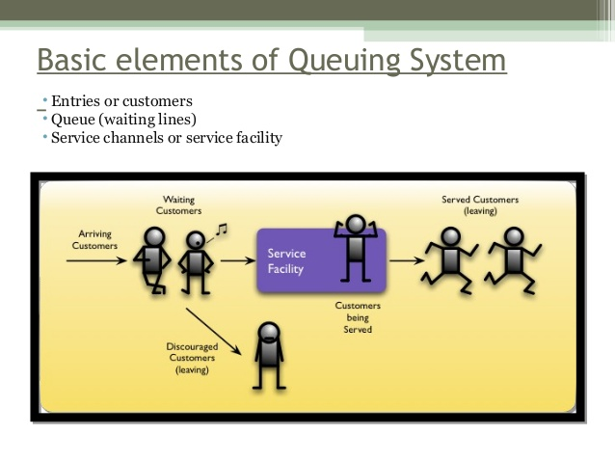

Slide 83
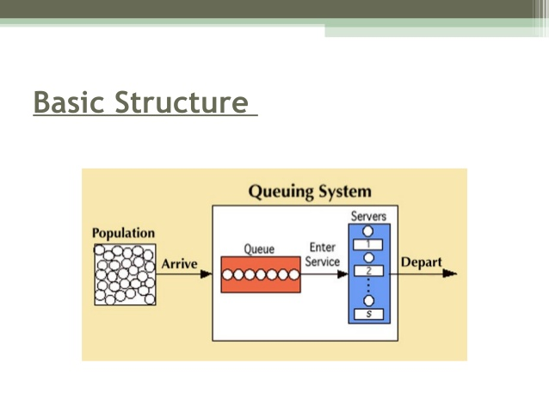

Slide 84
LINEAR PROGRAMMING
It is based on assumption that a linear or straight line relationship exists between variables
For example: In a factory, the variables may be units of output per worker, material cost per unit of output.
Linear theory is useful where input data can be quantified and object are subject to definite measurement.

Slide 85
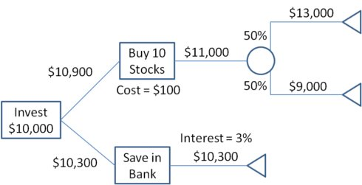

Slide 86
SIMULATION
The behaviour of events and variables is observed in an artificial or simulated situation.
The effect of decision making is observed in a simulated situation rather than in a real situation.
Example: an advertising agency can check the effectiveness of their campaign by screening it to selective audience in a shopping mall before releasing it for wider audience in the television network.

Slide 88

BRAINSTORMING
This technique was developed by Alex Osborn.
This technique was developed to generate new and creative solution to the problem.
Following are the requisite of a brain storming:
Encourage free flow of ideas
No ideas can be criticised.
One person can give as many ideas as possible.
People are allowed to piggyback on others ideas.
In a typical brainstorming session, a group of 5 to 6 person, sit across the table to generate idea.

Slide 89
2. DELPHI TECHNIQUE
Another technique which capitalises group's resources, while avoiding several possible disadvantages of relying on group decision-making processes
This approach, called the Delphi Technique, is similar to NGT in several respects, but also differs significantly in that the decision-makers never actually meet.
Its greatest advantage is that it avoids many of the biases and obstacles associated with interacting groups (that is, groups where the members meet face-to-face)

Slide 90
DELPHI follows these steps:
Select a group of individuals who possess expertise in a given problem area
Survey the experts for their opinions via a mailed
questionnaire.
Analyse and distil the experts' responses.
Mail the
summarised results of the survey to the
experts and request that they respond once again to a
questionnaire.
If one expert's opinion sharply differs from the rest,
he or
she may be asked to provide a rationale.
process is repeated several times, the experts achieve a consensus
usually

Slide 91

QUALITY CIRCLE
Ishikawa Kaoru popularised the concept of Quality circle in Japan in 1960.
It is a small group of employees from the same work area or department that volunteers to meet regularly in order to identify, analyse and solve problem.

Slide 92
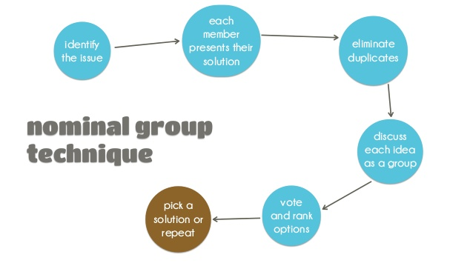

Slide 93
NOMINAL GROUP TECHNIQUE
In NGT, the group members think independently.
Each person comes with their own idea independently.
There are no initial interaction between group members.
The interaction takes place when the ideas are presented by each and every members of group.

Slide 94
The Keys To Making a Good Decision
Identify the decision to be made as well as the objectives or outcome you want to achieve.
Do your homework. Gather as many facts and as much information you can to assess your options.
Brainstorm and come up with several possible choices. Determine if the options are compatible with your values, interests and abilities.
Weigh the probabilities or possible outcomes. In other words, what's the worst that can happen? What will happen if I do A, B or C and can I live with the consequences?
Make a list of the pros and cons. Prioritize which considerations are very important to you, and which are less so. Sometimes when you match the pros against the cons you may find them dramatically lopsided.
Solicit opinions and obtain feedback from those you trust or have had a similar situation to contend with. There may be some aspects you haven't thought about.
Make the decision and monitor your results. Make sure you obtain the desired outcome.

Slide 95
ESSENTIALS OF DECISION MAKING
Essentials of decision making
Subject matter of decision making
Analysis of the objectives and policies
Systematic gathering of information
Analytical study of the alternatives
Proper communication system
Follow up

Slide 96

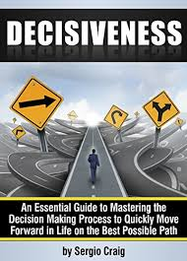
IMPACT OF TECHNOLOGY ON DECISION MAKING
Quick decision making.

Slide 97
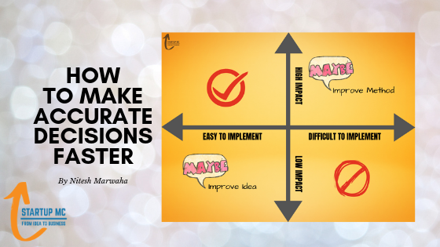




Accuracy of decision making

Slide 98



Facilitate group decision making

Slide 99



Collection of information
Exchange of information

Slide 100

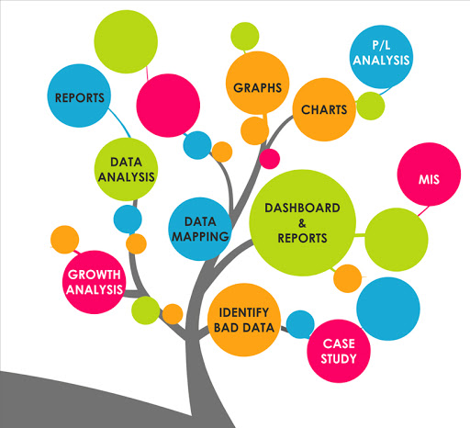
Access of data
Lower costs

Slide 101
Automation of routine matters

Slide 102
REFERENCES
◆ http://www.tutorialspoint.com/management_concepts/decision_making_proces
s.htm
◆ http://www.slideshare.net
◆ http://www.authorstream.com/
◆ http://en.wikipedia.org/wiki/Decision-making
◆ http://smallbusiness.chron.com/
◆ education-portal.com/.../bounded-rationality
◆ Books:
Introduction to management by L.M. Prasad
Handbook on Decision making by Lakhmi C Jain Vol 4
March 6, 2015

