Slide 1
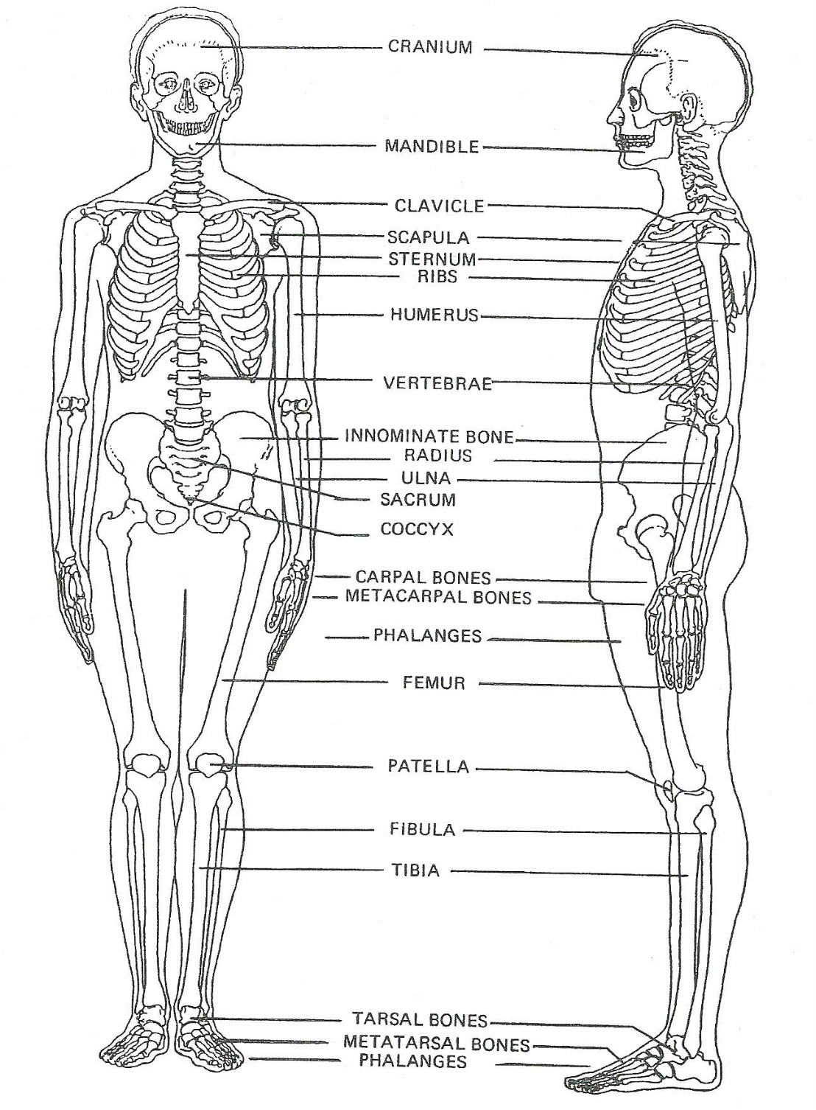
Thakur College of Science & Commerce
Department of Zoology
Academic Year – 2020-21
T.Y.B.Sc. Zoology
Semester – V
Paper –III Unit - II
Human Osteology
Dr. Vitthal T. Mohite

Slide 2
Osteology
Osteology, derived from the Greek words osteon.(bone) and logos (knowledge), is the scientific study of bones, practised by osteologists.
A subdiscipline of anatomy, anthropology, and paleontology, osteology is a detailed study of the structure of bones, skeletal elements, teeth, microbone morphology, function, disease, pathology, the process of ossification (from cartilaginous molds), and the resistance and hardness of bones.
Osteology is the science of bones, both of humans and animals.
It can be used in a variety of applications, including criminal investigations, engineering, and the study of human evolution.
Osteology should not be confused with osteopathy, which is a type of alternative medicine that emphasizes the healing of the “whole patient.”

Slide 3
Application of Osteology
Osteological approaches are frequently applied to investigations in disciplines such as vertebrate paleontology, zoology, forensic science, physical anthropology and archaeology, and has a place in research on topics including:
Ancient warfare
Activity patterns
Criminal investigations
Demography
Developmental biology
Diet
Disease
Genetics of early populations
Fossil assemblages
Health
Human migration
Identification of unknown remains
Physique
Social inequality
War crimes

Slide 4
Human Osteology
In the human body, there are 206 bones, which can be classified according to their shape: long bones, short bones, flat bones, and irregular bones.
Bones are also made of different types of tissues based on their texture.
There is compact bone, which is found on the surface of bones and is dense and solid, and spongy bone.
It is porous and is found on the inside of bones.
Bones have several functions, which include:
Acting as a frame to support the body and protect our organs like the heart and lungs.
Muscles, tendons, and ligaments also attach to our bones to help us move.
Producing blood cells and platelets, which are important for the formation of new blood and for healing wounds.
Storing minerals like calcium and phosphorus, as well as energy reserves like lipids.

Slide 5
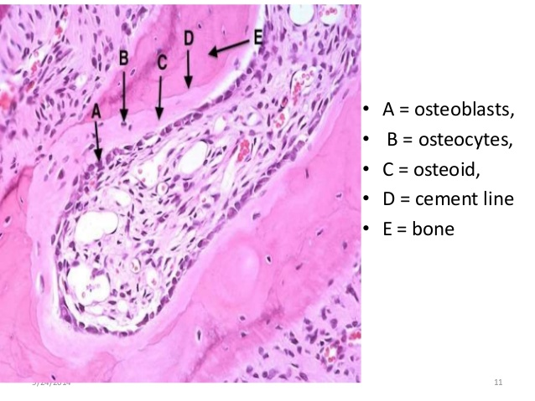
Bone Histology
Bone strong , flexible semi-rigid supporting tissue.
Bone is made up of cells & Extracellular Matrix.
1) Cells: Bone cells are called Osteoblasts & Osteocytes.
2) Extracellular Matrix : made up of organic matrix(30 %).
It contains proteoglycans, glycosaminoglycans, glycoproteins, Osteonectin, osteocalcin.
It contain 25% water & 70 % minerals called hydroxyapatite.
Bone id resistant to bending, twisting, compression & Streching.
It is hard calcified & the collagen fiber help bone to resists tensile stresses.
https://youtu.be/yxIDQ_qN3HM

Slide 6
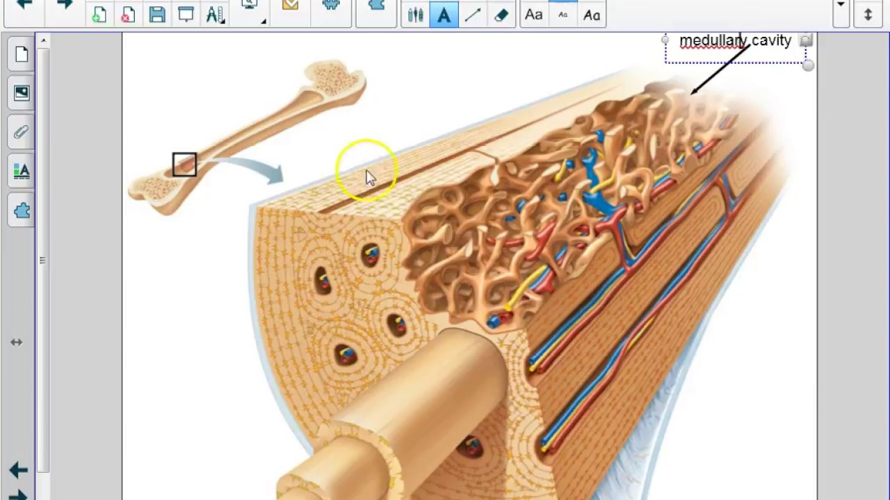

Slide 7
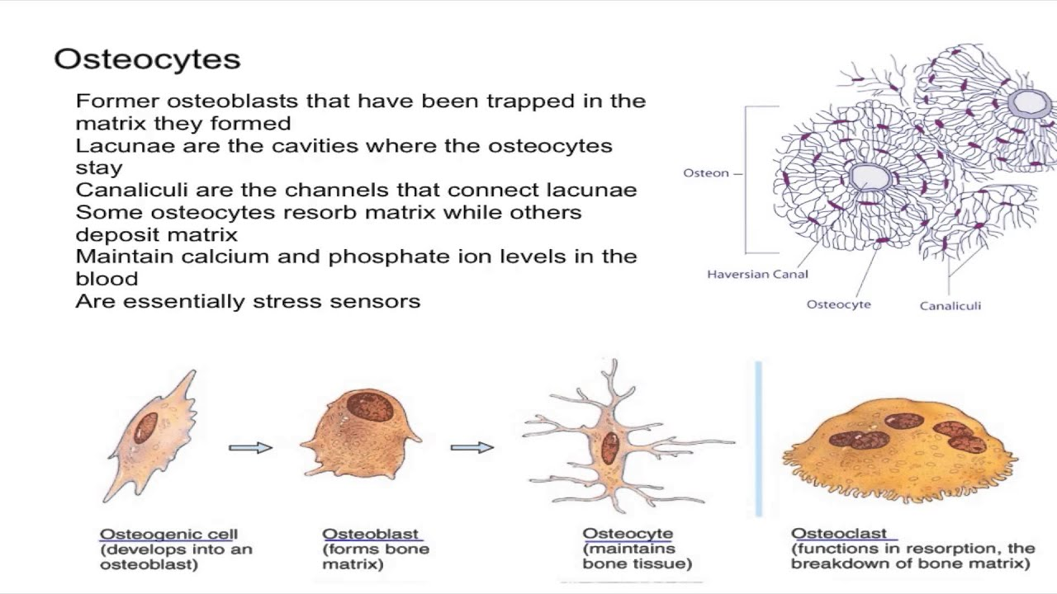
Types of Bone Cells

Slide 8
Physical properties of Bone
One of the hardest structure of human body.
Possesses certain degree of toughness & elasticity.
In fresh state it is pinkish-white externally & deep red within.
Made up of two type of tissue.
  a) Compact tissues : dense structure like ivory, Exterior bone.
  b) Cancellus tissues : Slender fibres &lamellae. Interior.
Compact tissues are extremely porous.
The different structure between two tissues depends upon solid matter, size, number of spaces in each.
Compact tissues cavities are small & filled with abundant solid matter.
Cancellus tissues cavities are large & filled with less quantity of solid matter.
Long bones of limbs are filled with cylindrical cavity filled with bone marrow.

Slide 9
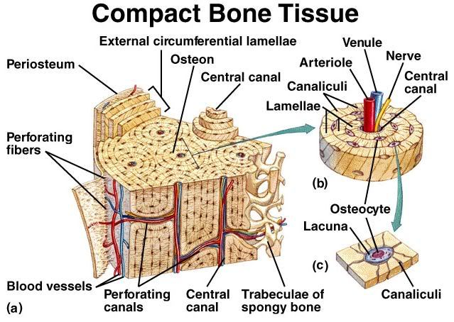
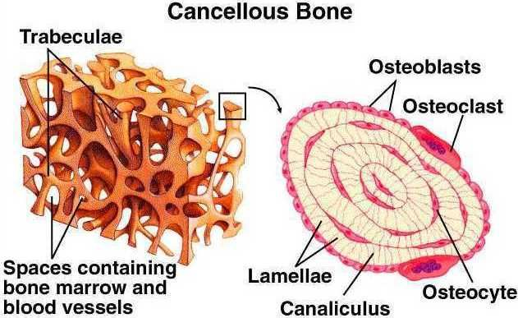

Slide 10
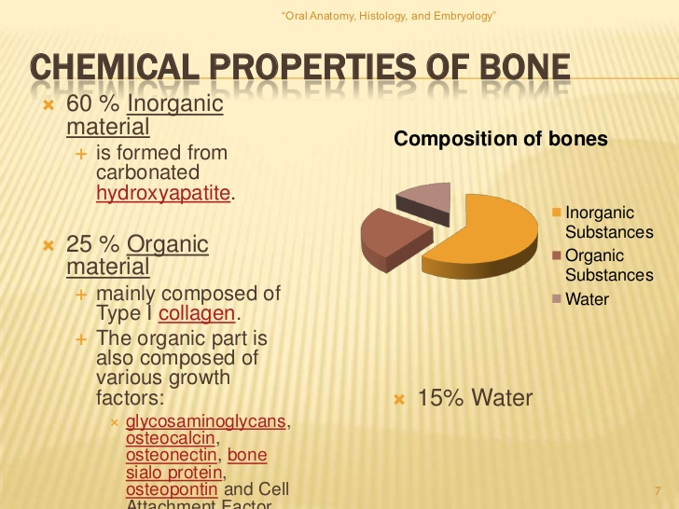

Slide 11
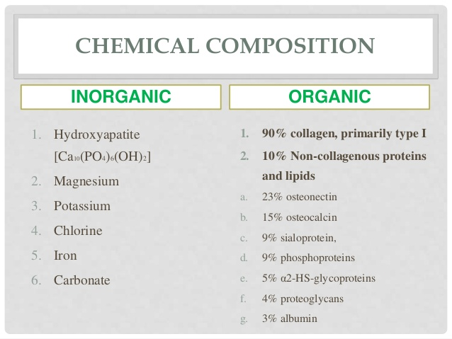
Chemical properties of Bone
Bones are rigid body tissue consisting of cells embedded in an abundant hard intercellular material.

Slide 12
General Functions of Bone
Protection :Protect all body organs.
Shape : Provide framework to the body.
Movements : Bones working moving machinery of human body.
Synthesis of blood cells : Capable of producing blood cells.
Mineral storage : It serves important storage house for variety of minerals.
Fat Storage : Yellow bone marrow serves as storage of fats.
Role in acid base balance : Bone buffers the blood against excessive pH by absorbing or realizing alkaline salts.

Slide 13
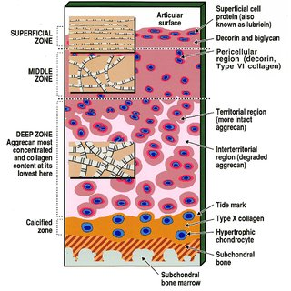
General Structure of Cartilage

Slide 14
General Structure of Cartilage
Cartilage is stiff but flexible connective tissues.
It is stiffer & less flexible than a muscle but not as hard and rigid as bones.
Made up of dense matrix of collagen fibers & elastic fibers embedded in rubbery ground substance.
The matrix is produced by cells called Chondroblasts.
Mature cartilage is called chondrocytes are present either in single or group.
Surface of cartilage is surrounded by membrane called perichondrium.
Perichondrium is of dense irregular connective tissues.
Cartilage except in pericardium do not possess any blood vessels or nerves.

Slide 15
Characteristic features of Cartilage
Cartilage has no B.V., nerves & Lymphatics.
Nutrition of cells diffuses through matrix.
Slow healing process in cartilage.
Due to absence of nerves cartilage is insensitive.
Surrounded membrane is called Perichondrium.
Perichondrium plays important role of regeneration of cartilage.
When cartilage calcifies the chondrocytes dies and that cartilage replaced by bone.
Calcium salt is not present in cartilage matrix.
Flexibility of cartilage is due to the presence of chondrium.

Slide 16
Types of Cartilage
1. Hyaline cartilage
2. Fibro Cartilage.
3. Elastic Cartilage

Slide 17
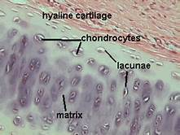
1. Hyaline cartilage
It is the type of cartilage with very thin fibers.
This is a articular cartilage of bones, sternum, ribs etc.
Its color is bluish white, shiny elastic material with matrix of chondroitin sulphate.
It contains numerous chondrocytes.
It provides smooth surfaces enabling tissues to move.
It also provides flexibility & support.

Slide 18
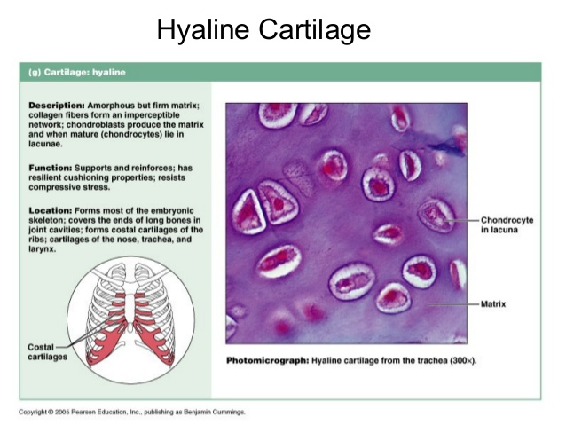

Slide 19
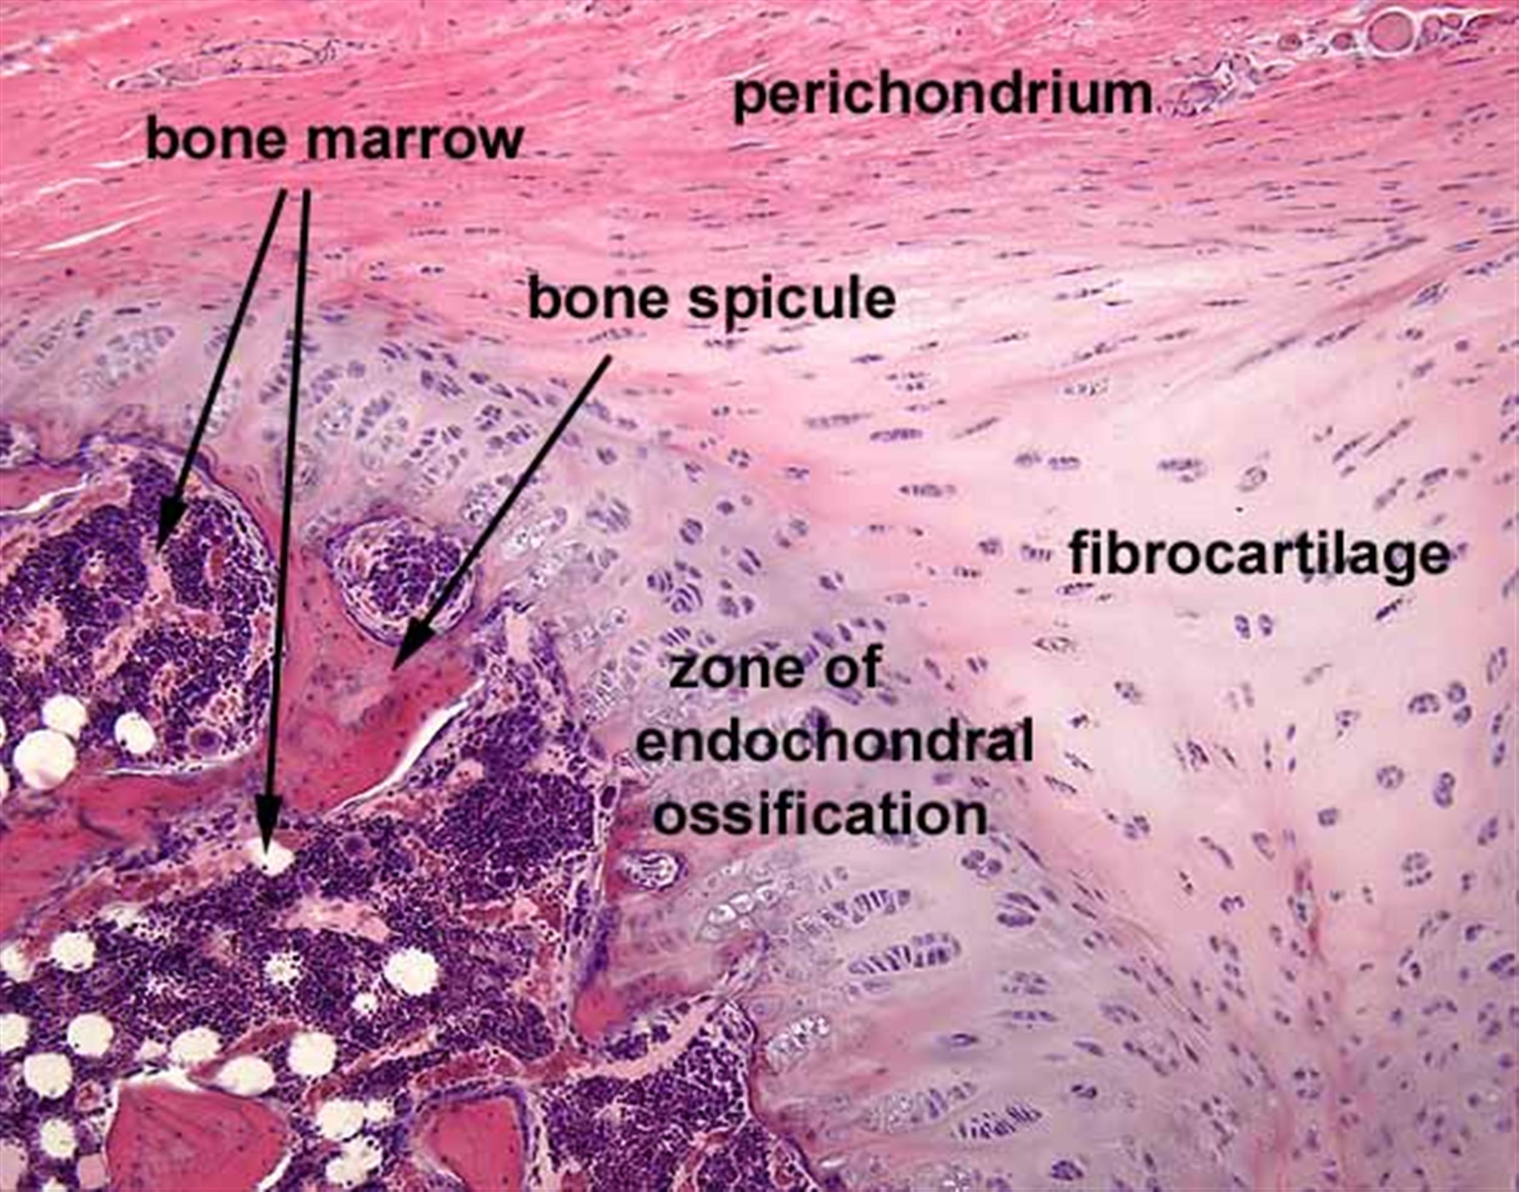
2. Fibro Cartilage.
This is made up of numerous white fibers.
It is present in the symphysis pubis, Sternoclavicular joint.
Its color is glistening white, opaque and tough cartilage.
It consists of chondrocytes scattered among the clearly visible dense bundles of collagen fibers.
It provides support & rigidity to structures.
It is strongest of all three types of cartilage.

Slide 20
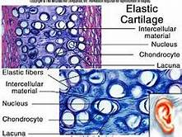
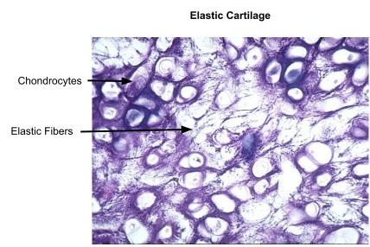
Elastic Cartilage
ggg

Slide 21
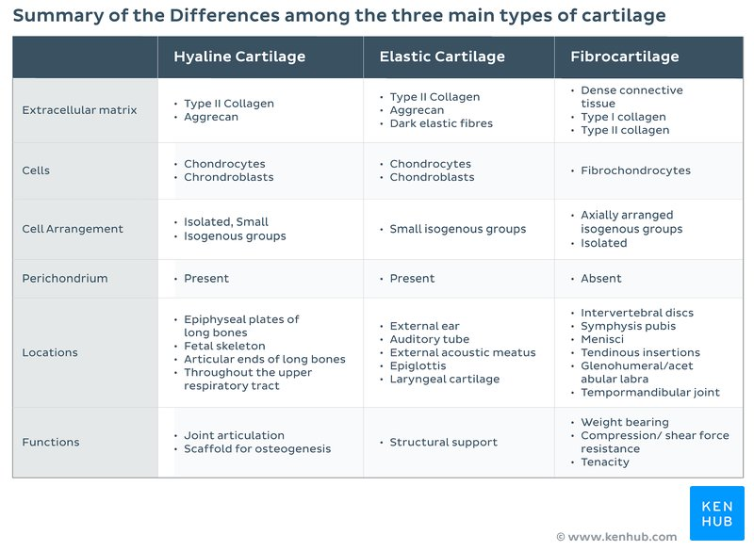

Slide 22
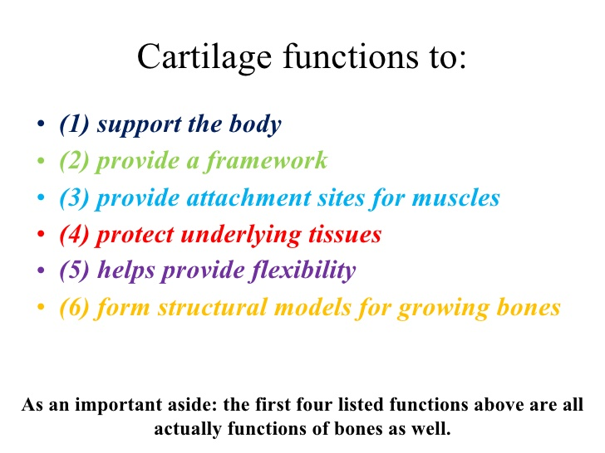

Slide 23
Human Skeleton
Skeleton is the hard framework of human body around which the entire body is built.
Almost all the hard parts of human body are components of human skeletal system.
Joints are very important because it allow different types of movements at different locations.
Humans are vertebrates, animals having a vertebral column or backbone.
They rely on a sturdy internal frame that is centered on a prominent spine.
It consists of bones, cartilage, ligaments and tendons and accounts for about 20 percent of the body weight.
Composed of 270 bones at birth, decrease upto 206 bones at adulthood.
At age of 21 density of bone is maximum.

Slide 24
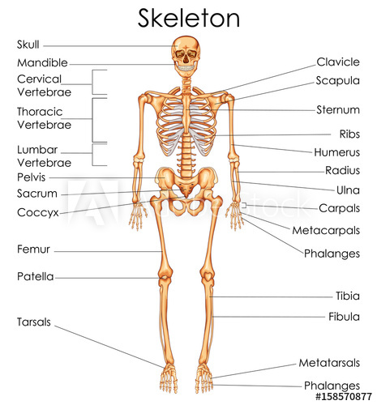

Slide 25
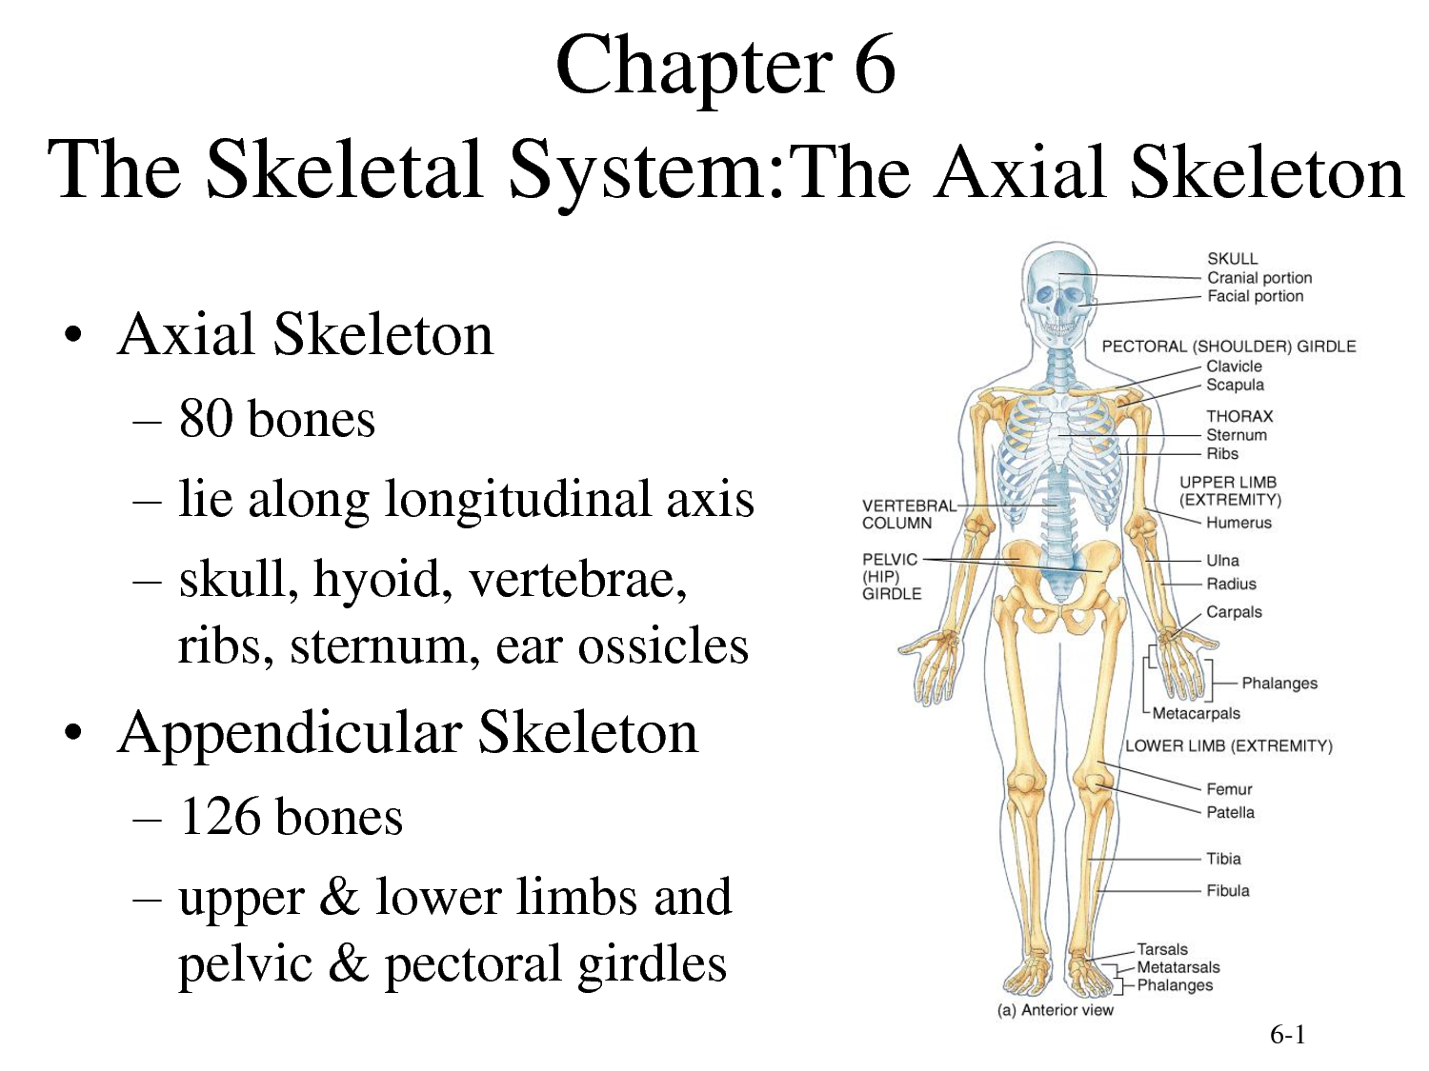

Slide 26
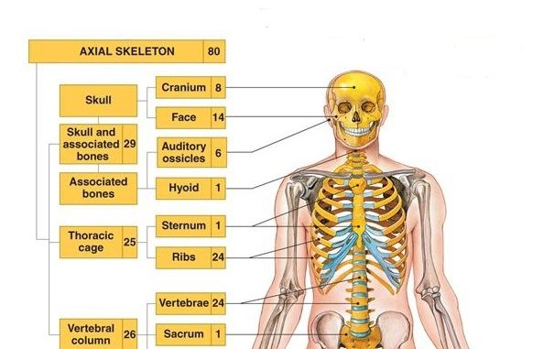

Slide 27
General Characters of Skull Bones
Provides protection to brain.
Have organ of vision, taste, hearing, equilibrium and smell.
Provide surface for attachment to the muscles.
The main and overall function of the skull is to protect the brain and sensory organs and support facial structures.
Individual bones within the structure of the skull take on other and more specific roles.
General Features and Functions of the Skull.
The human skull is the part of the skeleton that supports the structures.

Slide 28
Skull Bones
Of two Types
1. Cranial Bones : Frontal, parietal and Temporal
2. Facial Bones : Nasal, Maxillary,
The human skull is generally considered to consist of twenty-two bones — eight cranial bones and fourteen facial skeleton bones.
In the neurocranium these are the occipital bone, two temporal bones, two parietal bones, the sphenoid , ethmoid and frontal bones.

Slide 29
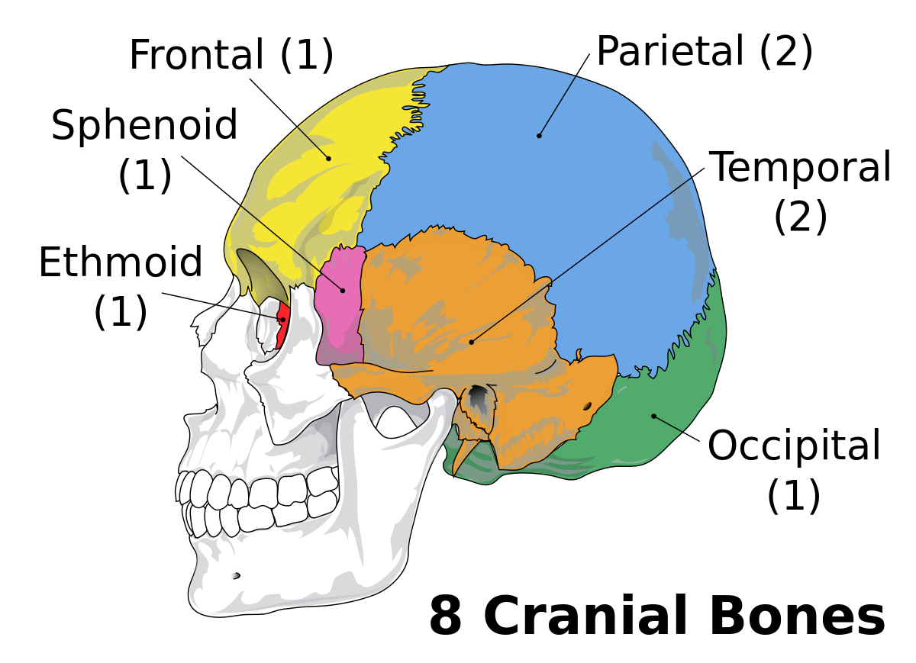

Slide 30
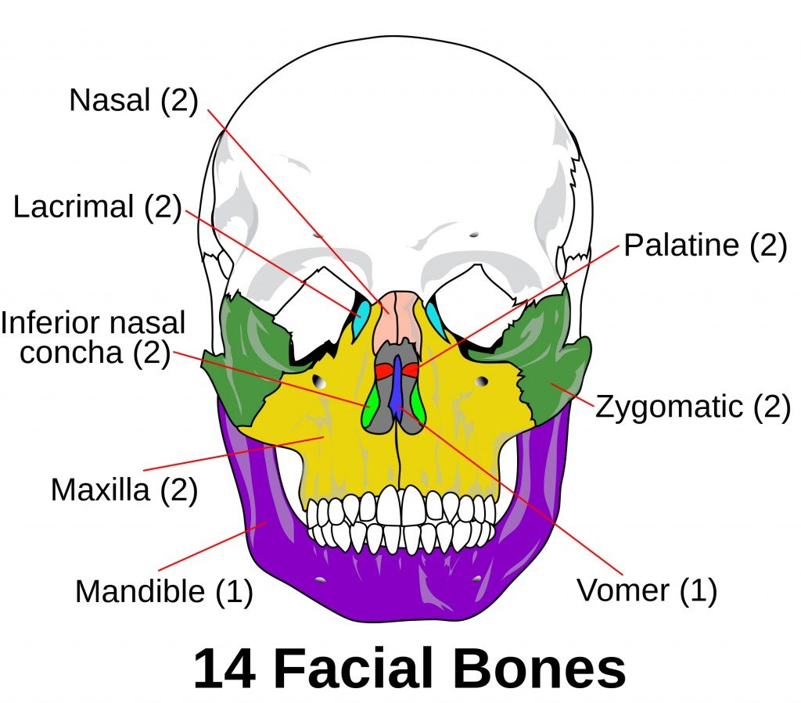

Slide 31
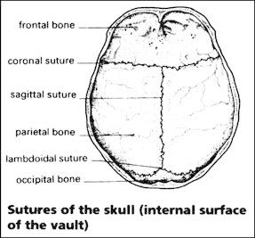
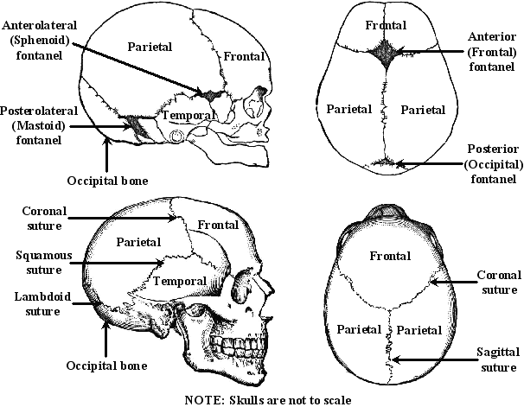
Different sutures in skull

Slide 32
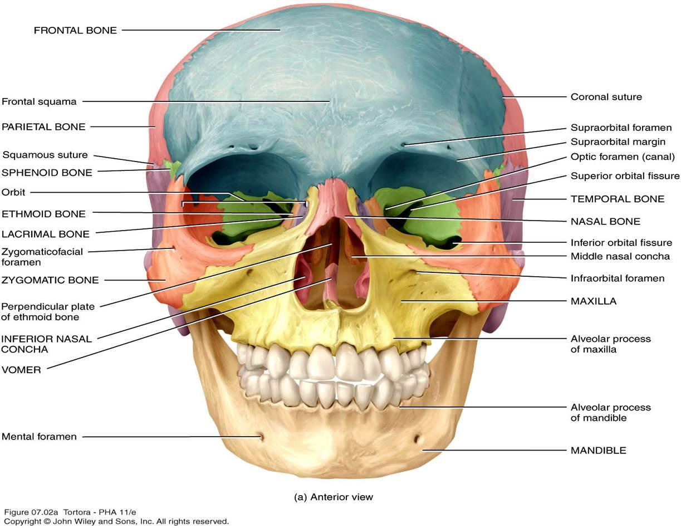
Cranial Bones
Frontal Bone :
The frontal bone is one of the principal paired mid-line bones in dinosaur skulls.
This bone is part of the skull roof, which is a set of bones that cover the brain, eyes and nostrils.
The frontal makes contact with several other bones in the skull.
The anterior part of the bone articulates with the nasal bone and the prefrontal bone.
The frontal bone is one of the principal paired mid-line bones in dinosaur skulls.
The frontal bone is made up of two main parts.
These are the squamous part, and the orbital part.
The squamous part marks the vertical, flat, and also the biggest part, and the main region of the forehead.
The orbital part is the horizontal and second biggest region of the frontal bone.
It enters into the formation of the roofs of the orbital and nasal cavities.
Sometimes a third part is included as the nasal part of the frontal bone, and sometimes this is included with the squamous part.
The nasal part is between the brow ridges, and ends in a serrated nasal notch that articulates with the nasal bones inferiorly, and with the lacrimal and maxilla bones laterally.

Slide 33
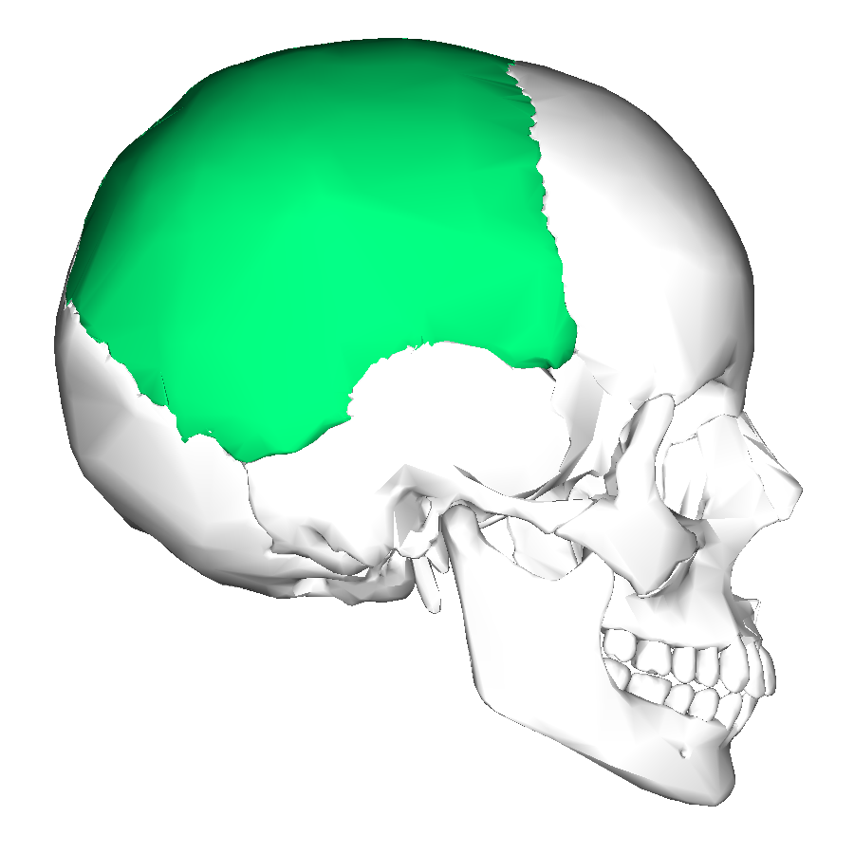
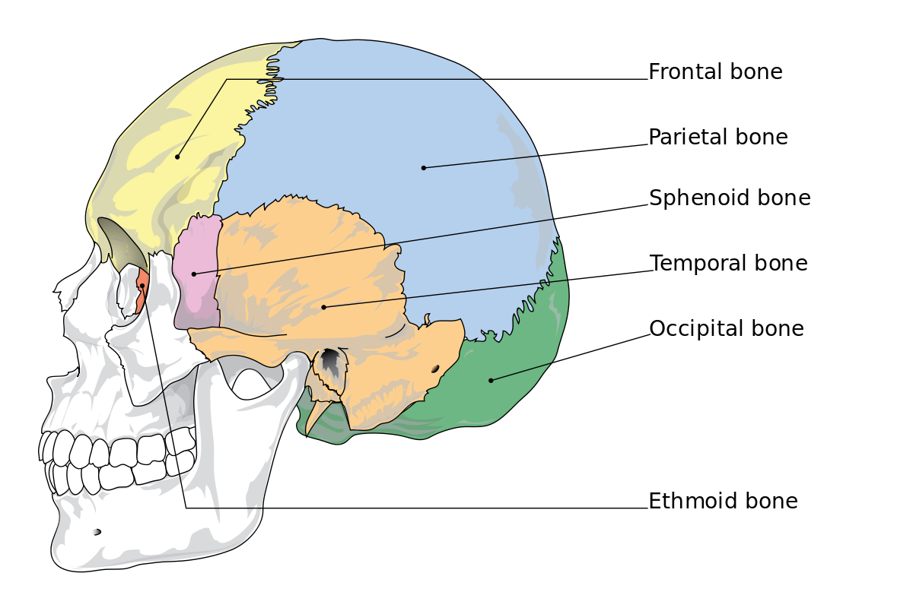
Parietal Bone
The parietal bone is an irregularly shaped bone that extends to cover the top of the skull along with some of each side of the skull.
Due to its location on the skull, the parietal bone also touches other parts of the skull, including the frontal bone, temporal bone, and occipital bone .
The external surface is convex, smooth, and marked near the center by an eminence, the parietal eminence (tuber parietale), which indicates the point where ossification commenced.
Crossing the middle of the bone in an arched direction are two curved lines, the superior and inferior temporal lines; the former gives attachment to the temporal fascia, and the latter indicates the upper limit of the muscular origin of the temporal muscle.
Above these lines the bone is covered by a tough layer of fibrous tissue – the epicranial aponeurosis; below them it forms part of the temporal fossa, and affords attachment to the temporal muscle.
At the back part and close to the upper or sagittal border is the parietal foramen which transmits a vein to the superior sagittal sinus, and sometimes a small branch of the occipital artery; it is not constantly present, and its size varies considerably.

Slide 34
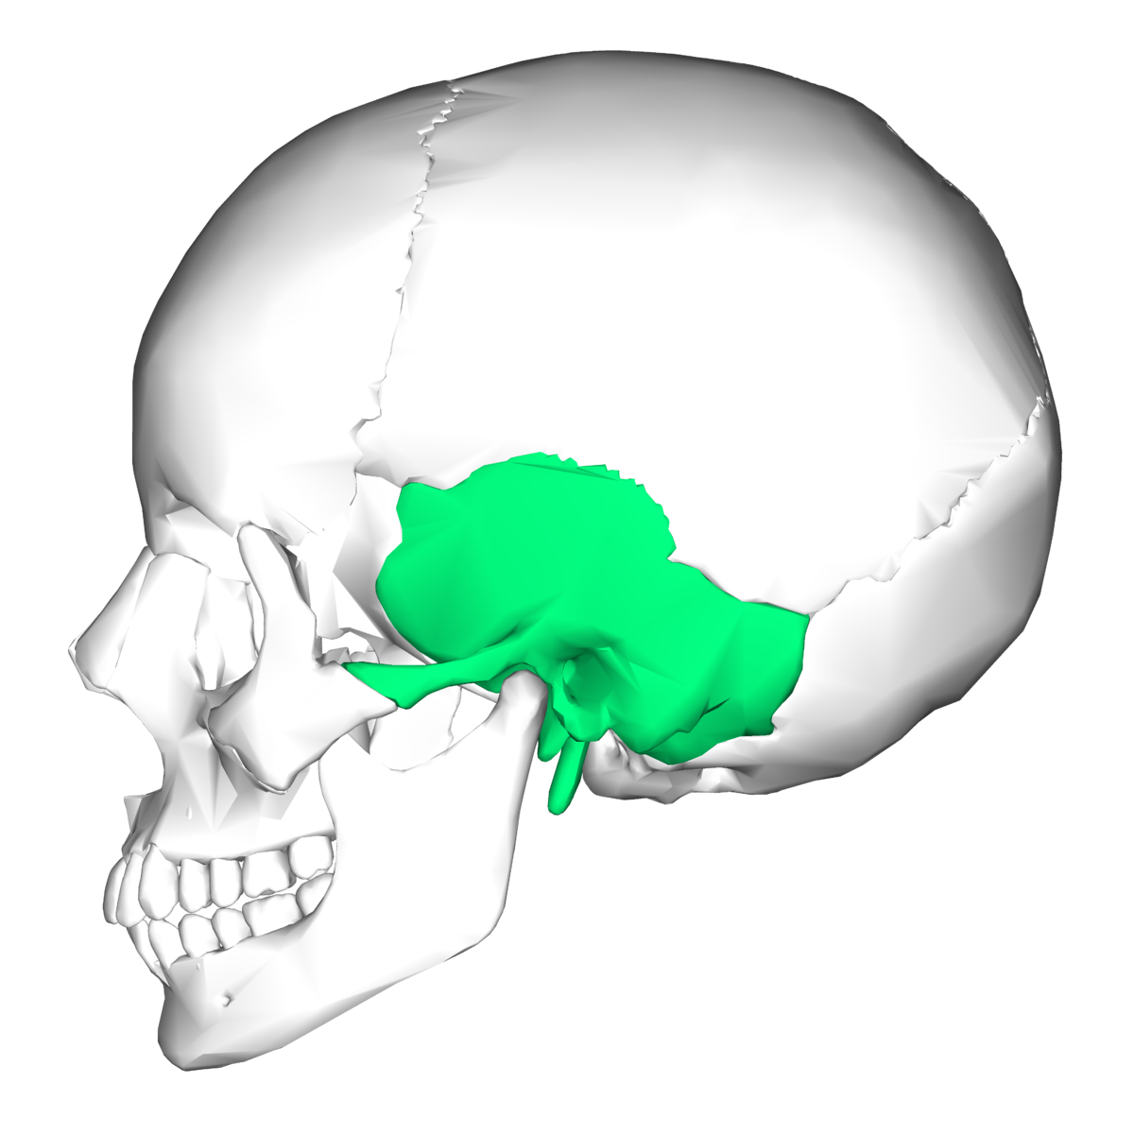
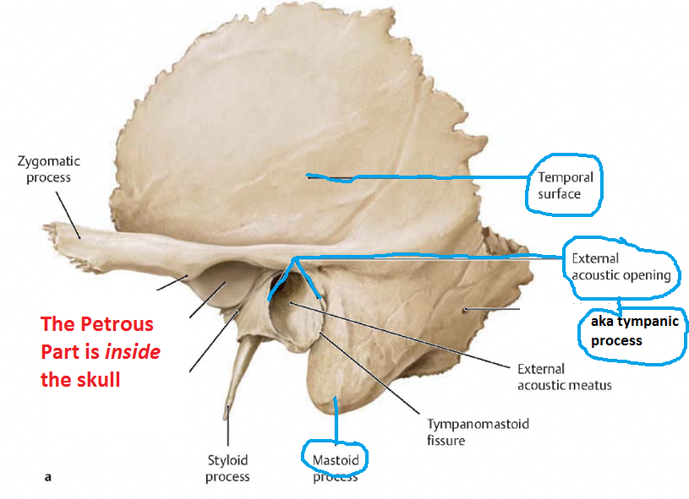
Temporal Bone
The temporal bones are paired bones that help make up the sides and base of the skull (cranium).
This places them lateral—to the side of—the temporal lobes of the brain’s cerebral cortex, ensuring that the cranium is properly supported and protecting the important structures there.
The mastoid part of the temporal bone is situated posteroinferior to the squamous part, and presents the following landmarks: 1 mastoid process, containing 2 mastoid cells, 3 mastoid antrum, 4 mastoid notch, 5 groove for occipital artery, 6 mastoid foramen, 7 groove for sigmoid sinus.
The temporal bone contributes to the lower lateral walls of the skull.
It contains the middle and inner portions of the ear, and is crossed by the majority of the cranial nerves.
The lower portion of the bone articulates with the mandible, forming the temporomandibular joint of the jaw.
In this article, we shall look at the different parts of the temporal bone, their articulations, and any clinical correlations.
The temporal bone consists of four parts the squamous, mastoid, petrous and tympanic parts.

Slide 35
Temporal Bone
The squamous part is the largest and most superiorly positioned relative to the rest of the bone.
The zygomatic process is a long, arched process projecting from the lower region of the squamous part and it articulates with the zygomatic bone.
Fused with the squamous and mastoid parts and between the sphenoid and occipital bones lies the petrous part, which is shaped like a pyramid.
The tympanic part is relatively small and lies inferior to the squamous part, anterior to the mastoid part, and superior to the styloid process.

Slide 36
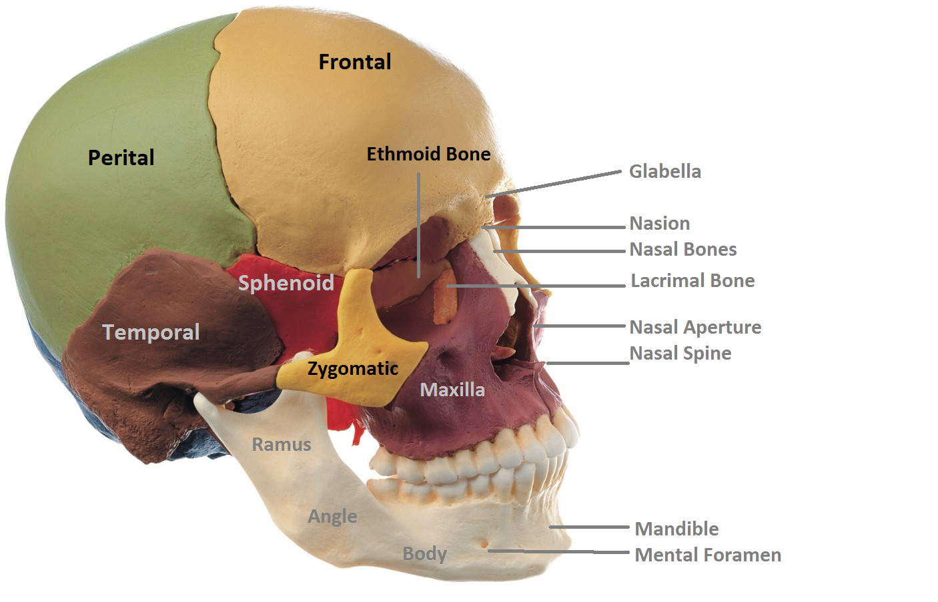
Ethmoid Bone

Slide 37
Ethmoid Bone
The ethmoid bone is an anterior cranial bone located between the eyes.
It contributes to the medial wall of the orbit, the nasal cavity, and the nasal septum.
The ethmoid has three parts: cribriform plate, ethmoidal labyrinth, and perpendicular plate.
The cribriform plate forms the roof of the nasal cavity and also contributes to formation of the anterior cranial fossa.
The ethmoidal labyrinth consists of a large mass on either side of the perpendicular plate, and the perpendicular plate forms the superior two-thirds of the nasal septum.
Between the orbital plate and the nasal conchae are the ethmoidal sinuses or ethmoidal air cells, which are a variable number of small cavities in the lateral mass of the ethmoid.

Slide 38
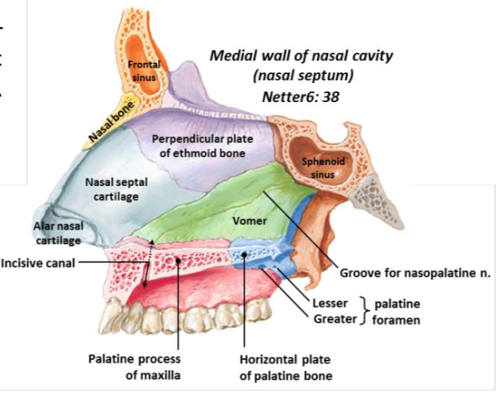

Slide 39
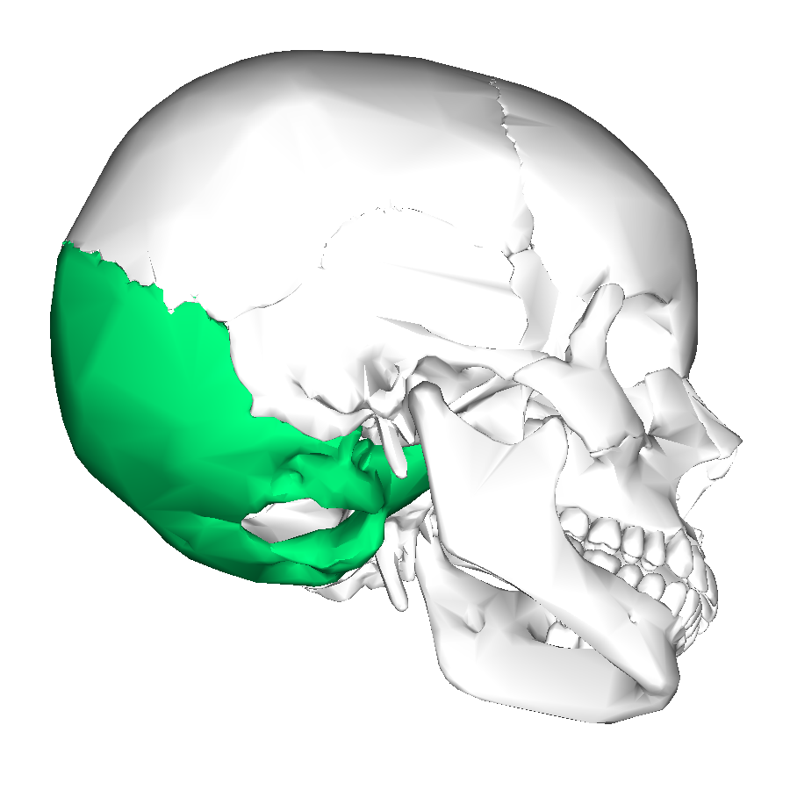
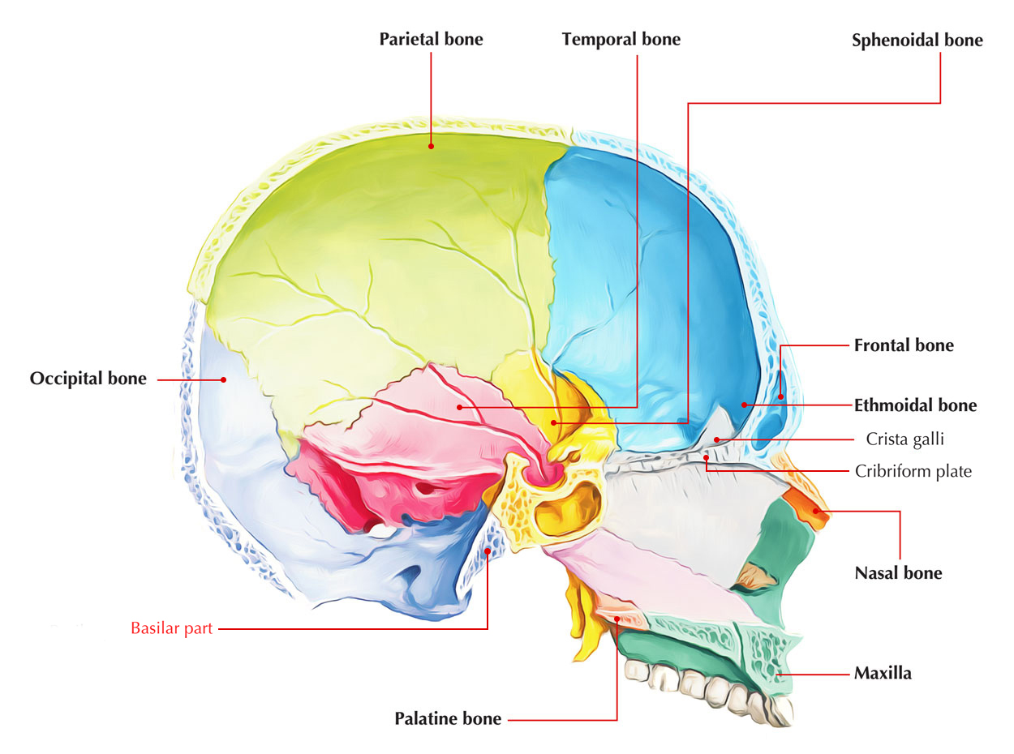
Occipital Bone
The occipital bone is a cranial dermal bone and the main bone of the occiput (back and lower part of the skull).
It is trapezoidal in shape and curved on itself like a shallow dish.
The occipital bone overlies the occipital lobes of the cerebrum.
At the base of skull in the occipital bone, there is a large oval opening called the foramen magnum, which allows the passage of the spinal cord.
Like the other cranial bones, it is classed as a flat bone.
Due to its many attachments and features, the occipital bone is described in terms of separate parts.
From its front to the back is the basilar part, also called the basioccipital, at the sides of the foramen magnum are the lateral parts, also called the exoccipitals, and the back is named as the squamous part.
The basilar part is a thick, somewhat quadrilateral piece in front of the foramen magnum and directed towards the pharynx.
The squamous part is the curved, expanded plate behind the foramen magnum and is the largest part of the occipital bone.

Slide 40
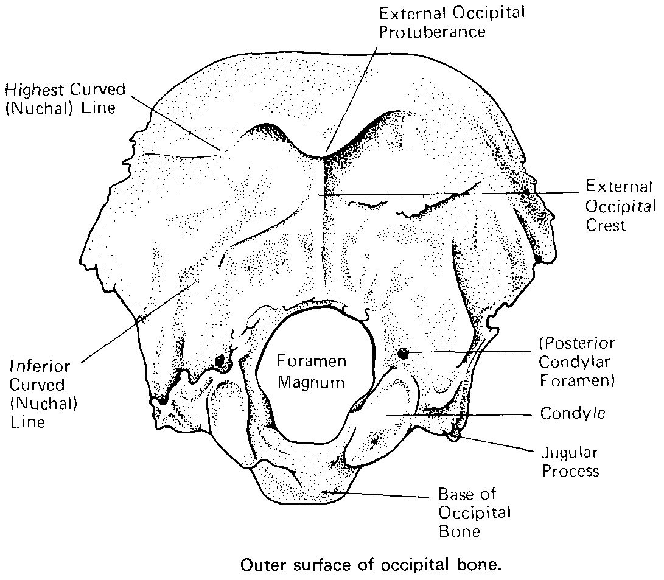

Slide 41
Facial Bones
Nasal bones
Maxillary bones
Zygomatic bones
Palatine bones
Vomer
Lacrimal Bones
Inferior nasal conchae
Mandibles
Hyoid

Slide 42
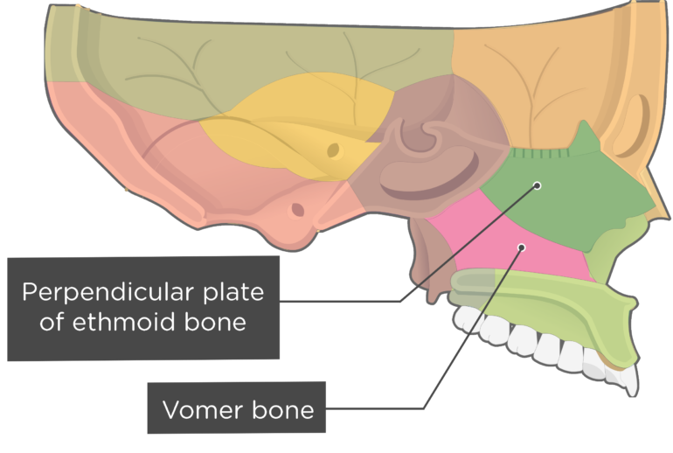

Slide 43
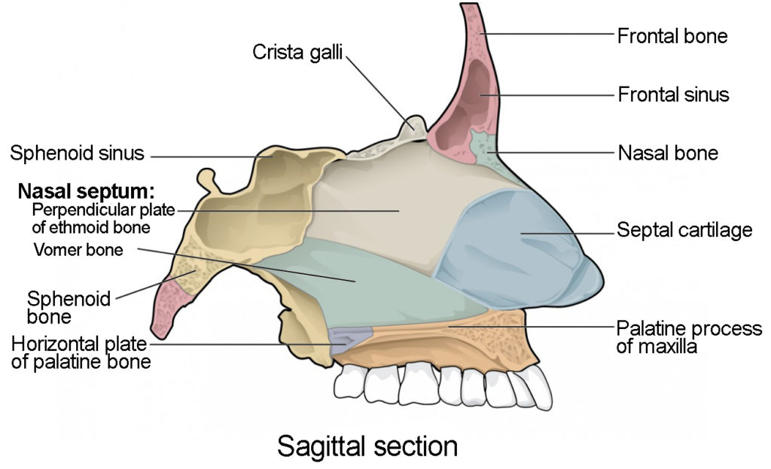

Slide 44
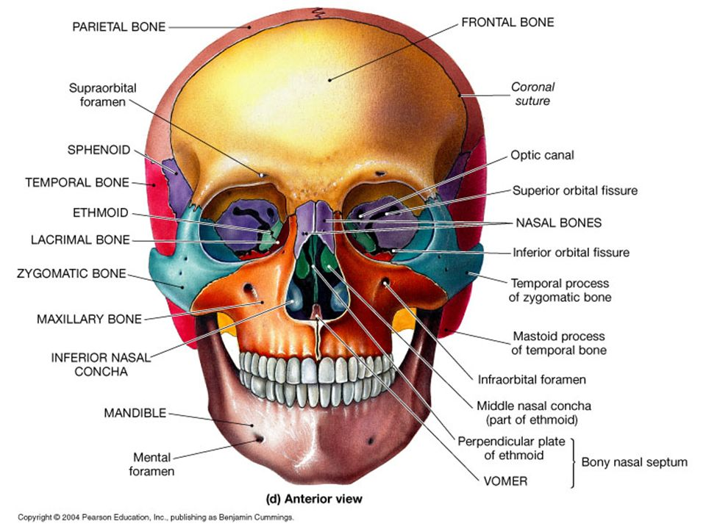

Slide 45
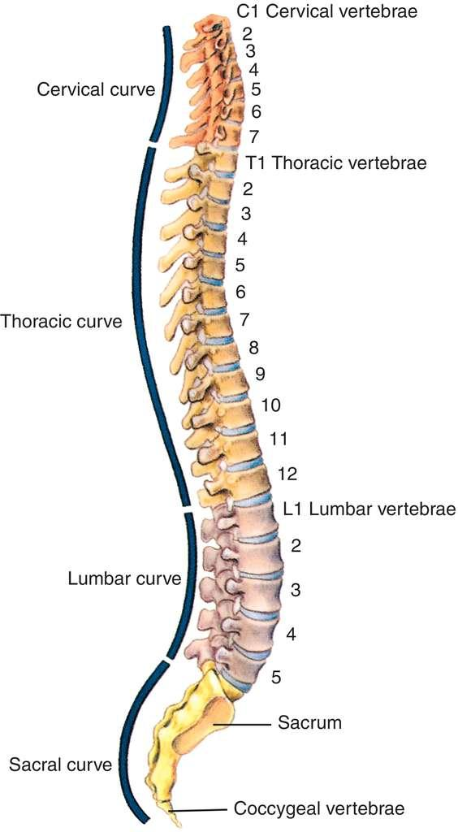
Vertebral Column
Vertebral column surrounds and Protects the spinal cord.
It supports head & acts as an attachment point for the ribs & muscles of the back & neck.
The adult vertebral column comprises with 26 bones.
24 vertebrae, the sacrum & the Coccyx bones.
7 Cervical, 12 thoracic, 5 lumbar, one sacrum and 1 coccyx.

Slide 46
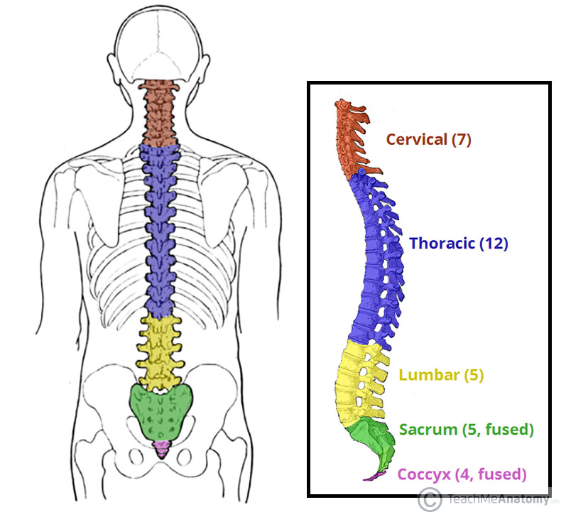

Slide 47
Function Vertebral Column
Permits movement (of the body), although limited movement between individual vertebrae.
Encloses and protects the spinal cord.
Provides points of attachment for the ribs (bones) and muscles of the torso, especially muscles of the back.

Slide 48
General Character of Typical Vertebra
The bodies in the middle of the thoracic region are heart-shaped and as broad in the anteroposterior as in the transverse direction.
At the ends of the thoracic region they resemble respectively those of the cervical and lumbar vertebrae.
They are slightly thicker behind than in front, flat above and below, convex from side to side in front, deeply concave behind, and slightly constricted laterally and in front.
They present, on either side, two costal demi-facets, one above, near the root of the pedicle, the other below, in front of the inferior vertebral notch; these are covered with cartilage in the fresh state.
when the vertebrae are articulated with one another, form, with the intervening intervertebral fibrocartilages, oval surfaces for the reception of the heads of the ribs.

Slide 49
Parts of Vertebra
Body : Larges part, more or less cylindrical. Upper & Lower surface is flattened, rough it gives attachment to intervertebral fibro-cartilage.
Pedicles : Two short thick processes which project backward, one on either side form upper part of body.
Laminae : Two broad plates directed backward & medial ward from pedicles. They fuse middle line posteriorly which posterior boundary of vertebral column.
Processes :
Spinous Processes : Directed backward & downward from the junction of laminae. Serve as attachment for muscles & Ligaments.
Articulate processes : Two Superior & Two inferior. Coated with hyaline cartilage
Transverse processes : Two transverse processes one at either side, serve as attachment of muscles & Ligaments.

Slide 50
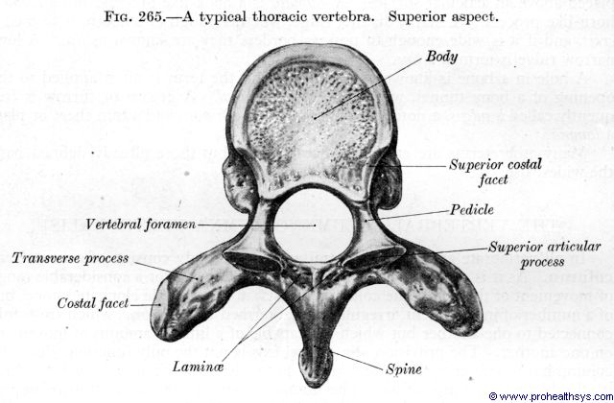

Slide 51
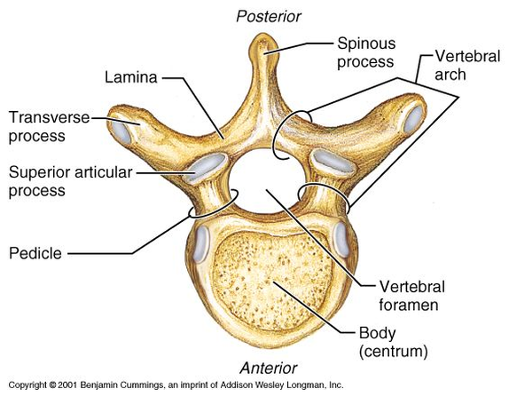

Slide 52
Structure of different types of Vertebra
V. C is with 26 bones but with 33 vertebrae.
At the age of 70 above sacrum & coccyx fused together.
Cervical vertebrae. At the base of the skull, the vertebral column starts with the cervical vertebrae.
There are seven of these, and they are numbered C1 through C7.
Thoracic Vertebrae. The thoracic vertebrae are the next 12vertebrae, moving down the body.
They articulate with the ribs, helping to protect the chest cavity containing the heart and lungs.
Lumbar Vertebrae. The next five vertebrae are the lumbar vertebrae, and these are the largest of the vertebrae.

Slide 53
Cervical Vertebra
In humans, cervical vertebrae are the smallest of the true vertebrae.
It can be readily distinguished from those of the thoracic or lumbar regions by the presence of a foramen (hole) in each transverse process, through which the vertebral artery, vertebral veins, and inferior cervical ganglion pass.
The remainder of this article focuses upon human anatomy.
The cervical vertebrae are numbered, with the first one (C1) closest to the skull and higher numbered vertebrae (C2–C7) proceeding away from the skull and down the spine.
The general characteristics of the third through sixth cervical vertebrae are described here.
The first, second, and seventh vertebrae are extraordinary, and are detailed later.

Slide 54
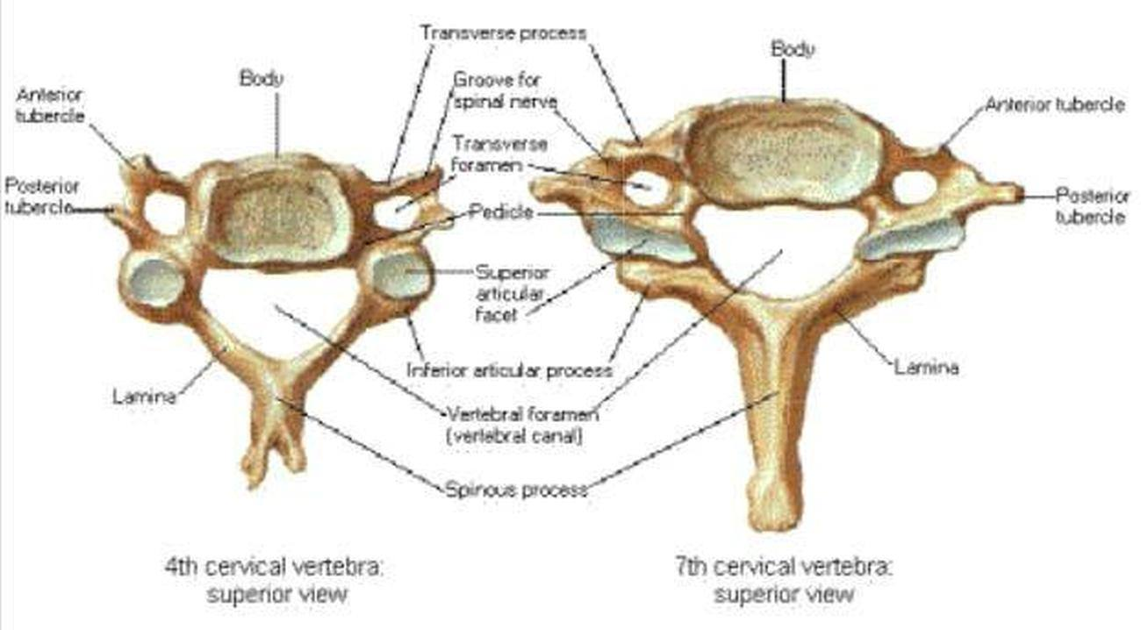
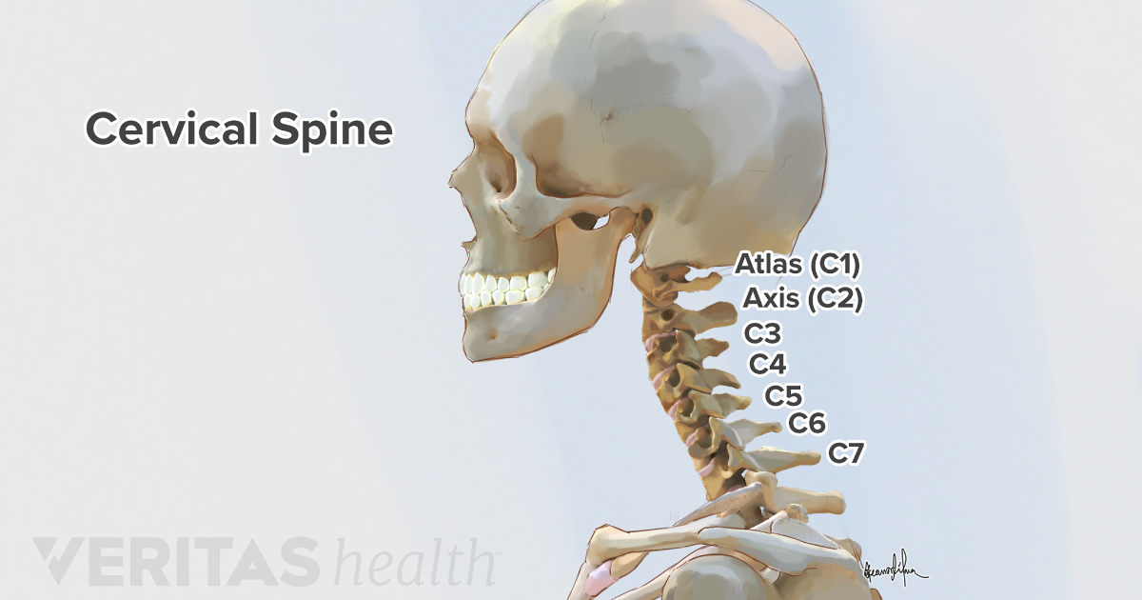

Slide 55
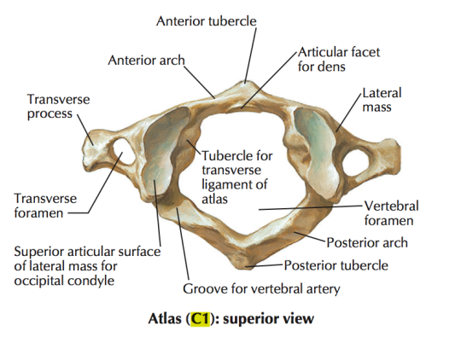
Atlas Vertebra ( 1st Cervical)

Slide 56
Atlas Vertebra
In anatomy, the atlas (C1) is the most superior (first) cervical vertebra of the spine and is located in the neck .
It is named for the Atlas of Greek mythology, because it supports the globe of the head which is the skull.
The atlas is the topmost vertebra and with the axis forms the joint connecting the skull and spine.

Slide 57
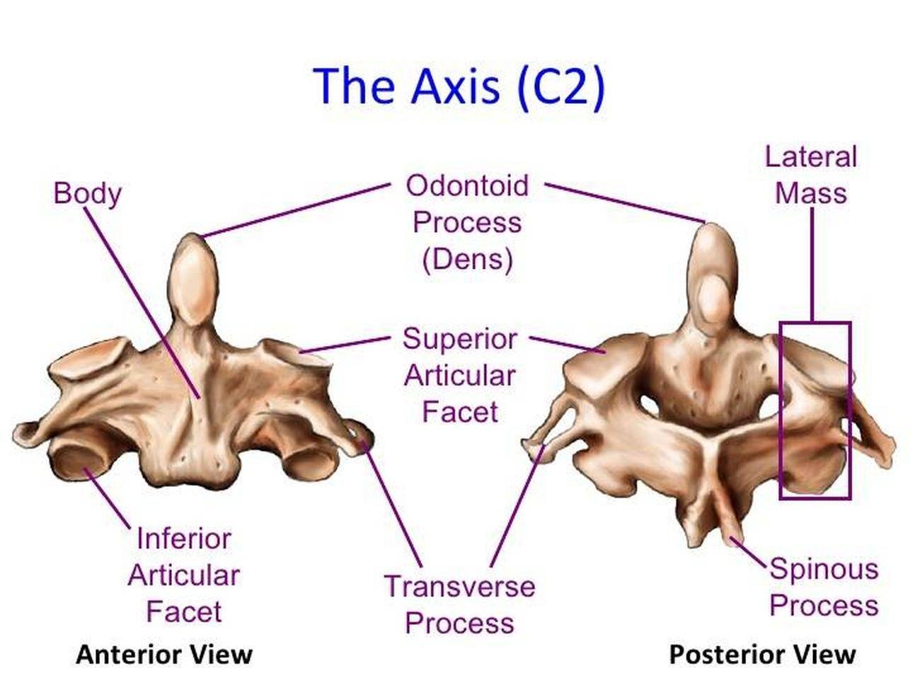
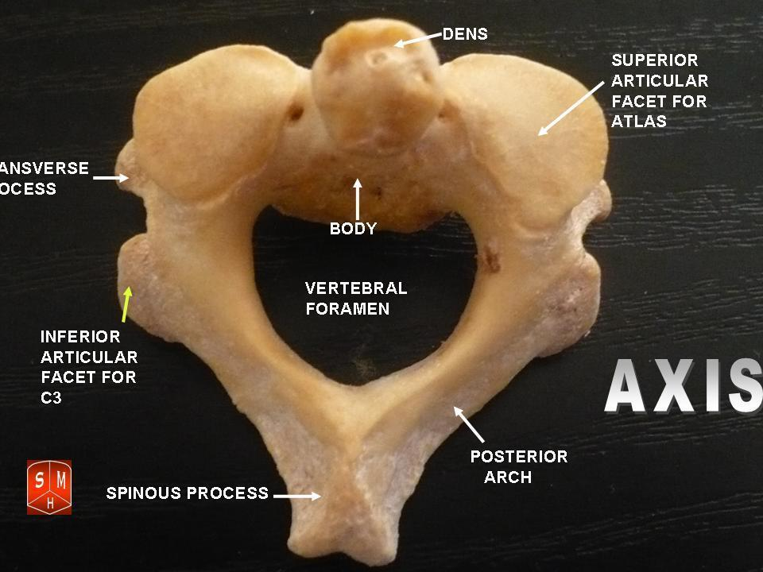
Axis Vertebra ( 2nd Cervical)

Slide 58
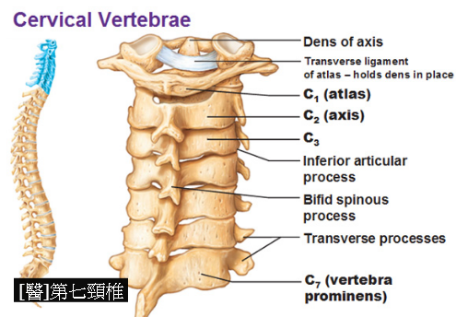
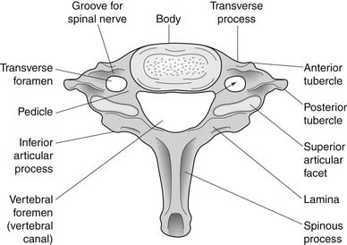
Seventh Cervical Vertebra
dd

Slide 59
Thoracic Vertebra
Anatomy. The thoracic vertebrae are located in the middle section of the vertebral column, specifically inferior to the cervical vertebrae and superior to the lumbar vertebrae.
In humans, there are twelve thoracic vertebrae and they are intermediate in size between the cervical and lumbar vertebrae.
They increase in size going towards the lumbar vertebrae, with the lower ones being a lot larger than the upper.
They are distinguished by the presence of facets on the sides of the bodies for articulation with the heads of the ribs, as well as facets on the transverse processes of all, except the eleventh and twelfth, for articulation with the tubercles of the ribs.
By convention, the human thoracic vertebrae are numbered T1–T12, with the first one (T1) located closest to the skull and the others going down the spine toward the lumbar region.

Slide 60
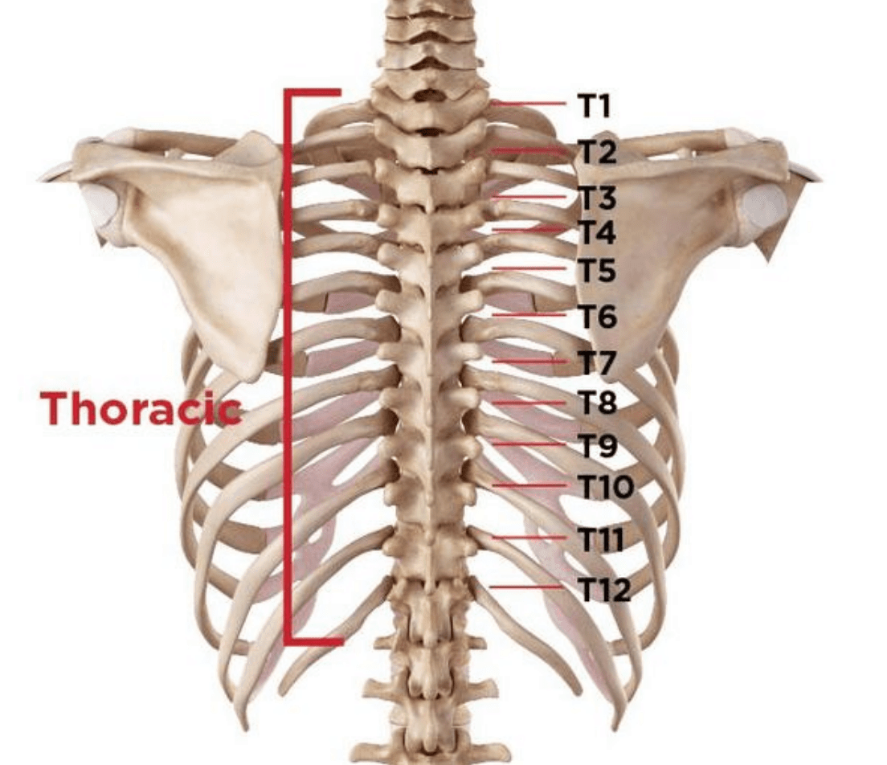
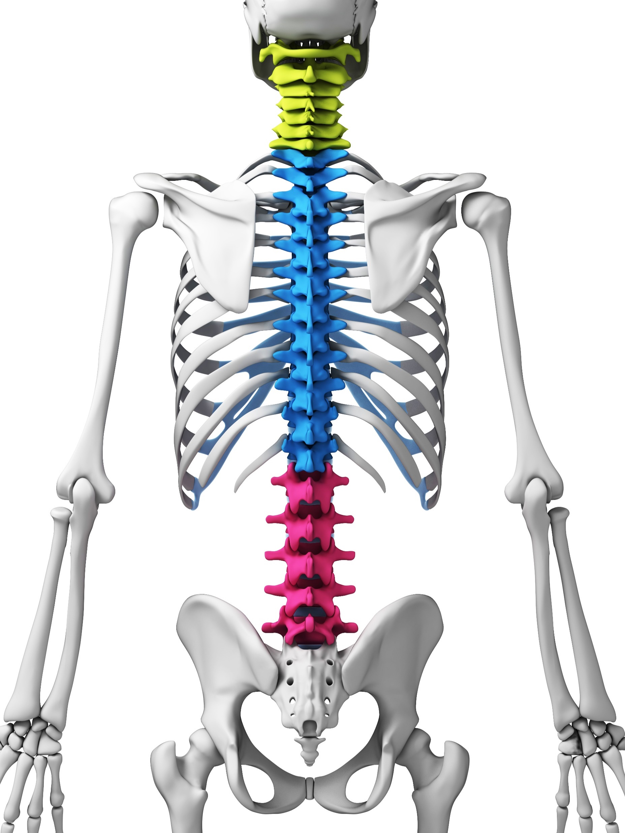
Thoracic Vertebra

Slide 61
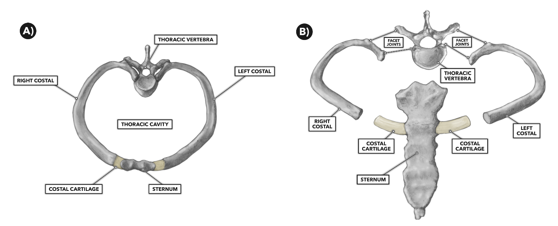

Slide 62

First Thoracic Vertebra
The first thoracic vertebra has, on either side of the body, an entire articular facet for the head of the first rib, and a demi-facet for the upper half of the head of the second rib.
The body is like that of a cervical vertebra, being broad, concave, and lipped on either side.
The superior articular surfaces are directed upward and backward; the spinous process is thick, long, and almost horizontal.
The transverse processes are long, and the upper vertebral notches are deeper than those of the other thoracic vertebrae.
The thoracic spinal nerve 1 (T1) passes out underneath it.

Slide 63


Slide 64
9th & 10th Thoracic Vertebra
Tenth thoracic vertebra (T10)[edit]
The tenth thoracic vertebra has an entire articular facet (not demi-facet) on either side, which is placed partly on the lateral surface of the pedicle. It doesn't have any kind of facet below, because the following ribs only have one facet on their heads.
The thoracic spinal nerve 10 (T10) passes out underneath it.
Eleventh thoracic vertebra (T11)[edit]
In the eleventh thoracic vertebra the body approaches in its form and size to that of the lumbar vertebrae.
The articular facets for the heads of the ribs are of large size, and placed chiefly on the pedicles, which are thicker and stronger in this and the next vertebra than in any other part of the thoracic region.
The spinous process is short, and nearly horizontal in direction.
The transverse processes are very short, tuberculated at their extremities, and do not have articular facets.
The thoracic spinal nerve 11 (T11) passes out underneath it.

Slide 65


Slide 66
12th Thoracic Vertebra
Twelfth thoracic vertebra (T12)
The twelfth thoracic vertebra has the same general characteristics as the eleventh, but may be distinguished from it by its inferior articular surfaces being convex and directed lateralward.
The general form of the body, laminae, and spinous process, in which it resembles the lumbar vertebrae.
Each transverse process being subdivided into three elevations, the superior, inferior, and lateral tubercles.
The superior and inferior correspond to the mammillary and accessory processes of the lumbar vertebrae.
Traces of similar elevations are found on the transverse processes of the tenth and eleventh thoracic vertebrae.
The thoracic spinal nerve 12 (T12) passes out underneath it.

Slide 67


Slide 68
Lumbar Vertebra
The lumbar vertebrae are, in human anatomy, the five vertebrae between the rib cage and the pelvis.
They are the largest segments of the vertebral column.
They are characterized by the absence of the foramen transversarium within the transverse process and by the absence of facets on the sides of the body (as found only in the thoracic region).
They are designated L1 to L5, starting at the top.
The lumbar vertebrae help support the weight of the body, and permit movement.
https://youtu.be/-hz7Z0ENfS4

Slide 69
Lumbar Vertebra Structure
Body is large, wider posteriorly and little thicker in front.
Pedicles are very strong, directed backward from the upper part of the body.
The Laminae are broad, short and strong.
The vertebral foramen is triangular, larger than the thoracic, but smaller than cervical,
The spine is thick, broad and somewhat quadrilateral
Superior & Inferior articular processes are well developed projecting in upward direction.
Facets on the superior process are concave while inferior are convex.
Transverse processes are long, slender and horizontal upper three vertebrae.

Slide 70


Lumbar Vertebra

Slide 71
Sacrum Vertebra
The sacrum (plural: sacra or sacrums), in human anatomy, is a large, triangular bone at the base of the spine that forms by the fusing of sacral vertebrae S1–S5 between 18 and 30 years of age.
The sacrum situates at the upper, back part of the pelvic cavity, between the two wings of the pelvis. It forms joints with four other bones.
The two projections at the sides of the sacrum are called the alae (wings), and articulate with the ilium at the L-shaped sacroiliac joints.
The upper part of the sacrum connects with the last lumbar vertebra (L5), and its lower part with the coccyx (tailbone) via the sacral and coccygeal cornua.
The sacrum has three different surfaces which are shaped to accommodate surrounding pelvic structures. Overall it is concave (curved upon itself).
The base of the sacrum, the broadest and uppermost part, is tilted forward as the sacral promontory internally.
The central part is curved outward toward the posterior, allowing greater room for the pelvic cavity.

Slide 72

Sacrum & Coccyx Vertebra Location

Slide 73

Sacrum Vertebra

Slide 74
Coccyx Vertebra
A coccyx with four vertebrae below the sacrum.
The coccyx is formed of either three, four or five rudimentary vertebrae.
It articulates superiorly with the sacrum. In each of the first three segments may be traced a rudimentary body and articular and transverse processes; the last piece (sometimes the third) is a mere nodule of bone.
The transverse processes are most prominent and noticeable on the first coccygeal segment.
All the segments lack pedicles, laminae and spinous processes.
The first is the largest; it resembles the lowest sacral vertebra, and often exists as a separate piece; the remaining ones diminish in size from above downward.

Slide 75

Coccyx Vertebra

Slide 76
Coccyx Vertebra
The coccyx, or tailbone, is located just below the sacrum. Though it’s much smaller than the sacrum, it too has an important weight-bearing role.
The coccyx helps support your weight while you sit.
If you lean back while sitting, such as reclining in a chair, the pressure on your coccyx increases.

Slide 77
Thoracic Ribs
The thoracic cage can also be described as an osteocartilaginous cage formed by the sternum, 12 pairs of ribs and costal cartilages, 12 thoracic vertebrae and the intervertebral (IV) discs interposed between them.
The thoracic cage, like skeletal tissue in most parts of the body, serves to support the thorax.
Together with the skin and associated fascia and muscles, the rib cage makes up the thoracic wall and provides attachments for the muscles of the neck, thorax, upper abdomen, and back.
Ribs are described based on their location and connection with the sternum.
All ribs are attached posteriorly to the thoracic vertebrae and are numbered accordingly one to twelve.
Ribs that articulate directly with the sternum are called true ribs, whereas those that do not articulate directly are termed false ribs.
The false ribs include the floating ribs (eleven and twelve) that are not attached to the sternum at all.

Slide 78

Thoracic Ribs

Slide 79
Sternum. The sternum is a bone that is located in the anterior midline of the thorax, supporting the thoracic cage.
Thoracic vertebrae.
There are twelve vertebrae forming the thoracic part of the vertebral column. .
Ribs. The ribs are long, flat, curved bones that form most of the thoracic cage.
Intercostal spaces.
The thoracic cage presents with spaces between adjacent ribs, which are called intercostal spaces.

Slide 80
Thoracic Ribs Function
The human rib cage is a component of the human respiratory system.
It encloses the thoracic cavity, which contains the lungs.
An inhalation is accomplished when the muscular diaphragm, at the floor of the thoracic cavity, contracts and flattens, while the contraction of intercostal muscles lift the rib cage up and out.
Expansion of the thoracic cavity is driven in three planes; the vertical, the anteroposterior and the transverse.
The vertical plane is extended by the help of the diaphragm contracting and the abdominal muscles relaxing to accommodate the downward pressure that is supplied to the abdominal viscera by the diaphragm contracting.
A greater extension can be achieved by the diaphragm itself moving down, rather than simply the domes flattening.
The second plane is the anteroposterior and this is expanded by a movement known as the 'pump handle.’
The downward sloping nature of the upper ribs are as such because they enable this to occur.
When the external intercostal muscles contract and lift the ribs, the upper ribs are able also to push the sternum up and out.
This movement increases the anteroposterior diameter of the thoracic cavity, and hence aids breathing further.
The third, transverse, plane is primarily expanded by the lower ribs (some say it is the 7th to 10th ribs in particular), with the diaphragm's central tendon acting as a fixed point.
When the diaphragm contracts, the ribs are able to evert and produce what is known as the bucket handle movement, facilitated by gliding at the costovertebral joints. In this way, the transverse diameter is expanded and the lungs can fill.

Slide 81
Types of Thoracic Ribs
True Ribs
False ribs
Floating ribs

Slide 82
Characteristics of Ribs
1. Posterior Extremity :
  Consists of head, neck and tubercle
  Head is kidney shaped articular surface with horizontal crest and two facets for articulation with two adjacent thoracic vertebrae.
2. Body
  Is thin & flat
  External surface is convex and smooth.
3. Anterior Extremity
  Anterior or Sternal extremity is flattened.
  Present a porous oval concave depression for coastal cartilage.

Slide 83

Types of Thoracic Ribs

Slide 84

11th Thoracic Ribs

Slide 85

Ribs

Slide 86
Sternum
The sternum or breastbone is a long flat bone located in the central part of the chest.
It connects to the ribs via cartilage and forms the front of the rib cage, thus helping to protect the heart, lungs, and major blood vessels from injury.
Shaped roughly like a necktie, it is one of the largest and longest flat bones of the body. Its three regions are the manubrium, the body, and the xiphoid process.

Slide 87

Sternum

Slide 88

Manubrium
The manubrium (Latin: handle) is the broad upper part of the sternum.
It has a quadrangular shape, narrowing from the top, which gives it four borders.
The suprasternal notch (jugular notch) is located in the middle at the upper broadest part of the manubrium.
This notch can be felt between the two clavicles.
On either side of this notch are the right and left clavicular notches.
The manubrium joins with the body of the sternum, the clavicles and the cartilages of the first pair of ribs.
The inferior border, oval and rough, is covered with a thin layer of cartilage for articulation with the body.
The lateral borders are each marked above by a depression for the first costal cartilage, and below by a small facet, which, with a similar facet on the upper angle of the body, forms a notch for the reception of the costal cartilage of the second rib.
Between the depression for the first costal cartilage and the demi-facet for the second is a narrow, curved edge, which slopes from above downward towards the middle.
Also, the superior sternopericardial ligament attaches the pericardium to the posterior side of the manubrium.

Slide 89

Sternum -Body
The body, or gladiolus, is the longest part.
It is flat and considered to have only a front and back surface.
It is flat on the front, directed upward and forward, and marked by three transverse ridges.
The pectoralis major attaches to it on either side.
At the junction of the third and fourth parts of the body is occasionally seen an orifice, the sternal foramen, of varying size and form.
The posterior surface, slightly concave, is also marked by three transverse lines, less distinct, however, than those in front; from its lower part, on either side, the transversus thoracis takes origin.
The sternal angle is located at the point where the body joins the manubrium.
Each outer border, at its superior angle, has a small facet, which with a similar facet on the manubrium,
The inferior angle has a small facet, which, with a corresponding one on the xiphoid process, forms a notch for the cartilage of the seventh rib. T
hese articular depressions are separated by a series of curved interarticular intervals, which diminish in length from above downward, and correspond to the intercostal spaces.
Most of the cartilages belonging to the true ribs, articulate with the sternum at the lines of junction of its primitive component segments.
This is well seen in some other vertebrates, where the parts of the bone remain separated for longer.^{[citation needed]}
The upper border is oval and articulates with the manubrium, at the sternal angle. The lower border is narrow, and articulates with the xiphoid process.

Slide 90

Xiphoid process
Located at the inferior end of the sternum is the pointed xiphoid process.
Improperly performed chest compressions during cardiopulmonary resuscitation can cause the xiphoid process to snap off, driving it into the liver which can cause a fatal hemorrhage.
The sternum is composed of highly vascular tissue, covered by a thin layer of compact bone which is thickest in the manubrium between the articular facets for the clavicles.
The inferior sternopericardial ligament attaches the pericardium to the posterior xiphoid process.

Slide 91

Hyoid Bone
The hyoid bone (lingual bone or tongue-bone) is a horseshoe-shaped bone situated in the anterior midline of the neck between the chin and the thyroid cartilage.
At rest, it lies at the level of the base of the mandible in the front and the third cervical vertebra (C3) behind.
Unlike other bones, the hyoid is only distantly articulated to other bones by muscles or ligaments.
The hyoid is anchored by muscles from the anterior, posterior and inferior directions, and aids in tongue movement and swallowing.
The hyoid bone provides attachment to the muscles of the floor of the mouth and the tongue above, the larynx below, and the epiglottis and pharynx behind.

Slide 92
Hyoid Bone : Function
The hyoid bone is present in many mammals.
It allows a wider range of tongue, pharyngeal and laryngeal movements by bracing these structures alongside each other in order to produce variation.
Its descent in living creatures is not unique to Homo sapiens, and does not allow the production of a wide range of sounds: with a lower larynx, men do not produce a wider range of sounds than women and 2-year-old babies.
Moreover, the larynx position of Neanderthals was not a handicap to producing speech sounds.
The discovery of a modern-looking hyoid bone of a Neanderthal man in the Kebara Cave in Israel led its discoverers to argue that the Neanderthals had a descended larynx, and thus human-like speech capabilities.
However, other researchers have claimed that the morphology of the hyoid is not indicative of the larynx's position.
It is necessary to take into consideration the skull base, the mandible and the cervical vertebrae and a cranial reference plane.

Slide 93
Appendicular Skeleton
126 bones are present in appendicular skeleton.
Important function :Locomotion & manipulation of objects.
Two Girdles : Pectoral & Pelvic
Pectoral for attachment of upper limbs to the rest of body.
Pelvic girdles lower limbs are arrached.
Lower limb include thigh, leg and feet.
Lower limb responsible for supporting the weight of the body.

Slide 94


Slide 95
Pectoral Girdle
Human shoulder girdle or pectoral girdle.
The shoulder girdle or pectoral girdle is the set of bones in the appendicular skeleton which connects to the arm on each side.
In humans it consists of the clavicle and scapula; in those species with three bones in the shoulder, it consists of the clavicle, scapula, and coracoid.
The clavicle is an anterior bone whose sternal end articulates with the manubrium of the sternum at the sternoclavicular joint.

Slide 96

Clavicle
The clavicle, or collarbone, is a long bone that serves as a strut between the shoulder blade and the sternum (breastbone).
There are two clavicles, one on the left and one on the right.
The clavicle is the only long bone in the body that lies horizontally. Together with the shoulder blade, it makes up the shoulder girdle.
It is a touchable bone, and in people who have less fat in this region, the location of the bone is clearly visible, as it creates a bulge in the skin.
It receives its name from the Latin clavicula ("little key"), because the bone rotates along its axis like a key when the shoulder is abducted.
The clavicle is the most commonly fractured bone.
It can easily be fractured due to impacts to the shoulder from the force of falling on outstretched arms or by a direct hit.

Slide 97

Scapula

Slide 98
Scapula
In anatomy, the scapula (plural scapulae or scapulas), also known as the shoulder bone, shoulder blade, wing bone or blade bone, is the bone that connects the humerus (upper arm bone) with the clavicle (collar bone).
Like their connected bones, the scapulae are paired, with each scapula on either side of the body being roughly a mirror image of the other.
The name derives from the Classical Latin word for trowel or small shovel, which it was thought to resemble.
In compound terms, the prefix omo- is used for the shoulder blade in Latin medical terminology.
This prefix is derived from ὦμος (ōmos), the Ancient Greek word for shoulder, and is cognate with the Latin (h)umerus.
The scapula forms the back of the shoulder girdle. In humans, it is a flat bone, roughly triangular in shape, placed on a posterolateral aspect of the thoracic cage.

Slide 99

Bones of Forelimbs
Humerus :1
Radius : 1
Ulna :1
Carpals : 8 arranged in two rows
Metacarpals 5
Phalanges : 14

Slide 101
Humerus
The Humerus is the long bone of the arm, articulating with the scapula to form the shoulder and the radius and ulna to form the elbow.
In situ, it lies obliquely along the ventral thorax and is more horizontal in larger species.
The head of the humerus comprises greater and lesser tubercles, separated by an intertubercular groove through which runs the tendon of the biceps brachii.
The shaft of the humerus takes on a characteristically twisted shape via a groove carrying the brachialis and radial nerve.
Laterally, the deltoid tuberosity is palpable through the skin and connects to the head of the humerus via a ridge and merges distally with the crest of the humerus.
Distally, the humerus culminates in a condyle which articulates to form the elbow.
Body or Shaft : almost cylindrical in upper half of its extent, and flattned.
Upper Extremity : Long rounded head joined to the body by constricted portion called neck.
Head : Nearly hemispherical articulates with glenoid cavity of Scapula.
Neck : Obliquely directed help in attaching to the articular capsule of the shoulder joint.
Greater Tubercle : Situated lateral to the head and lesser tubercle. Rounded and marked by three flat impression.
Lesser Tubercle : It is small but more prominent than the greater tubercle.

Slide 102

Humerus

Slide 103
Radius and Ulna
The
Radius
The radius and ulna are the bones of the forearm.
The forearm is the region of the upper limb that extends from the elbow to the wrist.
The radius bone supports the lateral (thumb) side of the forearm and the ulna bone supports the medial (little finger) side.
The long narrow medullary cavity is enclosed in a strong wall of compact bone.
It is thickest along the interosseous border and thinnest at the extremities, same over the cup-shaped articular surface (fovea) of the head.
The trabeculae of the spongy tissue are somewhat arched at the upper end and pass upward from the compact layer of the shaft to the fovea capitula.
They are crossed by others parallel to the surface of the fovea.
The arrangement at the lower end is somewhat similar. It is missing in radial aplasia.
The radius has a body and two extremities.
The upper extremity of the radius consists of a somewhat cylindrical head articulating with the ulna and the humerus, a neck, and a radial tuberosity.
The body of the radius is self-explanatory, and the lower extremity of the radius is roughly quadrilateral in shape, with articular surfaces for the ulna, scaphoid and lunate bones.
The distal end of the radius forms two palpable points, radially the styloid process and Lister's tubercle on the ulnar side.
Along with the proximal and distal radioulnar articulations, an interosseous membrane originates medially along the length of the body of the radius to attach the radius to the ulna.

Slide 104


Slide 105
Ulna
The ulna is a long bone found in the forearm that stretches from the elbow to the smallest finger, and when in anatomical position, is found on the medial side of the forearm.
It runs parallel to the radius, the other long bone in the forearm.
The ulna is usually slightly longer than the radius, but the radius is thicker.
Therefore the radius is considered to be the larger of the two.
The ulna is a long bone found in the forearm that stretches from the elbow to the smallest finger, and when in anatomical position, is found on the medial side of the forearm. It is broader close to the elbow, and narrows as it approaches the wrist.
Close to the elbow, the ulna has a bony process, the olecranon process, a hook-like structure that fits into the olecranon fossa of the humerus.
This prevents hyperextension and forms a hinge joint with the trochlea of the humerus. There is also a radial notch for the head of the radius, and the ulnar tuberosity to which muscles attach.

Slide 106

Bones of Hand
Carpals
scaphoid, 1
Trapezium: 1
Trapezoid :1
Lunate :1
Pisiform : 1
Triquetrum :1
Hamate : 1
Capitate :1
Metacarpals :1
Phalanges : 3 +3+3+3+2 =14

Slide 107


Slide 108

Pelvic girdle

Slide 109


Pelvic Girdle

Slide 110
Pelvic Girdle
The hip bone (os coxae, innominate bone, pelvic bone or coxal bone) is a large irregular bone, constricted in the center and expanded above and below.
In some vertebrates (including humans before puberty) it is composed of three parts: the ilium, ischium, and the pubis.
The two hip bones join at the pubic symphysis and together with the sacrum and coccyx (the pelvic part of the spine) comprise the skeletal component of the pelvis – the pelvic girdle which surrounds the pelvic cavity.
They are connected to the sacrum, which is part of the axial skeleton, at the sacroiliac joint.
Each hip bone is connected to the corresponding femur (thigh bone) (forming the primary connection between the bones of the lower limb and the axial skeleton) through the large ball and socket joint of the hip.

Slide 111
Function of Pelvic Girdle
Transfer of weight from the upper axial skeleton to the lower appendicular components of the skeleton, especially during movement.
Provides attachment for a number of muscles and ligaments used in locomotion.
Contains and protects the abdominopelvic and pelvic viscera.
During any movement such as walking, sitting and running, it helps in proper transfer of weight from the upper axial skeleton to the lower appendicular mechanism of the skeleton.
It serves as an attachment to various muscles and ligaments located within the structure of the pelvis
It comprises of the abdominopelvic and pelvic viscera and also provides protection to them.
During delivery of a large-headed fetus, it necessitates the female human body by providing an adequate birth canal.

Slide 112

Bones of Lower Limb
The lower limb is divided into three regions.
These are the thigh, located between the hip and knee joints; the leg, located between the knee and ankle joints; and distal to the ankle, the foot.
There are 30 bones in each lower limb.
These are the femur, patella, tibia, fibula, seven tarsal bones, five metatarsal bones, and 14 phalanges.
Bones of Lower Limb :
Femur : 1
Tibia : 1
Fibula : 1
Tarsals : 7
Metatarsals : 5
Phalanges : 14

Slide 113

Femur Bone

Slide 114

Femur Bone

Slide 115
Femur Bone
The femur is the only bone in the upper leg.
The two femurs converge medially toward the knees, where they articulate with the proximal ends of the tibiae.
The angle of convergence of the femora is a major factor in determining the femoral-tibial angle.
Human females have wider pelvic bones, causing their femora to converge more than in males.
In the general population the femoral-tibial angle is about 175 degrees.
The femur is the longest and, by some measures, the strongest bone in the human body.
Some strength tests show the temporal bone in the skull to be the strongest bone.
The femur length on average is 26.74% of a person's height, a ratio found in both men and women and most ethnic groups with only restricted variation.
It is useful in anthropology because it offers a basis for a reasonable estimate of a subject's height from an incomplete skeleton.

Slide 116

Tibia Fibula
ss

Slide 117
Tibia
Tibia and fibula are the two long bones located in the lower leg.
The tibia is a larger bone on the inside, and the fibula is a smaller bone on the outside.
The tibia is much thicker than the fibula. It is the main weight-bearing bone of the two.
The tibia also known as the shinbone or shankbone, is the larger, stronger, and anterior of the two bones in the leg below the knee in vertebrates and it connects the knee with the ankle bones.
The tibia is found on the medial side of the leg next to the fibula and closer to the median plane or centre-line.
The tibia is connected to the fibula by the interosseous membrane of the leg, forming a type of fibrous joint called a syndesmosis with very little movement.
The tibia is named for the flute tibia.
It is the second largest bone in the human body next to the femur.
The leg bones are the strongest long bones as they support the rest of the body.

Slide 118
Fibula
The fibula, sometimes called the calf bone, is smaller than the tibia and runs beside it.
The top end of the fibula is located below the knee joint but is not part of the joint itself.
The lower end of the fibula forms the outer part of the ankle joint.
The fibula helps stabilize the tibia but doesn’t carry much weight.

Slide 119

Patella
The patella, most commonly referred to as the kneecap, is the largest sesamoid bone in the body.
A sesamoid bone is one that is embedded in a tendon and, in the patella’s case, it exists within the quadriceps tendon.
This tendon helps hold the patella in place along with other muscles found in and near the quadriceps so it can do its most important job, protect the knee joint.
The patella sits between the femur and tibia, not only protecting the knee joint but connecting muscles in the front of the femur to the tibia.
Under the patella and the at the end of the femur is articular cartilage, which makes it possible for the patella and femur bones to move alongside each other.
This cartilage offers protection on top of added mobility with any knee movements.

Slide 120

Foot Bones
The foot contains 26 bones, 33 joints, and over 100 tendons, muscles, and ligaments.
The foot is a part of vertebrate anatomy which serves the purpose of supporting the animal’s weight and allowing for locomotion on land.
In humans, the foot is one of the most complex structures in the body.
It is made up of over 100 moving parts – bones, muscles, tendons, and ligaments designed to allow the foot to balance the body’s weight on just two legs and support such diverse actions as running, jumping, climbing, and walking.
Because they are so complicated, human feet can be especially prone to injury.
Strains, sprains, tendonitis, torn ligaments, broken bones, fallen arches, bunions, corns, and plantar warts can all occur.
Here we will talk more about the anatomy of the human foot and its many moving parts.

Slide 121
Bones of Foot
The Tarsus (ankle joint) : 7
  Calcaneus : Largest of tarsal bones.
    Situated at lower and back part of the foot.
    Weight bearing.
    Forming strong lever for the muscles of calf.
    It articulates with talus and cuboid.
  Talus : Second largest bone.
    It articulate with navicular with body, a neck and head.
    Body : Surface of body consists of the trochela articulate with tibia.
    Lateral surface carries a large triangular facet for articulation with the lateral malleolus.
    Neck: constricted portion of the bone between the body and oval head.
    Head : It is oval and convex articulates with four bones tibia, fibula, calcaneus and navicular.
  Navicular : Situated at medial side of tarsus articulate with four bones, talus and three cuneiforms.
  Cuboid : Present lateral side of foot and is pyramid shape and articulate with four metatarsus.
  First Cuneiform : Largest of three cuneiforms located at middle side of foot.
  Second Cuneiforms : The intermediate cuneiform if very important in the flexibility of the foot.
  Third Cuneiform : the third or lateral cuneiform

Slide 122
The Metatarsus : 5
The Phalanges (bones of the toes) : 14
The bones situated in the toe region are known as phalanges.
Every human foot has 14 phalanges.
Other than the big toe, the structure of all the toes is the same with three phalanges, namely proximal phalanx, middle phalanx, and distal phalanx.
The big toe on the other hand only has two phalanges, namely proximal phalanx and distal phalanx.
Proximal Phalanx: These phalanges are situated closer to the foot, hence the name proximal phalanx.
Middle Phalanx: These bones in the foot are situated further ahead from proximal phalanx. The big toe does not have a middle phalanx.
Distal Phalanx: The tip of the toes are the distal phalanx.
The foot is the weight bearing part of the body, hence, care should be taken not to injure the foot, to avoid inconvenience of any kind.

Slide 123

Bones of Foot

Slide 124


Slide 125
Thank You

