Slide 1
Understanding TV formats & Genres

Slide 2
Unit I – Nature of drama in television:
Various shows, formats and genres, telecast patterns, audience viewership performance

Slide 3
Reality TV
This type of TV shows involves ordinary people who are continuously filmed as they go about living their usual life or on a special set with a group of others functioning as the same. It is meant solely for entertainments purposes and not for any superior knowledge or informative uses.
In other words, the camera documents supposedly ‘unscripted’ real-life situations. Reality TV gained popularity in the late ‘90s and further exploded into the early 2000s with the world-wide of shows such as Survivor, Idols and the more famous (or rather infamous depending on your preference), Big Brother.
If may also include segments of an interview conducted with the participants later on in which they express their views, voice their thoughts or provide explanations and justifications for their actions. This automatically serves as the shows’ narration.

Slide 4
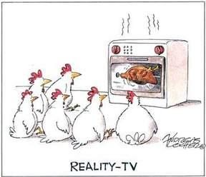
Reality TV

Slide 5
Sitcoms
Short for ‘situation comedy,’ sitcom is a TV show genre that is always high in demand because of its humor and hilarity. What defines this popular type of TV show is affixed set of characters that are featured in every episode. The show is set in the regular world and focuses on the lives and everyday routines of the characters. Laughter and giggles erupt from the way these characters interact with each other as they go about doing their daily chores.
Situation comedies are often recorded in front of a live studio audience but this is dependent on the production format of the program. Laugh tracks are usually added later on during final editing to imitate or enhance the effect of live studio viewers. Sitcoms must not be confused with comedy-drama because a comedy-drama is any story that has a happy outcome or a touch of humor here and there. A sitcom, on the other hand, is centered on real-life situations that have a funny outcome.
Despite countless reruns, you are unlikely to watch any sitcom repeatedly other than Friends, but if you ever need a ‘break’ like Ross did, we suggest these ones: The Big Bang Theory, Modern Family, Two and a Half Men, The Millers and 2 Broke Girls

Slide 6

Sticoms

Slide 7
Drama
This type of TV show refers to the portrayal of fictional or semi-fictional stories that are set in a particular place and follow a general theme.
The word ‘drama’ was coined back in the 16th Century when Greeks used it to refer to a theatrical play that had quite a neutral act, being neither a comedy nor a tragedy. With the invention of the television, this term was adopted by the industry in a similar context. However, as the industry developed with more varied TV shows being produced, the defining boundaries of this genre blurred to encompass several different tones. Today, ‘drama’ includes various subcategories such as comedy-drama, teen drama, legal drama and many more.
In a broader sense, drama TV shows comprise of any narrative so long as it is fictional or semi-fictional and tells the story through characters that are brought to life by real actors. The following are the types of TV shows that all come under the expansive term ‘drama.’

Slide 8
Drama
Comedy
Teen
Romantic
Family
Medical
Legal
Crime
Police procedural
Horror
Historic
Political
Musical
Docudrama
Space drama

Slide 9
Game show
Game shows are a type of TV genre in which contestants play a game in order to win prizes. Depending on the type of game, people may participate individually or as a team. The games include answering questions, solving puzzles or various other activities that lead to rewards such as checks, gift hampers, monetary prizes, trips and travel tickets and several other goods and services provided by the show’s sponsors.

Slide 10
Game show
Who Wants to be a Millionaire, The Price is Right, Deal or No Deal are just a few examples of the most hit game shows of all time. Some might be theme-oriented for example The Singing Bee and Beat Shazam revolve around music-themed games.

Slide 11

Gameshow

Slide 12
Soap Operas
Everybody loves soap operas, but have you ever wondered where did the term originate from?
Interestingly, soap opera gained its name from the fact that the initial radio dramas were sponsored by actual soap manufacturers. The Archers broadcasted on BBC’s radio platform in 1950 holds the record for the world’s most elaborate radio soap opera.
In television, soap operas are an ongoing drama serial that is made up of the lives of numerous characters and their relationship with others. Some of the best American soap operas include Days of Our Lives, The Bold and the Beautiful, All My Children, As the World Turns and Guiding Light.

Slide 13
Animated series
Animated series refers to a set of hand drawn or computer generated art that are normally linked with each other. The different episodes share the same lead characters and a fundamental theme. Various secondary characters might be introduced on a need basis from time to time.
A common misconception surrounding animated series is that they are only for children. But true TV show fans will be very well aware of the fact that animated series have several target audience including both children and adults.
From Felix the Cat, Mickey Mouse Club, Daria, and Recess to, American Dragon, and Final Space, animated series have entertained children and their parents alike. As for animated TV shows mainly for adults, the list includes The Simpsons, South Park, Family Guy, Avatar: The Last Airbender, The Venture Bros, and Thundercats.

Slide 14
Television Serials
TV serials hold true to the definition of the word ‘serial’ – they are a continuing plot that follows a sequential order as the events unfold episode by episode. TV serials usually pursue an extended storyline also called story arc that covers the whole season or even the entire run of the serial. What makes the viewers keep coming back for the next installment is the clever portrayal of events that does not reveal the complete story or the full meaning of the plot. Each episode often contains a short recap of the previous one to renew the suspense and make the serial more intriguing.

Slide 15
Telenovela
A telenovela is quite similar to a TV serial or soap opera except that it runs for a very limited period of time. The word is derived from television and ‘novela’ which is the Spanish word for the novel.
American Heiress and El Alma herida are US TV series that were based on a telenovela.

Slide 16
Factual tv
Unlike most other TV shows that follow an imaginary or self-created plot, factual TV shows are exclusively real as is evident by their name. It is a type of non-fiction TV program that documents actual events and people. Prominent factual TV shows and documentaries include Top Gear, COPS and Rescue 911.

Slide 17
Mockumentary
Mockumentary, derived from the combination o the words ‘mock’ and ‘documentary’ is the exact opposite of factual TV shows or a documentary. Although it follows a documentary filming style, what sets it apart from the other is that the events presented are completely fictional. The purpose of mockumentaries is to analyze or comment on real events occurring in the world by portraying them in a fictional setting.
American Vandal originally aired on Netflix is a well-known American mockumentary.

Slide 18

On demand TV & streaming TV

Slide 19
Telecast pattern
Television
In 1927, Baird transmitted a signal over 438 miles (705 km) of telephone line between London and Glasgow. In 1928, Baird's company (Baird Television Development Company/Cinema Television) broadcast the first transatlantic television signal, between London and New York, and the first shore-to-ship transmission. He also demonstrated an electromechanical color, infrared (dubbed "Noctovision"), and stereoscopic television, using additional lenses, disks and filters. In parallel, Baird developed a video disk recording system dubbed "Phonovision"; a number of the Phonovision recordings, dating back to 1927, still exist.[10] In 1929, he became involved in the first experimental electromechanical television service in Germany.
On 2 November 1936 the BBC began transmitting the world's first public regular high-definition television (HDTV) service from the Victorian Alexandra Palace in north London.[12] It therefore claims to be the birthplace of television broadcasting as we know it today. Instead a 17.5mm film was shot, rapidly developed and then scanned while the film was still wet. This intermediate film system was discontinued within three months in favor of a 405-line all-electronic system developed by Marconi-EMI. Television programmes are telecast in different ways –write about the patterns followed by our T.V channels on daily basis.

Slide 20
Terrestrial television
Terrestrial television is a mode of television broadcasting which does not involve satellite transmission or cables — typically using radio waves through transmitting and receiving antennas or television antenna aerials. The term is more common in Europe, while in the United States it is referred to as broadcast television or sometimes over-the-air television (OTA) and requires a Tuner (television) the view content.

Slide 21
Satellite TV
ST is television programming delivered by the means of communications satellite and received by an outdoor antenna, usually a parabolic mirror generally referred to as a satellite dish, and as far as household usage is concerned, a satellite receiver either in the form of an external set-top box or a satellite tuner module built into a TV set. Satellite TV tuners are also available as a card or a USB stick to be attached to a personal computer. In many areas of the world satellite TV provides a wide range of channels and services, often to areas that are not serviced by terrestrial or cable providers.

Slide 22
Cable TV
CT is a system of providing television programs to consumers via radio frequency (RF) signals transmitted to televisions through coaxial cables or digital light pulses through fixed optical fibers located on the subscriber's property, much like the over-the-air method used in traditional broadcast television (via radio waves) in which a television antenna is required. FM radio programming, high-speed Internet, telephony, and similar non-television services may also be provided. The major difference is the change of radio frequency signals used and optical connections to the subscriber property. Add examples about our local cable operators which we discussed in lecture

Slide 23
DTH Television
Direct broadcast satellite, (DBS) also known as "Direct-To-Home" can either refer to the communications satellites themselves that deliver DBS service or the actual television service. DBS systems are commonly referred to as "mini-dish" systems. DBS uses the upper portion of the Ku band, as well as portions of the Ka band. We have discussed about different DTH operators, their services, different packages and offers settup box and other operating system.

Slide 24
Television Rating Point (TRP) is a tool provided to judge which programmes are viewed the most. This gives us an index of the choice of the people and also the popularity of a particular channel. For calculation purpose, a device is attached to the TV set in a few thousand viewersâ€™ houses for judging purpose. These numbers are treated as sample from the overall TV owners in different geographical and demographic sectors. The device is called as Peopleâ€™s Meter. It records the time and the programme that a viewer watches on a particular day. Then, the average is taken for a 30-day period which gives the viewership status for a particular channel.

Slide 25
Nielsen TV Ratings
NR are the audience measurement systems operated by Nielsen media research that seek to determine the audience size and composition of television programming in the United States using a rating system.
Nielsen Media Research was founded by Arthur C. Nielsen, a market analyst who started his career in the 1920s with marketing research and performance analysis. The company expanded into radio market analysis in the late 1930s, culminating in the Nielsen Radio Index in 1942, which was meant to provide statistics as to the markets of radio shows. The first Nielsen ratings for radio programs were released the first week of December 1947. They measured the top 20 programs in four areas: total audience, average audience, cumulative audience, and homes per dollar spent for time and talent.
In 1950, Nielsen moved to television, developing a ratings system using the methods he and his company had developed for radio. That method became the primary source of audience measurement information in the US television industry. In September 2020, Nielsen started compiling a weekly Top 10 list of most watched shows on streaming platforms. Search about current scenario of this company and their area of operation.

Slide 26
https://www.youtube.com/watch?v=gZlqfrxbkWQ&t=14s
History of Indian TV

Slide 27
https://www.youtube.com/watch?v=OpkatIqkLO8
How does Satellite Television work?

Slide 28
https://www.youtube.com/watch?v=qvJXAAT-BU4
Top 20 Greatest TV Shows of All Time

Slide 29
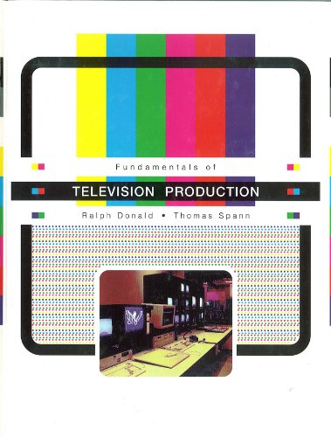
Reference

Slide 30
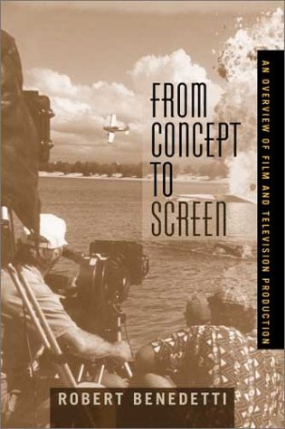

Slide 31


Slide 32


