Slide 1
Project Management

Slide 2
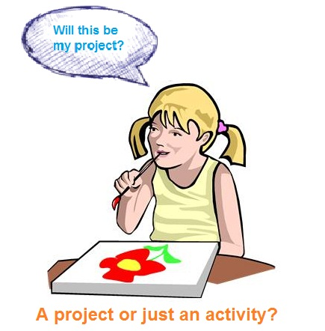
What is Project ?

Slide 3
What is Project ?
Project is a great opportunity for organizations and individuals to achieve their business and non-business objectives more efficiently through implementing change.
Projects help us make desired changes in an organized manner and with reduced probability of failure.
A Project is defined as a specific, finite activity that produces an observable and measurable result under certain preset requirements.

Slide 4
A Project is a temporary, unique and progressive attempt or endeavor made to produce some kind of a tangible or intangible result (a unique product, service, benefit, competitive advantage, etc.).
It usually includes a series of interrelated tasks that are planned for execution over a fixed period of time and within certain requirements and limitations such as cost, quality, performance etc.
By using projects we can plan and do our activities, for example: build a garage, run a marketing campaign, develop a website, Doing any construction activities

Slide 5
Key characteristics
:
Temporary. This key characteristic means that every project has a finite start and a finite end. The start is the time when the project is initiated and its concept is developed.
The end is reached when all objectives of the project have been met (or unmet if it’s obvious that the project cannot be completed – then it’s terminated).
Unique Deliverable(s). Any project aims to produce some deliverable(s) which can be a product, service, or some another result.
Deliverables should address a problem or need analyzed before project start.
Progressive Elaboration. With the progress of a project, continuous investigation and improvement become available, and all this allows producing more accurate and comprehensive plans.
This key characteristic means that the successive iterations of planning processes result in developing more effective solutions to progress and develop projects.

Slide 6
Characteristics of the Project
Purposeful as it has a rational and measurable purchase
Logical as it has a certain life-cycle
Structured as it has interdependencies between its tasks and activities
Conflict as it tries to solve a problem that creates some kind of conflict
Limited by available resources
Risk as it involves an element of risk

Slide 7
Some examples of a project are:
Developing a new product or service
Constructing a building or facility
Renovating the kitchen
Designing a new transportation vehicle
Acquiring a new or modified data system
Organizing a meeting

Slide 8
Work Breakdown
In organizations, a project is defined as a piece of work that is planned for implementation within current business environment. This definition lets make a distinction between other pieces of work, such as:
Program – a broad, long-term objective that is often decomposed into a series of projects and sub-projects
Task – an identifiable and measurable activity that create a small unit of work for a related project
Work package – division of a project task
Work unit – division of work packages
Projects along with programs, tasks, work packages and work units are the elements of work breakdown structure or WBS. Often WBS is used to determine an activity-based hierarchy of projects, with reference to their deliverables and objectives.
A program includes several or more larger projects. A larger project can be broken down into smaller interrelated sub-projects. Each one can be divided into tasks which in term are decomposed into interrelated activities or sub-tasks. A task includes a series of smaller goals which are monitored against milestones.

Slide 9
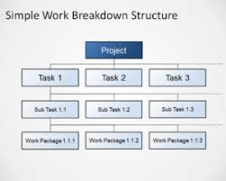
Work Break Down

Slide 10
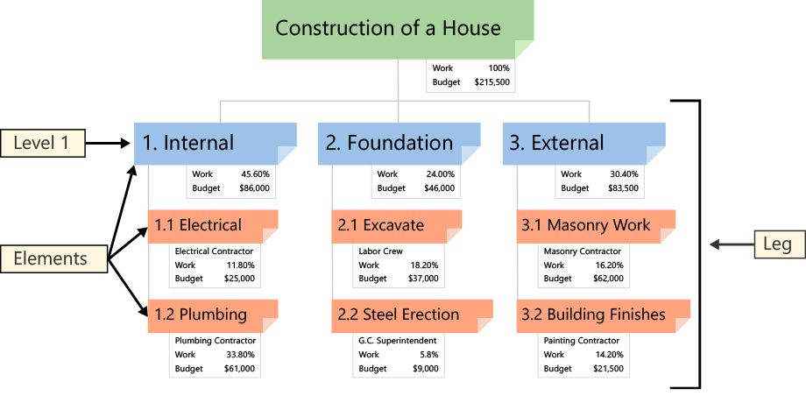
Example

Slide 11
Project management
Project management is the art of planning, controlling and executing a project in a way that ensures successful delivery of the desired outcome. It is widely used in organizations as a complex of tools for delivering strategic goals and objectives.
Project management is the discipline of initiating, planning, executing, controlling and closing the work of a team to achieve specific goals and meet specific success criteria at the specified time

Slide 12
The key advantages of using project management within a company’s business environment can be described as:
Accelerating improvement and strengthening of the company’s management through implementing the ideas of participatory management. Projects help involve employees in decision making
Adopting systems engineering approach that helps deal with risks effectively
Accomplishing specific changes that are linked to the company’s strategies

Slide 13
Classification of the Project
Business Projects
Developmental Projects
Technical Projects
Manufacturing Projects
Civil Engineering, Construction, Petrochemical, Mining and Quarrying

Slide 14
Need for Project Management
Strategic Alignment
Leadership
Clear Focus and Objectives
Realistic Project Planning
Risk Management
Continuous Oversight
Subject Matter Expertise
Managing Quality

Slide 15
Need for Project Management
Managing Change
Clearing Issues
Retaining and Using Knowledge
Learning From Failure

Slide 16
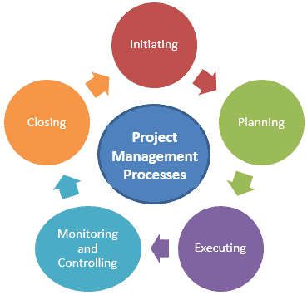

Slide 17
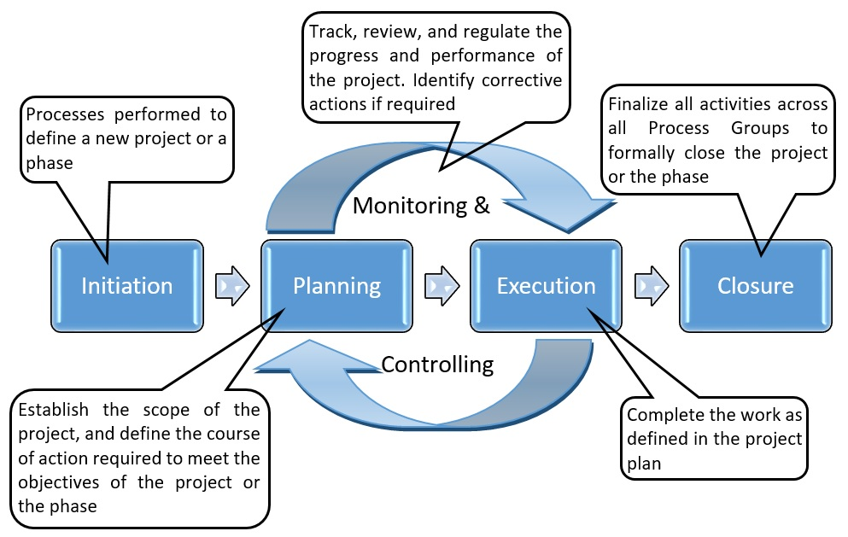

Slide 18
Project Stakeholders
Project stakeholders in general can be single individuals or entire organization who are affected by the execution or outcome of a project
Key project Stakeholders are those stakeholders who have the influence Anand authority to dictate whether a project is a success or not.
These are groups whose objective must be specified

Slide 19
Key stakeholders in the Project are as follows
Customers
Project manager
Project team members
Project sponsor
Steering Committee
Executives
Resource Managers

Slide 20
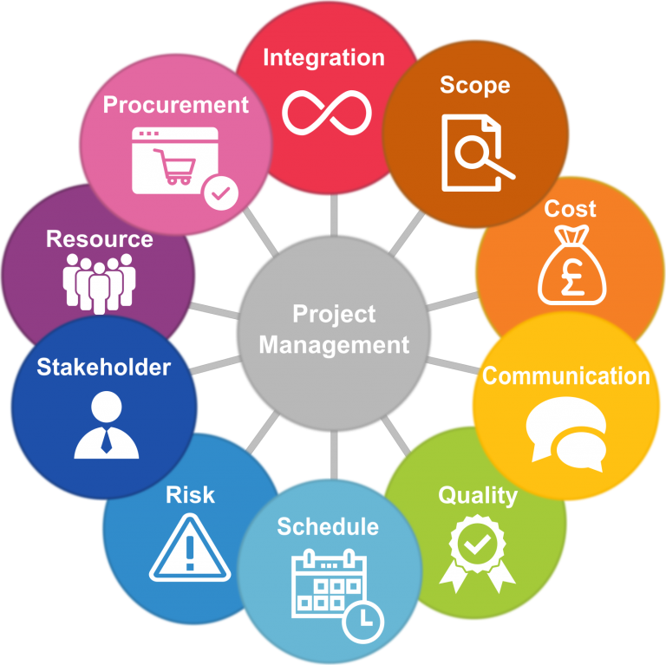
Key Knowledge Area

Slide 21
Project Life Cycle
Conception Phase
Definition Phase
Planning and Organizing Phase
Implementation Phase
Commissioning Shut Down or Clean Up Phase

Slide 22
Project Management Philosophy
Dialogue and Cooperation:. The involvement of counterparts in the design and implementation is essential to ensure that change management programs are effective and supported
Ownership and Empowerment: It is important to emphasize the development of local talent. empowering staff based on solid risk management approaches and motivational strategies. enjoy coaching project staff and interns in field offices on all aspects of project management, including human resources, turn around and change management, donor relations, internal financial control and work planning

Slide 23
Integrity and Accountability: Especially in difficult environments such as Afghanistan and many other developing countries, it is important to adhere to the highest standards of professionalism, integrity, client concern and service.
Internal Financial and Risk Control Proper and Strong risk control measures
Should be taken by implementing systems which help to track the risk
Quality and Innovation Quality of work with Innovative style is one of the parameter to success of the project

Slide 24
Reasons of Delay in Project Management
Unreasonable project scope.
Inadequate early planning.
Lack of risk management systems.
Lack of resources & Labor productivity.
Over-ambitious estimates and incorrect task assessment.
Lack of task clarity.
Owner interference & decision-making process.

Slide 25
Project Management Principle
Formal project management structure
Invested and engaged project sponsor
Clear and objective goals and outcomes
Documented roles and responsibilities
Strong change management
Risk management
Mature value delivery capabilities
Performance management baseline
Communication plan

Slide 26
Thank You

