Slide 1
IT APPLICATIONS AND BANKING
SYBBI-UNIT-3
By-Renuka Pal(M.Sc CS)

Slide 2
Objectives
Information technology is any computer based tool that people use to work with information and support the information and information-processing need of an organization.
Benefits of Information Technology are:
Operational excellence.
Major business initiatives.
Supply chain management.
Customer relationship management.
Sales force automation.
Business Intelligence.

Slide 3
Electronic Commerce in Banking
Many companies are embracing “e-commerce,” or business conducted on-line over computer networks, as a means of expanding markets, improving customer service, reducing costs, and enhancing productivity.
Computers have traditionally used computers to manage their product and customer data.
Now, however, advances in networking technology have enabled firms to streamline their transactions with suppliers, distributors, and retailers through the electronic exchange of information.
Like other companies, banks are taking steps to expand the use of networking technology in their business operations.

Slide 4
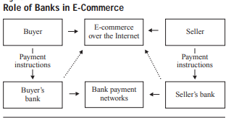
Cont.

Slide 5
Advantages of E-Commerce for Banks
Electronic billing: Electronic billing is one of the biggest benefits that e-commerce has brought to both consumers and businesses.
ID verification: Banks can and should take identification very seriously. The job of a credible financial institution is to ensure that the person spending is the person who should have access to the funds in the account.
Mobile payments: Mobile commerce, or m-commerce, is an important part of e-commerce.
Digital-only banking: E-commerce has enabled app payments and transactions, leading the way for reeducation in physical brick and mortar banks.
B2B innovation: The e-commerce experience has changed the way B2B buyers anticipate buying and selling experiences to go.
International commerce: E-commerce has made it easier for people to bank internationally or pay for goods and services from another country without having to work around banking regulations or exchange rates.

Slide 6
Banking Software
Banking software is enterprise software that is used by the banking industry to provide and manage the financial products they provide.
Within retail banks, banking software typically refers to core banking software and all its interfaces that allows them to connect to other modular software and to the interbank networks.
Within investment banking, banking software typically refer to the trading software used to access capital markets.
Categories are:
Retail banks
Investment banks.

Slide 7
Cont.
Commercial or retail banks use what is known as core banking software which record and manage the transactions made by the banks' customers to their accounts. For example, it allows a customer to go to any branch of the bank and do its banking from there. In essence, it frees the customer from their home branch and enables them to do banking anywhere. Further, the bank's databases can be connected to other channels such as ATMs, Internet Banking, payment networks and SMS based banking.
Investment banks use software to manage their trading desks and their clients accountants. These systems often connect to financial markets such as securities exchanges or third party providers of such as Financial data vendors.

Slide 8
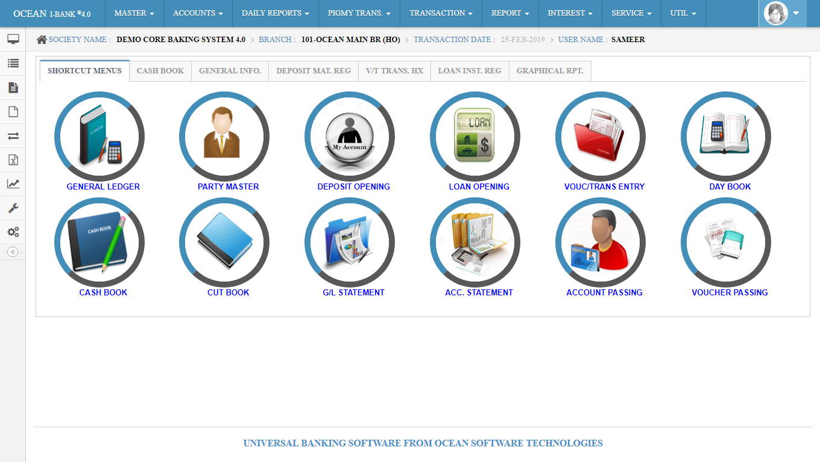
Banking software

Slide 9
Electronic payment and settlement systems.
Payment and settlement systems in India are used for financial transactions. They are covered by the Payment and Settlement Systems Act, 2007 (PSS Act), legislated in December 2007 and regulated by the Reserve Bank of India and the Board for Regulation and Supervision of Payment and Settlement Systems.
India has multiple payments and settlement systems, both gross and net settlement systems. For gross settlement India has a real-time gross settlement (RTGS) system called by the same name and net settlement systems include Electronic Clearing Services (ECS Credit), Electronic Clearing Services (ECS Debit), credit cards, debit cards, the National Electronic Fund Transfer (NEFT) system, Immediate Payment Service and Unified Payments Interface (UPI).

Slide 10
Cont.
RBI’s permission required for setting and operation of payment systems in India
Payment Systems
Electronic payment
Real-Time Gross Settlement (RTGS)System
Electronic Clearing Service (ECS) Credit
National Electronic Clearing Service (NECS)
Regional ECS (RECS)
Electronic Clearing Service (ECS) Debit
National Electronic Funds Transfer (NEFT) System
Pre-paid Payment Systems
Mobile Banking System
ATMs / Point of Sale (POS) Terminals / Online Transactions
National Payments Corporation of India.

Slide 11
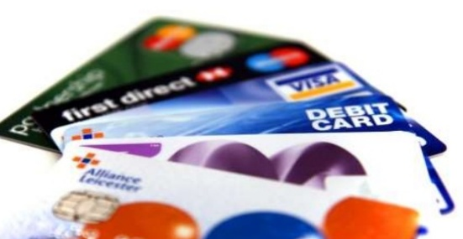
Plastic Money
Plastic Money or Polymer Money, made out of plastic, is a new and better way of paying for goods and services and is used every day in place of actual bank notes.
Plastic money is a generic term for all types of bank cards, credit cards, debit cards, smart cards, Automated Teller Machine cards and charge cards. In recent years, there has been a dramatic growth in the usage of plastic money among the people.
A new way of paying for goods and services.
Introduced in 1950s and is now an essential form of ready money.

Slide 12
Parties Involved in Plastic Money
Cardholder
Card-issuing Bank
Acquiring Bank
Merchant account
Credit card association
Transaction network
Affinity partner
Insurance providers

Slide 13
Transaction Steps
Authorization: The card holder presents the card as payment to the merchant and the merchant submits the transaction to the acquiring bank. Then the bank verifies the card.
Batching: Authorized transactions are stored in batches which is sent to the acquirer.
Clearing and Settlement: The acquirer sends the batch transaction through the card association.
Funding: Once the acquirer has been paid, the acquirer pays to the merchant.

Slide 14
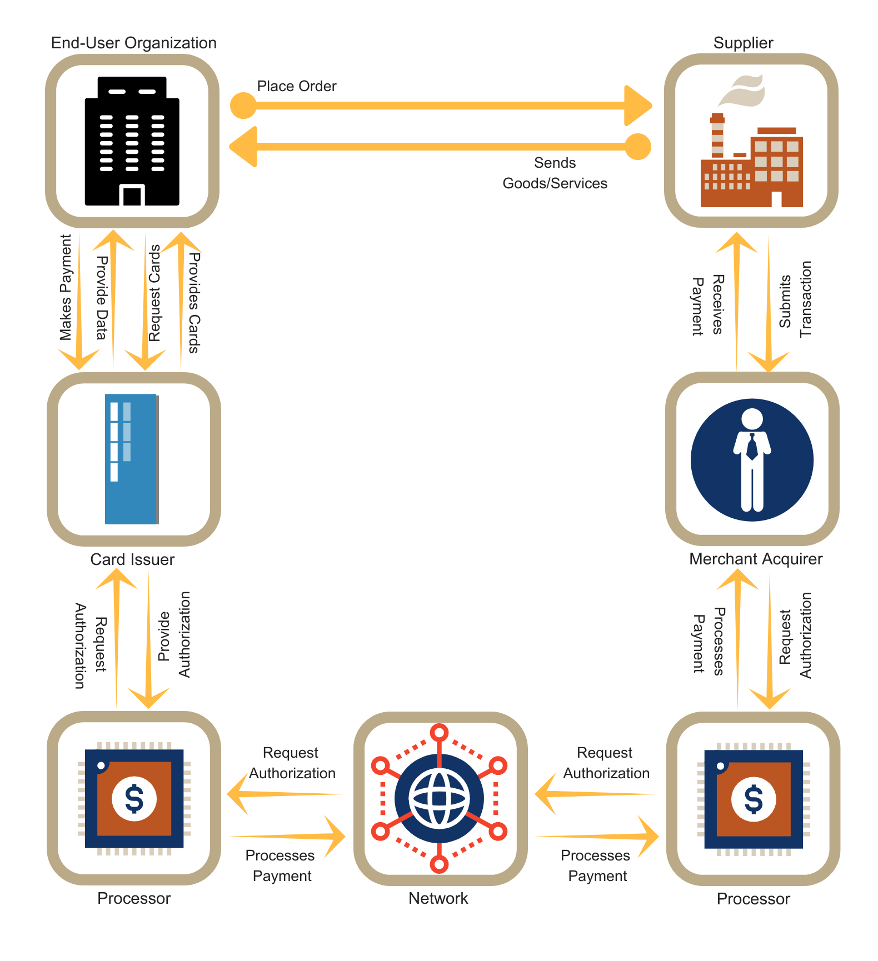
Processing Work

Slide 15
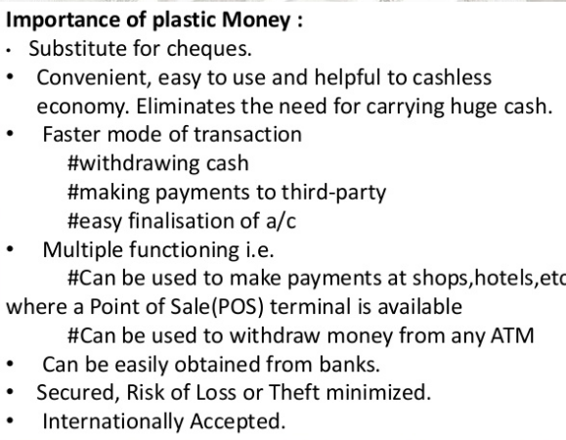

Slide 16
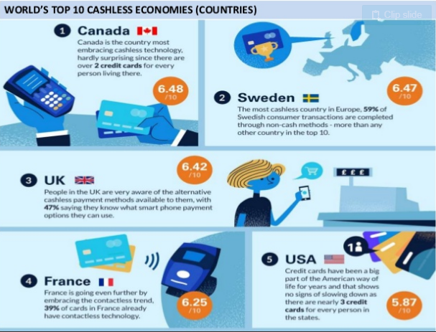

Slide 17
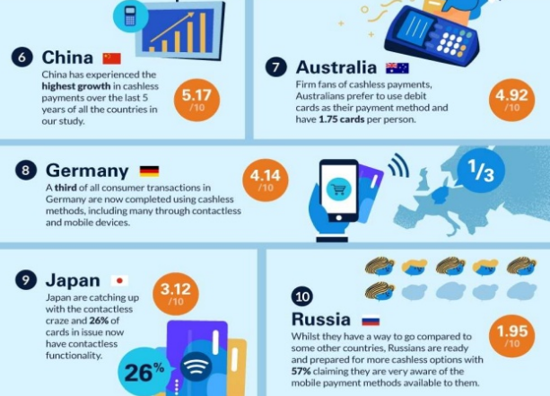

Slide 18
Banking Software Features and Capabilities:
Real-time account & transaction processing
Financial product builder
Customizable interface and product workflow
Customer self-service portal & management
Online payment processing & bill pay
Source capture & remote deposit
Customer interaction (e.g. live chat)
Account-holder transaction history tracking
Account-holder data & document store
Multi-currency funds management
Financial instrument workflow
Accounting workflow
Mobile app development

Slide 19
Banking Software Integrations & Ancillary Products:
Fraud risk management
Financial crime mitigation
Line of credit & credit background check
Loan origination & servicing
Corporate supply chain financing
Customer wealth management
Investor servicing & accounting
Enterprise content management
Marketing resource management and automation
Banking investment & operational intelligence

Slide 20
Core Banking Software Companies:
1. EdgeVerve Finacle:- Finacle is a core banking system developed by Edgeverge, a wholly-owned subsidiary of Infosys, that enables banks to provide digital banking services to their customers.
2. Oracle FLEXCUBE Core Banking:- Oracle FLEXCUBE Universal Banking is core banking software designed to modernize a bank’s core systems and support digital transformation of banking processes and systems of the future.
3. Tata Consultancy Services (TCS) BaNCS:- The TCS BaNCS Global Banking Platform, deployed at more than 400 financial institutions, enables your bank to offer products and services to customers throughout their lifecycle and across all touch points.

Slide 21
Cont.
4. Wipro Core Banking As-a-Service:- Wipro offers Core Banking As-a-Service offering for financial institutions wherein you get access to a hosted core banking application and the underlying technology infrastructure on a variabilized cost model.
5. SAP Banking and Financial Services:- SAP provides a digital platform to enable banks to better serve current customers and reach the underbanked to support financial inclusion. The platform includes services and technologies such as mobile banking apps, omnichannel banking, and digital banking analytics.

Slide 22
THANK YOU

