Slide 1

Magazines/Books/Internet/Films in India
Divya Narang Tinna
AP, TCSC

Slide 2
History of Magazines
First magazine appeared in France in 1663 (Philosophy and Literature)
Erbauliche Monaths-Unterredungen (“Edifying Monthly Discussions”) (Edifying-providing intellectual instruction)
Soon other light and entertaining periodicals started appearing in Italy, UK and France
Le Mercure Galant came in 1672 (Court Events, Theatre and Literature) in France
By the early 19th century a different, less learned audience had been identified
New types of magazines for entertainment and family enjoyment began to appear
Among them the popular weekly were the women’s weekly, the religious and missionary review, the illustrated magazine, and the children’s weekly

Slide 3
History of Magazines
The first periodic/magazine in India was perhaps ‘Asiatick Miscellany’ in Kolkata in 1785
Bombay Quarterly was another notable magazine
Mirat-ul-Akbar was started by Raja Ram Mohan Roy in Persian Language
“The Bramhanical Magazine” was in English started by Raja Ram Mohan Roy
After 1857’s revolt, there came a clear shift between the magazines and the newspapers
The Illustrated Weekly started in 1880 and final issue came in 1993
After the advent of Internet, magazine readership in India has been on decline

Slide 4
Magazines in India
1980s saw a boom in magazines in India
From English to Regional Languages
Four Fifth of the magazines were in regional languages
Hindi magazines had the largest circulation (57.4 lakh)
There were more than 3000 Hindi periodicals
Followed by English-2670
Magazine boom was set off by the launch of “India Today” in mid 70s
“India Today” (1975) was inspired from ‘Time” magazine
1992- It became official agent of the “Time”

Slide 5
Magazines in India
‘Bombay’ Started in 1979
Some other magazines of 1980s were
Gentleman
Gentleman Fashion Quarterly
Bombay
The Week
Magazines like Filmfare, Stardust, Cine Blitz introduced colour, gloss and snazzy style of reporting
Magazines used high quality printing and imported paper
Source of revenue-Advertisements
The boom continued into the 1990s

Slide 6
Magazines in India
But, The Illustrated Weekly and Bombay closed down
Two Genres of Magazines
General Interest Magazines
Caters to wide variety of reading interest
E.g. India Today
Special Interest Magazines
Made for niche audience
Such as females, kids, senior citizens etc.
E.g. Femina

Slide 7
Magazines in India
Special Interest Periodicals launched in 1993 were
Parenting
Young Mother
Auto India
Car and Bikes
Grihshobha, Sarita, Vaneeta and Meri Saheli are some popular women magazines in Hindi language

Slide 8
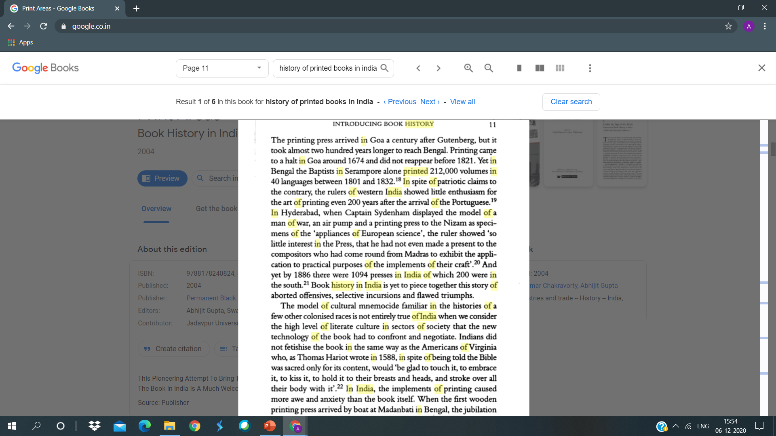

Slide 9
History of Films in India
The credit of creating first motion film goes to ‘Lumiere Brothers’
Silent Movie to Audio-Visuals
1896-First cinematographic exhibition was held in July
1897-Exhibition in Mumbai
First Talkie was projected in Paris in 1900
First Sound based film was ‘The Jazz Singer” released in 1927
1913-Raja Harishchandra was the first film
It was a silent movie
Directed by Dada Saheb Phalke
His other films were Savitri, Lanka Dahan, Krishna-Janama

Slide 10
History of Films in India
A Salunke used to play the role of a woman in his film
Harishchandra and Bhatvadekar ordered a movie camera from London
They took it to a wrestling match and shot it live
Bhatvadekar is known as the father of Indian factual film
First Indian Sound based film was ‘Alam Ara’ which came in 1931
The Premiere was a proud occasion
It was attended by the Governor also

Slide 11
History of Films in India
50s and 60s are considered the golden age of Indian cinema
Satyajit Ray, Guru Dutt, Bimal Roy, Mehboob Khan and Raj Kapoor made many beautiful films in this era
In South, NT Rama Rao, Sivaji Ganeshan and MG Ramachandran were gaining popularity
50-70- Films on caste system, poverty, zamindar system etc.
Do Aankhen Barah Hath, Mughel-e-Azam, Mother India, Awara and Pyasa
60-70 Hrshikesh Mukherjee, Sham Benegal and Mrinal Sen
90s- Era of Khans, Sridevi, Madhuri Dixit
Post 90s-Rudali, Machis, Bandit Queen, Roja
Directors like Meghna Gulzar, Meira Nair and Deepa Mehta

Slide 12
History of Books in India
Book Publishing started in India with the coming of printing press in Goa in 1566
Another Printing Press in Tranqabar near Madras
After 200 years later another press in Serampore near Calcutta
Between 1801-1832, the Serampore Mission Press alone published 212000 volumes in fifty languages
The books were in English and Regional Languages
Material related to Education was being printed
1835-Government decided that higher education would be in English
In 1881, a survey was conducted
Total number of European and Indian Language books were 931
Out of these 117 were in European and rest were in Marathi, Gujarati, Kannada, Sindhi and Hindi

Slide 13
History of Books in India
During 50s and 60s the publishing industry grew steadily
Suffered a lot in 70s due to high price of paper
Less supply of paper
1967-National Book Development Board was set up to promote the development of books in India
Government set up National Book Trust
Raja Rammohan Roy Educational Resource Centres for the publication of low-cost editions of foreign reprint

Slide 14
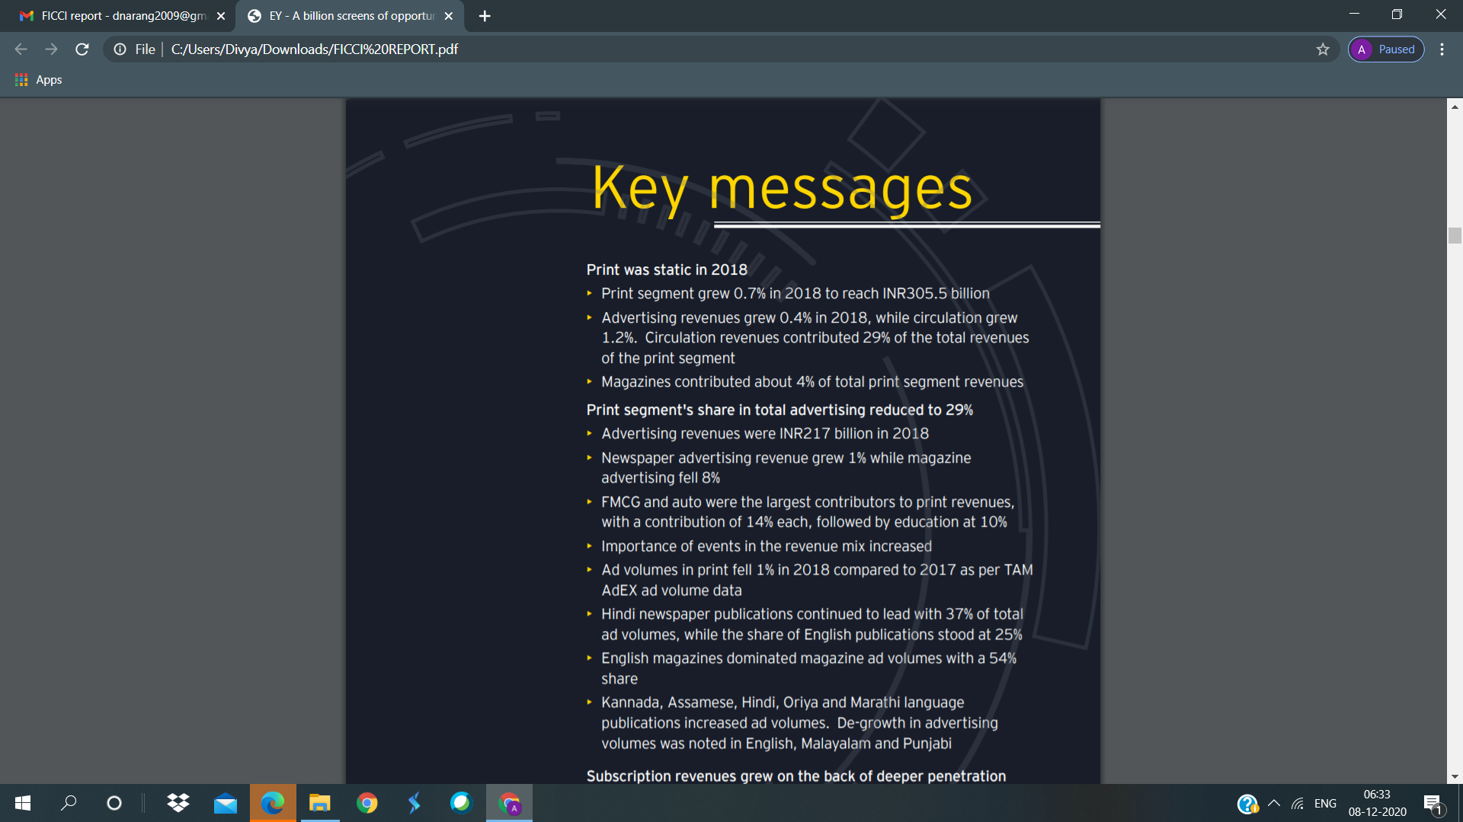

Slide 15
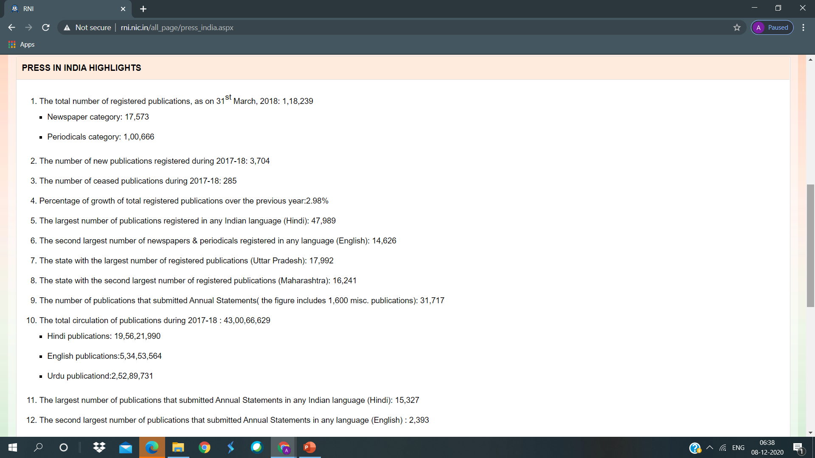

Slide 16
