Slide 1
Venture Capital and Private Equity
UNIT 1:Conceptual understanding of Venture Capital and Private Equity

Slide 2
Syllabus
UNIT 1:Conceptual understanding of Venture Capital and Private Equity
Venture Capital –Over View of Venture Capital- Definition- Features- Types – Roles
Concept of PE and its characteristics- Definition- Difference between PE,VC and Hedge Funds- Nature of PE Firm- Players in the PE market– Benefit of PE Finance
PE Fund –Legal structure and terms- Private Equity Investments and Financing Private Equity Multiples and Prices- Private Equity Funds and Private Equity Firms- Investment Feature and Consideration

Slide 3
Syllabus
UNIT 2: Structure and Valuation approaches
Structure and Regulation of Venture Capital and Private Equity- Business Cycle of PE –Structure of VC/PE firms- Limited Liability Partnerships- Routes of VC/PE investments in India- Regulatory Aspects of VC/PE investments
Valuation approaches- Risk and Returns- Analysis of Funds- Conventional Method- Revenue Multiplier Method

Slide 4
Syllabus
UNIT 3 :Strategies of Private Equity
Leverage Buyout, Growth Capital, Mezzanine Capital
Distressed Debt, other Strategies
Due Diligence- Procedure and Challenges
Due Diligence in Emerging PE Market
Investing in Developing Market
Past Performance and Strategy

Slide 5
Syllabus
UNIT 4 Exit strategies for Private Equity
Modes of exits in Indian Context and Challenges involved-
IPO, Promoter Buyback
Sale to Other PE funds
Sale to other strategic Investors
Stake Swap
M & A’s
Open Market-
Secondary Market

Slide 6
UNIT 1:Conceptual understanding of Venture Capital and Private Equity
Start up companies with a potential to grow need a certain amount of investment. Wealthy investors like to invest their capital in such businesses with a long-term growth perspective. This capital is known as venture capital and the investors are called venture capitalists.
Venture capital, also called VC, refers to the financing of a startup company by typically high-wealth investors who think the business has potential to grow substantially in the long run. Typically, VCs only invest in startup companies up to a certain percentage.

Slide 7
Venture Capital
VC is used to fund a startup when there is a need to grow the business and realize an above-average profit. At this stage, a venture capitalist invests in a firm that has a high growth potential and can generate viable profits in the long-term.
Usually, venture capitalists invest their money in firms that have limited or no access to capital markets, thereby fueling their core operations while leveraging risk. From the business owner perspective, the downside is that venture capitalists are free to state their opinion and require changes in the company so that it becomes profitable and they are not losing the invested capital.

Slide 8
Definition of Venture Capital
A venture capital can be defined as a temporary equity or quasi-equity investment in a growth-oriented small or medium business managed by a highly motivated entrepreneur. The investment is combined with managerial assistance.
Before going in for venture capital finance, the venture capital institution will have to assess the potentiality of the borrowing concern by a proper appraisal. This appraisal will be similar to the project appraisal undertaken by commercial banks.

Slide 9
Features of Venture capital
High Risk
Lack of Liquidity
Long term horizon
Equity participation and capital gains
Venture capital investments are made in innovative projects
Suppliers of venture capital participate in the management of the company

Slide 10
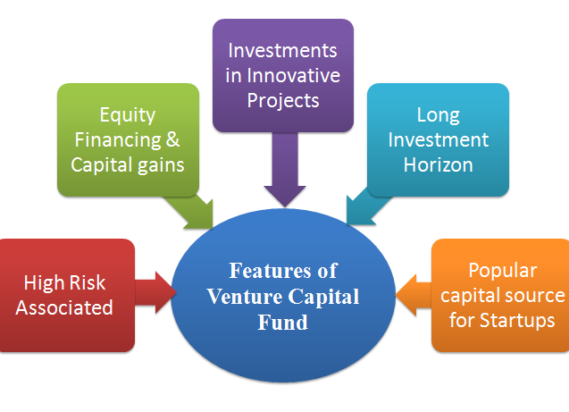

Slide 11
Features of Venture capital
1.High Risk:
By definition the Venture capital financing is highly risky and chances of failure are high as it provides long term start up capital to high risk-high reward ventures. Venture capital assumes four types of risks
Management risk - Inability of management teams to work together.
Market risk - Product may fail in the market.
Product risk - Product may not be commercially viable.
Operation risk - Operations may not be cost effective resulting in increased cost decreased gross margins.

Slide 12
Features of Venture capital
2. Equity Participation & Capital Gains:
In the early stage of business, because dividends can be delayed, equity investment implies that investors bear the risk of venture and would earn a return commensurate with success in the form of capital gains.
3. Participation In Management
Based upon the experience other companies, a venture capitalist advise the promoters on project planning, monitoring, financial management, including working capital and public issue. Venture capital investor cannot interfere in day today management of the enterprise but keeps a close contact with the promoters or entrepreneurs to protect his investment.

Slide 13
Features of Venture capital
4.Length of Investment :The process of having significant returns takes several years and calls on the capacity and talent of venture capitalist and entrepreneurs to reach fruition.
5.Illiquid Investment :Venture capital investments are illiquid, that is, not subject to repayment on demand or following a repayment schedule. Investors seek return ultimately by means of capital gains when the investment is sold at market place. The investment is realized only on enlistment of security or it is lost if enterprise is liquidated for unsuccessful working.
6.High-tech: Venture capital finance caters largely to the needs of first- generation entrepreneurs who are technocrats, with innovative technological business ideas that have not so far been tapped in the industrial field .

Slide 14
Advantages of Venture Capital
They bring wealth and expertise to the company
Large sum of equity finance can be provided
The business does not stand the obligation to repay the money
In addition to capital, it provides valuable information, resources, technical assistance to make a business successful

Slide 15
Disadvantages of Venture Capital
As the investors become part owners, the autonomy and control of the founder is lost
It is a lengthy and complex process
It is an uncertain form of financing
Benefit from such financing can be realized in long run only

Slide 16
Types of Venture Capital funding
The various types of venture capital are classified as per their applications at various stages of a business.
The three principal types of venture capital are :
Early Stage Financing
Expansion Financing
Acquisition/Buyout financing.

Slide 17
Six stages of financing
Seed money: Low level financing for proving and fructifying a new idea
Start-up: New firms needing funds for expenses related with marketingand product development
First-Round: Manufacturing and early sales funding
Second-Round: Operational capital given for early stage companies which are selling products, but not returning a profit
Third-Round: Also known as Mezzanine financing, this is the money for expanding a newly beneficial company
Fourth-Round: Also called bridge financing, 4th round is proposed for financing the "going public" process

Slide 18
A) Early Stage Financing:
Early stage financing has three sub divisions seed financing, start up financing and first stage financing.
Seed financing is defined as a small amount that an entrepreneur receives for the purpose of being eligible for a start up loan.
Start up financing is given to companies for the purpose of finishing the development of products and services.
First Stage financing: Companies that have spent all their starting capital and need finance for beginning business activities at the full-scale are the major beneficiaries of the First Stage Financing.

Slide 19
B) Expansion Financing:
Expansion financing may be categorized into second-stage financing, bridge financing and third stage financing or mezzanine financing.
Second-stage financing is provided to companies for the purpose of beginning their expansion. It is also known as mezzanine financing. It is provided for the purpose of assisting a particular company to expand in a major way.
Bridge financing may be provided as a short term interest only finance option as well as a form of monetary assistance to companies that employ the Initial Public Offers as a major business strategy.

Slide 20
C) Acquisition or Buyout Financing:
Acquisition or buyout financing is categorized into acquisition finance and management or leveraged buyout financing.
Acquisition financing assists a company to acquire certain parts or an entire company.
Management or leveraged buyout financing helps a particular management group to obtain a particular product of another company.

Slide 21
Venture Capital Funding Process
The venture capital funding process typically involves four phases in the company’s development:
Idea generation
Start-up
Ramp up
Exit

Slide 22
Step 1: Idea generation and submission of the Business Plan
The initial step in approaching a Venture Capital is to submit a business plan. The plan should include the below points:
There should be an executive summary of the business proposal
Description of the opportunity and the market potential and size
Review on the existing and expected competitive scenario
Detailed financial projections
Details of the management of the company
There is detailed analysis done of the submitted plan, by the Venture Capital to decide whether to take up the project or no

Slide 23
Step 2: Introductory Meeting
Once the preliminary study is done by the VC and they find the project as per their preferences, there is a one-to-one meeting that is called for discussing the project in detail. After the meeting the VC finally decides whether or not to move forward to the due diligence stage of the process.

Slide 24
Step 3: Due Diligence
The due diligence phase varies depending upon the nature of the business proposal. This process involves solving of queries related to customer references, product and business strategy evaluations, management interviews, and other such exchanges of information during this time period.

Slide 25
Step 4: Term Sheets and Funding
If the due diligence phase is satisfactory, the VC offers a term sheet, which is a non-binding document explaining the basic terms and conditions of the investment agreement. The term sheet is generally negotiable and must be agreed upon by all parties, after which on completion of legal documents and legal due diligence, funds are made available.

Slide 26
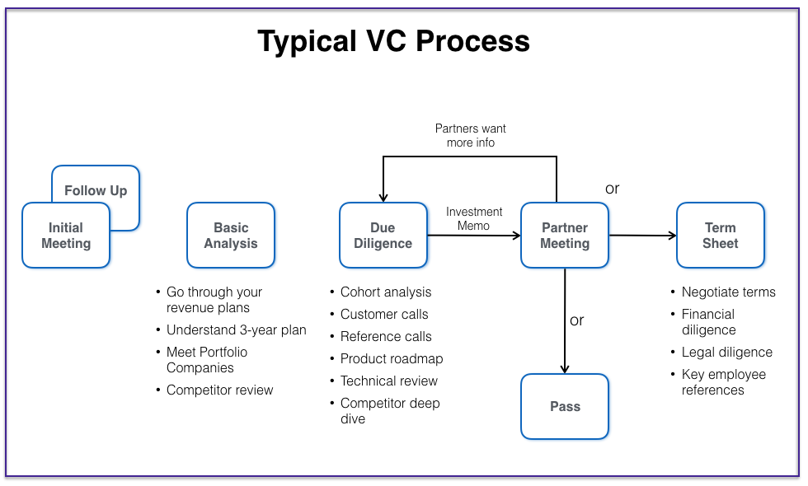

Slide 27
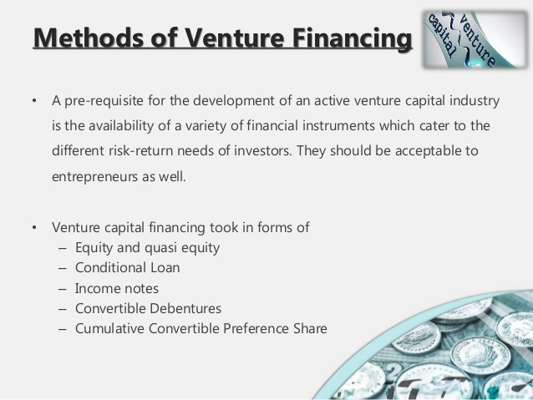

Slide 28
Methods of Venture financing
Equity: All VCFs in India provide equity but generally their contribution does not exceed 49 percent of the total equity capital.
Thus, the effective control and majority ownership of the firm remains with the entrepreneur. They buy shares of an enterprise with an intention to ultimately sell them off to make capital gains.
• Quasi Equity: A form of finance that combines some of the benefits of equity and debt •.

Slide 29
Methods of Venture financing
Conditional Loan: It is repayable in the form of a royalty after the venture is able to generate sales. No interest is paid on such loans. In India, VCFs charge royalty ranging between 2 to 15 percent; actual rate depends on other factors of the venture such as gestation period, cost- flow patterns, riskiness and other factors of the enterprise.
• Income Note : It is a hybrid security which combines the features of both conventional loan and conditional loan. The entrepreneur has to pay both interest and royalty on sales, but at substantially low rates.
• Other Financing Methods: A few venture capitalists, particularly in the private sector, have started introducing innovative financial securities like participating debentures, introduced by TCFC is an example

Slide 30
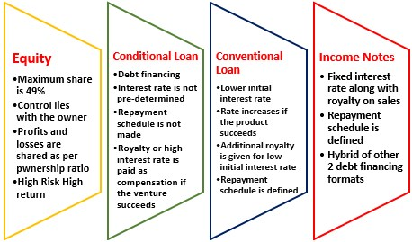

Slide 31
Main Role and Importance of Venture Capital
1. Promotion of the Enterprise: For it, the entrepreneur carries out various functions, like – emergence of the business idea, to obtain information about related facts, selection of the location, preparation of plant layout, registration of the enterprise and completion of various legal formalities.
2. Encouragement to Entrepreneurship
Venture capital is an important tool or method to encourage entrepreneurship, the reason being that on one side, the venture capital encourages the innovators to establish the industries/ and on the other side small and medium entrepreneurs and also encouraged.

Slide 32
Main Role and Importance of Venture Capital
3. Performance of Economic Activities: Economic activities, like – sale and purchase for products, purchase of means and machinery for converting raw material into finished products, carrying out production and its availability to the consumers may be efficiently performed through venture capital.
4. Management and Organization
Management and Organisation of the industry should be efficient for the performance of various economic activities.
For example, manpower planning, taking work from competent persons, to engage the service of professionals and maintaining balance therein, for getting economic activities accomplished.

Slide 33
Main Role and Importance of Venture Capital
5. Fulfillment of Financial Requirements of High-Risk Entrepreneurs
Use of automatic machines, computers, the latest machinery, robots, new sources of energy, email, rocket research, etc.Due to scientific progress have not only brought the technical Revolution but has also increased the risks. The financial requirement of entrepreneurs involving high risks has been met by venture capital companies.
6. Assistance in Strategy Formulation
Today’s age is the age of competitions, which can be seen in all areas, activities, stages, and places.
However, venture capital has to sustain in all types of competition, which enables the entrepreneur to prepare strategies right from the establishment of the industry to its development expansion.

Slide 34
Main Role and Importance of Venture Capital
7.Possibility of Rapid Development Expansion:Venture capital includes all types of high risk and high probable investments.Hence, venture capital is made available to a new company from the starting stage (promotion of the enterprise) to advance further.As a result, the possibility of rapid development expansion of the company increases
8.Other Roles and Importance
Investment of venture capital for the purchase of modern machinery establishment of laboratories, the appointment of scientists and training for new functions and activities, etc.
Employees’ welfare and amenities.
Project evolution and reports

Slide 35
Role of Venture Capital
Making predictions is tough. So is spotting a pattern before it becomes a trend. There are a bunch of professionals whose job is to do both—venture capital (VC) executives.
Flipkart wouldn’t have possibly happened had someone at Accel Partners not believed that two young Amazon executives could build Amazon’s bête noire in India. Similarly, Oyo probably wouldn’t have become a behemoth under Ritesh Agarwal had somebody at Lightspeed Venture Partners not shown faith in the high school dropout’s business acumen.
These were risky calls. But, VC is a high stakes job. The pinstriped mavens of the private market are rewarded for the making the right calls, but failure isn’t taken kindly either.

Slide 36
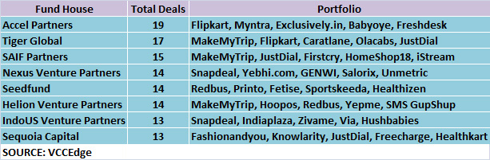

Slide 37
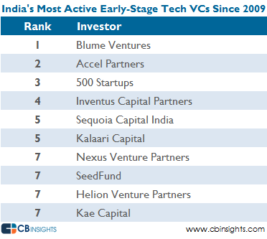

Slide 38
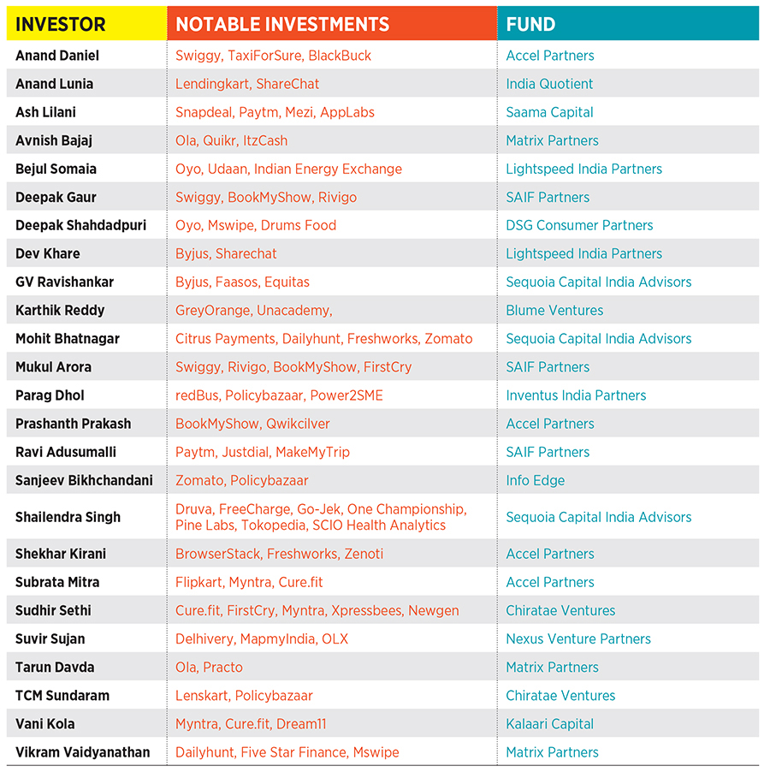

Slide 40
Private Equity
Private equity is an alternative investment class and consists of capital that is not listed on a public exchange.
Private equity is composed of funds and investors that directly invest in private companies, or that engage in buyoutsof public companies, resulting in the delisting of public equity

Slide 41
Features of Private Equity
Long-term time horizons:
The optimal strategy for mitigating the volatility of the investment cycle is a long-term disciplined approach for committing to attractive investment opportunities every year, for over a three-year period.
Expertise:
The talent that your business is provided abundantly by private equity firms. These are generally hands-on groups that enable the company to maximize the value of your company and meeting new business goals

Slide 42
Features of Private Equity
Illiquid asset: As compared to various other alternative investments, redemption features or investor-driven reinvestment is not available with private equity investments.
Active involvement: If we consider other funding options and study them in detail, we notice that the lenders or investors are minimally involved in the day-to-day running of the business. On the other hand, PE firms are seen to be more hand-on, assisting you for re-evaluating each and every aspect of your business, for the objective of maximizing its value

Slide 43
Features of Private Equity
Manager selection and due diligence: Achievement of the top quartile performance does not take place randomly, but rather has a correlation with the level of access of the partnership to various investment opportunities, management teams, and strength of entrepreneurial relationships. It depends on their ability for capturing the highest yielding business plans and tap the strategic investors, and expert operating experience in strengthening and building businesses, to mention a few aspects.

Slide 44
Features of Private Equity
Confirmed returns: For the purpose of value creation, private equity firms are actual experts. According to researches, at least two-thirds of all private equity deals led to at least 20 percent annual growth for the purchased firm. Thus, in most of the cases, there is a good rate of return experienced by businesses involved in private equity investments.
Growth capital: This is a kind of deal of private equity where the firm takes a comparatively smaller stake, as the prime objective is not a turnaround, but the growth of the company. Here, it might be just like venture capital, actually venture capital is regarded usually as a subset of private equity. The prime difference for growth capital private equity if is more interested in more mature and larger companies, and not the early-stage companies that are looked for by the venture capitalists

Slide 45
Features of Private Equity
J-curve phenomenon: A private equity investor needs to be at ease with the J-curve effect in PE investments. Basically, the J-curve phenomena illustrate the pattern of returns generated by a PE fund against time, from inception to termination, realized by plotting the returns. The start-up costs in the initial stakes of a partnership and payment of fees, before any returns to the investor, results in the finance contributed to be more than the portfolio investments’ book value.
Therefore, in the early years, a private equity fund might show a negative return in a typical manner. The other influence on early returns is the portfolio investments’ writing down, under an investment program of a sponsor, is considered to be the behind strategy. Normally, the investment gains arrive in far ahead years, as the portfolio companies gain maturity and rise in value. After the very first realizations are done, the return on funds may rise in a pretty steep manner and can counterbalance the rest of the capital calls for expenses and investments.

Slide 46
Features of Private Equity
Success of investment: PE firms have their own conferred interests in ensuring that your business does well. When a PE firm invests or acquires your company, you can fully depend on their commitment to ensuring that its future is a success.
Overall responsibility: The PE investment firms provide a high level of flexibility and sound financing practices. The cyclical trends are considered in-depth and the firms are in-tune with the particularities of the particular sectors in which the investment is done. They do not just concentrate on one aspect of the business, whereas considering every factor and put in effort and expertise for the improvement of the same.

Slide 47
Features of Private Equity
High competition for investment opportunities: The activity of completing, realizing, and identifying attractive investments is extremely competitive, involving a high degree of uncertainty. There can be no guarantee or assurance that the fund will able to consummate, locate, and exit investments that satisfy the rate of return objectives of the funds, or comprehend upon their values or that it will be enabled to invest completely to its committed capital finance.
Systemized approach: For the purpose of counterbalancing the initial fall in cash flows early in the PE cycle, investors may pick to invest regularly over several years. Often, investors consider overcommitting to private equity for ensuring that they have sufficient assets at work. It depends upon the time invested in order to attain the anticipated exposure to private equity.

Slide 48
Advantages of Private Equity
Private equity offers several advantages to companies and startups. It is favored by companies because it allows them access to liquidity as an alternative to conventional financial mechanisms, such as high interest bank loans or listing on public markets.
Certain forms of private equity, such as venture capital, also finance ideas and early stage companies.
In the case of companies that are de-listed, private equity financing can help such companies attempt unorthodox growth strategies away from the glare of public markets. Otherwise, the pressure of quarterly earnings dramatically reduces the time frame available to senior management to turn a company around or experiment with new ways to cut losses or make money.

Slide 49
Disadvantages of Private Equity
Private equity has unique challenges.
First, it can be difficult to liquidate holdings in private equity because, unlike public markets, a ready-made order book that matches buyers with sellers is not available. A firm has to undertake a search for a buyer in order to make a sale of its investment or company.
Second, pricing of shares for a company in private equity is determined through negotiations between buyers and sellers and not by market forces, as is generally the case for publicly-listed companies.
Third, the rights of private equity shareholders are generally decided on a case-by-case basis through negotiations instead of a broad governance framework that typically dictates rights for their counterparts in public markets

Slide 50
Players in Private Equity Market
Issuers | Intermediaries | Investors
New Ventures | Limited Partnership | Public pension funds
Private Companies | Other Intermediaries like | Insurance companies
 | Small Business Investment Co’s
Public Companies | Publicly traded investment Co’s | Corporate pension funds
 | And other companies
 |  | Investment Banks,NFC,s

Slide 51
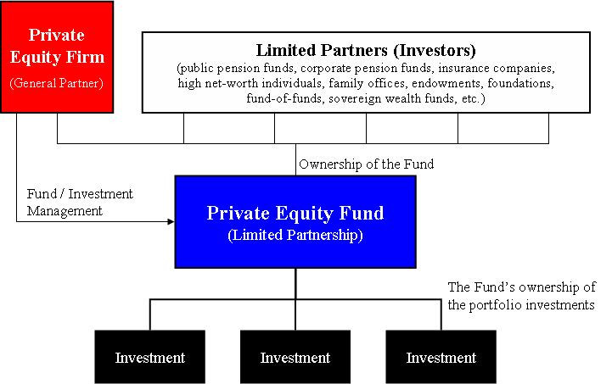

Slide 52
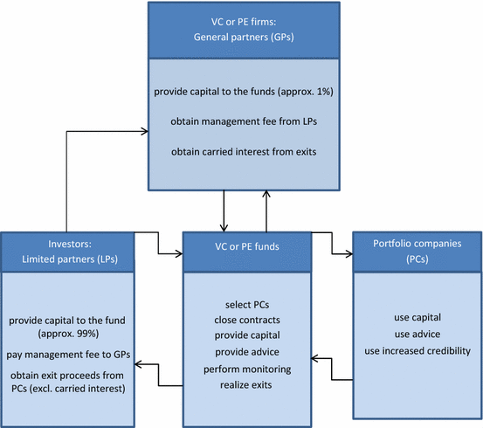

Slide 53
General Partners
A private equity firm is called a general partner (GP) and its investors that commit capital are called limited partners (LPs). Limited partners generally consist of pension funds, institutional accounts and wealthy individuals.
The general partner invests the fund’s committed capital in public and private companies, manages the portfolio of investments and seeks to exit the investments in the future for sizable returns. A general partner may manage one or a few funds that may have different investment restrictions such as geography, industry or typical size of each investment.
Each fund generally makes 10 to 12 investments and the life of a fund is usually 5 to 7 years. As a general partner’s funds become almost fully invested, the firm will need to plan future fundraising to raise new funds using its proven track record of success in previous funds.
General partners generally charge both a management fee and a performance fee. While this varies by firm and its funds, typical management fees consist of 2% of assets under management and performance fees of 20% which are taken from exited investments. Performance fees are also called “carried interest” or “carry”.

Slide 54
Limited Partner
The limited partnership is that which consists of one or more limited or general partners. The acronym for the term is LP
The limited partners have limited liability, in that they are only accountable for debts based on the amount of investment they have brought into the business.
They also, have no management control and make minimal decisions.
Their remuneration is a return on their investment which is should be predetermined in the agreements.
Profits and losses are shared according to the investment brought in as listed in the contracts and binding agreements

Slide 55
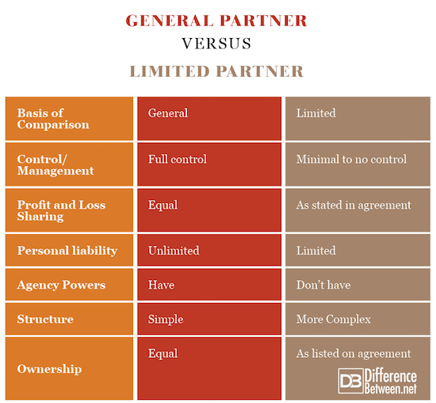

Slide 56
Private Equity Firms
Top foreign funds include Blackstone, KKR, Carlyle, TPG, TA Associates, Warburg Pincus, Barings Private Equity Asia, Apax, Bain Capital, General Atlantic, Advent, etc. Foreign Bank PE arms such as Goldman Sachs PE, Standard Chartered PE, etc
Some of the most famous Indian PE funds are Multiples PE, Kedaara, Samara, CX Partners, Gaja Capital, ChrysCap, Westbridge Capital, True North and PE arms of Indian Banks and Financial Services companies such as Motilal Oswal PE, Kotak PE, ICICI Ventures, etc
Everstone Capital (Sameer Sain and Atul Kapur) is one of the most prominent PE funds with significant Indian Investments but is headquartered in Singapore.
Other funds that are family offices of wealthy Indians such as Azim Premji’s Premji Invest, Narayan Murthy’s Catamaran Ventures, Ranjan Pai’s Aarin Capital, etc. These are family offices and may be more difficult to classify them as PE or VC on the basis of investing styles.

Slide 57
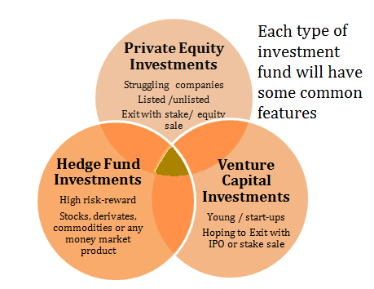

Slide 58
Difference between private equity and venture capital
c
Private Equity
Venture Capital
PE firms often invest in mature businesses in traditional industries.
Using capital committed from LPs, PE investors invest in promising companies—typically taking a majority stake (>50%).
VC firms often invest in tech-focused startups and other young companies in their seed
Using committed capital, VC investors usually take a minority stake (<50%) in the companies they invest in.

Slide 59
Difference between private equity and venture capital
Private Equity
Venture Capital
When a PE firm sells one of its portfolio companies to another company or investor, returns are distributed to the PE investors and to the LPs. Investors typically receive 20% of the returns, while LPs get 80%.
Most of these companies are not fully established or profitable, so they can be risky investments—but with that risk comes the opportunity for big returns

Slide 60
Difference between VC &PE
Parameters | Venture Capital | Private Equity
Meaning | These are small investments used to grow the company in their primary stage | It is the investments to those firms which are not listed on any public stock exchange
Investment Stages | Initial stage | Later stage
Fund Invested | In a large number of firms | In a few companies
Industries | Industries such as high technology, energy conservation, etc. that need initial investments | All Industries
Focus on | Management Skill | Corporate Governance
Risk Involved | High | Low
Capital Required | For operations growth | It is required for business expansion and growth

Slide 61
Key Differences Between Private Equity and Hedge Funds
Private equity funds are the investment funds that are typically owned by limited partnerships to buy and restructure companies that are not traded publicly on the stock exchange. In contrast, hedge funds are privately held, and these pool investors’ funds and then reinvest the same into financial instruments that have a complicated portfolio.
Private equity funds invest in companies that can provide higher profits over a more extended period. In contrast, hedge funds are used to invest in assets that yield good ROI or return on investment over a shorter period.
Investors in private equity funds have the liberty to invest funds as and when required, whereas, in hedge funds, the investors will need to make investments all in a single go.
Private equity funds are closed-ended investment funds, whereas hedge funds are open-ended investment funds.

Slide 62
Key Differences Between Private Equity and Hedge Funds
Private equity funds do not have any sort of restriction on transferability over a specified time frame, whereas hedge funds have restrictions on transferability.
Private equity funds are less risky in comparison to hedge funds.
The investors in private equity funds act as active participants, whereas the investors in hedge funds are vested with the passive status.
Funds life is contractually defined in private equity funds, whereas there is zero limitation on funds’ life in the case of hedge funds.
Investors in Private equity funds have a higher level of control over operations and asset management, whereas hedge funds have a lower level of control over assets

Slide 63
Private Equity Fund Structure
Private equity funds are closed-end investment vehicles, which means that there is a limited window to raise funds and once this window has expired no further funds can be raised. These funds are generally formed as either a Limited Partnership (“LP”) or Limited Liability Company (“LLC”).

Slide 64
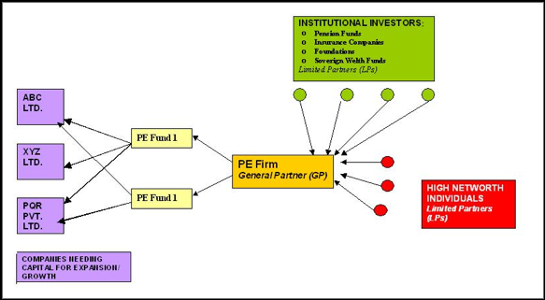

Slide 65
Private Equity Fund Structure & Terms
Raising a private equity fund requires two groups of people:
1) Financial Sponsor:
The team of individuals that will identify, execute and manage investments in privately-held operating businesses. This is generally comprised of a General Partner and a Management Company.
General Partner: The entity with the legal authority to make decisions for the fund. This entity also assumes all legal liability.
Management Company: The operating entity that employs the investment professionals responsible for allocating capital and managing investments.

Slide 66
Private Equity Fund Structure & Terms
2) Investors: The individuals that will provide the capital to make those investments. Because funds are generally formed as Limited Partnerships, investors are often referred to as limited partners.
In raising a fund, the fund founders will reach out to sources of institutional capital such as pension plans and university endowments, as well as high net worth family offices and individuals. The commitment to the fund, known as the “capital commitment,” will be made via a partnership agreement stipulating that the capital invested or resulting assets will be returned within a fixed period of time (typically 10 years)

Slide 67
Private Equity Fund Structure & Terms
In most cases this is structured as a limited partnership agreement (LPA). The LPA will typically include the following:
Mandate: The partnership agreement may provide parameters for acceptable investments. These restrictions could relate to scale, geography and security type, etc
Fund Term: This defines the time horizons available for investment and divestment.

Slide 68
Private Equity Fund Structure & Terms
Management Fees: This defines the fee tied to the capital raised, or assets under management (“AUM”). The Management Company will typically earn an annual 2% fee on AUM.
Distribution Waterfall: Distribution waterfalls define the economic relationship between the general partner (“GP”) and limited partners (“LP”). This is how the GP earns what is known as a carried interest, which is typically 20% of the proceeds after the LP has received distributions equal to the original capital invested plus a defined preferred return.

Slide 69
What are valuation multiples?
Valuation multiples are financial measurement tools that evaluate one financial metric as a ratio of another, in order to make different companies more comparable.
Multiples are the proportion of one financial metric (i.e. Share Price) to another financial metric (i.e. Earnings per Share). It is an easy way to compute a company’s value and compare it with other businesses.

Slide 70
Types of valuation multiples
There are two main types of valuation multiples:
Equity Multiples
Enterprise Value Multiples
There are two main methods of performing analysis using multiples:
Comparable Company Analysis (“Comps”)
Precedent Transaction Analysis (“Precedents”)

Slide 71
Equity multiples
Investment decisions make use of equity multiples especially when an investor aspires for minority positions in companies. The list below shows some common equity multiples used in valuation analyses.
P/E Ratio – the most commonly used equity multiple; needed data is easily accessible; computed as the proportion of Share Price to Earnings Per Share (EPS)
Price/Book Ratio – useful if assets primarily drive earnings; computed as the proportion of Share Price to Book Value Per Share
Dividend Yield – used for comparisons between cash returns and investment types; computed as the proportion of Dividend Per Share to Share Price
Price/Sales – used for firms that make losses; used for quick estimates; computed as the proportion of Share Price to Sales (Revenue) Per Share

Slide 72
Enterprise Value (EV) multiples
When decisions are about mergers and acquisitions, enterprise value multiples are the appropriate multiples to use. The list below shows some common enterprise value multiples used in valuation analyses.
EV/Revenue – slightly affected by differences in accounting; computed as the proportion of Enterprise Value to Sales or Revenue.
EV/EBITDAR – most used in industries in the hotel and transport sectors; computed as the proportion of Enterprise Value to Earnings before Interest, Tax, Depreciation & Amortization, and Rental Costs
EV/EBITDA – EBITDA can be used as a substitute of free cash flows; most used enterprise value multiple; computed as the proportion of Enterprise Value to Enterprise Value / Earnings before Interest, Tax, Depreciation & Amortization
EV/Invested Capital – used for capital-intensive industries; computed as the proportion of Enterprise Value to Invested Capital

Slide 73
Methods of using multiples
All of the above metrics can be analyzed with two common approaches to valuation multiples:
Comparable Company Analysis – This method analyzes public companies that are similar to the company being valued. An analyst will gather share prices, market capitalization, capital structure, revenue, EBITDA, and earnings for each company.
Precedent M&A Transactions – This method analyzes past mergers and acquisitions (M&A) for companies in the same industry, which can be used as a reference point for the company that is being valued

Slide 74
Investment feature and consideration
How venture capitalists make investment choices?
Venture capitalists (VCs) are known for making large bets in new start-up companies, hoping to hit a home-run on a future billion-dollar company.
With so many investment opportunities and start-up pitches, VCs often have a set of criteria that they look for and evaluate before making an investment.
The management team, business concept and plan, market opportunity, and risk judgement all play a role in making this decision for a VC.

Slide 75
Key considerations for a VC when evaluating a potential investment
1. Management
VCs invest in a management team and its ability to execute on the business plan, first and foremost. They are looking ideally for executives who have successfully built businesses that have generated high returns for the investors.
2. Size of the Market
The bigger the market size, the greater the likelihood of a trade sale, making the business even more exciting for VCs looking for potential ways to exit their investment. Ideally, the business will grow fast enough for them to take first or second place in the market.

Slide 76
Key considerations for a VC when evaluating a potential investment
3. Great Product with Competitive Edge
VCs look for a competitive advantage in the market. They want their portfolio companies to be able to generate sales and profits before competitors enter the market and reduce profitability. The fewer direct competitors operating in the space, the better.
4. Assessment of Risks
A VC's job is to take on risk. So, naturally, they want to know what they are getting into when they take a stake in an early stage company

Slide 77
Key considerations for a VC when evaluating a potential investment
VCs will want to be absolutely clear about what the business has accomplished and what still needs to be accomplished.
Could regulatory or legal issues pop up?
Is this the right product for today or 10 years from today?
Is there enough money in the fund to fully meet the opportunity?
Is there an eventual exit from the investment and a chance to see a return?

